Slide 1
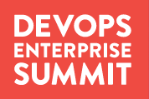
ITIL. You keep using that word.
I don’t think it means what you think it means.
Akshay Anand
Product Development Manager, AXELOS
@bloreboy
Kaimar Karu
Head of Product Strategy
and Development, AXELOS
@kaimarkaru

Slide 2





APPRECIATE THE JOURNEY
@kaimarkaru

Slide 3
何不食肉糜？
APPRECIATE THE CONTEXT
@kaimarkaru
Notes:
From: Emperor Hui of Jin

Slide 4

IT STEREOTYPES
No!
@kaimarkaru

Slide 5
PROCESS MANAGEMENT
@kaimarkaru

Slide 6
COMMON ANTI-PATTERNS
By-the-book ITIL ‘implementations’
Ideal world process documentation
Expensive ‘Level 5’ maturity projects
‘Watermelon’ SLAs
CAB used as ‘Change Approval Board’
Search for the silver bullet
@kaimarkaru

Slide 7


CUSTOMER AND USER VALUE
?
@kaimarkaru

Slide 8
THINKING IN SERVICES
„A means of delivering value to customers by facilitating outcomes customers want to achieve without the ownership of specific costs and risks.“
@kaimarkaru

Slide 9
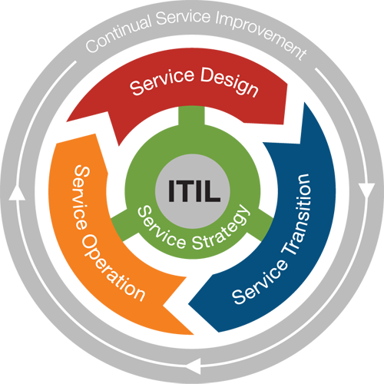
THE FLOW OF SERVICE MANAGEMENT
Strategy: who are the customers and what services they require to solve their problems
Design: how should the services look and feel like, and what capabilities are needed to provide them
Transition: how to develop, test, integrate, and release services
Operation: how to support live services, and how to provide a great customer and user experience
@kaimarkaru

Slide 10









SERVICE MANAGEMENT
£
@kaimarkaru

Slide 11





ORGANISING FOR FLOW – PRODUCT / SERVICE TEAMS
SERVICE
X
SERVICE DESIGN
SOFTWARE DEVELOPMENT
SERVICE TRANSITION
SERVICE OPERATION
PLATFORM SERVICES
TECHNICAL OPERATIONS
VENDOR MANAGEMENT
SERVICE DESK
@kaimarkaru

Slide 12

CONTINUAL IMPROVEMENT
@kaimarkaru

Slide 13

ITIL GUIDING PRINCIPLE #1
FOCUS ON VALUE
All activities must deliver customer value
The customer determines what is of value
Not all ‘improvements’ deliver value
$
@kaimarkaru

Slide 14

ITIL GUIDING PRINCIPLE #2
DESIGN FOR EXPERIENCE
Understand the interactions
Walk a mile in your customer’s shoes
Empathy is the key
@kaimarkaru

Slide 15

ITIL GUIDING PRINCIPLE #3
START WHERE YOU ARE
Understand the vision and the direction
Seek out the value in what you have
Leverage what already exists
@kaimarkaru

Slide 16

ITIL GUIDING PRINCIPLE #4
WORK HOLISTICALLY
Organizations are complex systems
Value is co-created through interactions
Local optimization != value
@kaimarkaru

Slide 17

ITIL GUIDING PRINCIPLE #5
PROGRESS ITERATIVELY
Avoid ‘big bang’ change initiatives
Keep each improvement manageable
Keep delivering value, continually
@kaimarkaru

Slide 18

ITIL GUIDING PRINCIPLE #6
OBSERVE DIRECTLY
Understanding context is important
Direct observations trump reports
Going to the source kills assumptions
@kaimarkaru

Slide 19

ITIL GUIDING PRINCIPLE #7
BE TRANSPARENT
The unknown is scary
Missing information is replaced by myths
Transparency creates supporters
@kaimarkaru

Slide 20

ITIL GUIDING PRINCIPLE #8
COLLABORATE
Understand the end-to-end flow
Work with your customers and users
Manage your stakeholders
@kaimarkaru

Slide 21

ITIL GUIDING PRINCIPLE #9
KEEP IT SIMPLE
Minimum Viable/Valuable Process
Minimum Viable/Valuable Procedure
Minimum Viable/Valuable Reporting
@kaimarkaru

Slide 22





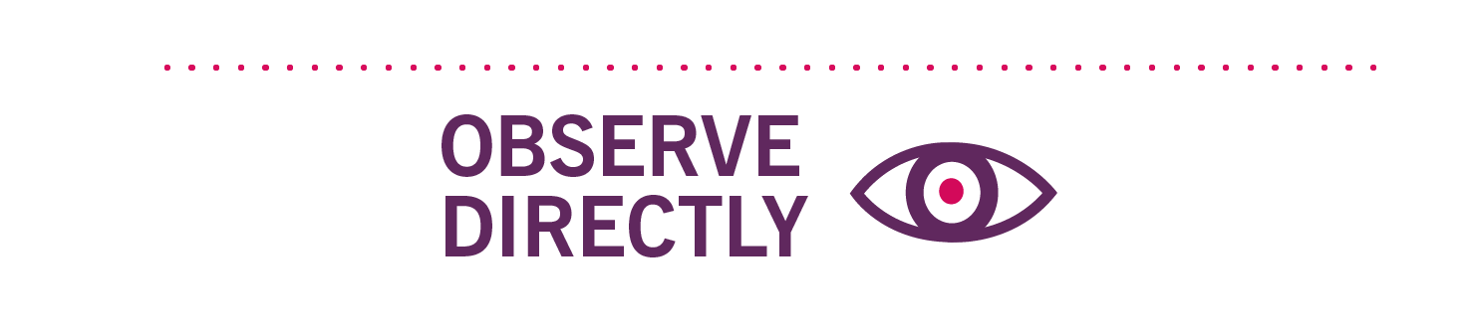




ITIL GUIDING PRINCIPLES
@kaimarkaru

Slide 23
EXTEND “MINIMUM VIABLE …”
Product: The ‘goods’ that the customer is buying
Product Management: The minimum capability to manage the Product
Service: The benefit or outcome the customer is buying
Service Management: The minimum capability to manage the Service
@bloreboy

Slide 24
IMPROVING SERVICE MANAGEMENT, ITERATIVELY
Define a vision and work towards it
Start where you are
@bloreboy

Slide 25
ALIGNING PRODUCT AND SERVICE MANAGEMENT
Does the Product Team’s capability to deliver “X“
align with
the Service Organisation’s capability to manage “X“?
@bloreboy

Slide 26











ITIL & THE THREE WAYS
Dev
Ops
@bloreboy

Slide 27


SERVICE OPERATION & THE THREE WAYS
Dev
(Tech) Ops
Service Ops
@bloreboy

Slide 28


SERVICE DESIGN & THE THREE WAYS
Service Design
Dev
Ops
@bloreboy

Slide 29
GLOBAL OPTIMISATION USING ITSM
Dev
Ops
Service Design
Service Ops
Customer/ User
Business
@bloreboy

Slide 30
Thank you!
@kaimarkaru & @bloreboy
WWW.AXELOS.COM

