Slide 1

Hybrid Cloud How to move slowly and hemorrhage money doing it
Kris Saxton: Partner, Automation Logic
Dave Rogers: CTO, Ministry of Justice UK

Slide 2
Collaborating at the Ministry of Justice
Notes:
Dave Rogers: MOJ Chief Technology Officer
We provide courts, tribunals, prisons, probation and legal aid for the citizens of England and Wales
Criminal justice is our main business, but
Civil & family also
We’ve been working with Automation Logic for three years to deliver better digital and technology services in the cloud….
Kris Saxton: Automation Logic Partner and co-founder
We’re here to deliver an automated world where people are free to realise their creative potential.
We’ve delivered over 55 cloud and automation platforms to date, many for central gov including MOJ.
Today we want to talk to you about Hybrid Cloud. What it is, what it is not, and why you don’t need one.

Slide 3
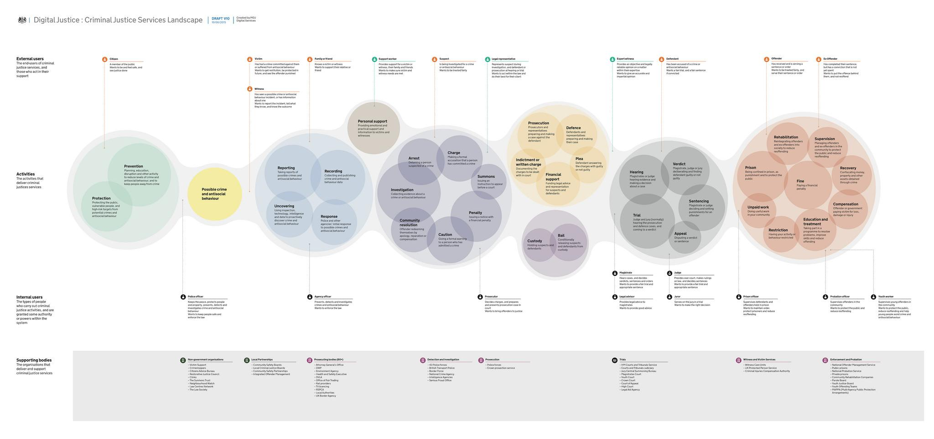
The UK criminal justice system What the users see
support
victims
gather the evidence
prevent
&
protect
hear the evidence, judge & sentence
detain
or
monitor
the
crime?
detect
investigate
detain or
monitor
Notes:
Prevent, crime, discover, police, prosecution / bail, courts, offender management

Slide 4
The UK criminal justice system A well-established system
1188
prison
1907
probation
over 800 years old
1829
police
1178
courts
Notes:
Prevent, crime, discover, police, prosecution / bail, courts, offender management

Slide 5
Digital and Cloud in UK Justice
2010 2011 2012 2013 2014 2015 2016 2017
Alphagov
Government Digital Service
Exemplars x 4
MOJ Digital
MOJ DigiTech
MOJ Digital & Tech

Slide 6
What is Hybrid Cloud?
<->
Private
Public
Notes:
Our first type of Hybrid Cloud which we call ‘Private/Public’ can be defined as a mix of private (i.e. on premises) and public cloud hosted resources, combined and consumed as a single, unified service.

Slide 7
What is Hybrid Cloud?
USER
REQUEST
BROKER
Cloud Provider A (£x)
Cloud Provider
B (£2x)
Notes:
Hybrid Cloud can also take the form of a broker or abstraction layer. Broker-based Hybrid Clouds, attempt to give you the ability to dynamically chose between providers depending on certain criteria (cost, performance etc).
In practical terms, with a broker or abstraction layer approach, you design your service on the abstraction layer or you send your request to a broker and the translation and deployment to the specific cloud provider is made for you, transparently and in the background. The example often used is you check spot prices between two public cloud providers at the time of deployment and deploy to the cheapest.

Slide 8
Why Hybrid Cloud
Support different workloads
Protect against supplier lock in
Notes:
Many organisations opt for hybrid cloud believing it will enable them to support different workloads depending on factors such as data sensitivity, data sovereignty, compute architecture, service architecture.
Many also think hybrid cloud will protect you from vendor lock in by allowing you seamlessly deploy to (or migrate between) different cloud providers depending on price and performance.

Slide 9
Why This is Fantasy: Private <-> Public
Not true clouds
<->
Public
Notes:
For Private/Public hybrid clouds, where the Private side is based on existing infrastructure, it is almost never worthy of the term cloud. Not to say these on premises systems are not genuinely useful, they are, but they are typically only virtual machine provisioning platforms, albeit with some advanced automation.
They are almost always missing several of the key characteristics that would warrant the term ‘cloud’, e.g. usage based billing, massive elasticity, limitless scalability or direct API access. In practical terms, you can’t spin up 1000 machines in 5 mins, destroy them and only pay for what you’ve used. Whilst it may be unfair to hold these systems up to these kind of standards (they were never designed for that) it’s also disingenuous to call them clouds.

Slide 10
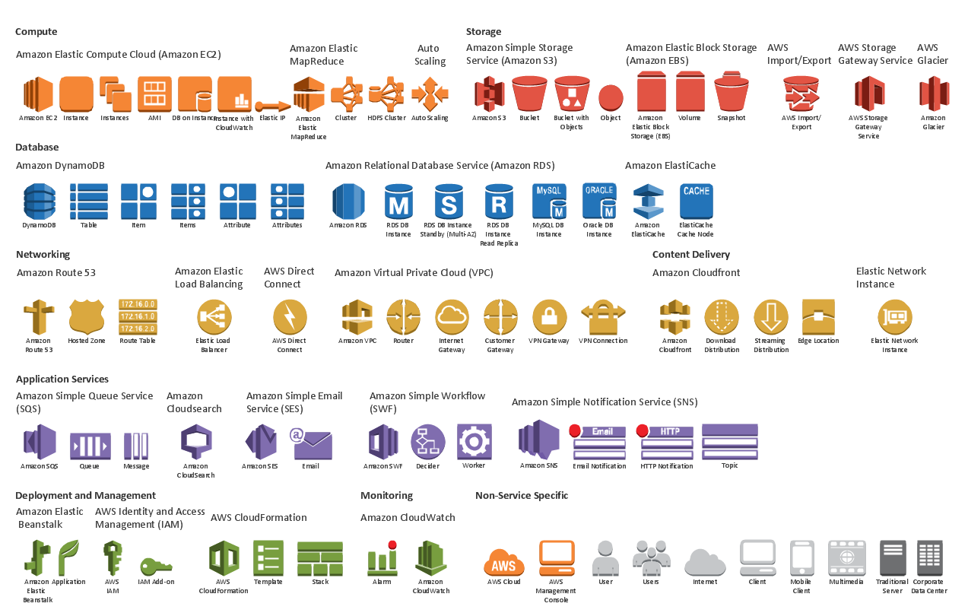
Why This is Fantasy: Broker-based
No Common Standards
Greatly Reduced Choice
Notes:
As for the broker-based model, attempting to build this an attempt move the industry, one which currently has no single common denominator, format or standard for *any* cloud service, not even compute.
So a hybrid cloud implementation not only has to build the abstraction layer, but also the model and interfaces to every cloud provider they want to support and maintain it and we all know the pace at which some cloud providers are moving.
Hybrid Cloud will always deliver perpetually reduced choice.

Slide 11
Hybrid Cloud: False Promises
Protect against supplier lock-in?
Support different workloads?
Notes:
The abstraction layers we must currently create, the data formats, the languages and translation mechanisms, are likely to be esoteric and proprietary, so you’re just moving the point of lock in from the cloud provider to the abstraction layer.
As for diverse workloads, most Hybrid-Cloud implementations can support this, but as we will show there’s an easier and cheaper way to achieve this with a Multi-Cloud approach.

Slide 12
Hybrid Cloud: Get Real
Private-Public = Incomplete Transformation
Notes:
So what you really have with a Private/Public hybrid cloud is a mix of ageing (not very cloudy at all) infrastructure and public cloud
Hybrid Clouds is not a strategy, but an incomplete transformation. A position of compromise that you need to transition through to full public cloud adoption.

Slide 13
Hybrid Cloud: Get Real
Hybrid Cloud is not a strategy,
it’s a predicament
Notes:
Declaring Hybrid Cloud as a strategy will put a drag on your efforts towards digital transformation and operational efficiency

Slide 14
Hybrid Cloud: Get Real
Broker/Abstraction = Expensive Fantasy
Notes:
And for those few considering a broker-based Hybrid Cloud then be prepared to spend a lot of time and money for benefits that we will show you you can can far more reliably and quickly.

Slide 15
So What is the Alternative?
Multi-cloud
Notes:
We believe a better strategy for cloud adoption, is to build highly automated software ecosystems, based on a single cloud provider, but to run more than one of them. We call this simply, Multi-Cloud.

Slide 16
Multi-Cloud: Benefits
Quick to build (around ½ the time)
Simple to maintain and operate (1/3 code base)
Focused on developer productivity (NoOps)
Easy to automate (components work well together)
Supports diverse workloads
Similar levels of lock-in
Notes:
Unlike Hybrid-Cloud, you can get some amazing benefits from building around single cloud providers, most importantly the ability to move really fast. This is exactly what we did at MoJ and with great results.

Slide 17
MOJ Background
Digital and technology
transformation at MOJ
Notes:
Started 4 years ago with only five people
GDS exemplar services
Transformation lead through digital services, but has now gone deeper (infra, data, organisation design, service design)
MOJ’s Digital & Technology directorate:
Multiple teams, across the UK
Currently hiring a range of roles

Slide 18
Varied Context
Capability
Culture & Policy
Technology
Notes:
Capability - different skills, outsourced vs. in-house
Culture & policy - e.g. continuous delivery, risk management
Technology - 90s Oracle middleware, microservices spaghetti from 3 years ago

Slide 19
Our Software, in Numbers
~750 complex software systems
~50 ‘modern’
~700 ‘legacy’
Notes:
Modern = cloud native, continuous delivery
Legacy = private datacentre, long delivery cycles (18 month typical)

Slide 20
Hosting Strategy
Public cloud hosting by default
Notes:
GDS service standard, public cloud by default
Overcome the security/assurance issues with hosting citizens data in public infrastructure

Slide 21
Hosting Strategy
Cloud transition strategy
&
Multi-cloud
Notes:
Security

Slide 22
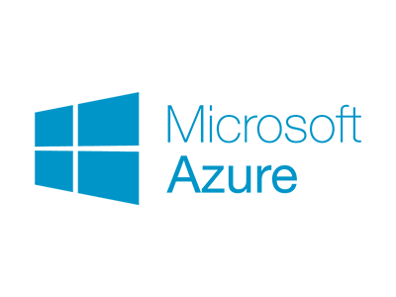
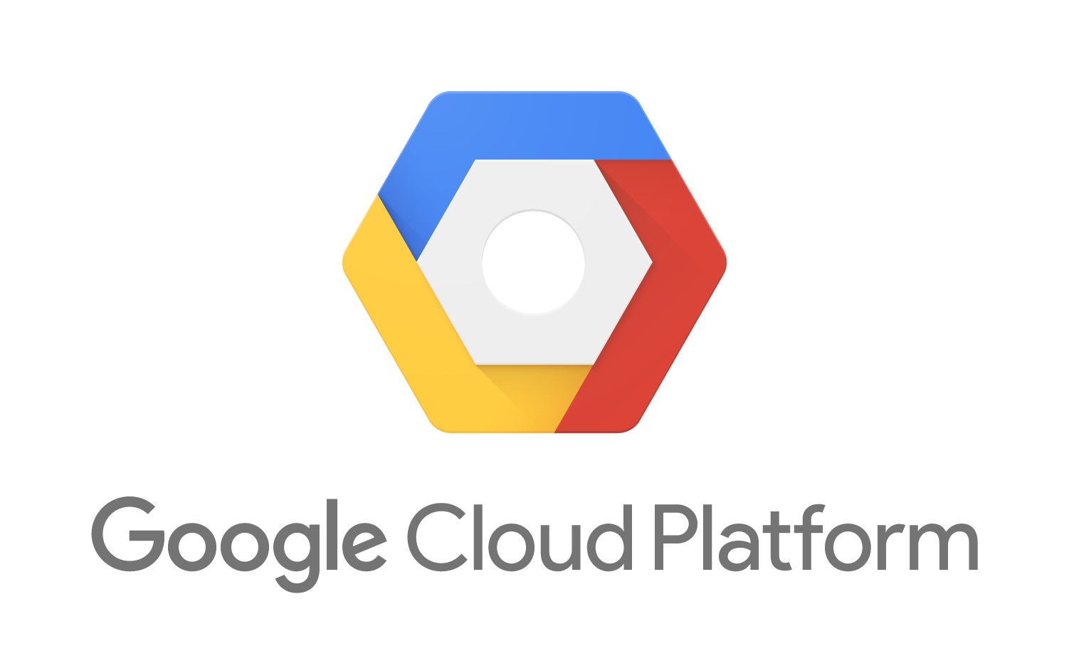

Hosting Strategy
Multi-cloud
(with controlled diversity)
Notes:
Only genuine public cloud
Low latency APIs, super-high availability, high-scale elasticity, mature eco-system

Slide 23
Hosting Strategy
Formalised patterns of use for cloud services
Vary patterns to context
Offer an internal ‘wrapper’ service
Notes:
Patterns - Not really a PaaS
Formalised through: automation, process, standards, org design, governance
Subsets - not every service included (security, need)
Vary for context (multiple ‘services’ to the business)

Slide 24
Controlled Lock In
Lock in is not necessarily bad
Balance simplicity and time to delivery
with switching cost
Notes:
Don’t oversimplify lock in.
Sometimes zero lock-in is desirable
Sometimes total lock-in is desirable

Slide 25
Multi-Cloud Benefits
Speed of delivery
Focus on value
Simple access to latest services
Resilient to organisational change
Notes:
Speed - simpler pipelines, utilising native tools
Focus - minimal investment in ‘glue’
Latest stuff - no need to incorporate into ‘glue’
Resilient - allows for some diversity across teams (avoid conway’s platform)

Slide 26
Go Multi-Cloud
Forget Hybrid Cloud
Go Multi-cloud
Notes:
Hybrid is not ‘best of all things’
Use the right number of cloud providers for your organisation
Be wary of lock-in, but don’t avoid it
Remember the choice of cloud provider is a critical strategic decision - do not make it based on a sales pitch - understand the technology.
Multi-cloud supports greater trialing of providers before a commitment is made.

Slide 27
Just one more thing
Collaboration with public cloud provider
Codified, reusable patterns of use
Interested?

Slide 28
Thank You
Dave Rogers
Chief Technology Officer
UK Ministry of Justice
@daverog
Kris Saxton
Partner (co-founder)
Automation Logic
@KrisSaxton
Notes:
Use the right number of cloud providers for your organisation
Be wary of lock-in, but don’t avoid it

Slide 29
THANK YOU

