Slide 1
REXX Programming

Slide 2
INTRODUCTION
  What is REXX ?
      REstructured eXtended eXecuter
      Simple Programming Language
      Can run Inside / Outside of a
      TSO/E Address Space

Slide 3
Features of REXX
      Ease to Use
      Free Format
      Convenient Built - in Functions
      Debugging Capabilities
      Interpreted Language
      Extensive Parsing capabilities

Slide 4
Components of REXX
        Instructions
        Built – in Functions
        TSO/E External Functions
        Data Stack Functions

Slide 5
Writing a REXX Exec

Slide 6
What is a REXX Exec ?
      Contains REXX language Instructions and
      Commands
      Starts with the comment line with the word
      REXX
      Example :
        /* REXX */
        Say ‘This is my First REXX program’

Slide 7
Syntax of REXX Instructions
    Literal String
        Using Single quotes
        Using double quotes
    Format of a REXX Instruction
        Can begin in any column on any line
        Comma (,) used as a continuation
        character
        Semi colon (;) indicates the end of an
        Instruction

Slide 8
Types of REXX Instructions
        Keyword
        Assignment
        Label
        Null
        Command

Slide 9
Operators
        Comparison Operators
        Logical (Boolean) Operators
        Concatenation Operators

Slide 10
Controlling the Flow Within an Exec
Conditional Instruction
  IF / THEN / ELSE Instruction
  SELECT / WHEN / OTHERWISE / END Instruction
Looping Instruction
  Repetitive Loops
    LEAVE
    ITERATE
  Conditional Loops
Interrupt Instruction
  EXIT
  SIGNAL
  CALL / RETURN

Slide 11
Subroutines & Functions
Made up of sequence of instruction that can receive data , process the data and return a value (Optional for Subroutine & Mandatory for Functions)
Passing the Information
RESULT
PROCEDURE Instruction
PROCEDURE EXPOSE Instruction

Slide 12
Built-In Functions
Arithmetic Functions
  ABS - Returns the Absolute value of the input number
  MAX - Returns the largest number from the list specified
  MIN - Returns the smallest number from the list specified
  RANDOM - Returns a quasi-random, non-negative whole
  number in the range Specified

Slide 13
Built-In Functions …..Contd
Comparison Function:
  COMPARE :
  Returns 0 if the two input strings are identical. Otherwise
  returns the position of the first character that doesn’t match.
  DATATYPE :
  Returns a String indicating the input data type of the input
  string such as Number or Character.

Slide 14
Built-In Functions …..Contd
Conversion Functions :
    B2X – Binary to Hexadecimal
    C2D – Character to Decimal
Formatting Functions:
    CENTER / CENTRE – Returns a String of a specified
    length with the input string centered
    in it.
    COPIES – Returns the specified number of concatenated
    copies of the input string.
    LEFT / RIGHT – Returns a String of the specified length
    truncated or padded on the Right / Left as
    needed.

Slide 15
Built-In Functions …..Contd
String Manipulating Function:
    INDEX – Returns the character position of the first character
    of the specified string found in the input string.
    LENGTH – Returns the Length of the Input String.
    STRIP – Returns a character String after removing leading or
    trailing character or both from the Input String.
    SUBSTR – Returns a portion of the Input String beginning at
    a specified character position.

Slide 16
String Manipulating Functions ….. Contd
    WORD – Returns a word from the Input String as indicated
    by a specified number.
    WORDS – Returns a number of words in the Input String.
    VERIFY – Returns a number indicating whether an input
    String is composed only of characters from
    another input string or returns the character
    position of the first unmatched character.

Slide 17
Built-In Functions …..Contd
Miscellaneous functions:
    DATE – Returns the date in the default format(dd mon yyyy) or in
    one of the various optional format.
    TIME – Returns the local time in the default 24 – hour clock format
    (hh:mm:ss) or in one of the various optional formats.
    USERID – Returns the TSO/E user id, if the REXX exec is running
    TSO/E address space.

Slide 18
Passing Information
SAY
  Passing Information to the Terminal
PULL
  Getting Information from the Terminal
ARG
  Specifying the inputs while invoking the execs
  Periods (.) will act as the dummy variables
PARSE
  Preventing the translation of Uppercase

Slide 19
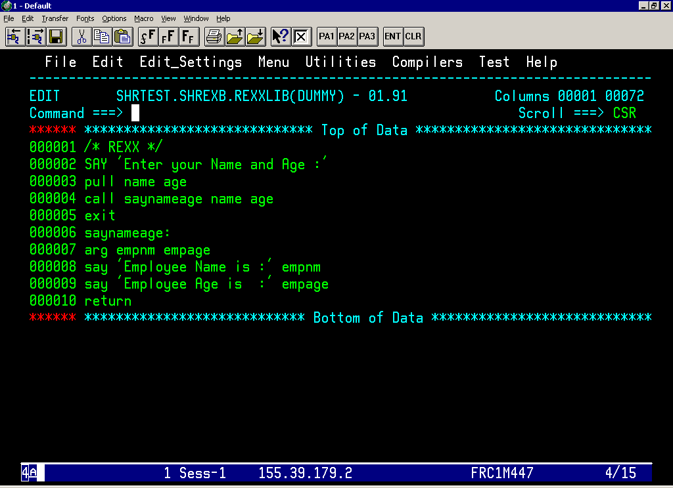

Slide 20
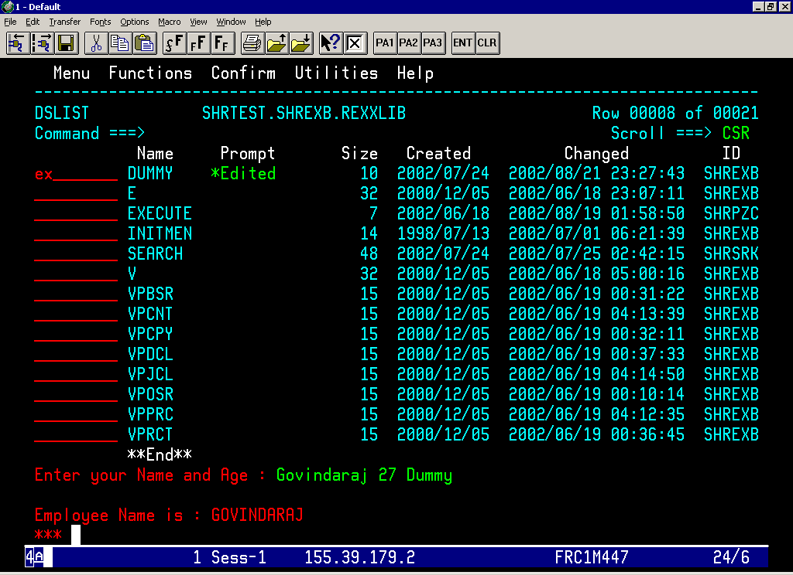

Slide 21
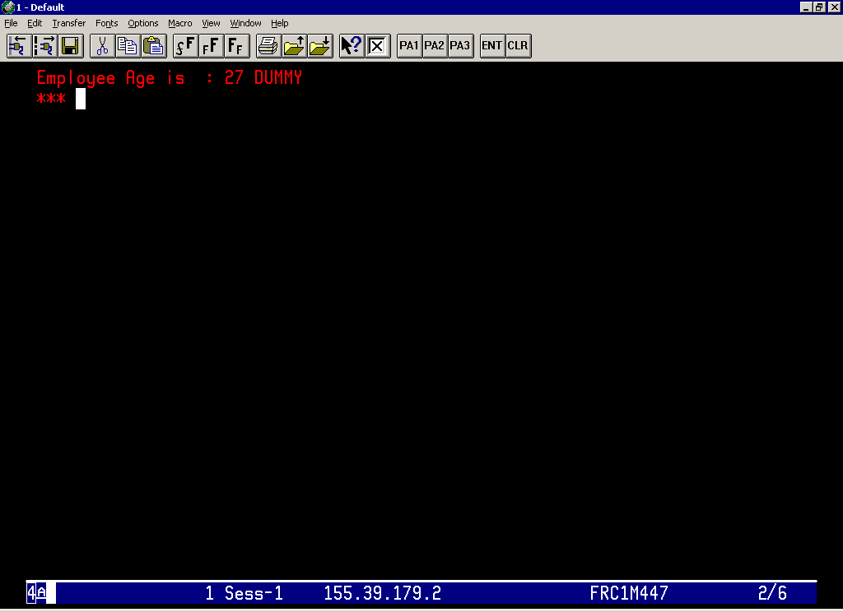

Slide 22
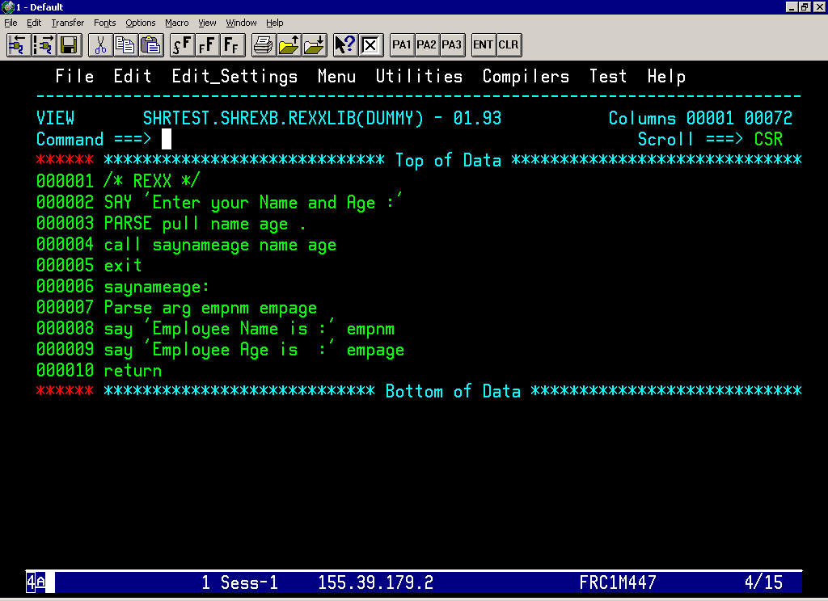

Slide 23
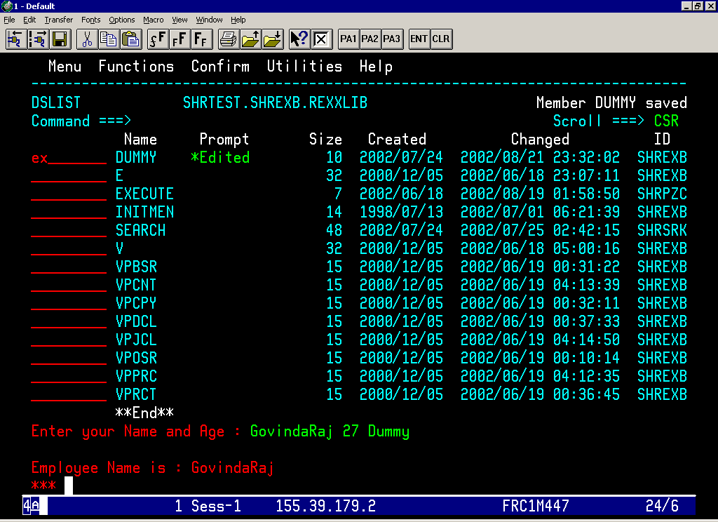

Slide 24
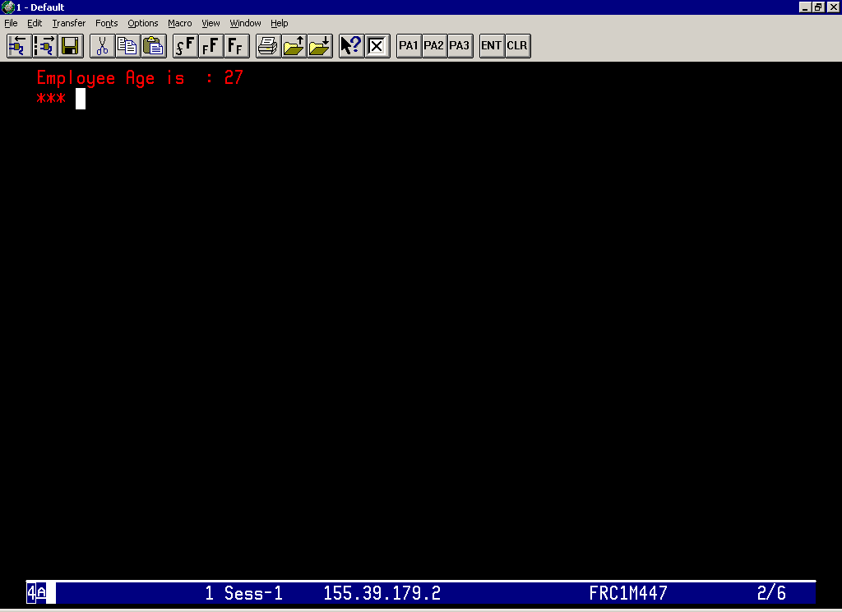

Slide 25
Compound Variables & Stems
Compound Variables
    a way to create a multi dimensional array or a list of variables
  in REXX.
Stems
    First variable name and the first period of a compound variable
    Every compound variable begins with a stem

Slide 26
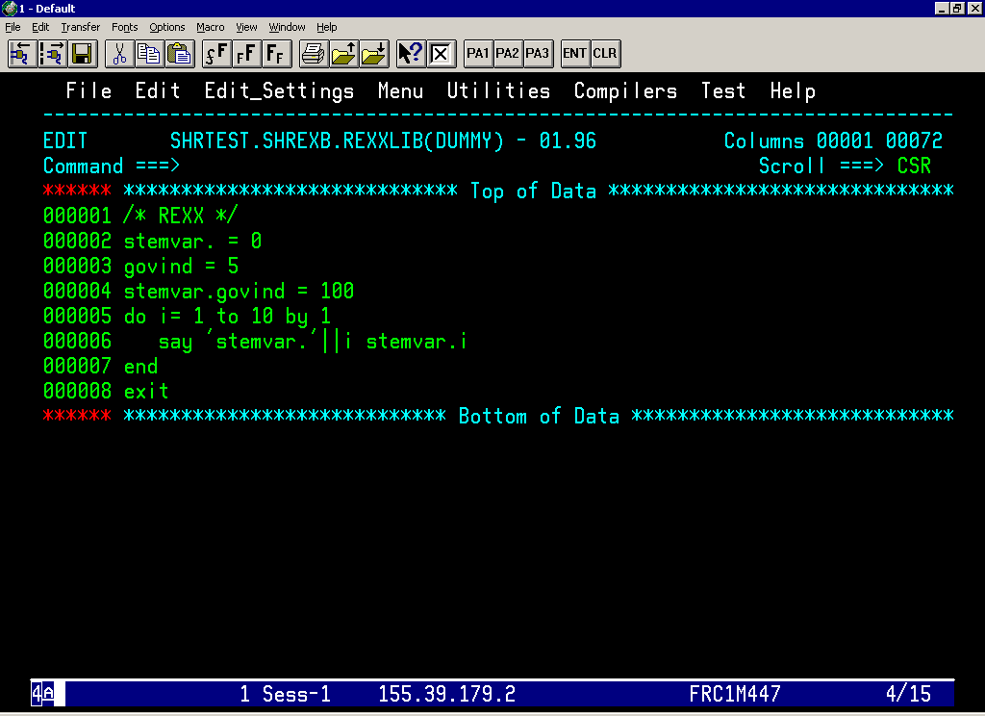

Slide 27
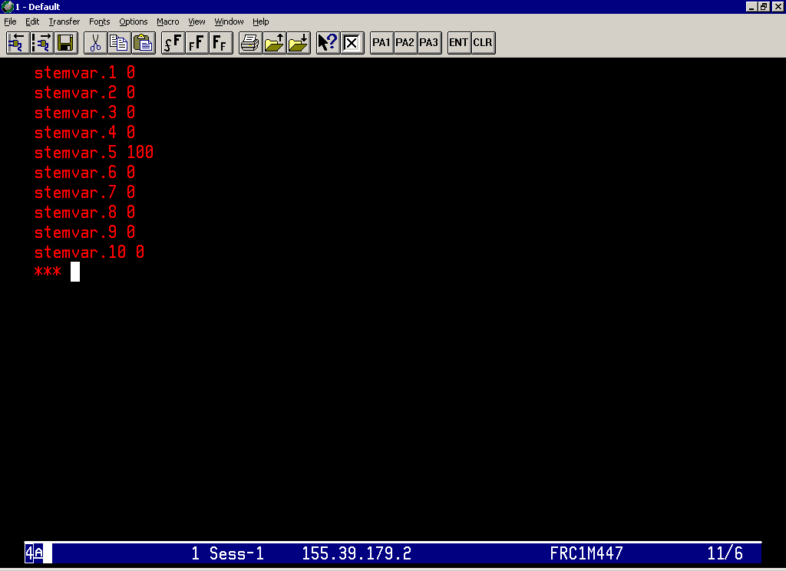

Slide 28
Parsing Data
PARSE UPPER PULL
PARSE UPPER ARG
PARSE UPPER VAR
  For Example
  quote = ‘Knowledge is power’
  PARSE UPPER VAR quote word1 word2 word3
PARSE UPPER VALUE
  For Example
  PARSE UPPER VALUE ‘Knowledge is power ‘ WITH word1
  word2 word3.

Slide 29
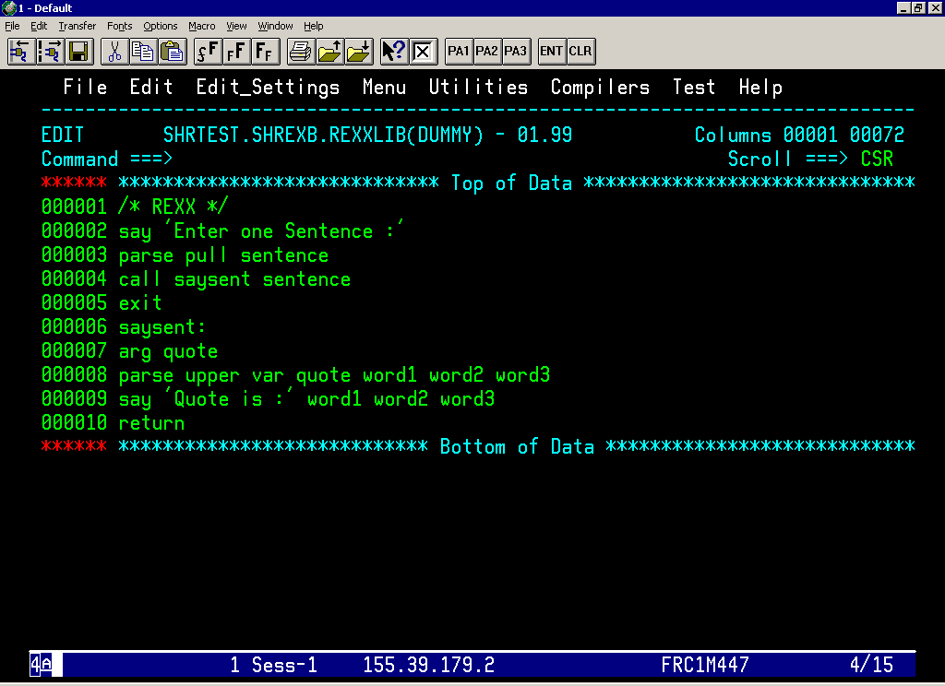

Slide 30
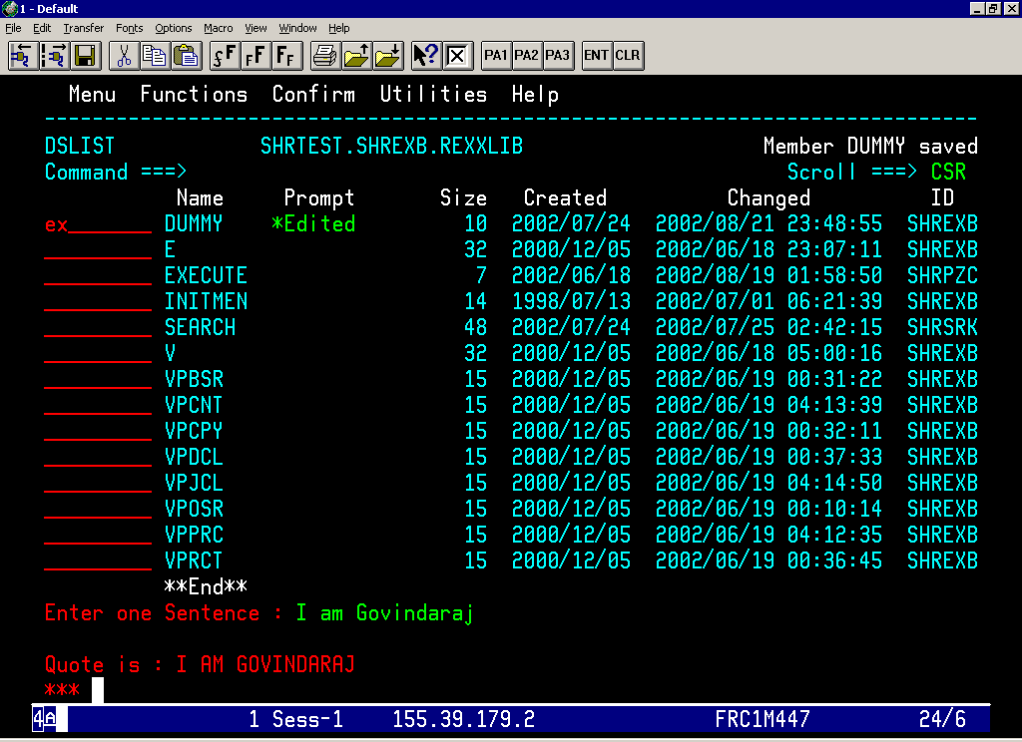

Slide 31
Commands from an Exec
TSO/E REXX COMMANDS
  Provided with the TSO/E implementation of the language
  Will do the REXX – related tasks in an execs.
  For Example
  EXECIO – Controls the I/O operations to and from the dataset
  NEWSTACK & DELSTACK – Perform data stack services
  SUBCOM – Checks for the existence of a host command
  Environment.

Slide 32
Commands from an Exec …. Contd
Host Commands :
  Recognized by the Host Environment in which an exec runs.
  RC is set to the return code of the Host Command issued
  Enclose the Command within single or double quotation marks
  For Example
  “ALLOC DA(NEW.DATA) LIKE(OLD.DATA) NEW ”
  name = myrexx.exec
  “LISTDS” name “STATUS”

Slide 33
Host Command Environments
TSO
  Default Host command Environment
ISPEXEC
  The environment in which the ISPF commands execute.
ISREDIT
  The environment in which ISPF/PDF EDIT commands execute.
ADDRESS
  The command used to change the Host Command Environment.
  For Example
  ADDRESS ISPEXEC
  “EDIT DATASET(“datasetname”)”

Slide 34
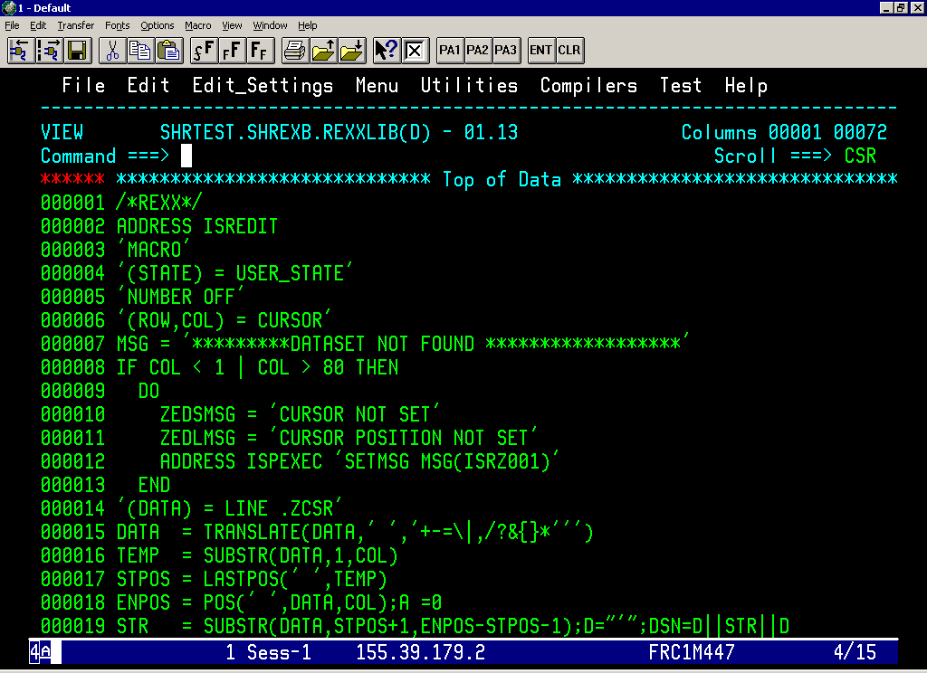

Slide 35
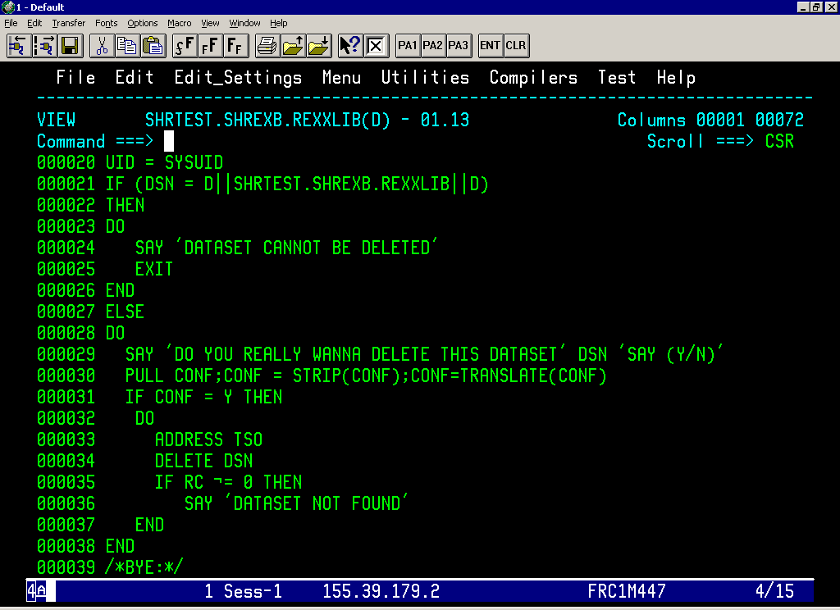

Slide 36
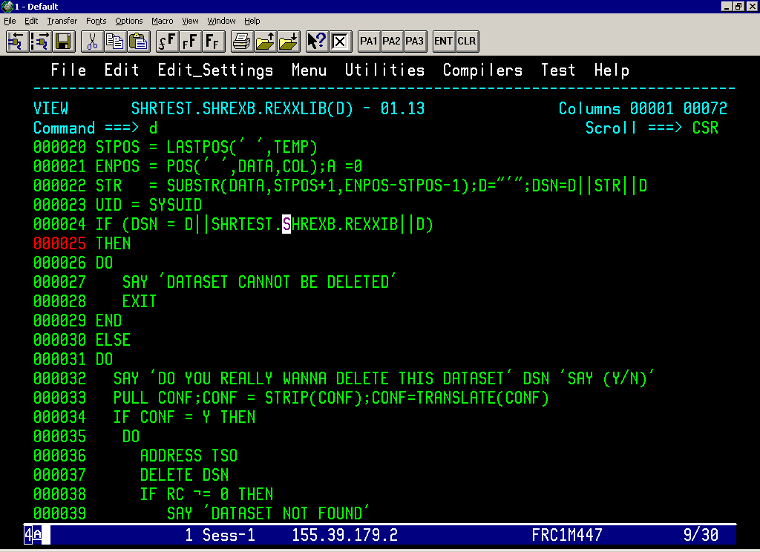

Slide 37
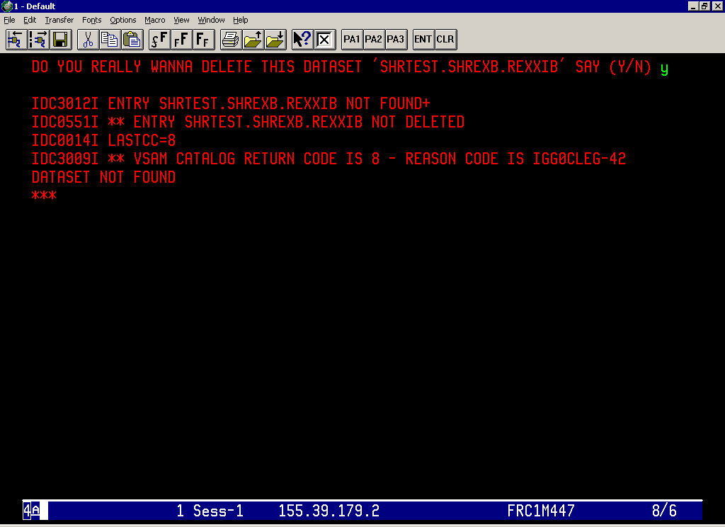

Slide 38
Data Stack
Expandable data structure to store the information
STACK - Last In First Out (LIFO)
QUEUE – First In First Out (FIFO)
PUSH – Puts one item of data on the top of the Data Stack
QUEUE - puts one item of data on the bottom of the Data Stack
QUEUED() – Total number of elements in a Data Stack
PARSE EXTERNAL – Gets the input directly from the terminal and
by pass the data stack.

Slide 39
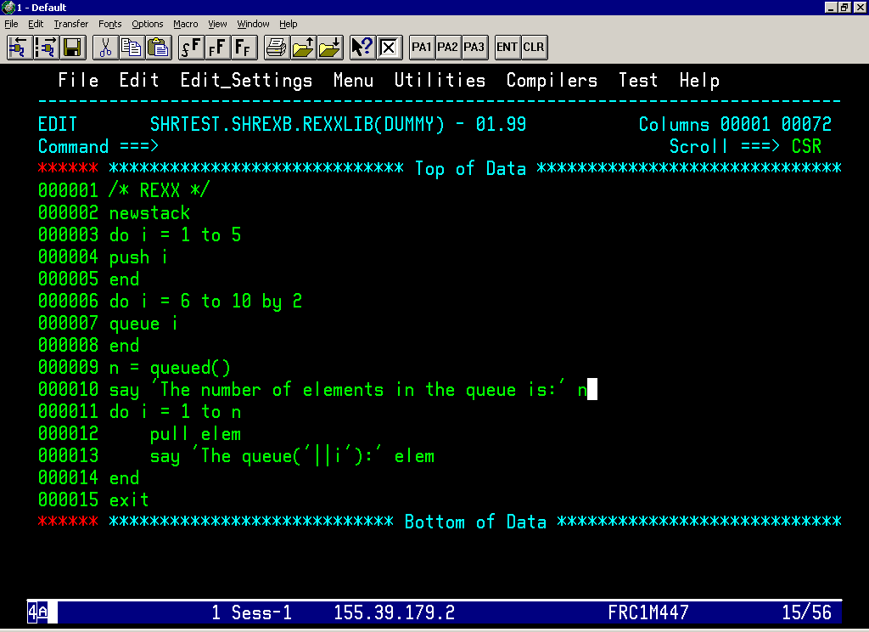

Slide 40
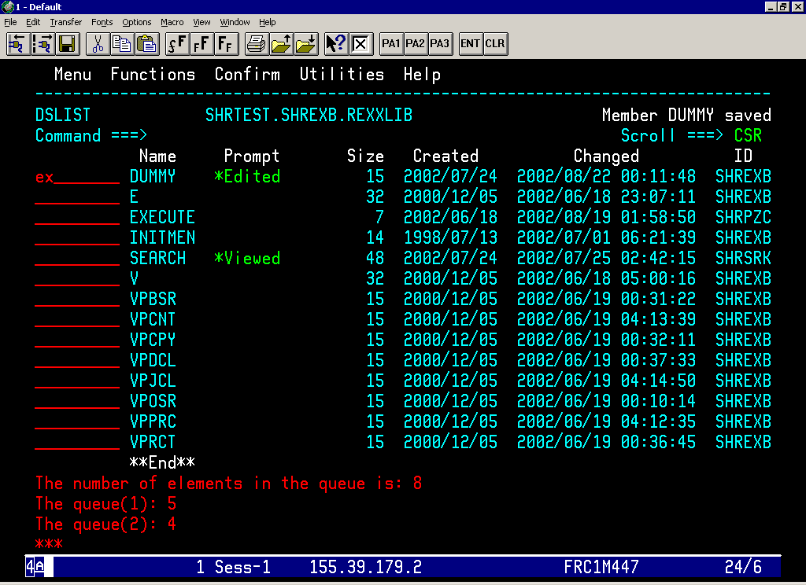

Slide 41
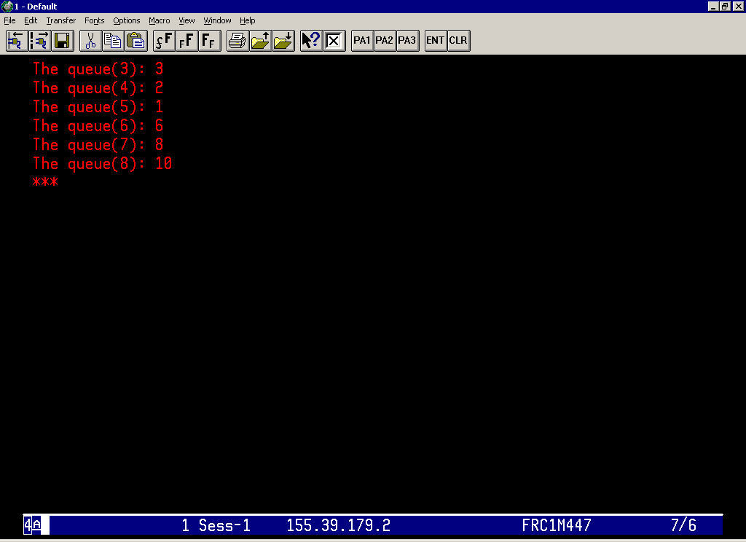

Slide 42
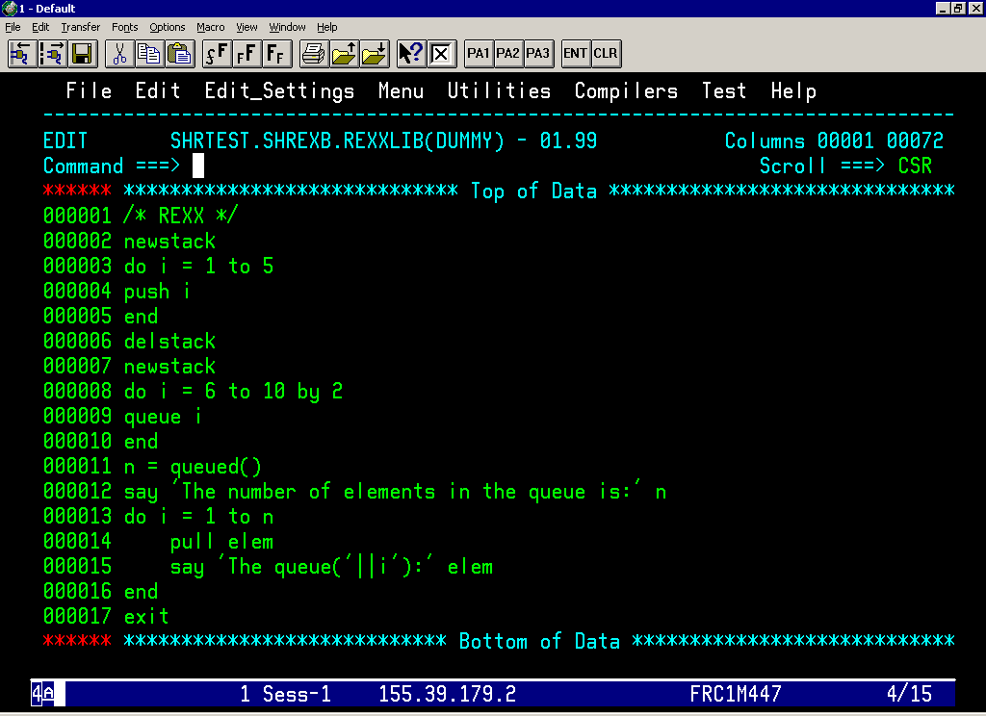

Slide 43
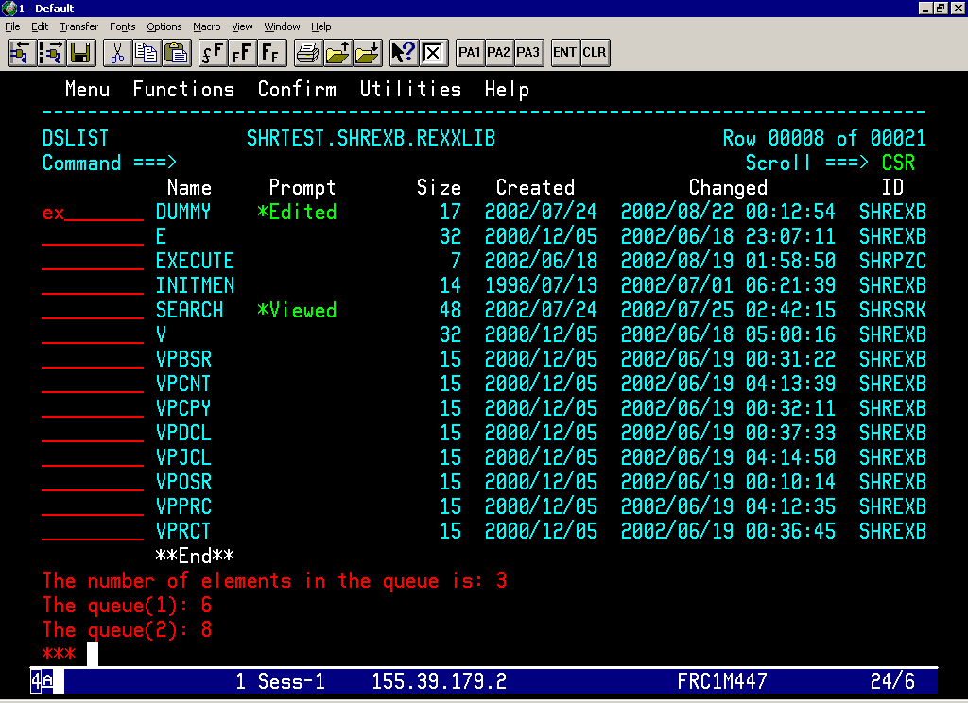

Slide 44


Slide 45
TSO/E External Functions
LISTDSI
  To retrieve the detailed information about a dataset’s attribute.
  The attribute information will be stored in a system variables.
  For Example
  x = LISTDSI(‘’’proj5.rexx.exec’’’)
  SYSDSNAME - Dataset name
  SYSUNIT - Device unit
  SYSDSORG - Dataset Organization
  SYSRECFM - Record Format
  SYSLRECL - Logical Record Length

Slide 46
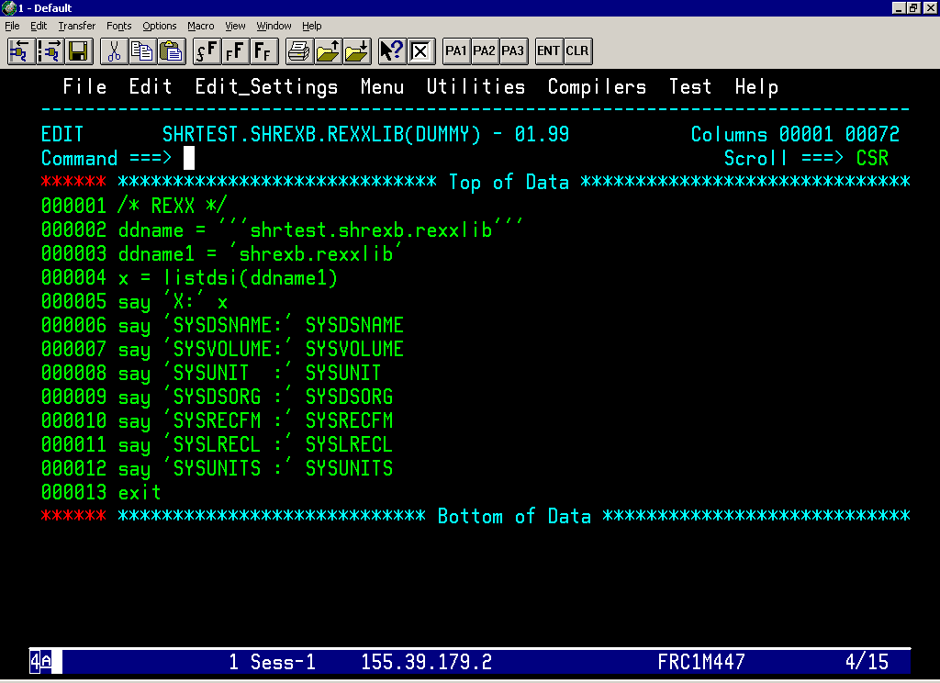

Slide 47
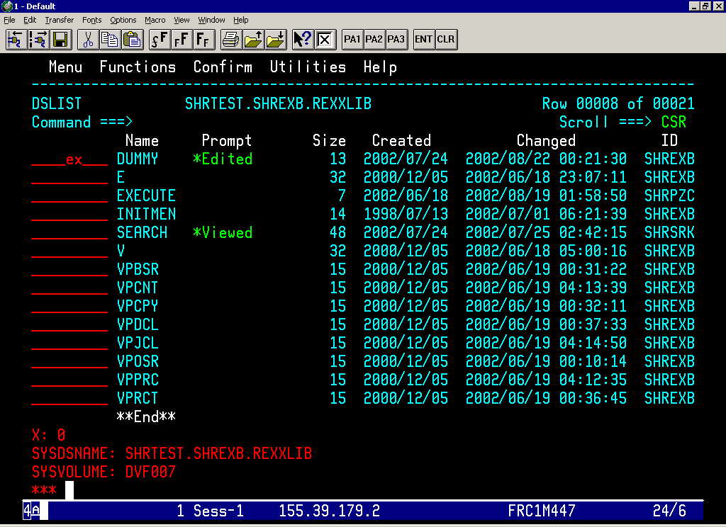

Slide 48
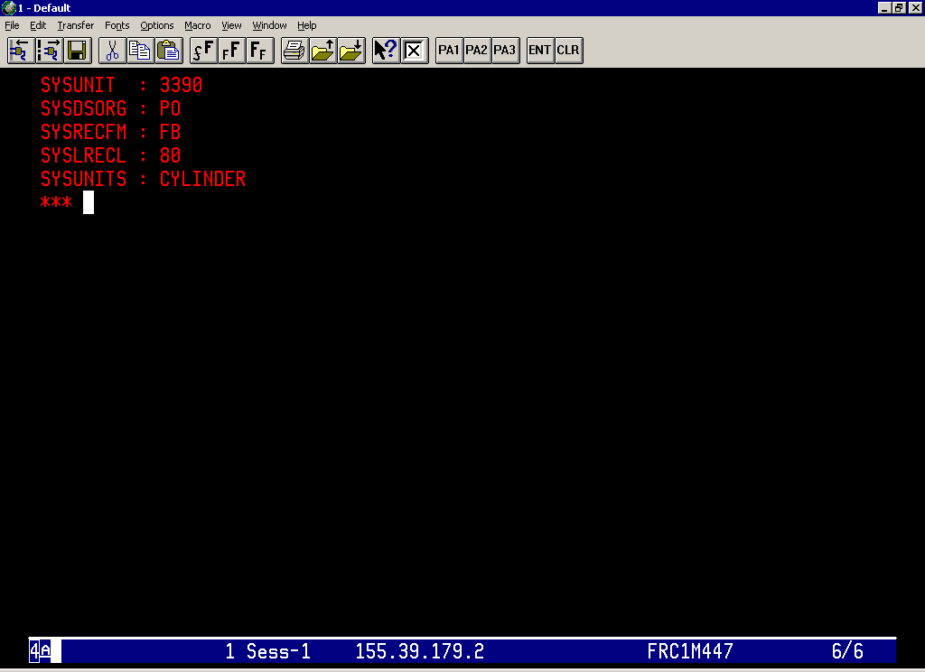

Slide 49
TSO/E External Functions….Contd
OUTTRAP
  Puts lines of command output into a series of numbered
  variables each with the same prefix.
  These variables will save the command output.
  Specify the variable name in parentheses following the function
  call.
  For Example
  X = OUTTRAP(var.)
  “LISTC”
  X = OUTTRAP(‘OFF’)

Slide 50
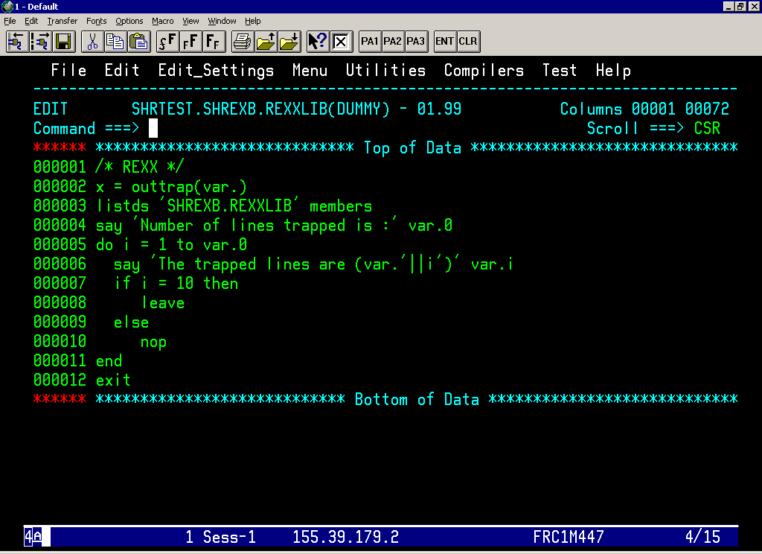

Slide 51
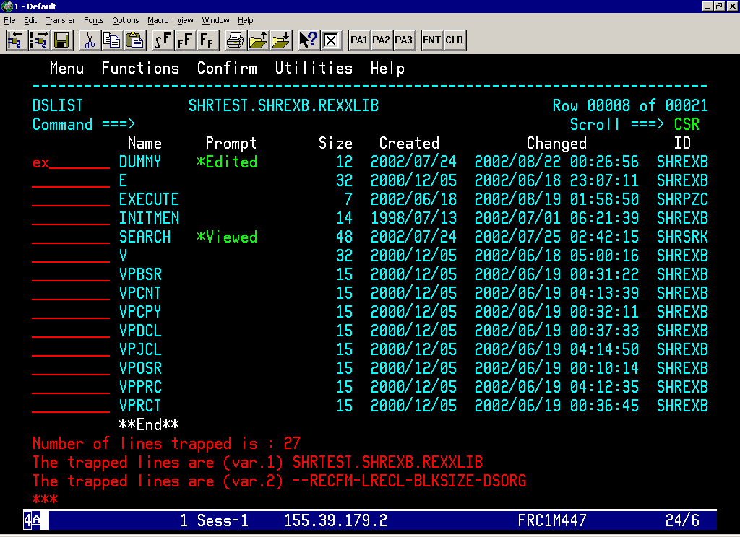

Slide 52
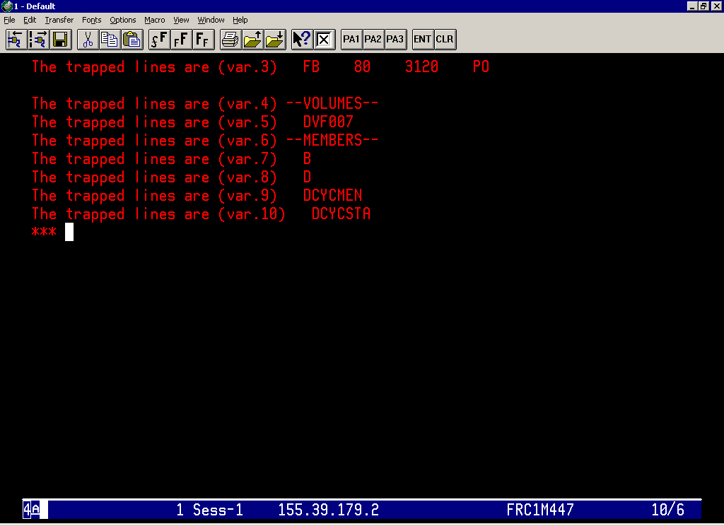

Slide 53
TSO/E External Functions….Contd
PROMPT
  Prompting the user for the valid input for the TSO/E commands
  TSO/E Profile - For the terminal session
    TSO PROFILE PROMPT
    TSO PROFILE NOPROMPT
  TSO/E EXEC command
    When invoking an exec with the EXEC command, can specify the
    PROMPT operand to set prompting on for the TSO commands
    Issued within the exec.
    The default value is NOPROMPT
  PROMPT External Function
    PROMPT(‘ON’) – to set the PROMPT option
    PROMPT(‘OFF’) – to set the NOPROMPT option

Slide 54
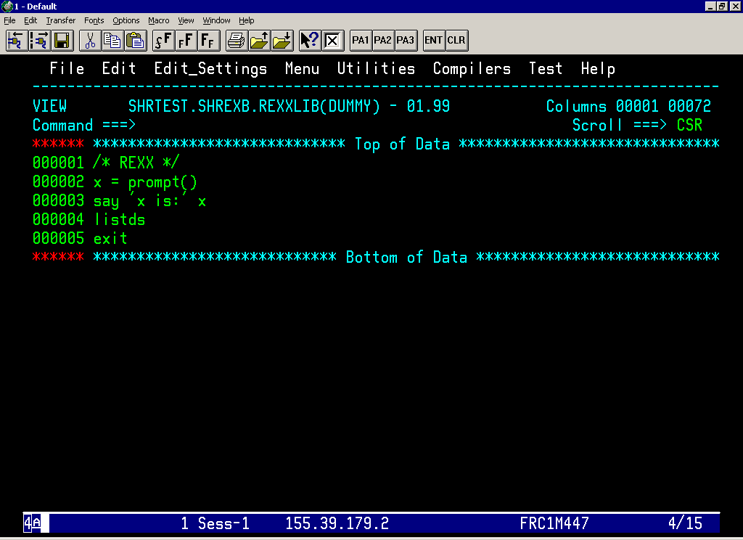

Slide 55
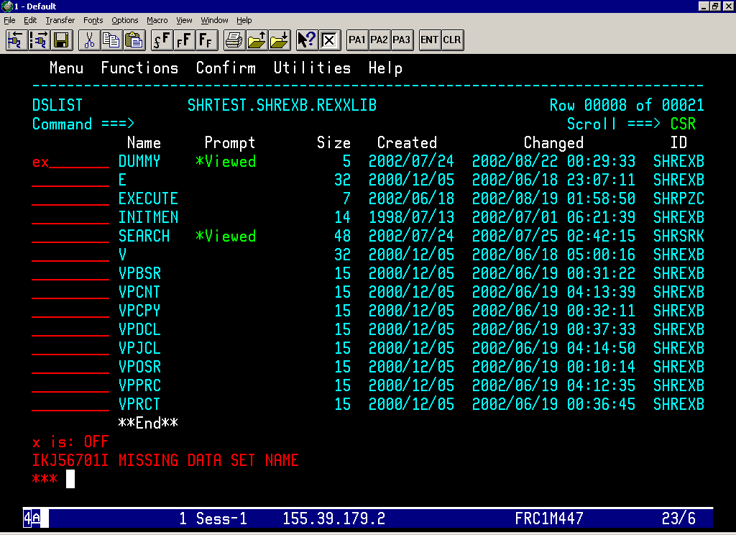

Slide 56
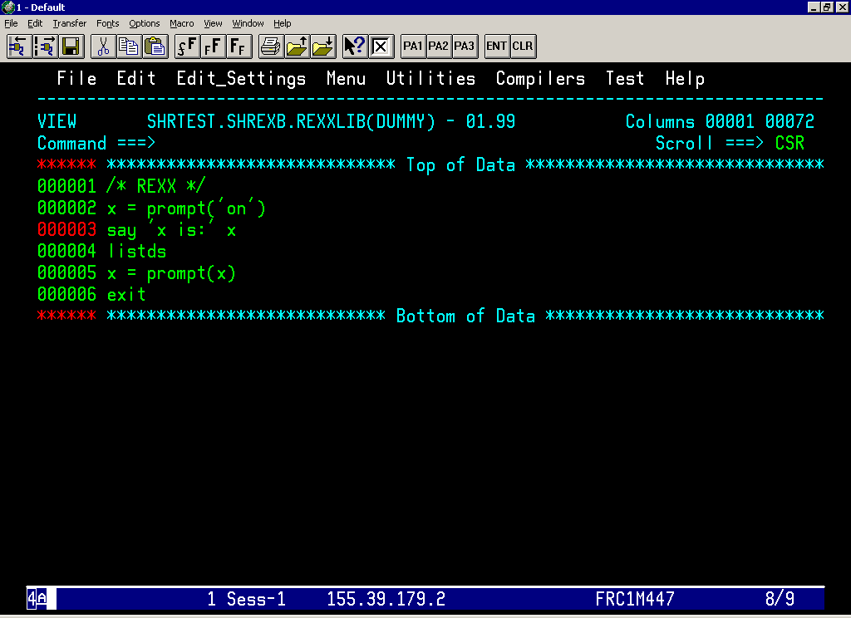

Slide 57
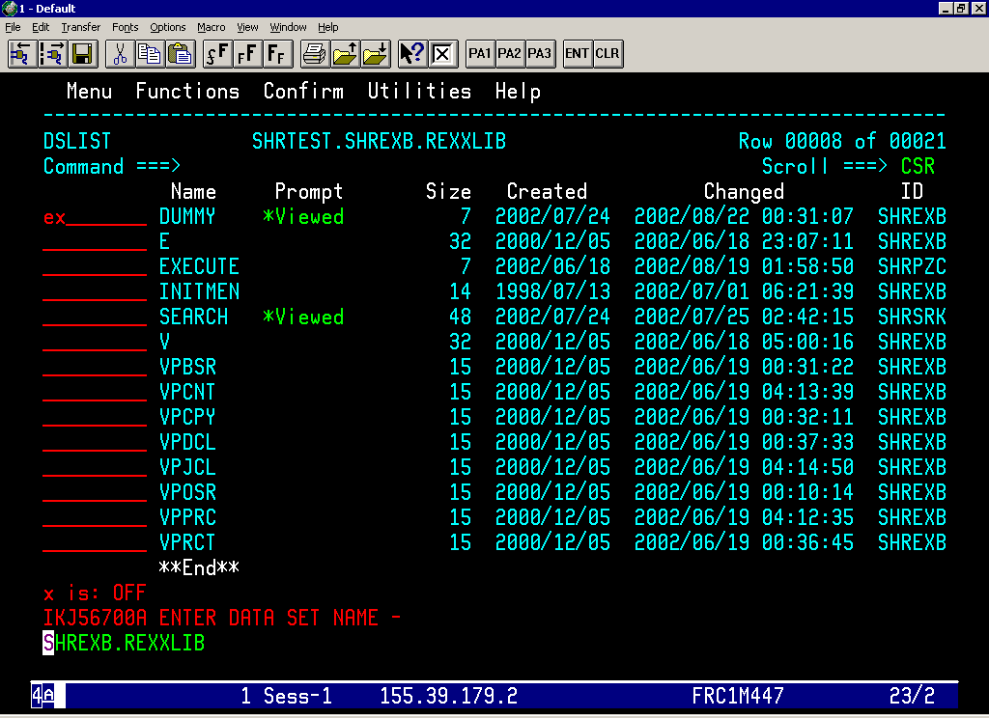

Slide 58
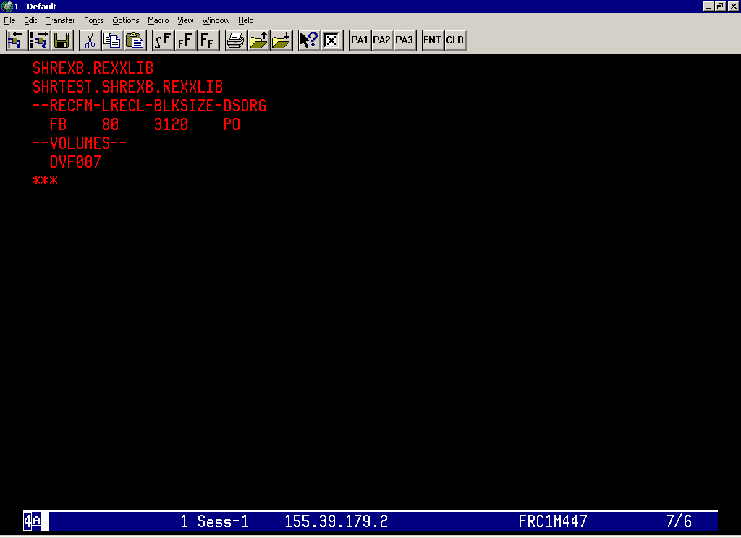

Slide 59
TSO/E External Functions….Contd
SYSDSN
  Determines if a specified dataset is available or not
  For Example
  X = SYSDSN(‘myrexx.exec’)
  The value of X will be ‘OK’ if it is available for use otherwise
  The value of the X will be
      MEMBER SPECIFIED, BUT DATASET IS NOT PARTITIONED
      MEMBER NOT FOUND
      DATASET NOT FOUND
      PROTECTED DATASET
      UNAVAILABLE DATASET
      INVALID DATASET NAME, data-set-name:
      MISSING DATASET NAME

Slide 60
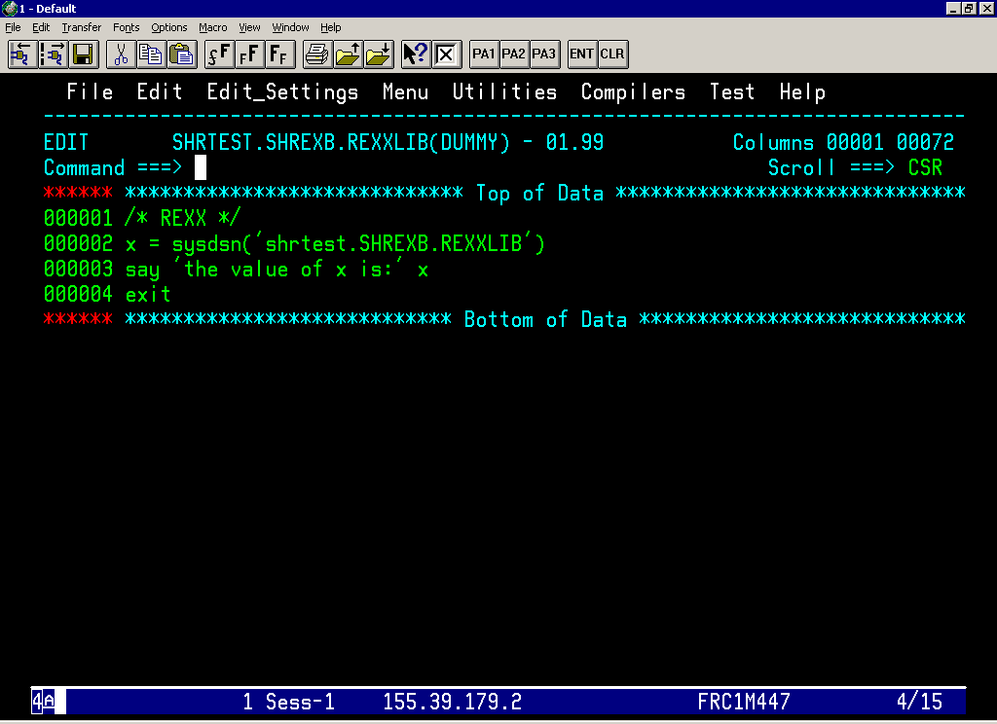

Slide 61
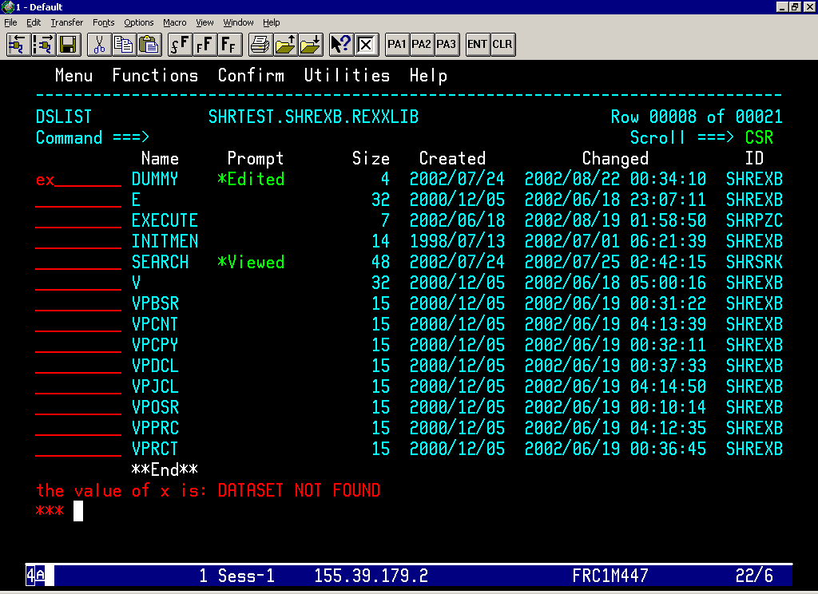

Slide 62
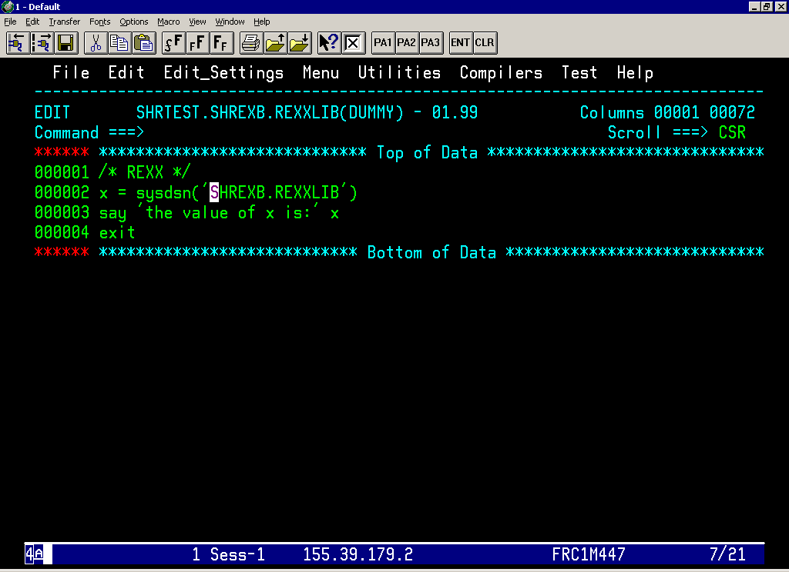

Slide 63
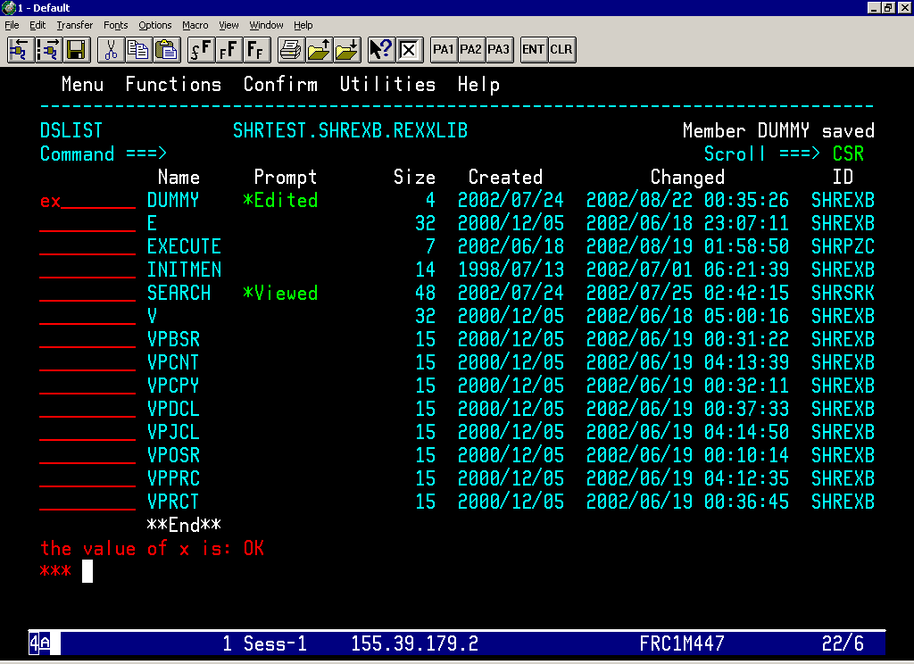

Slide 64
TSO/E External Functions….Contd
SYSVAR
  Retrieves the information about the MVS , TSO/E and the
  current session, such as logon procedure and the user id.
  Information retrieved depends upon the argument specified.
  For example
  Argument Value Description
  SYSPREF Prefix as defined in user profile
  SYSPROC Logon procedure of current session
  SYSUID User id of the current session

Slide 65
Dynamic Modification of a Single REXX Expression
INTERPRET Instruction
  Evaluate the expression and also treat it as an instruction after it
  is evaluated
  For Example
  action = ‘ DO 3 ; SAY “HELLO” ; END ’
  INTERPRET action

Slide 66
Process Information to and from the Data Sets
Using EXECIO
  reads information from a data set to the data stack (or a list of variables) and
  writes information from the data stack (or list of variables) back to a data set.
  The dataset must be either sequential or a single member of a PDS.
  OPTIONS with DISKR / DISKRU
    OPEN
    FINIS
    STEM
    SKIP
    LIFO
    FIFO
  OPTIONS with DISKW
    OPEN
    FINIS
    STEM
  QUEUE ‘’ – Used to queue a null line at the bottom of the stack to indicate the
  end of the information

Slide 67
EXECIO ….. Contd
Return Codes from EXECIO Command
  0 - Normal Completion
  1 - Data was truncated during the DISKW
  operation.
  2 - End of file Reached before the number of lines
  were read during DISKR / DISKRU operation.
  4 - An empty dataset was found during the DISKR / DISKRU operation.
  20 - Severe error .

Slide 68
Executing a REXX Exec……

Slide 69
Executing the REXX Exec
Explicit Execution
  EXEC command runs the non-compiled REXX programs in
  TSO/E.
  Enter EXEC command followed by the dataset name that
  contains the exec and keyword ‘exec’ to distinguish it from the
  CLIST.
  For Example
  EXEC ‘SHRTEST.SHREXB.EXEC(SEARCH)’ exec
  EXEC SHREXB(SEARCH) exec

Slide 70
Executing the REXX Exec …. Contd
Implicit Execution
  Running the Exec by simply entering the member name of the
  dataset that contains the exec.
  Allocate the PDS that contains the execs to the system file
  SYSPROC or SYSEXEC
  SYSPROC
    Is a system file whose dataset can contain both CLISTS and EXEC
  SYSEXEC
    Is a system file whose dataset can contain only the EXECs.
  If both the system files are available, SYSEXEC will be
  searched first.

Slide 71
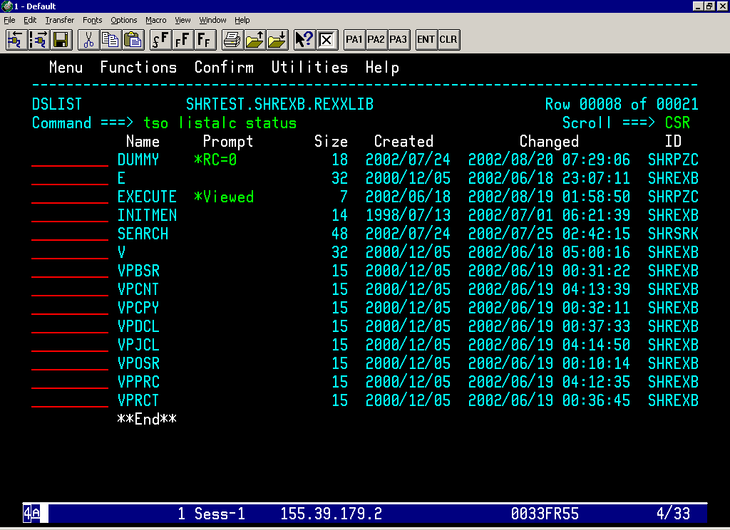

Slide 72
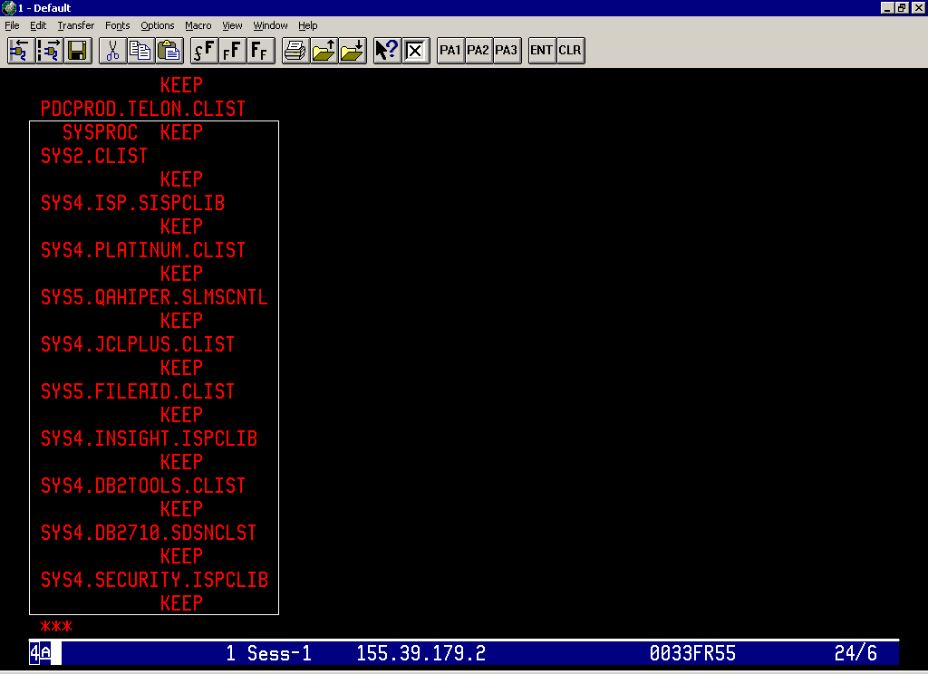

Slide 73
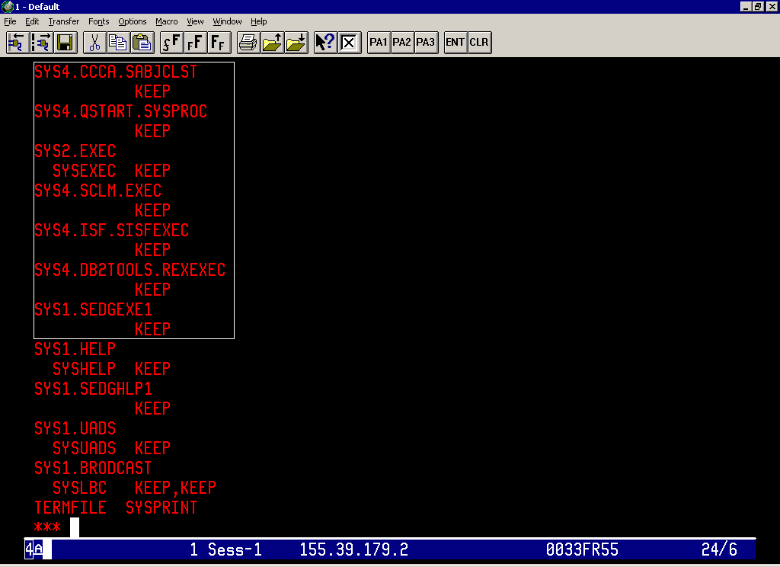

Slide 74
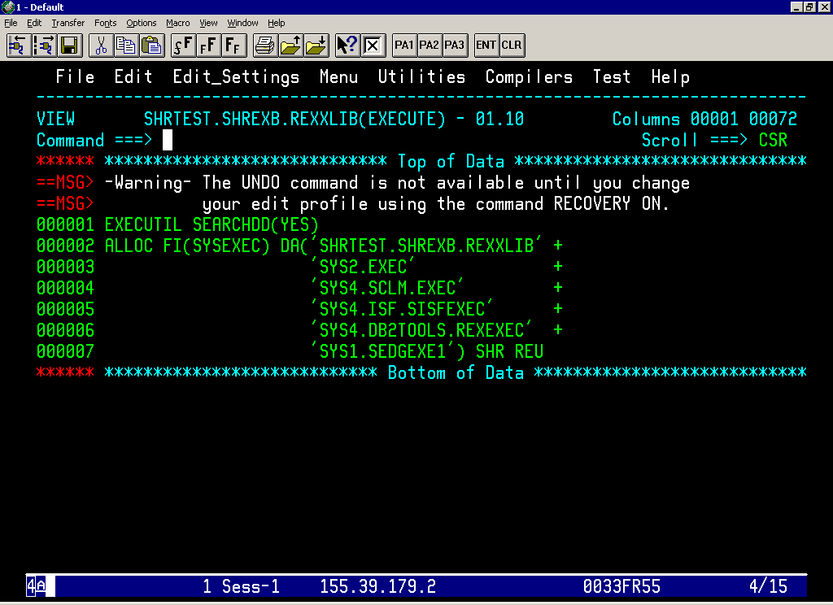

Slide 75
Executing the REXX Exec …. Contd
Through Batch Mode
  Program IKJEFT01 will be used to submit the REXX execs in
  Batch mode
  The member name and the arguments will be passed thru the
  PARM parameter.
  The PDS that contains the member exec will be mentioned in
  SYSEXEC DD statement.
  The output (if any) from the REXX exec will be stored in
  the dataset mentioned in the SYSTSPRT DD statement.

Slide 76
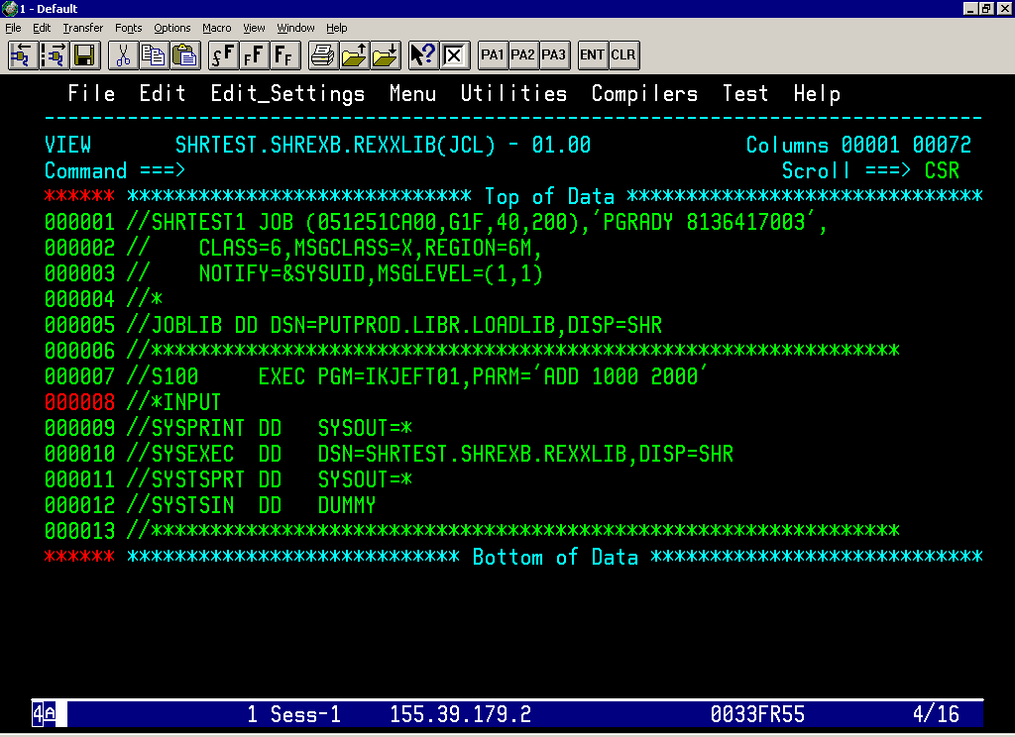

Slide 77
Debugging the REXX Exec

Slide 78
Debugging the REXX Exec
TRACE
  Displays how the language processor evaluates each
  operations.
  TRACE I (Trace Intermediates)
    Will Trace the Intermediate states of the Expression or an
    Instruction.
  TRACE R (Trace Results)
    Will Trace the Result or Output of the Expression or an Instruction.

Slide 79
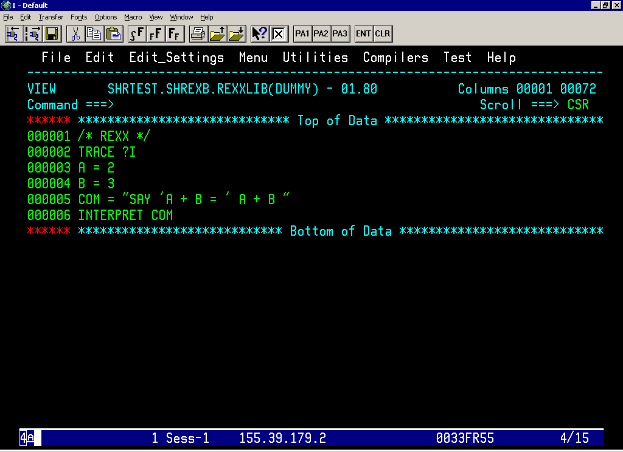

Slide 80
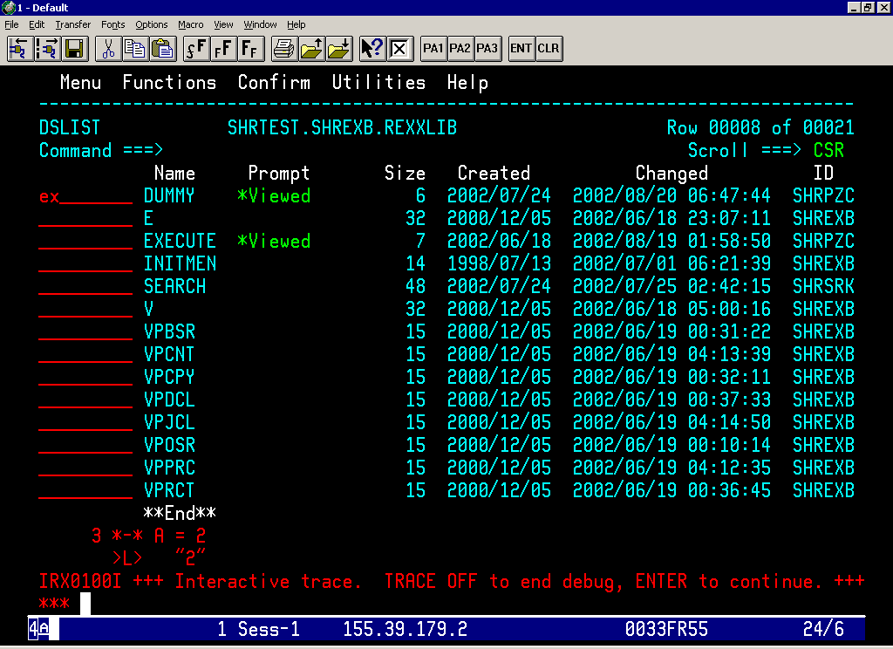

Slide 81
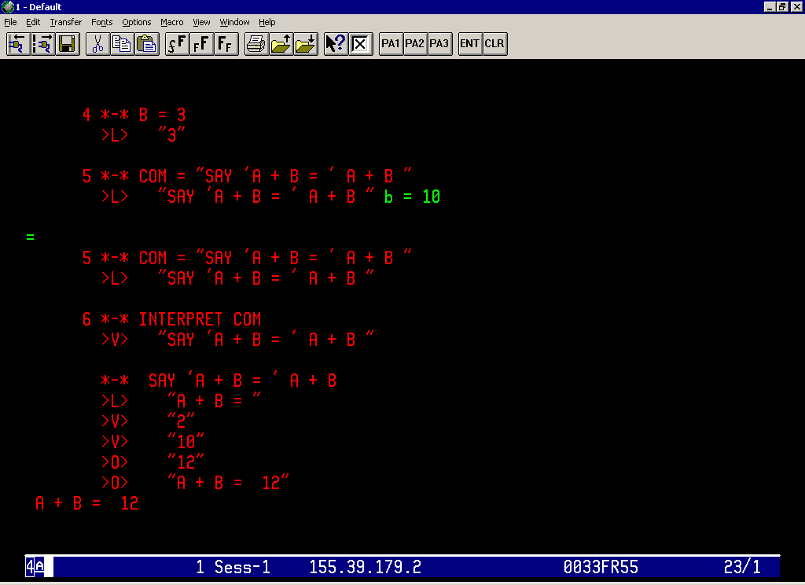

Slide 82
Debugging the REXX Exec …. Contd
SPECIAL VARIABLES
  RC – Will contain the Return code the latest command
  SIGL – The line number from which there was a transfer of
  control because of the function call, a SIGNAL
  instruction , or a call instruction.
  Interactive Debug Facility
    EXECUTIL TS(TRACE Start)
    EXECUTIL TE(TRACE End)
    Option within Interactive Trace

Slide 83
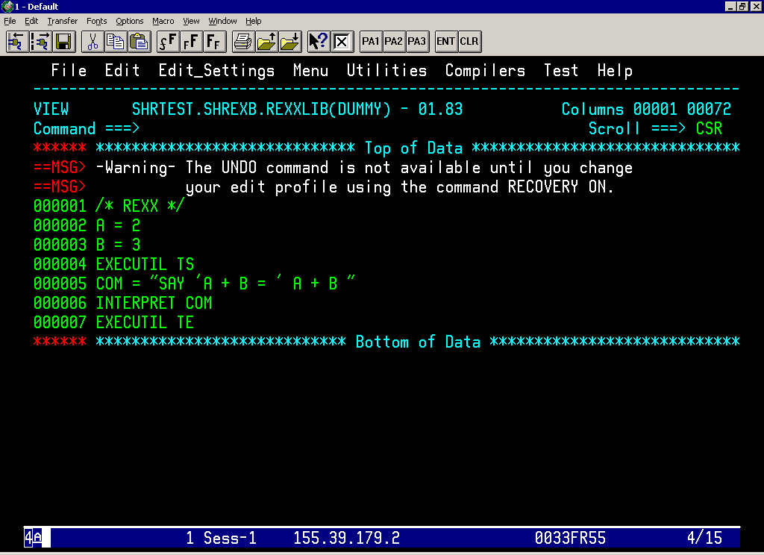

Slide 84
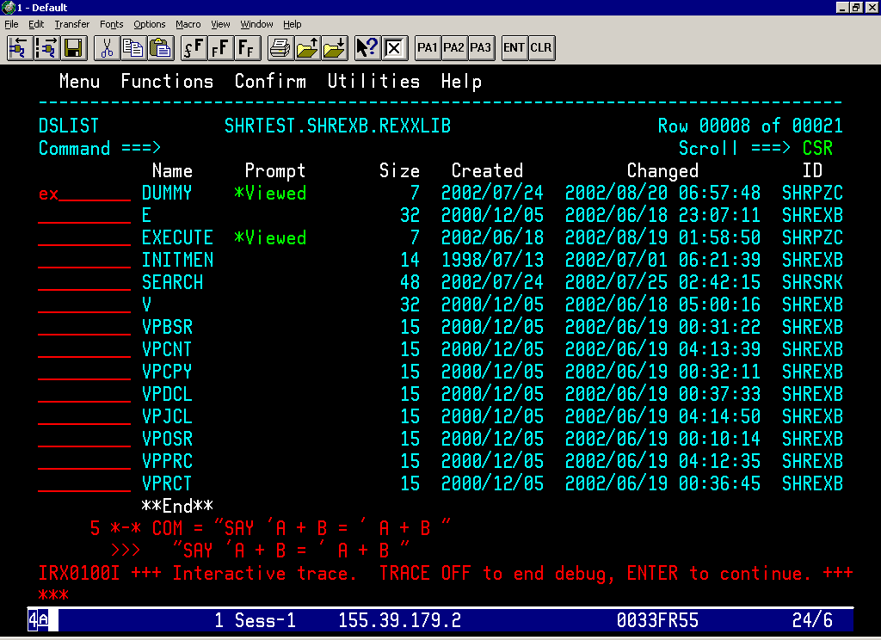

Slide 85
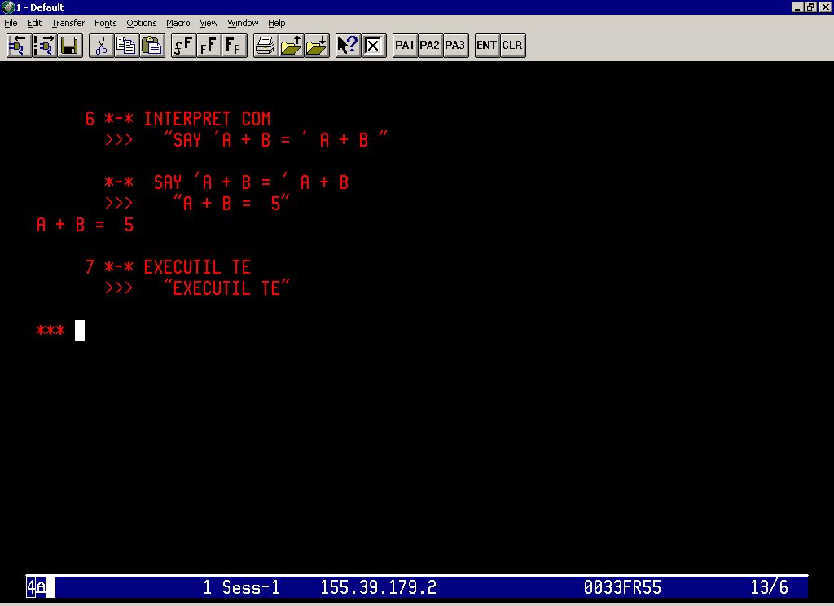

Slide 86
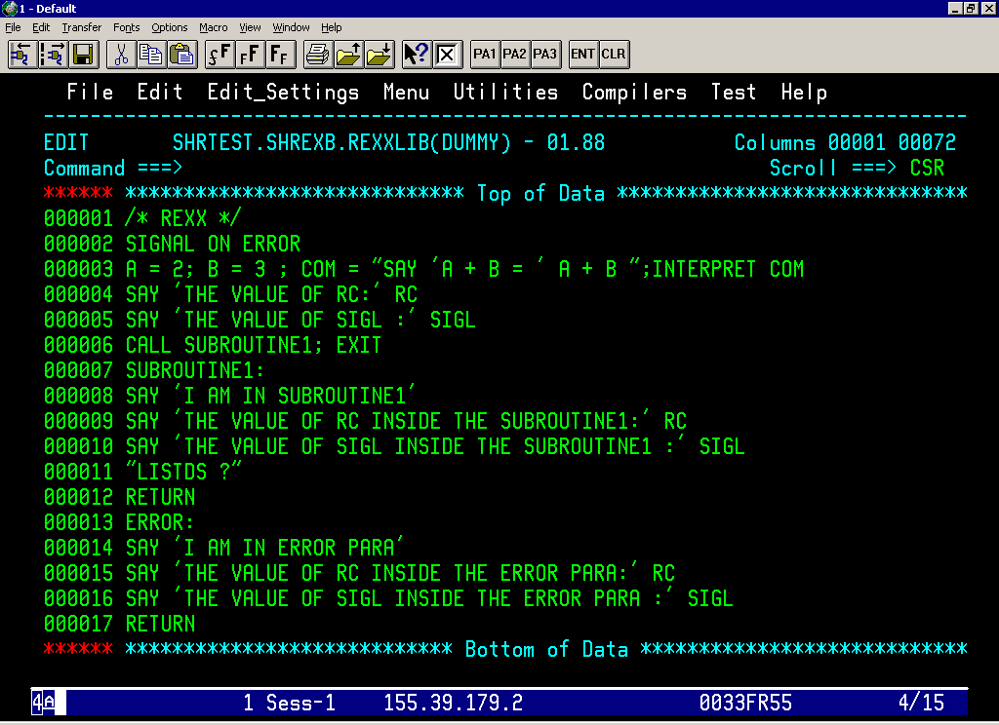

Slide 87
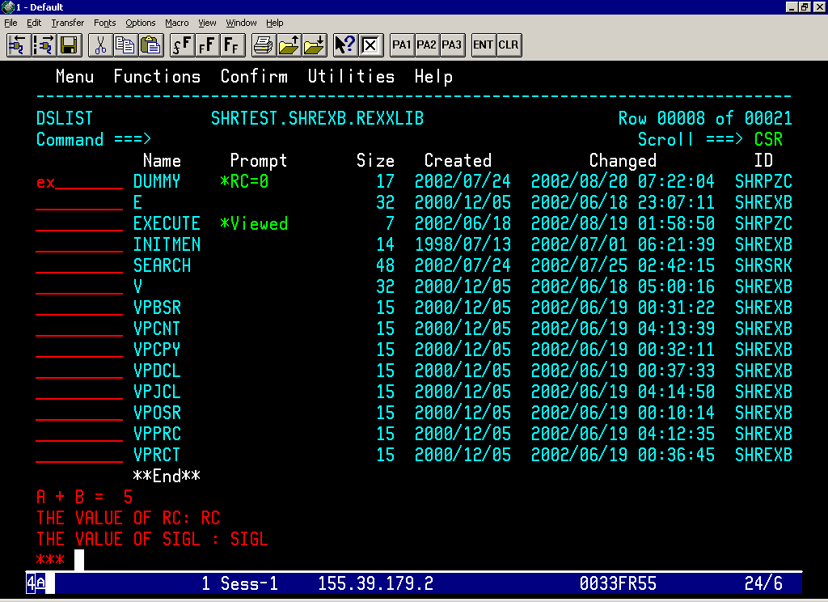

Slide 88
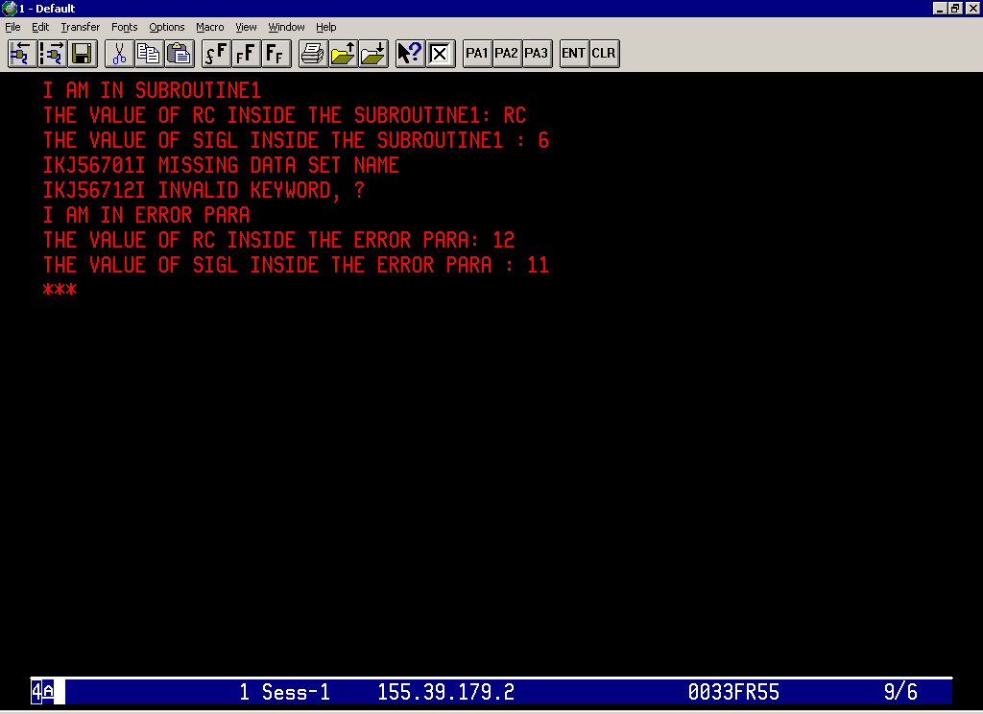

Slide 89
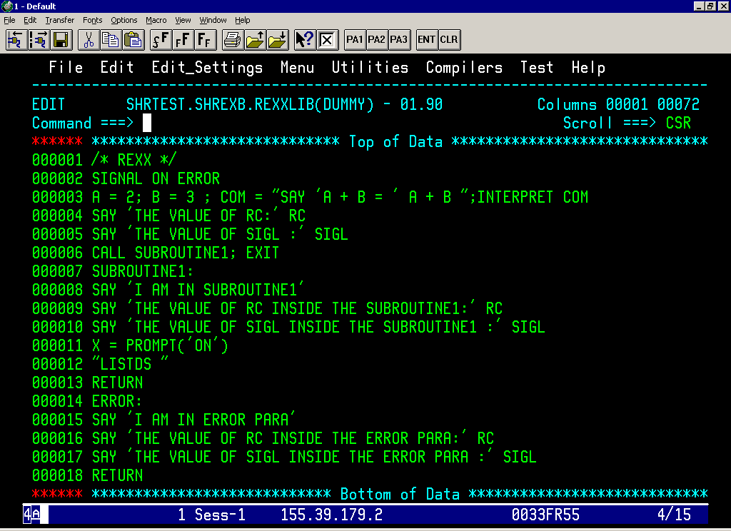

Slide 90


Slide 91
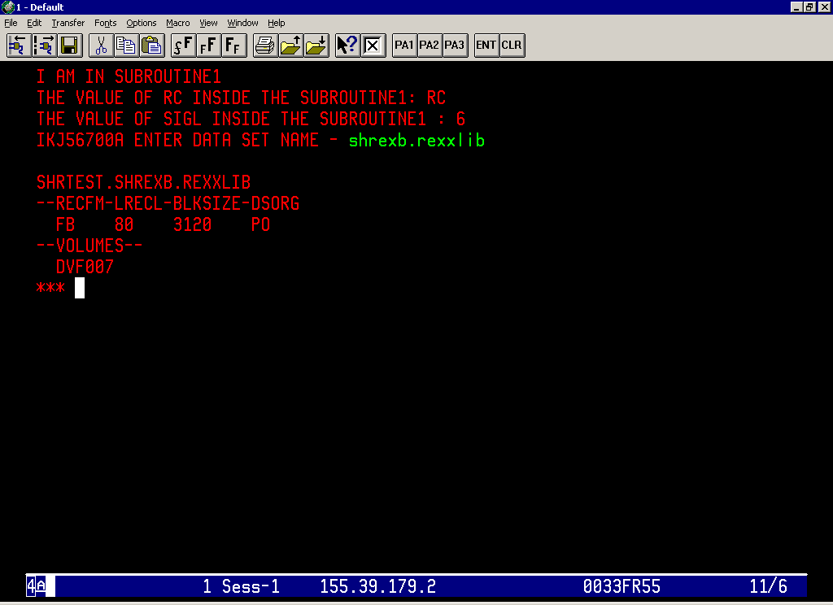

Slide 92
Thank You……………..

