Slide 1
DevOps
MeETUP 2017-01-19
@ Bukalapak OFFICE

Slide 2

Source : http://blog.cbtnuggets.com

Slide 3
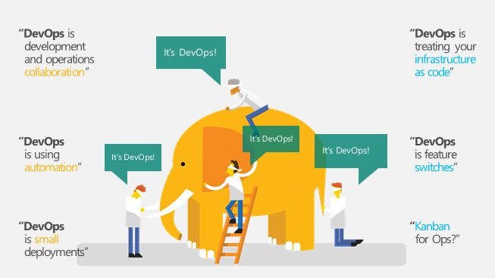
Source : http://ed-baker.com/wp-content/uploads/2015/12/image.png

Slide 4

Source : http://boomeon.com

Slide 5

Source : http://devops.com

Slide 6
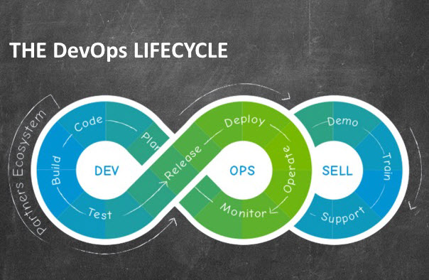

Slide 7
How to Adopt DevOps

Slide 8
Achievement
KMK Mengadopsi DevOps lebih dari 2 tahun
KMK Deploy : 13 times a week in Average Across 3 main services
KMK Max Deploy for Publishing Per day : 4
KMK Max Deploy for Vidio Per day : 4
KMK Deploy Time to Prod : Fastest (15 Mins), Longest (2 Hours)
KMK Automatic Staging Environment Deploy Time : 20 Mins ~ 1 Hours
KMK BlueGreen Deployment
Total CI Jobs : 99 (Master + Slave)
Total Instance that we deploy every morning to staging : 30
Total Running Automatic Testing Pre-Prod : 309
Total Running Testing KMK TE : 877
Total Running Testing KMK Developer : ~5000+

Slide 9
DevOps value in the Market

Slide 10
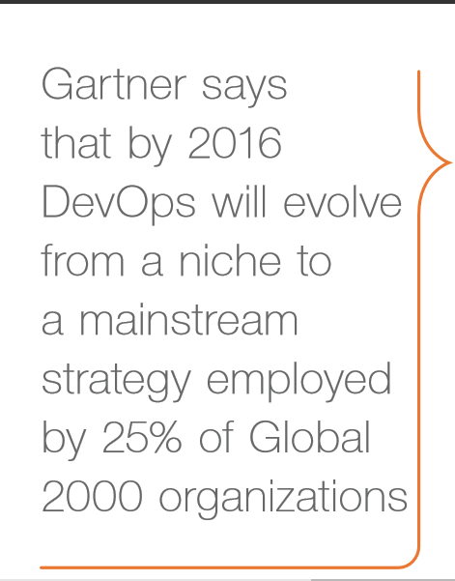
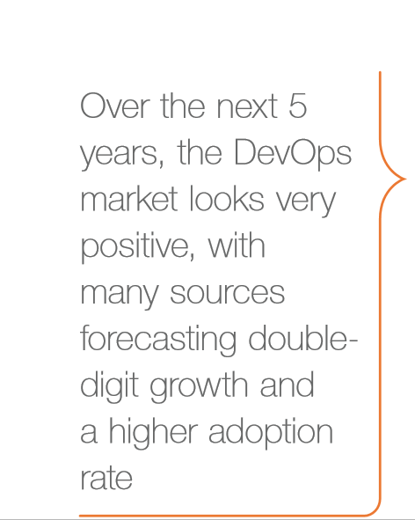

Slide 11
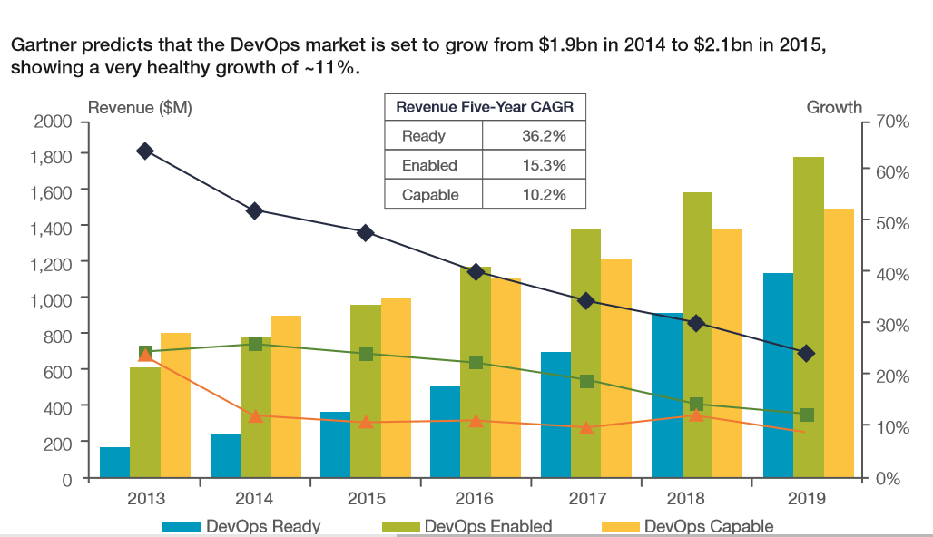

Slide 12
Media Social
Twitter : @devopsjakarta
Github: devopsjakarta
Meetup link: meetup.com/DevOps-Jakarta
Milis: groups.google.com/d/forum/devopsjakarta
Milis Email: devopsjakarta@googlegroups.com

