Slide 1


Introduction to Git and Github

Slide 2
Git is Source code management tool
It is version control system
Version control system records the changes to a file, so that we can recall specific version later
Git can be installed in windows,linux and MAC OS etc..
Git is distributed version control and hence not single point of failure
Multiple branches can be created for different projects as working area and merge can be done if required

Slide 3
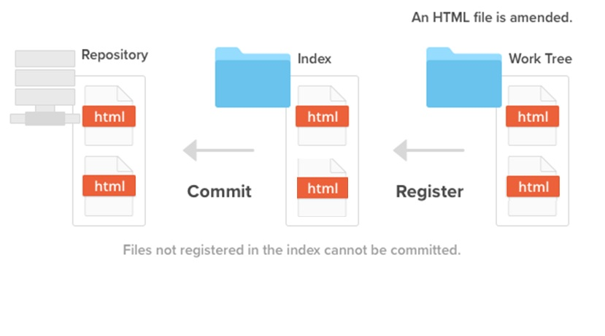
Git work flow

Slide 4
Everyday Git Commands
Create Repository
  init
  clone
Snap Shots
  add
  status
  commit
  reset
  stash
  rebase
Branching and Merging
  branch
  merge
  checkout
  log
Sharing
  fetch
  push
  remote
Inspection
  log, diff

Slide 5
Git Basic commands
git init -- (creates the local repository)
git --version (to find the version)
git add .
git status
git add moves the file to the staging area
git commit -m "message"
git commit moves to the local repository

Slide 6
git config
The git config assign settings
git config --global user.name "username "
git config --global user.email " mailid"
Branch
git branch
lists the branches
To create a branch
git branch <branchname>
and
git checkout -b <branchname>

Slide 7
Merge the branches
git checkout master
git merge <another branch>
Clone
Cloning is like git init and creates the working directory from remote repos
git clone <RR url>
once git clone is done, the changes in the remote repos can be pulled from the local working area using
git pull

Slide 8
Any changes in the local working area can be pushed to the remote repos using
git push origin master
Advanced Git commands
stash
log
rebase
revert

Slide 9
Stash
to hide the current staging area and create clean working area
git stash -u
git stash list
to bring the stash to the staging
git stash apply
git status

Slide 10
GIT log
git log is used to revert the version control to the previous version control for reference
git log --oneline
git revert HEAD

Slide 11
Git REBASE
The master will be updated if rebase is done
The files inserted in the other branch can be rebased in the master branch using rebase and master branch will be updated
git rebase master

Slide 12
Gitting Started on Windows
Install msysgit from www.git-scm.org
Choose (and install) a Git Interface
  GitHub for Windows (Phil Haack)
  TortoiseGIT
  Git Extensions
  Command Line (Powershell)
  Many others available
Set your name and email address
  Via Gui
  Via Command Line
    git config –global user.name “Joshua Gall”
    git config –global user.email “josh@imtraum.com”

Slide 13
Remotes
Remotes are what make Git Distributed
Remotes are just a URL that’s been aliased
Commands
  remote
  push
  fetch (or pull)
  merge

Slide 14
Cool GitHub Stuff
GitHub hosts repositories – a remote for your local repo
GitHub hosts Wiki’s versioned by Git
GitHub has simple defect tracking
Pull Requests – Code Review and Collaboration
Numerous ways to navigate your code
demo

Slide 15
A Simple Git Workflow
To work on something new, create a descriptively named branch off of master. This is a topic branch.
Commit to that branch locally and regularly push your work to the same named branch on the server.
Keep your topic branch up to date with master.
When you need feedback or help, or you think the branch is ready for merging, open a pull request
After someone else has reviewed and signed off on your new feature, merge it into master.
Once deployed to master, you can and should deploy immediately.

