Slide 1



Practising DevOps with Azure DevOps
Talk Overview:
Introduction to Azure DevOps Services
Demo

Slide 2

VSTS
Azure DevOps Services
Azure DevOps Server
Credits: https://www.danclarke.com

Slide 3
Azure Devops
Azure DevOps provides developer services to support teams to plan work, collaborate on code development, and build and deploy applications.
build and deploy applications
plan work
collaborate on code development

Slide 4





Azure Boards
Azure Pipelines
Azure Repos
Azure Artifacts
Azure Test Plans

Slide 5
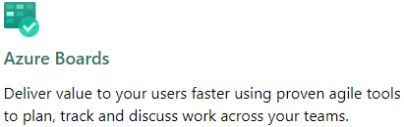
“plan work”
Workflow management
Work Item management
GitHub integration
Service integrations

Slide 6
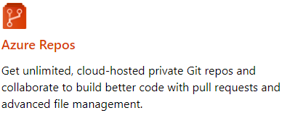
“collaborate on code development”
Version control
Code search
Pull requests (& draft PRs)
Branch policies

Slide 7
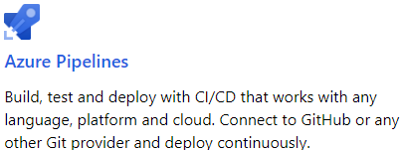
“build and deploy applications”
Build & release pipelines
Pipeline as code
Triggers including pre-merge
Build/release task extensions

Slide 8
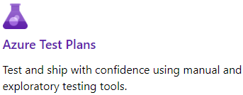
Test plans
Manual testing
Exploratory testing
Integration with other services

Slide 9
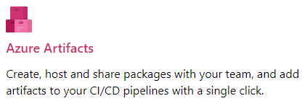
Artifacts
Package feed (NuGet, npm etc)
Public / private feeds
Upstream sources
Integration with other services

Slide 10





Concepts
Project A
Project B
Project C
Organization

Slide 11

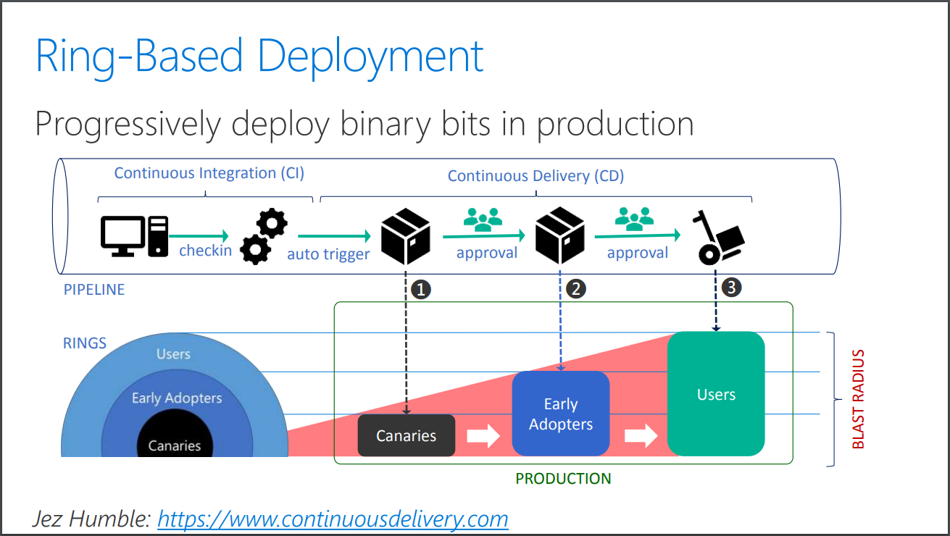

Slide 12





Demo
Build
Release
Consumes

Slide 13
Demo

Slide 14
Thank You
Dushyant Priyadarshee
Twitter: @dp7g09
Github: https://github.com/dp7g09

