Slide 1

The STFC Cloud
Alexander Dibbo and Martin Summers

Slide 2
Contents
Overview – What, Why, Who: regarding Openstack Cloud ?
Who uses the STFC cloud ?
What does our cloud look like now ?
What does it take to keep it running ?
How do we measure how it is performing ?
Summary

Slide 3
What is the STFC Cloud ?
Dynamic compute resource available to STFC departments & beyond
Tailored to researchers requirements (with some boundaries) & Support
Available on demand
Compute resources recovered and made available to others when usage complete
The STFC Cloud is not a long term data archive (yet)

Slide 4
Why run a cloud ?
Provide Self Service VMs to SCD and wider STFC
Underpin Horizon 2020 projects
To support SCD’s Facilities program
To support a more diverse range of Scientific research – IRIS.
To run dynamic production services.
Run test new services in development.

Slide 5
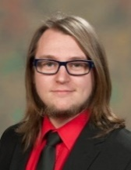
Core Cloud Team.
Alex Dibbo (Team Leader, Senior Cloud Sysadmin)
Martin Summers (50%) (Lead User Support/Sysadmin)
Warren Jeffs (50%) (Cloud Sysadmin)
Matthew Richards (Apprentice) (Image production)
Currently being recruited – Sysadmin and Cloud Delivery Manager
The STFC Cloud Core Team is currently funded by SCD

Slide 6
Who is using it now ?
Diamond (DLS) (IRIS) – 1760 core peak, 8.16 TB – 2nd July ’19
WLCG Tier 1 (SCD – virtual WN) – 2544 core peak, 14.75 TB - 25th Jun ‘19
IDAaaS (ISIS) (IRIS) – 1650 core peak, 7.33 TB mem – 21st May ‘19
EUCLID (IRIS) – 726 core peak, 2.96TB – 12th Aug ’19
CCFE (IRIS) – 254 core peak, 274 GB – 23rd Apr ‘19
Xchem-follow-up (DLS – IRIS)-360 core peak, 1.52 TB – 27th Jun ‘19
admin (SCD) – 702 cores peak, 3.71 TB mem -27th Jun ‘19
Total at present=8140 cores, 40.8TB (21st Aug ‘19)
126 projects registered

Slide 7
World
LSST
EUCLID
AENEAS
UKAEA
STFC
ISIS
DLS
Technology
PPD
SCD
H2020
CLF
SCD Cloud
UKATC
Other cloud providers, incl. IRIS and commercial
IDAaaS
ASTEC
DAFNI-a
DAFNI-b
UKT1-a
RALSpace
RCaH
SCARF
UKT1-b
Jasmin
Nuclear Phys
(Hartree)
Notes:
Current cloud users
User support model
STFC departments currently in focus
Would expect the current user support model to be continued across STFC Departments

Slide 8
What does the cloud look like now ?
211 Hypervisors, 8850 cores max, 44.2 TB of Memory
229 TB disk space Sirius (Ceph object store)
13 racks of equipment (2 racks not full….yet).
16 Mellanox top of rack routers running Cumulus
34 Ceph storage servers
22 service infrastructure 1U servers.

Slide 9
Hypervisor Types
14 x Dellr430-2015: Xeon_e5_2640v3@2.6Ghz x2, 128GB RAM (16 cores) – 10Gb network
108 x Dellc6420-2017: Xeon_silver_4108@1.8Ghz x 2, 96GB RAM (16 cores) – 25 Gb network.
74 x XMA-2018: Xeon_gold_6130@2.10Ghz x2, 384GB RAM (32 cores) -25Gb network
10 x Dellr730-2016: Xeon_E5-2650v4@2.2Ghz x2, 384GB RAM (24 cores) – 25Gb network, 2x Quadro k620 (GPU)
5 x Dellr740-2018: Xeon_gold_6130@2.10Ghz x2, 384GB RAM (32 cores) – 25Gb network, 2-4 x GPU cards(P100 TESLA or Quadro4000)(GPU)
Note that we enable Hyperthreading so cores are multiplied by 2 !

Slide 10
Cloud and Service Features
Internal local network access routed within the STFC: non-internet facing. (DNS A record customisation and Host grid certs)
Project dedicated “private” network, with some allocated valid internet addresses. (DNS alias names)
Full “sudo” access to VMs created by a user. FEDID login to the “console”. Images are semi-managed.
Disk space for VMs system file system does not count against quota, but “Volumes” (additional disk space) is managed on a per-project basis.
O/S images for use include Scientific Linux 6, 7 , Ubuntu (3 latest LTS versions), and introducing Centos 7.
No network upload/download quotas

Slide 11
What else do we need for the service?
15 x new “service” nodes: galera, network, Loadbalancer, rabbit, Sirius.
2 x 100Gb/s “network” nodes (previously on 1 x 10Gb/s) – private nets
Now have 6 x neutron nodes, 3 x horizon nodes, 3 x “webfe” nodes
Pending expansion:-
30 x Storage nodes for use in manila (shared file system) – due by end of year.
12 x SSD storage nodes for Ceph object storage.
3 x bare-metal “service” nodes to come online
2019 HV compute + some R420 older HVs

Slide 12
How has the Cloud grown since Spring 2018 – use ?
15 Projects in 6th April 2018 (126 projects now)
DAaaS was biggest user of cores – 114 cores 240 by June 2018
In 2018 new calls logged =233 and 216 resolved by 22nd Aug.
In 2019 new calls logged =329 and 330 resolved by 22nd Aug
Only using about 7 racks for Openstack in April 2018. (13 now)
Opennebula system decommissioned.

Slide 13
What does it take to keep it all running ?
…so what have been the challenges ?
People, Monitoring, running a Helpdesk, Planning, Meetings, Finance, Knowledge, training, reporting, Research & Development, hardware investment, Patching, power, networking, Hackathons, running workshops, visiting conferences, Experimentation, Development cloud, Pre-production Cloud, Luck (good and bad), donuts.

Slide 14
Challenge 1 – new technical issues not seen before:
Example 1: Intermittent loss of packets, then total connectivity to one type of network. Cause: Router, Current solution: workaround. Pain: Originally Big – non-contact with VMs on Internal hosts.
Example 2: Poor disk I/O from 7PM to 7AM (Feb 2019). Cause: “data integrity check activity on Ceph”, Current solution: Multiple – expand cluster, increase placement groups, schedule over 24 hours, investment in SSD’s.
Example 3: VMs created on the same private network may not be able to talk to each other. Expanded Neutron services
Example 4: Power outage / Glitches !

Slide 15
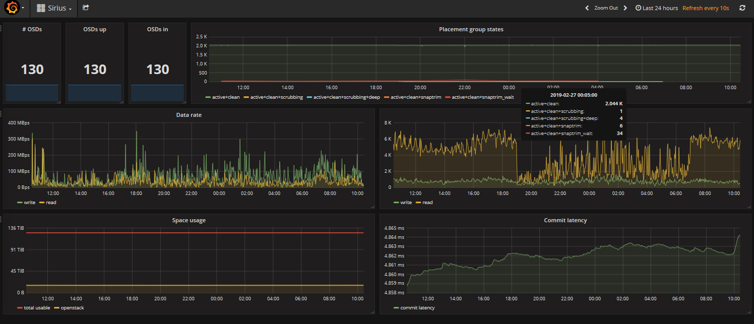
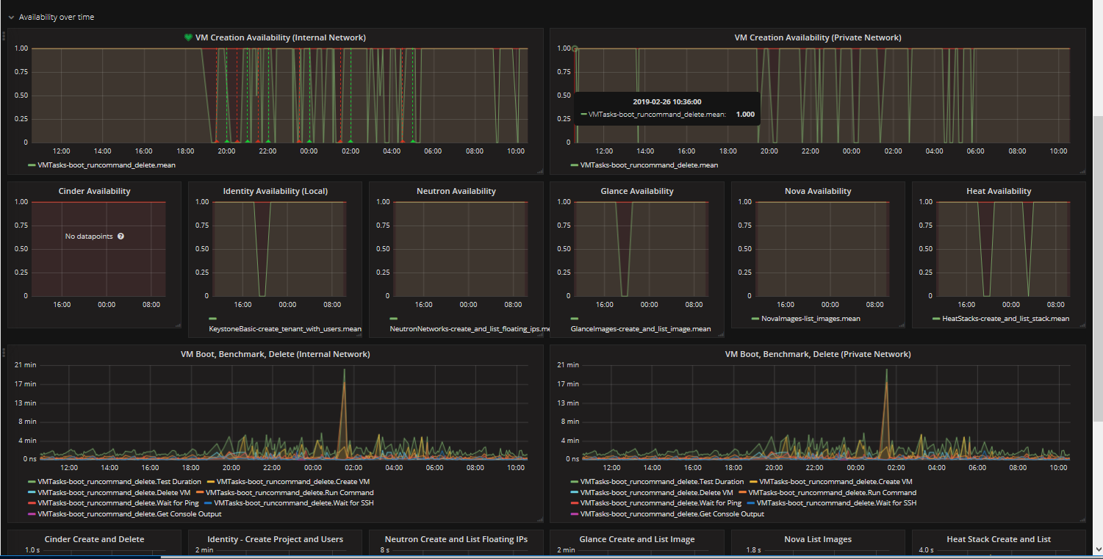
Example 2
Initial Issue: Data scrubbing 19:00-07:00 daily
Sirius Graph: Shows Sirius lower throughput during “data scrubbing” hours.
(Source: Sirius on 2019-02-26 for 24 hours)
Openstack “availability” graph – for 2019-02-26, for 24 hours – shows Outage of “VM creation ability” during 19:00 to 07:00 – when data scrubbing occurs.

Slide 16
Challenge 2: Resourcing priorities
Keeping Monitoring and alerting systems up to date.
Deploying new hardware in change window with production services, with resource available.
Getting project objectives completed within change window.
Hiring new people.
Responding in a timely manner to support queries.
Keeping up to date with technical knowledge and diversity of technologies implemented (complexity) – with scale.

Slide 17
Challenge 3: Pace of Growth
Many technical challenges appear due to growth of systems not scaling in such a way that is easy to predict when other systems need to grow.
Individual components of Openstack change features and capabilities. Affects systems they interact with.
Some earlier choices made can make it difficult to change to a different solution later on.
Complexity seems to be getting greater as new versions released. (opinion !)

Slide 18
How do we measure how the cloud is performing ?
Functional testing is done by “Rally” and produces “Availability statistics”
Keeping an eye on the hypervisor usage, and resource usage.
Alerting with Nagios for base system outages with auto-ticketing to helpdesk software (and call outs).
Benchmarking – indicative.
Human test procedures.

Slide 19
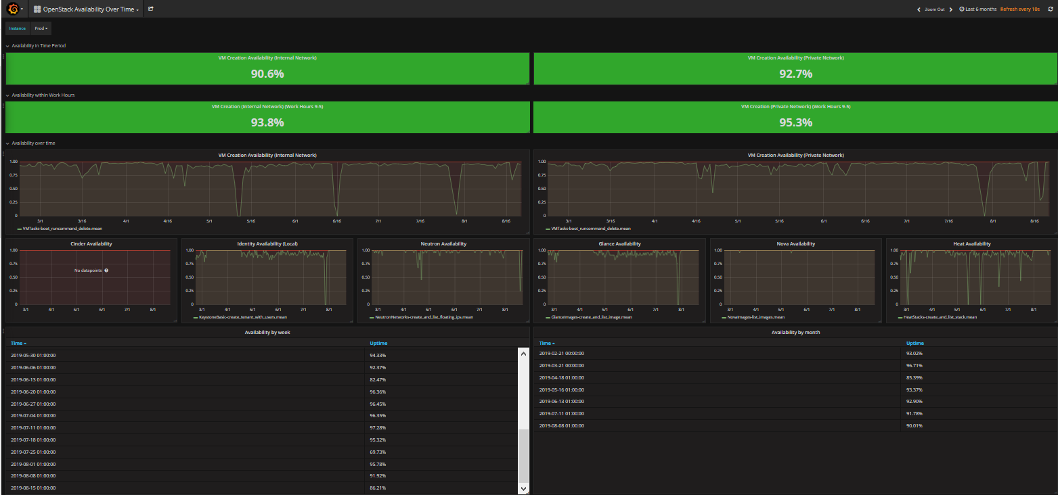
Example 1: STFC Cloud Availability over 6 months

Slide 20
Example 4: Benchmarking HEPSPEC06
Cores | Flavour | Lowest HS | Highest HS | HV type
1 | m1-tiny | 10.97 | 15.45 | dell-r430-2015-hv
2 | c2-small | 33.87 | 34.47 | xma-irishv-2018
2 | c2-small | 32.53 | 35.14 | dell-c6420-2017-hv
4 | c2.medium | 54.86 | 55.66 | dell-c6420-2017-hv
8 | c2.large | 108.54 | 109.82 | dell-c6420-2017-hv
16 | c2.xlarge | 216.01 | 219.22 | dell-c6420-2017-hv
30 | c1.5xl | 420.59 | 424.22 | xma-irishv-2018
60 | g-p100.xlarge | 799.5 | 853.01 | dell-r740-2018-hv-p100
Bare metal wn-xma-2018 = 785 average (64 cores)

Slide 21
Summary
Cloud Service is expanding rapidly.
Use of cloud is expanding rapidly.
Challenges exist regarding dealing with the rate of expansion.
Expecting to continue to see new technical challenges.
Documenting fixes based on symptoms and results.
We’ll continue to utilize Apprentices and Graduates to work on Cloud Infrastructure based projects.

Slide 22
Thank you for listening !
Any Questions ?
Jobs available @ https://topcareer.jobs
Alexander.dibbo@stfc.ac.uk

