Slide 1

Attracting Tech Talent
A rundown of 5 things you can do today to attract new staff into your business
(not including using a recruiter)

Slide 2
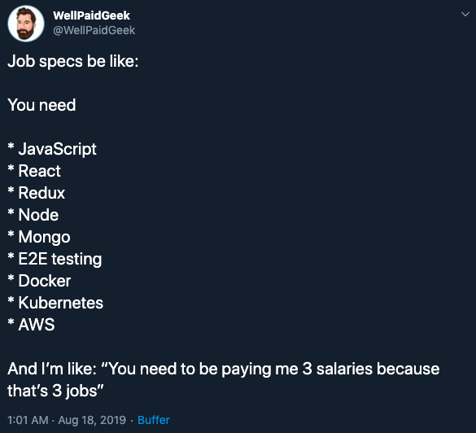
1
Be Realistic

Slide 3

2
Be Diverse

Slide 4

3
Be Flexible

Slide 5







4
Be Social

Slide 6

5
Be Positive
“Please note this is very much a hands-on position, if you are not hands on please do not apply!!!”
“CVs alone will not be considered”
“ DO NOT APPLY IF YOU HAVE NO EXPERIENCE PLEASE DO NOT WASTE YOUR TIME OR OUR TIME”
“IF YOU DO NOT HAVE THE RIGHT TO WORK OR REMAIN IN THE UK, PLEASE DO NOT APPLY”

