Slide 1
Azure AKS
Dan Haywood
27 Mar 2018

Slide 2
Use case
CI of some open source projects + internal client projects
gitlab.com for the CI bit
Sonatype Nexus v3 for
Maven artifacts
Docker images
Use Azure AKS to host Sonatype Nexus v3
Successor to Azure ACS
Also spiked on Azure ACI, discarded

Slide 3
Prereqs
kubectl – client for k8s cluster
Azure Tools
Azure CLI
Powershell
portal.azure.com – UI (but no UI for “within” the k8s cluster”)
shell.azure.com – includes kubectl
az login – does the Azure-specific stuff
create a resource group
Create file storage account
Create file share
Create the k8s cluster itself
Upgrade the k8s cluster
Kubernetes Dashboard – UI “within” the cluster

Slide 4
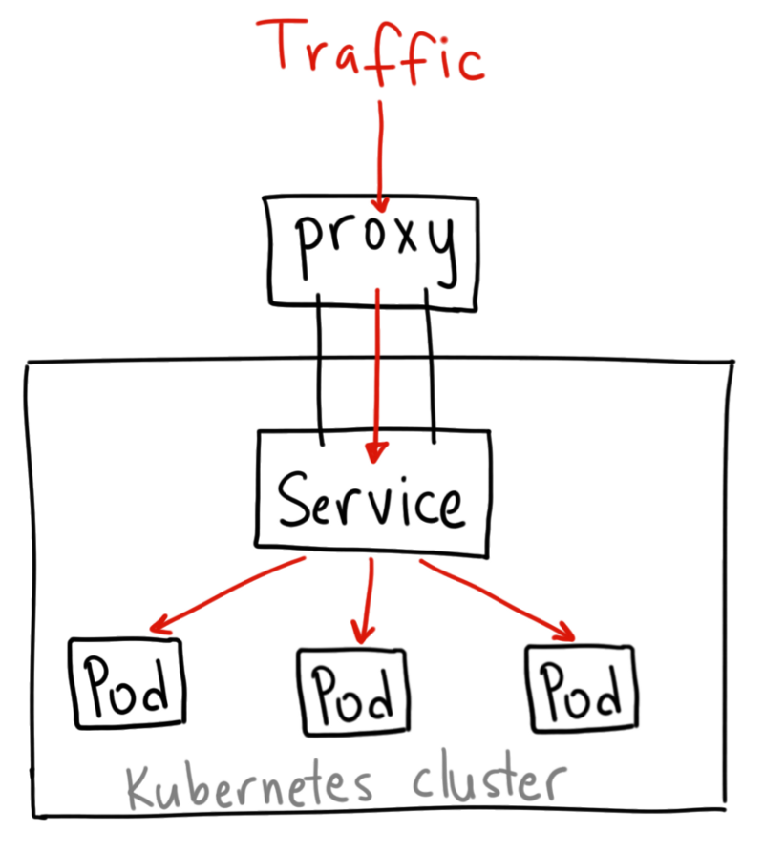
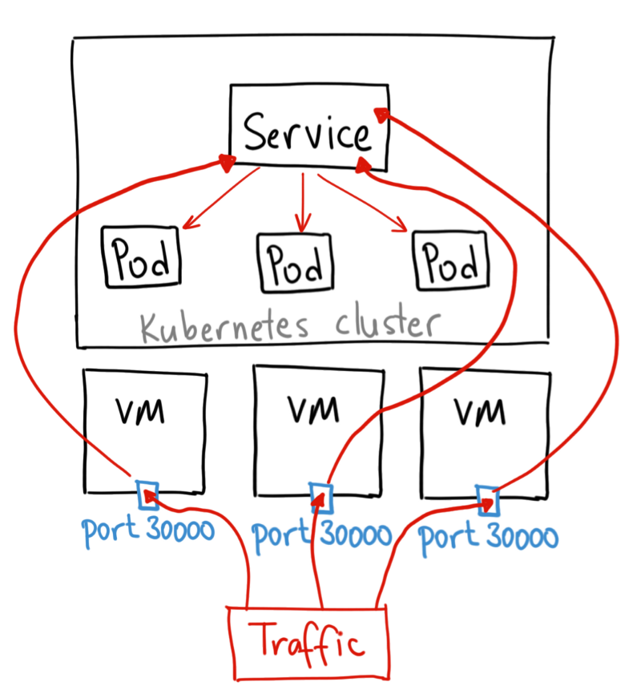
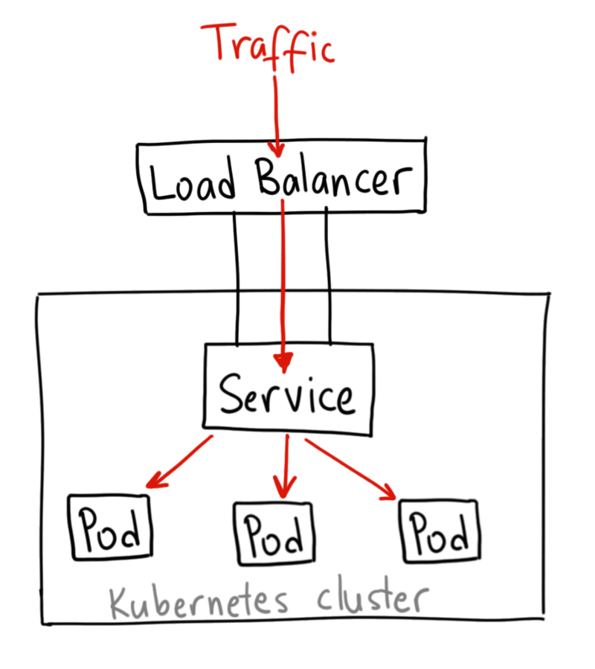
Different ways to get traffic into the cluster
credit: https://medium.com/google-cloud/kubernetes-nodeport-vs-loadbalancer-vs-ingress-when-should-i-use-what-922f010849e0

Slide 5
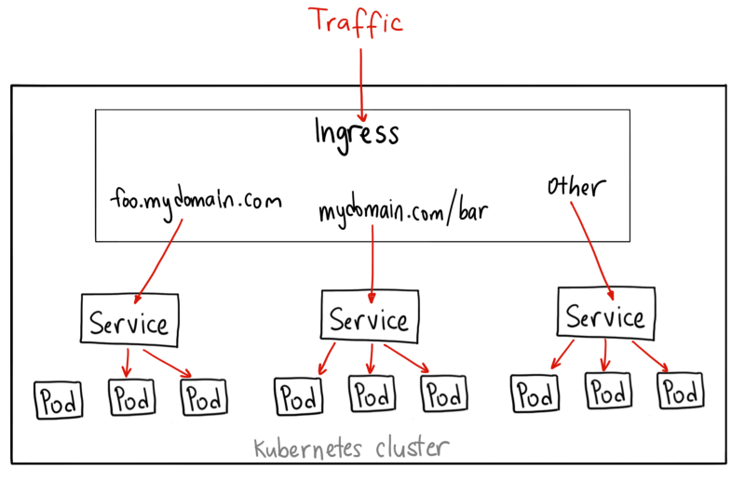
Using an Ingress
credit: https://medium.com/google-cloud/kubernetes-nodeport-vs-loadbalancer-vs-ingress-when-should-i-use-what-922f010849e0

Slide 6
In practice, the manifests you need are
Deployment
Replica Set
Pods (which runs one or many containers)
Service
Ingress
Also CNAME records
for the Ingress to use as routes

Slide 7
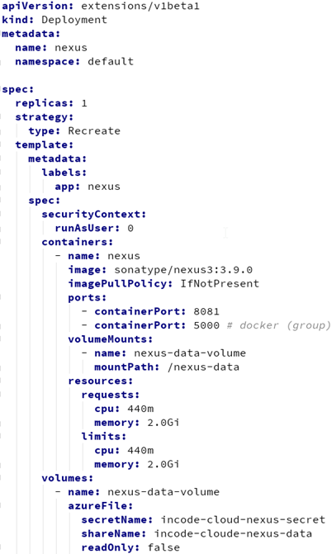
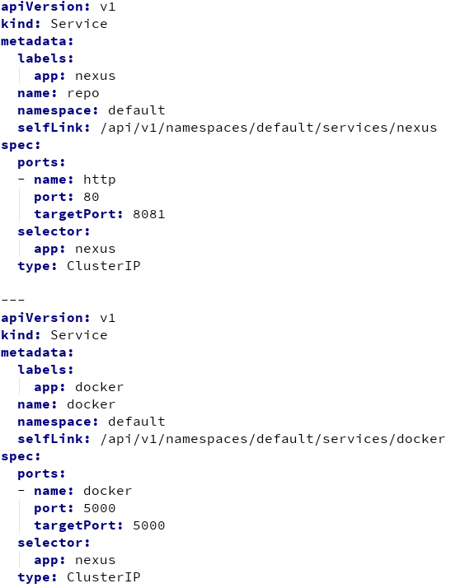
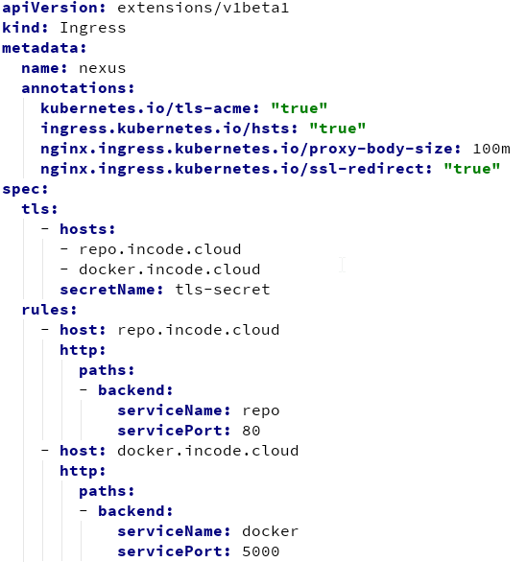

Slide 8
Helm
Basically templated k8s descriptors
Called a “chart”
Some additional lifecycle stuff on top
Parameterizable bit factored out into chart-specific values.yml
Tiller is the backend component
Public repository at https://github.com/kubernetes/charts
And can register your own

Slide 9
SSL
https in front of the Ingress, http within
LetsEncrypt
Free SSL certificates, valid 90 days
KUBE-LEGO
Pod that handles Acme protocol to LetsEncrypt
Automatically manages expiration
Installed using Helm … “just works”

Slide 10
https
LetsEncrypt
http
Maven Central
Docker hub
Final design
<<AzureFileShare>>
incode-cloude- nexus-data
<<pod>>
KUBE LEGO
SSL certs
<<deployment>> Nexus
<<Ingress Controller>>
Nginx
<<services>>
<<maven group>> maven
<<proxy>>
central
443
<<ingress rule>> repo.incode.cloud
80
<<service>> repo
8081
maven-dev
maven-interim
<<docker group>> docker
5000
<<ingress rule>> docker.incode.cloud
5000
<<service>> docker
<<proxy>>
docker-hub
5000
5000
<<ingress rule>> docker-dev.incode.cloud
5000
<<service>> docker-dev
docker-dev
docker-test
docker-prod
5000
<<ingress rule>> docker-test.incode.cloud
5000
<<service>> docker-test
5001
5002
5003
5000
<<ingress rule>> docker-prod.incode.cloud
5000
<<service>> docker-prod

Slide 11
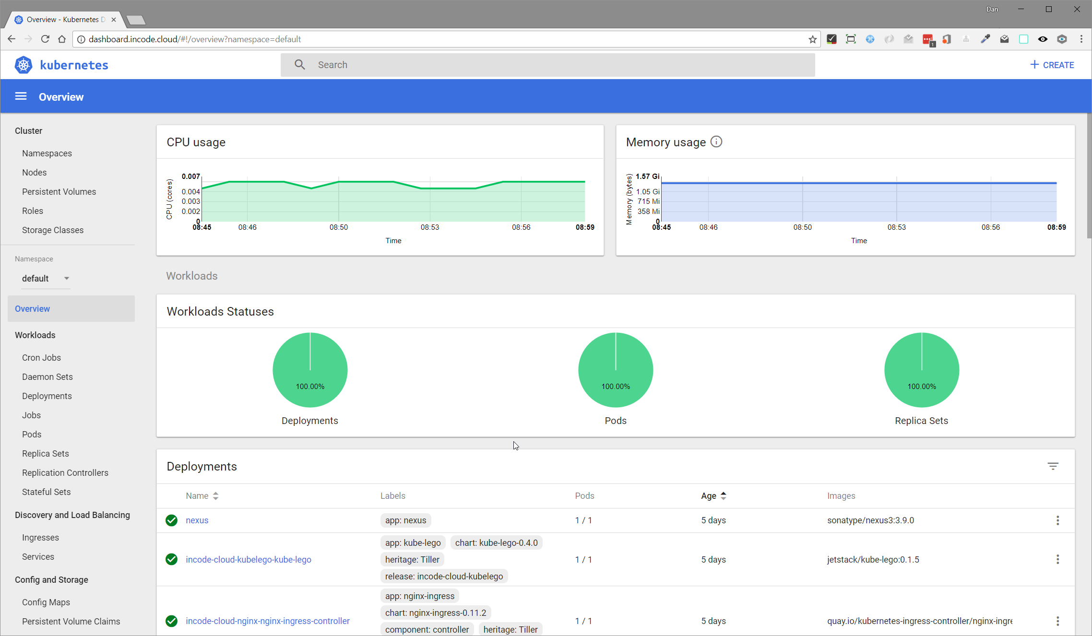
k8s Dashboard

Slide 12
Still to tackle…
Cloud-agnostic file shares
PersistentVolumeClaim
Liveness and readiness
Deployments of demo apps into the cluster
Use kubectl from gitlab.com to deploy, with a custom Helm chart
Documentation – antora.org
Authentication - OpenID Connect
Authorisation – KeyCloak
Monitoring – Prometheus
Tracing – Zipkin

