Slide 1
DEVOPS TOOLS

Slide 2
TOOLS
Git
Docker
Selenium
Maven
Jenkins
Puppet
Ansible
Kubernetes
Nagios

Slide 3
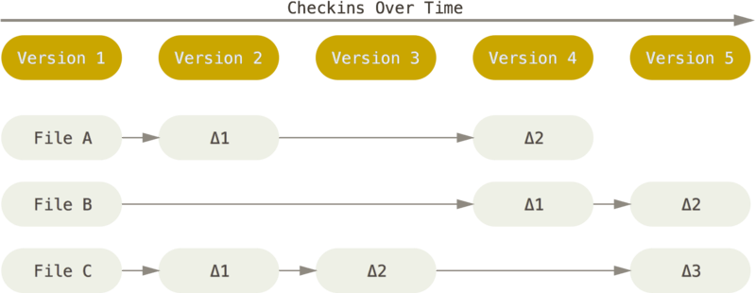
GIT
Git is a Version Control System.
Git was initially designed and developed by Linus Torvalds for Linux kernel development.
Git is a free software distributed under the terms of the GNU General Public License version 2.
The major difference between Git and any other VCS (Subversion and friends included) is the way Git thinks about its data. Conceptually, most other systems store information as a list of file-based changes. These other systems (CVS, Subversion, Perforce, Bazaar, and so on) think of the information they store as a set of files and the changes made to each file over time (this is commonly described as delta-based version control).

Slide 4
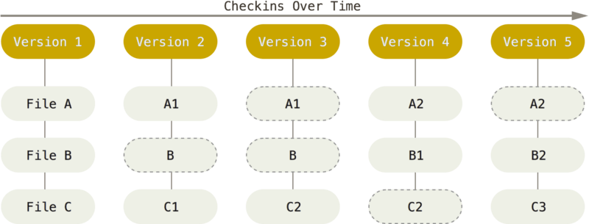
GIT Continues...
Git doesn’t think of or store its data this way. Instead, Git thinks of its data more like a series of snapshots of a miniature filesystem. With Git, every time you commit, or save the state of your project, Git basically takes a picture of what all your files look like at that moment and stores a reference to that snapshot. To be efficient, if files have not changed, Git doesn’t store the file again, just a link to the previous identical file it has already stored. Git thinks about its data more like a stream of snapshots.

Slide 5
Docker
What is a container?
A container is a standard unit of software that packages up code and all its dependencies so the application runs quickly and reliably from one computing environment to another. A Docker container image is a lightweight, standalone, executable package of software that includes everything needed to run an application: code, runtime, system tools, system libraries and settings.
Container images become containers at runtime and in the case of Docker containers - images become containers when they run on Docker Engine. Available for both Linux and Windows-based applications, containerized software will always run the same, regardless of the infrastructure. Containers isolate software from its environment and ensure that it works uniformly despite differences for instance between development and staging.
Docker containers that run on Docker Engine:
Standard: Docker created the industry standard for containers, so they could be portable anywhere
Lightweight: Containers share the machine’s OS system kernel and therefore do not require an OS per application, driving higher server efficiencies and reducing server and licensing costs
Secure: Applications are safer in containers and Docker provides the strongest default isolation capabilities in the industry

Slide 6
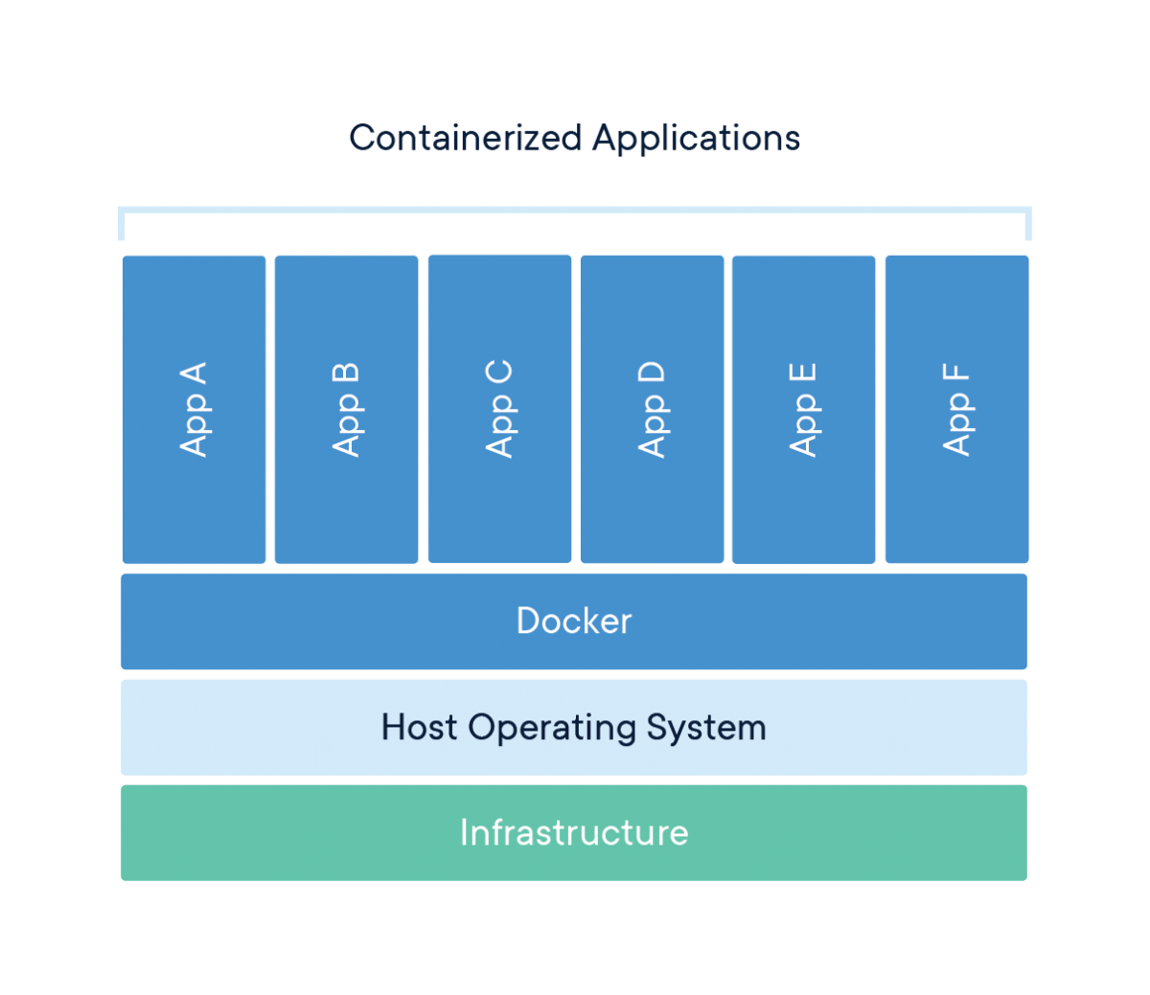
Docker continues...

Slide 7
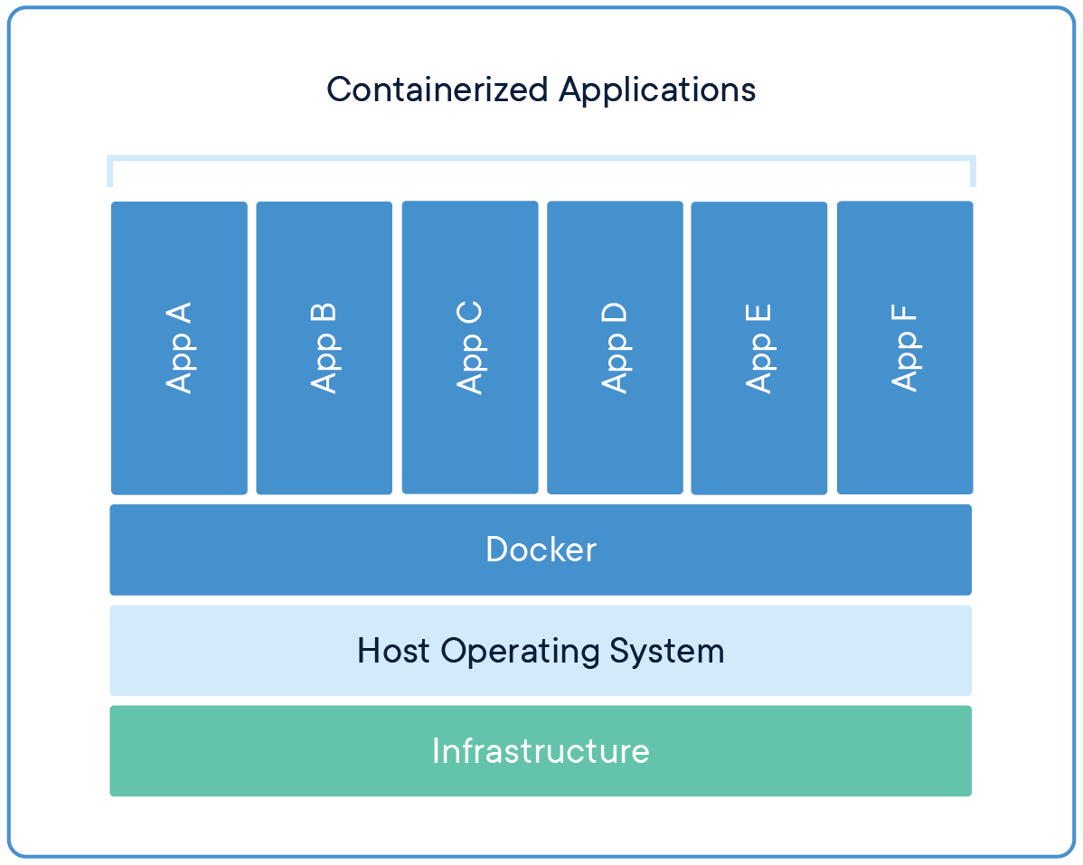
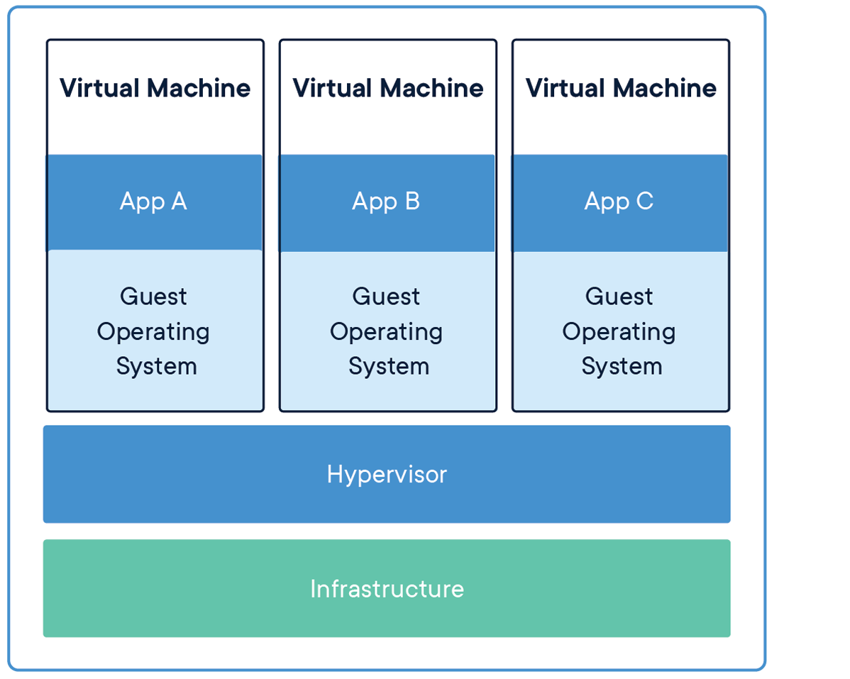
Containers Vs Virtual Machine

Slide 8
Container Vs. Virtual Machine
CONTAINERS Containers are an abstraction at the app layer that packages code and dependencies together. Multiple containers can run on the same machine and share the OS kernel with other containers, each running as isolated processes in user space. Containers take up less space than VMs (container images are typically tens of MBs in size), can handle more applications and require fewer VMs and Operating systems. | VIRTUAL MACHINES Virtual machines (VMs) are an abstraction of physical hardware turning one server into many servers. The hypervisor allows multiple VMs to run on a single machine. Each VM includes a full copy of an operating system, the application, necessary binaries and libraries - taking up tens of GBs. VMs can also be slow to boot.

Slide 9
Selenium
Selenium automates browsers. That's it! What you do with that power is entirely up to you.
Primarily, it is for automating web applications for testing purposes, but is certainly not limited to just that.
Boring web-based administration tasks can (and should!) be automated as well.
Selenium first came to life in 2004 when Jason Huggins was testing an internal application at ThoughtWorks.
Selenium is a set of different software tools each with a different approach to supporting test automation. Most Selenium QA Engineers focus on the one or two tools that most meet the needs of their project, however learning all the tools will give you many different options for approaching different test automation problems. The entire suite of tools results in a rich set of testing functions specifically geared to the needs of testing of web applications of all types. These operations are highly flexible, allowing many options for locating UI elements and comparing expected test results against actual application behavior.

Slide 10
Maven
Apache Maven is a software project management and comprehension tool. Based on the concept of a project object model (POM), Maven can manage a project's build, reporting and documentation from a central piece of information.
Maven Objectives
Making the build process easy
Providing a uniform build system
Providing quality project information
Providing guidelines for best practices development
Allowing transparent migration to new features

Slide 11
Jenkins
Jenkins is a self-contained, open source automation server which can be used to automate all sorts of tasks related to building, testing, and delivering or deploying software.
Jenkins can be installed through native system packages, Docker, or even run standalone by any machine with a Java Runtime Environment (JRE) installed
Jenkins is a free and open source automation server written in Java. Jenkins helps to automate the non-human part of the software development process, with continuous integration and facilitating technical aspects of continuous delivery.

Slide 12
Puppet
Puppet lets you automate how your teams enforce state, secure, and deliver infrastructure faster.
Start automating easily with no prerequisites or Puppet knowledge using an agentless, task based approach.
Remove manual work and enforce consistency and changes across the data center and cloud service providers.
Quickly move from one-off management of the state of resources to ongoing state management to enforce consistency and changes across the data center and cloud platforms.
Get visualization and reporting you need to make key decisions or support security or compliance initiatives.
Deliver infrastructure, no matter where it lives, using leading agile practices.
The result: A new standard for automating the enforcement, security, and delivery of infrastructure from one platform, at scale.

Slide 13
Ansible
Ansible is simple open source IT engine which automates application deployment, intra service orchestration, cloud provisioning and many other IT tools.
Ansible is easy to deploy because it does not use any agents or custom security infrastructure.
Ansible uses playbook to describe automation jobs, and playbook uses very simple language i.e. YAML (It’s a human-readable data serialization language & is commonly used for configuration files, but could be used in many applications where data is being stored)which is very easy for humans to understand, read and write. Hence the advantage is that even the IT infrastructure support guys can read and understand the playbook and debug if needed (YAML – It is in human readable form)

Slide 14
Kubernates
is an open-source system for automating deployment, scaling, and management of containerized applications.

Slide 15
Nagios
Nagios is the most powerful IT infrastructure monitoring solution on the market. Nagios XI extends on proven, enterprise-class Open Source components to deliver the best monitoring solution for today’s demanding organizational requirements.

