Slide 1
Unit 2

Slide 2
Agile Methodology
Agile software development refers to a group of software development methodologies based on iterative development, where requirements and solutions evolve through collaboration between self-organizing cross-functional teams.
Agile methods or Agile processes generally promote a disciplined project management process that encourages frequent inspection and adaptation, a leadership philosophy that encourages teamwork, self-organization and accountability, a set of engineering best practices intended to allow for rapid delivery of high-quality software, and a business approach that aligns development with customer needs and company goals.

Slide 3
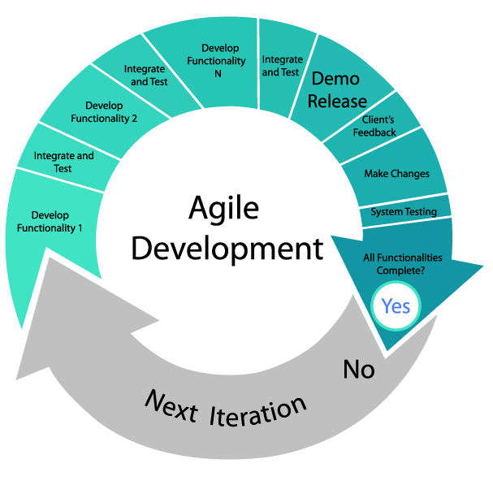

Slide 4
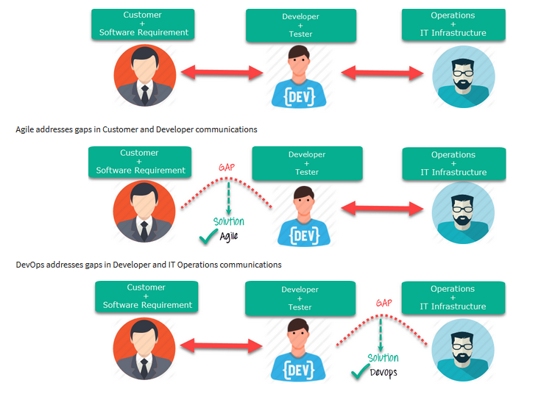

Slide 5
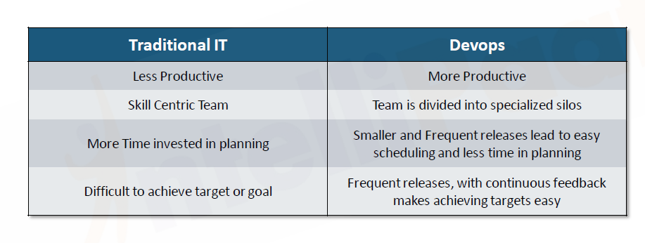

Slide 6
Agile vs Devops
Agile
DevOps
Agile refers to an iterative approach which focuses on collaboration, customer feedback, and small, rapid releases.
Agile helps to manage complex projects.
Agile development emphasizes training all team members to have a wide variety of similar and equal skills.
DevOps is considered a practice of bringing development and operations teams together.
DevOps central concept is to manage end-to-end engineering processes.
DevOps divides and spreads the skill set between the development and operation teams.

Slide 7
Agile vs DevOps
Agile
DevOps
Agile emphasizes on software development methodology for developing software. When the software is developed and released, the agile team will not care what happens to it.
Any team member should be able to do what's required for the progress of the project. Also, when each team member can perform every job, it increases understanding and bonding between them.
It addresses the gap between customer need and development & testing teams.
DevOps is all about taking software which is ready for release and deploying it in a reliable and secure manner.
In DevOps, development teams and operational teams are separate. So, communication is quite complex.
It addresses the gap between development + testing and Ops.

Slide 8
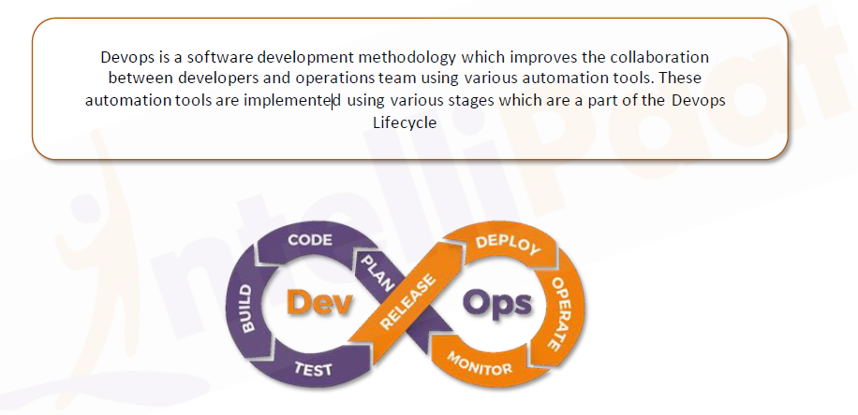
DevOps

Slide 9
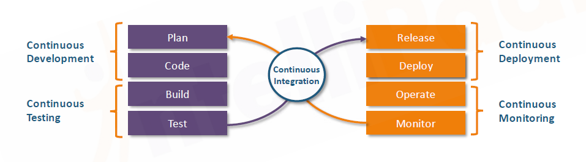
How it works ?

Slide 10
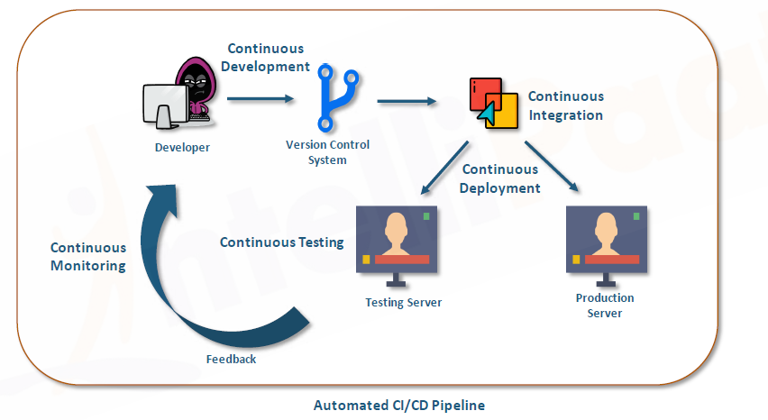
How it Works ?

Slide 11
Continuous Development
In this phase of Devops Cycle developer needs to upload code on Version control tools like Git and then with the help of other tool like maven we can convert the code into executable file and then send to testing team.

Slide 12
Continuous Integration
This stage is basically to integrate the different stages of Devops
Continuous integration is a DevOps software development practice where developers regularly merge their code changes into a central repository, after which automated builds and tests are run. Continuous integration most often refers to the build or integration stage of the software release process and entails both an automation component (e.g. a CI or build service) and a cultural component (e.g. learning to integrate frequently). The key goals of continuous integration are to find and address bugs quicker, improve software quality, and reduce the time it takes to validate and release new software updates.
Notes:
Continuous integration is the practice by which developers are required to integrate the developed codes into a common software repository. That repository receives multiple entries every day, each of which is verified and checked through an automated build. This routine helps teams with quick and early detection and location of any issue with the coding.
Several benefits of continuous integration are:
Teams spend less time in debugging the coding problems.
System integration becomes convenient.
Developers don’t have to wait to check the viability of their coding.

Slide 13
Continuous Deployment
In this stage code is built, and then we need to check environment and pushed the code to desire server. The key process in this stage is configuration management, virtualization and containerization.

Slide 14
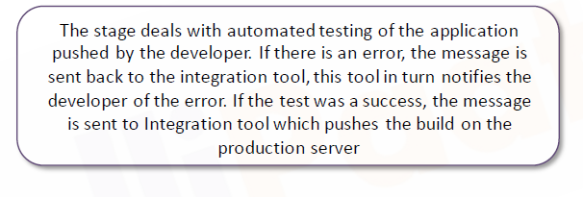
Continuous testing
Notes:
Using to tools to generate test automation suite from user stories/requirements
Create Test Environment.
Copy and anonymize production data to create test data bed
Use service virtualization to test API
Parallel performance testing

Slide 15
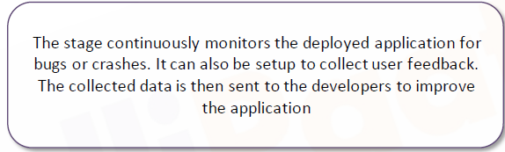
Continuous monitoring

