Slide 1
Python Types, Conditions Looping Operators Exceptions

Slide 2

Module Overview
Data Types
Flow Control Loops Dictionaries Exceptions
Other Data Types

Slide 3
Types in Python – Wait, What?

Slide 4
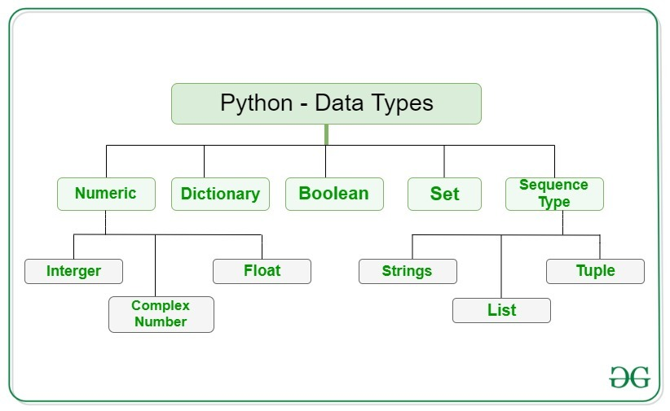

Slide 5
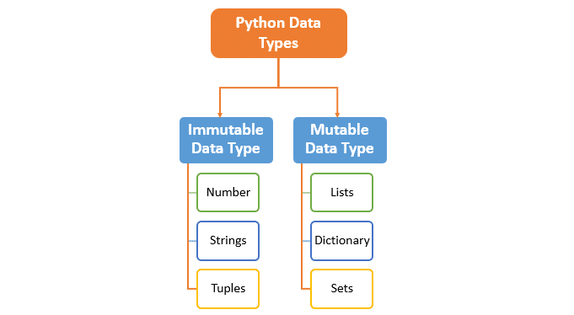
Mutable Data Types: Data types in python where the value assigned to a variable can be changed.
Immutable Data Types: Data types in python where the value assigned to a variable cannot be changed.

Slide 6
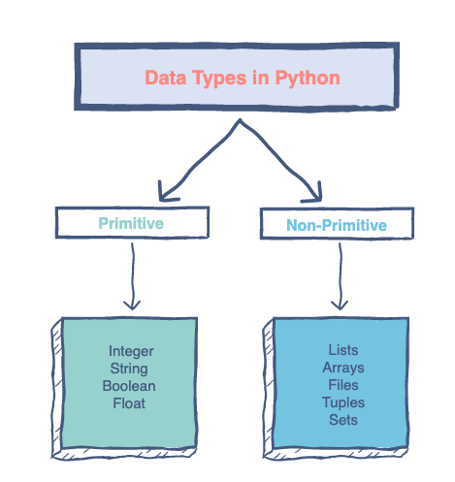

Slide 7
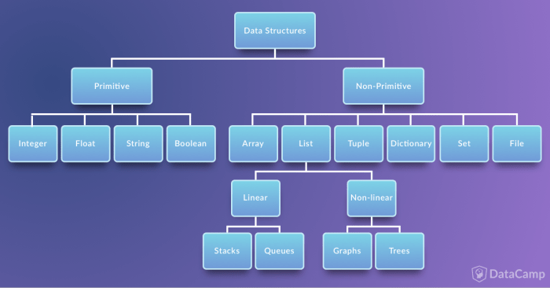

Slide 8
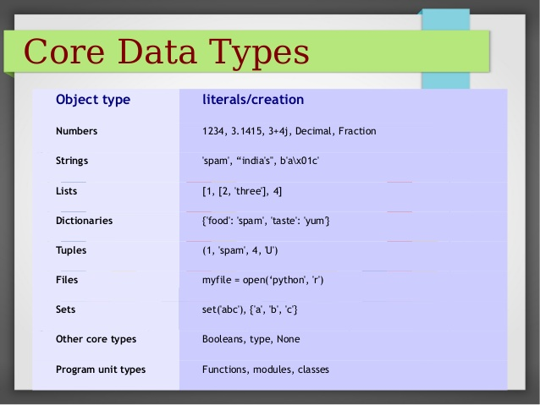

Slide 9
Python vs. the Others… again
// C# or Java int answer = 42;
String name = "PythonBo”;
# Python answer = 42
name = "PythonBo"

Slide 10

Python Numbers

Slide 11
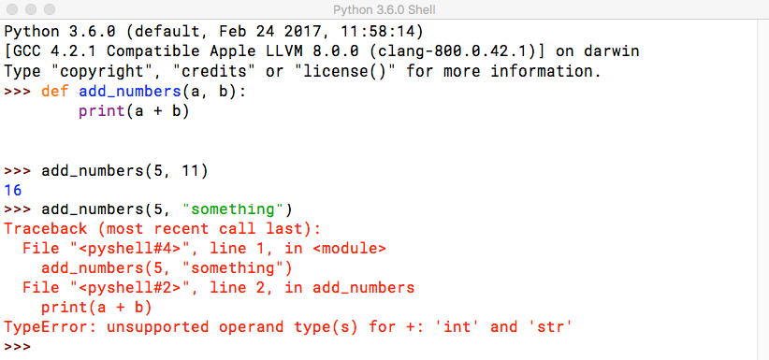
Combining Data Types

Slide 12
Type Hinting
def add_numbers(a: int, b: int) -> int:
return a + b

Slide 13
Integers and Floats
answer = 42
pi = 3.14159
answer + pi = 45.14159 int(pi) == 3
float(answer) == 42.0
# Don’t worry about conversion!

Slide 14
Operators
Operators are used to perform operations on values and variables.
The Python operators are classified into seven different categories:
Arithmetic operators
Assignment operators
Comparison operators
Logical operators
Identity operators
Membership operators
Bitwise operators

Slide 15
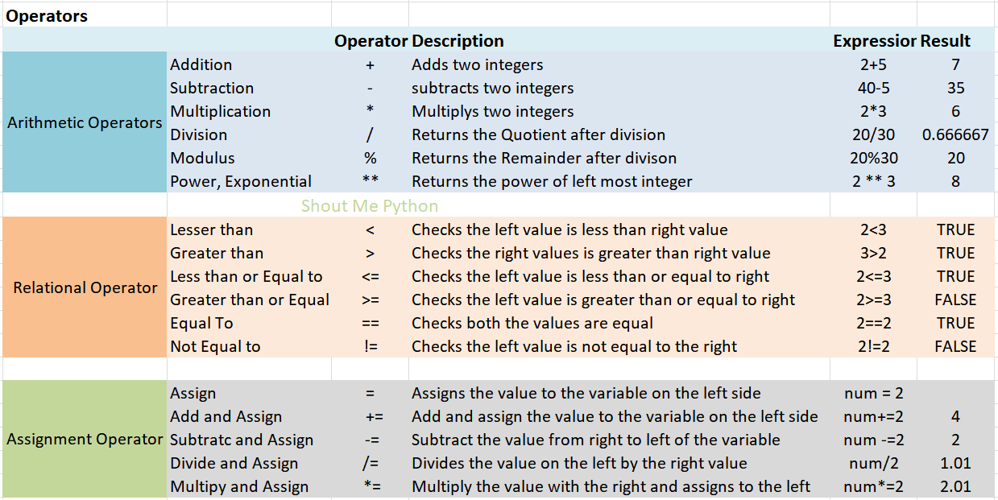
Arithmetic, Relational and Assignment Operators

Slide 16
Strings
'Hello World' == "Hello World" == """Hello World""" "hello".capitalize() == "Hello" "hello".replace("e", "a") == "hallo" "hello".isalpha() == True
"123".isdigit() == True # Useful when converting to int "some,csv,values".split(",") == ["some", "csv", "values"]

Slide 17
String Format Function
name = "PythonBo"
machine = "HAL"
"Nice to meet you {0}. I am {1}".format(name, machine) f"Nice to meet you {name}. I am {machine}"

Slide 18
Boolean and None
python_course = True java_course = False int(python_course) == 1
int(java_course) == 0 str(python_course) == "True"
aliens_found = None

Slide 19
Lists
A list is a sequence of values (similar to an array in other programming languages but more versatile)
The values in a list are called items or sometimes elements.
The important properties of Python lists are as follows:
Lists are ordered – Lists remember the order of items inserted.
Accessed by index – Items in a list can be accessed using an index.
Lists can contain any sort of object – It can be numbers, strings, tuples and even other lists.
Lists are changeable (mutable) – You can change a list in-place, add new items, and delete or update existing items.

Slide 20
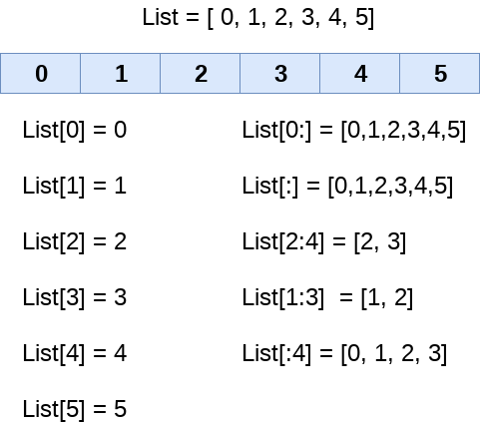
Lists

Slide 21
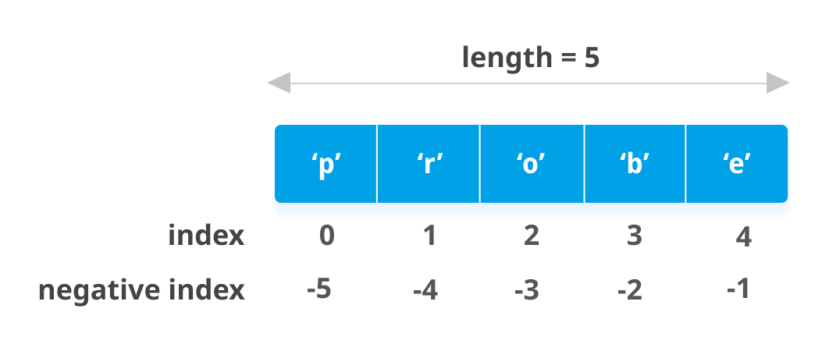
Lists

Slide 22
Lists
student_names = []
student_names = ["Mark", "Katarina", "Jessica"]

Slide 23
Getting List Elements
student_names = ["Mark", "Katarina", "Jessica"]
student_names[0] == "Mark" student_names[2] == "Jessica" student_names[-1] == "Jessica"

Slide 24
Changing List Elements
student_names = ["Mark", "Katarina", "Jessica"]
student_names[0] = "James"
student_names == ["James", "Katarina", "Jessica"]

Slide 25
List Functions
student_names = ["Mark", "Katarina", "Jessica"]
student_names[3] = "Homer" # No can do! student_names.append("Homer") # Add to the end student_names == ["Mark", "Katarina", "Jessica", "Homer"] "Mark" in student_names == True # Mark is still there! len(student_list) == 4 # How many elements in the list del student_names[2] # Jessica is no longer in the list :( student_names = ["Mark", "Katarina", "Homer"]

Slide 26
List Slicing
student_names = ["Mark", "Katarina", "Homer"]
student_names[1:] == ["Katarina", "Homer"] student_names[1:-1] == ["Katarina"]

Slide 27
Printing List Elements
student_names = ["Mark", "Katarina", "Jessica"] print(student_names[0]) print(student_names[1]) print(student_names[2])
...

Slide 28
Python if else elif Statement

Slide 29
Often, you need to execute some statements only when some condition holds.
You can use following conditional statements in your code to do this.
if Statement: use it to execute a block of code, if a specified condition is true
else Statement: use it to execute a block of code, if the same condition is false
elif (else if) Statement: use it to specify a new condition to test, if the first condition is false

Slide 30
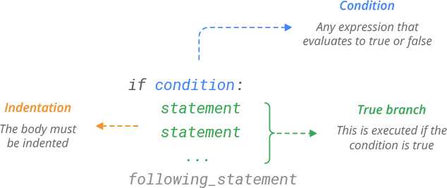
The if Statement

Slide 31
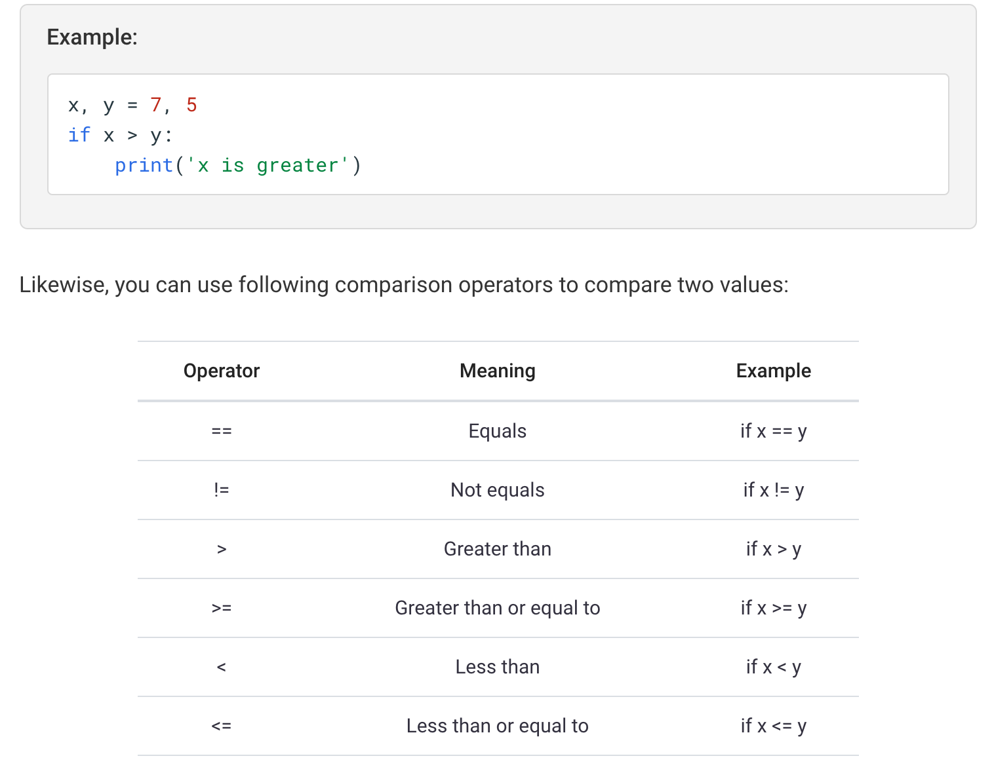
The if Statement

Slide 32
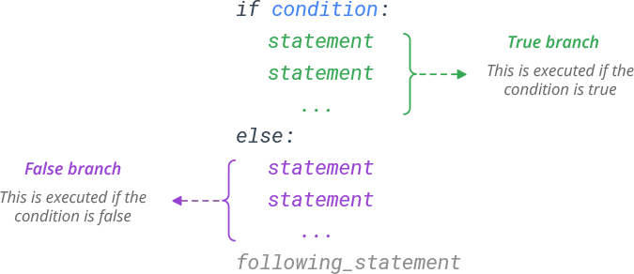
The else Statement

Slide 33
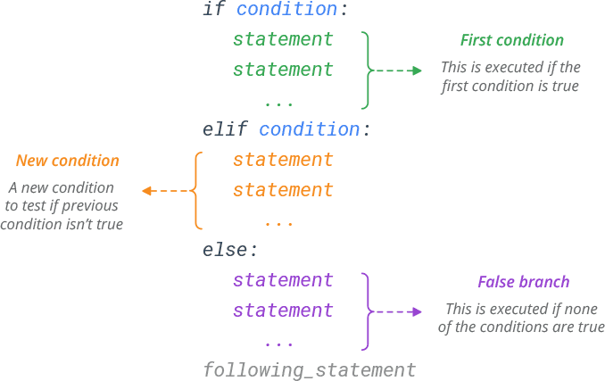
The elif (else if) Statement

Slide 34
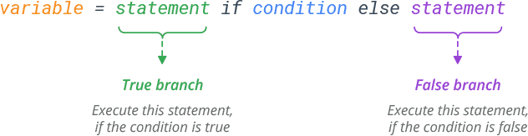
Conditional Expressions (ternary operator)

Slide 35
If Statements
number = 5
if number == 5: print("Number is 5")
else:
print("Number is NOT 5")

Slide 36
Truthy and Falsy Values
number = 5
if number:
print("Number is defined and truthy")
text = "Python" if text:
print("Text is defined and truthy")

Slide 37
Boolean and None
python_course = True
if python_course: # Not python_course == True print("This will execute")
aliens_found = None if aliens_found:
print("This will NOT execute")

Slide 38
Not If
number = 5
if number != 5:
print("This will not execute")
python_course = True if not python_course:
print("This will also not execute")

Slide 39
Multiple If Conditions
number = 3
python_course = True
if number == 3 and python_course: print("This will execute")
if number == 17 or python_course: print("This will also execute")

Slide 40
Ternary If Statements
a = 1
b = 2
"bigger" if a > b else "smaller"

Slide 41
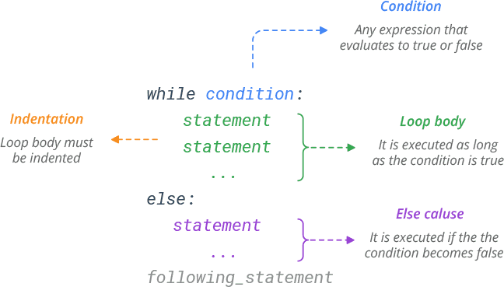
While Loop

Slide 42
While Loops
x = 0
while x < 10:
print("Count is {0}".format(x)) x += 1

Slide 43
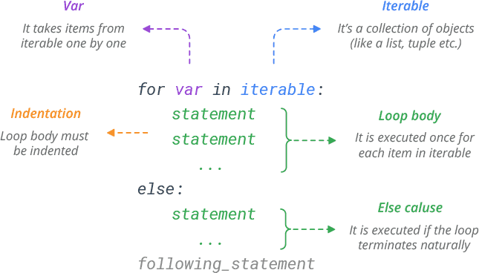
Python for Loop

Slide 44
For Loop
for name in student_names:
print("Student name is {0}".format(name))

Slide 45
Other Code
for (var i = 0; i < someArray.length; i++) {
var element = someArray[i]; console.log(element);
}

Slide 46
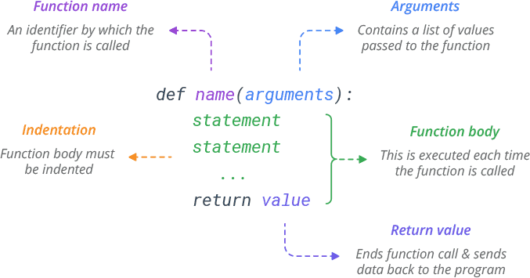
Python Functions

Slide 47
Infinite Loops
num = 10
while True:
if num == 42: break
print("Hello World")

Slide 48
Dictionaries
student = {
"name": "Mark", "student_id": 15163, "feedback": None
}

Slide 49
List of Dictionaries
all_students = [
{"name": "Mark", "student_id": 15163 },
{"name": "Katarina", "student_id": 63112 },
{"name": "Jessica", "student_id": 30021 }
]

Slide 50
Dictionary Data
student["name"] == "Mark"
student["last_name"] == KeyError student.get("last_name", "Unknown") == "Unknown" student.keys() = ["name", "student_id", "feedback"] student.values() = ["Mark", 15163, None] student["name"] = "James"
del student["name"]

Slide 51
Other Data Types
complex
long # Only in Python 2 bytes and bytearray tuple = (3, 5, 1, "Mark") set and frozenset
set([3, 2, 3, 1, 5]) == (1, 2, 3, 5)

Slide 52
Demo
Break and Continue

Slide 53
Demo
Exceptions

Slide 54
Data types
Lists Dictionaries
For and while loops Exception handling
Summary

