Slide 1
Functions, Files, Yield, and Lambda

Slide 2
Our App - PyStudentManager

Slide 3

Our App
Name: PyStudentManager
Student Details Easy to Expand
From Console to a Web App

Slide 4
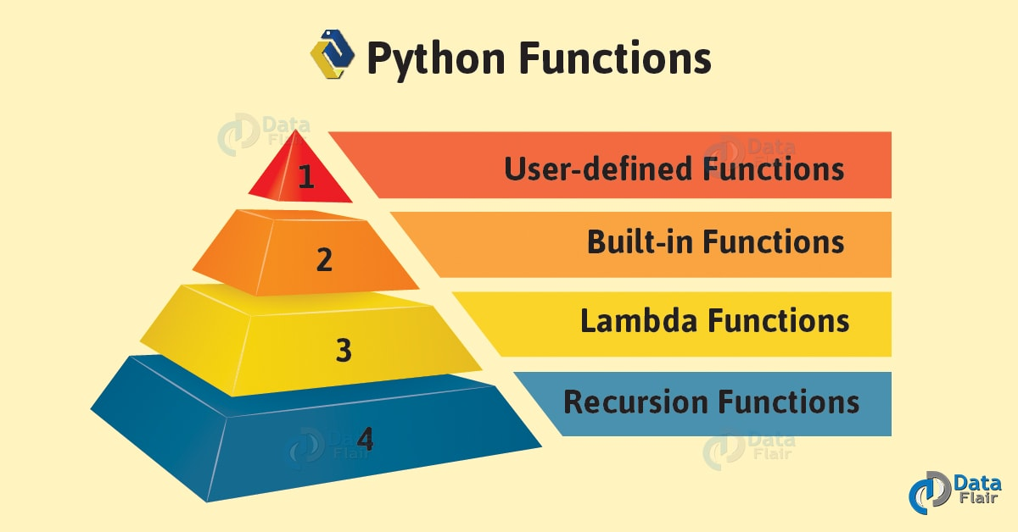

Slide 5
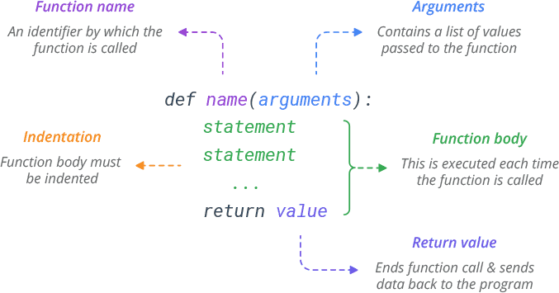
User Defined Functions

Slide 6
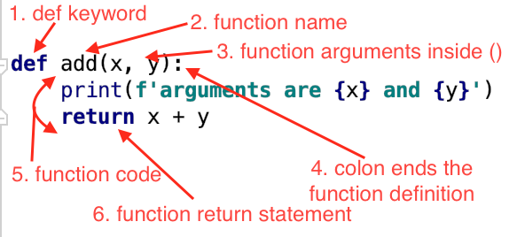
Functions

Slide 7
Functions
print("Hello World")
str(3) == "3"
int("15") == 15
username = input("Enter the user's name: ")

Slide 8
Nested Functions
def get_students():
students = ["mark", "james"] def get_students_titlecase():
students_titlecase = [] for student in students:
students_titlecase.append(student.title()) return student_titlecase
students_titlecase_names = get_titlecase_names() print(students_titlecase_names)

Slide 9
Generator Functions - Yield

Slide 10
Lambda Functions

Slide 11
Lambda functions
def double(x):
return x * 2
double = lambda x: x * 2
double(5) == 10

Slide 12
Lab https://www.learnbyexample.org/python-functions/

Slide 13
Summary
Functions
Function arguments Reading and writing to files Lambda functions Generators

