Slide 1
Python - Object Oriented Programming

Slide 2
Classes and Why Do We Need Them?

Slide 3
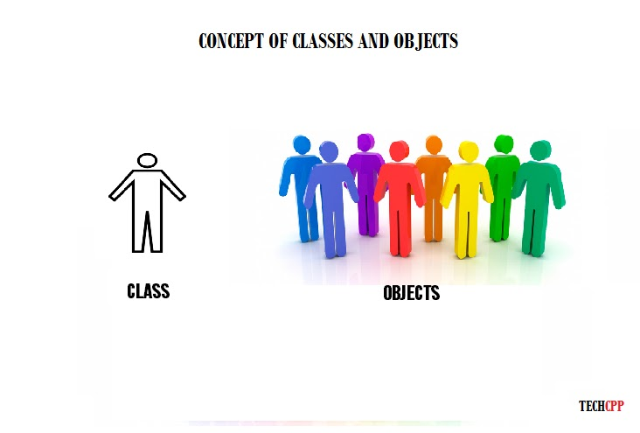

Slide 4
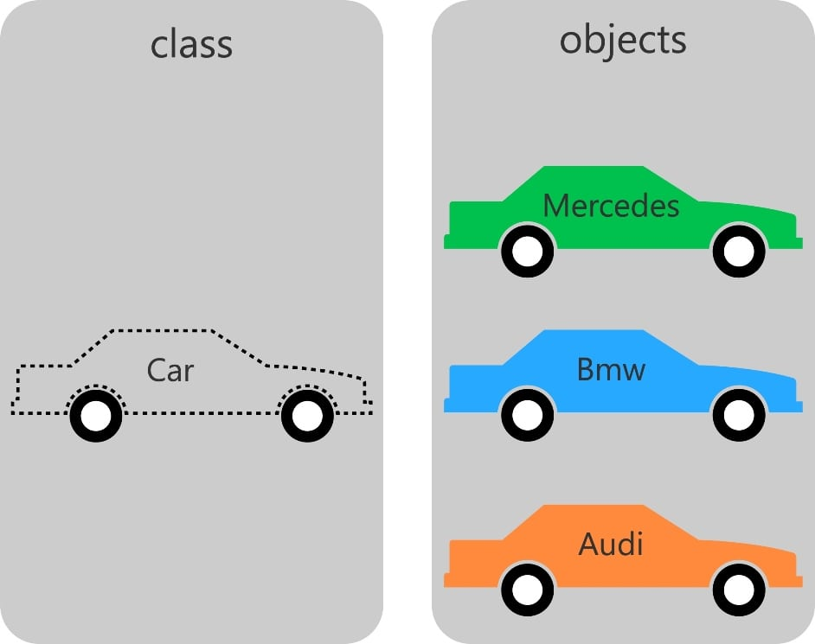

Slide 5
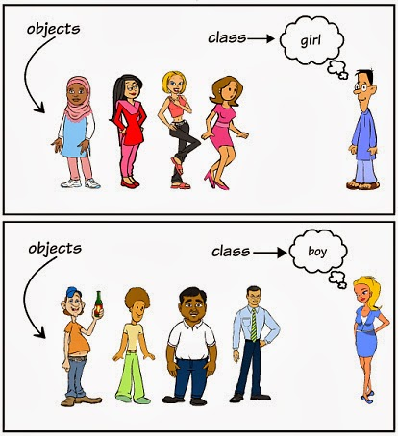

Slide 6
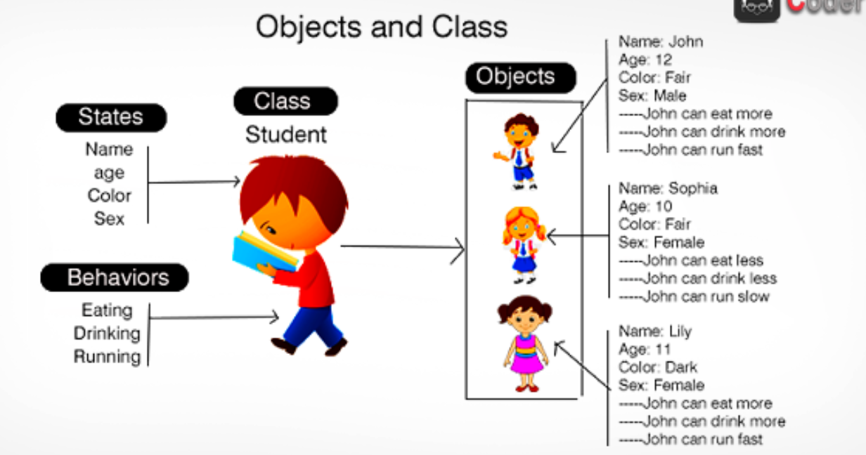

Slide 7
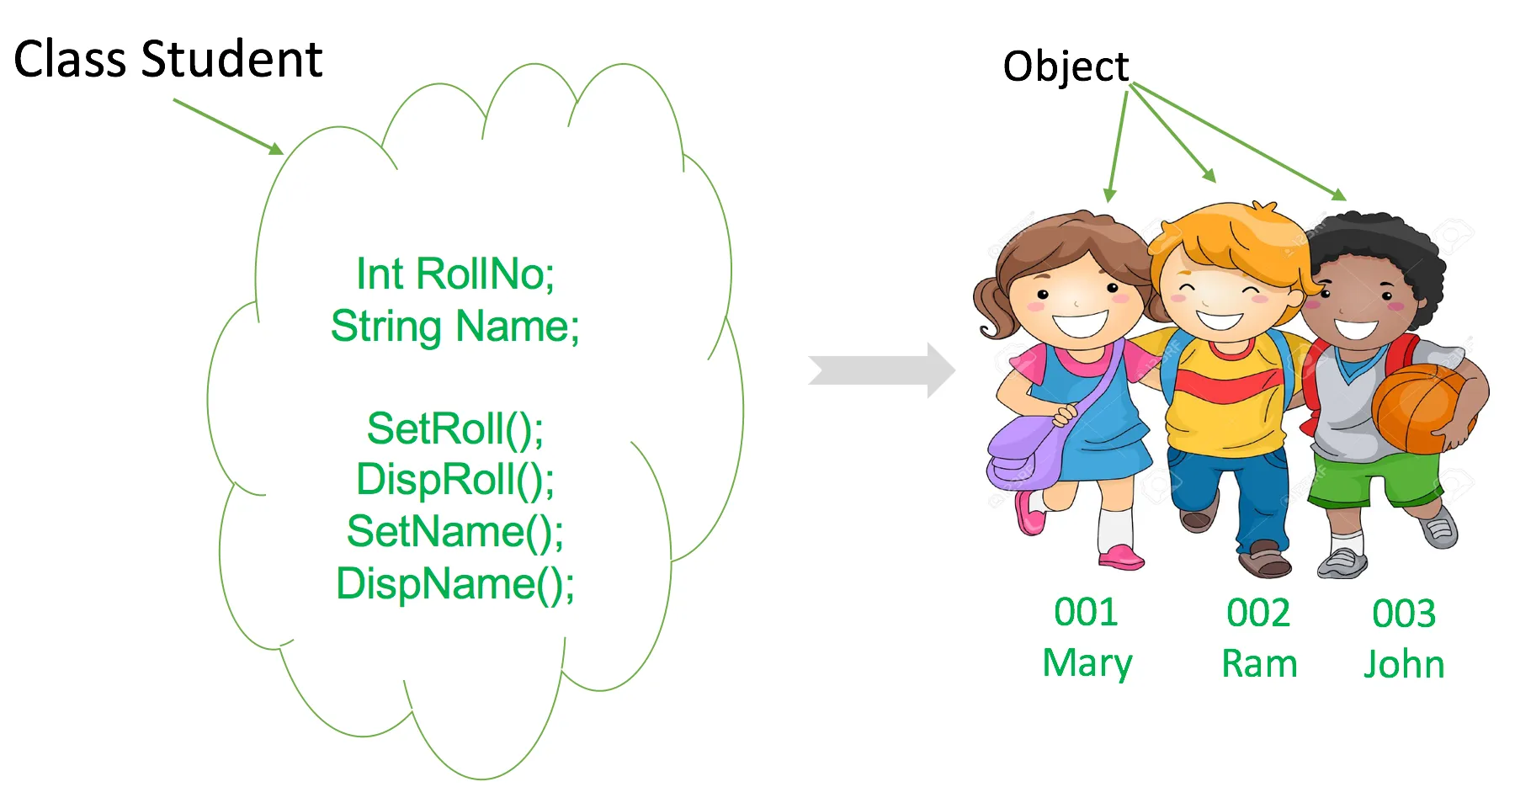

Slide 8
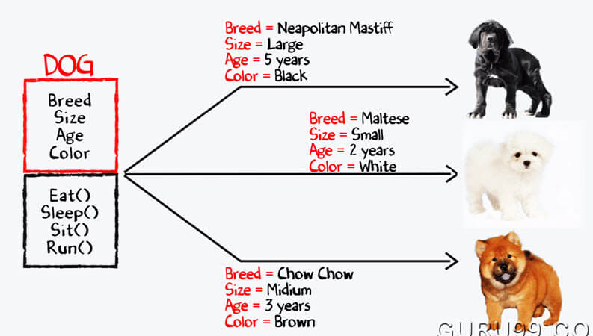

Slide 9
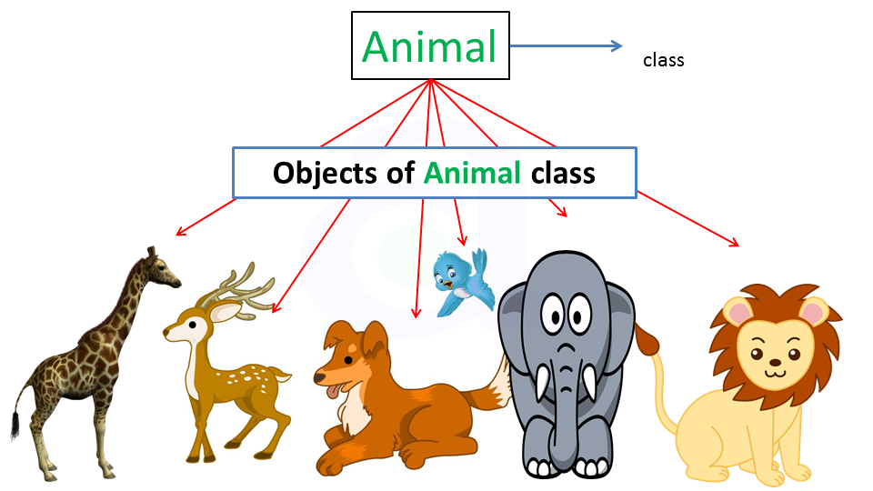

Slide 10
A Class
class Student:
Student Name
Student ID
Student Grades

Slide 11
class Student:
Defining a new class

Slide 12
student = Student()
Creating a new instance of a Student class

Slide 13
Constructors in Python
Constructors are generally used for instantiating an object.The task of constructors is to initialize(assign values) to the data members of the class when an object of class is created.In Python the __init__() method is called the constructor and is always called when an object is created.
default constructor : The default constructor is simple constructor which doesn’t accept any arguments. It’s definition has only one argument which is a reference to the instance being constructed.
Parameterized constructor : constructor with parameters is known as parameterized constructor.The parameterized constructor take its first argument as a reference to the instance being constructed known as self and the rest of the arguments are provided by the programmer.

Slide 14
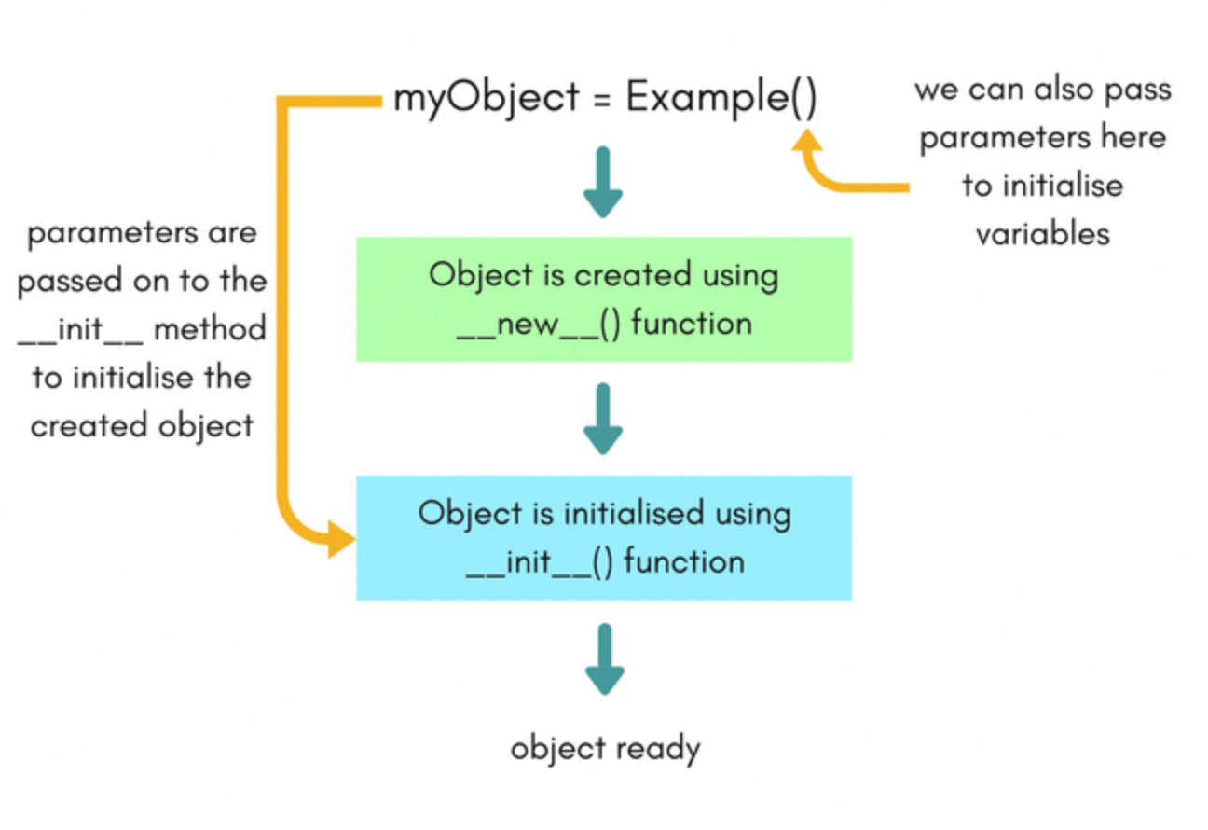

Slide 15
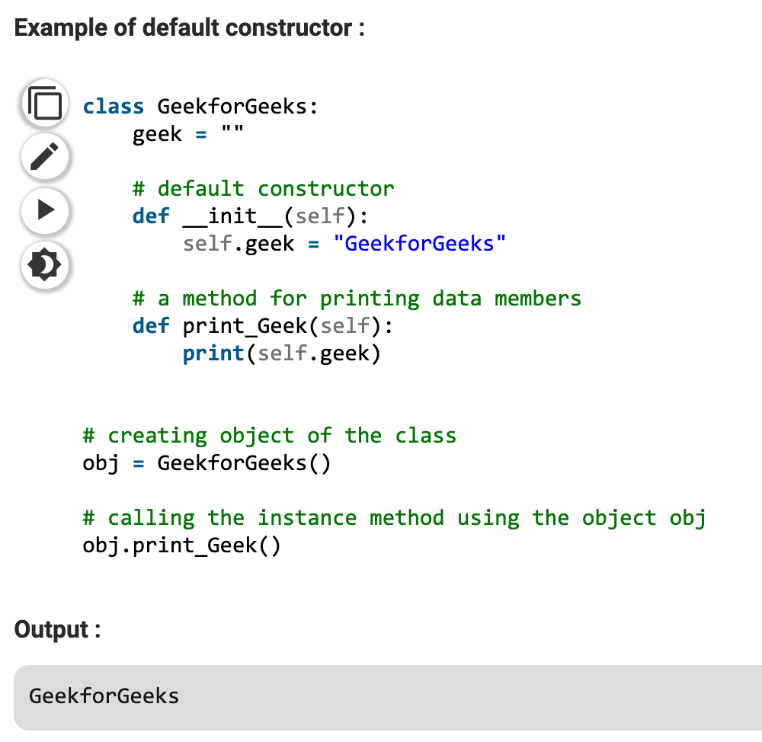

Slide 16
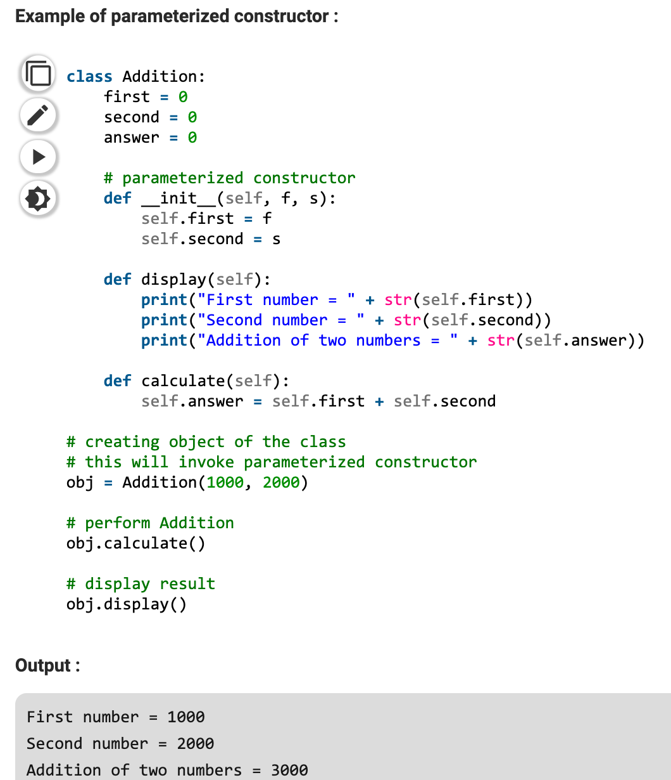

Slide 17
Class Instances
mark = Student("Mark")
james = Student("James") jessica = Student("Jessica")
mark != james != jessica

Slide 18

Demo
Defining a Class in Python

Slide 19
Class and Instance Attributes

Slide 20
Comments

Slide 21
Single-Line Comments
# Set the student name here
name = "Mark"
def add_student(name):
last_name = "" # Set as empty for now, pending feature

Slide 22
Multi—Line Comments
def add_student(name, student_id=332):
"""
Adds the student to the student list.
:param name: string - student name
:param student_id: integer - optional student ID
"""
student = "Mark"
...

Slide 23

Summary
Writing Classes
Special Class methods Overriding Class behavior

