Slide 1

JIRA

Slide 2
- Plan track and work faster.
- The main source of information.
- Organize the documentation tasks.
- Track the progress of our documentation.
- Helps to met the deadlines of documentation release.
- Measures the the time spent on documentation.
- Provides feedback faster.
- Cost Management.
- Transparency
- Custom Workflow.
- Integration with othertools.
Why JIRA

Slide 3
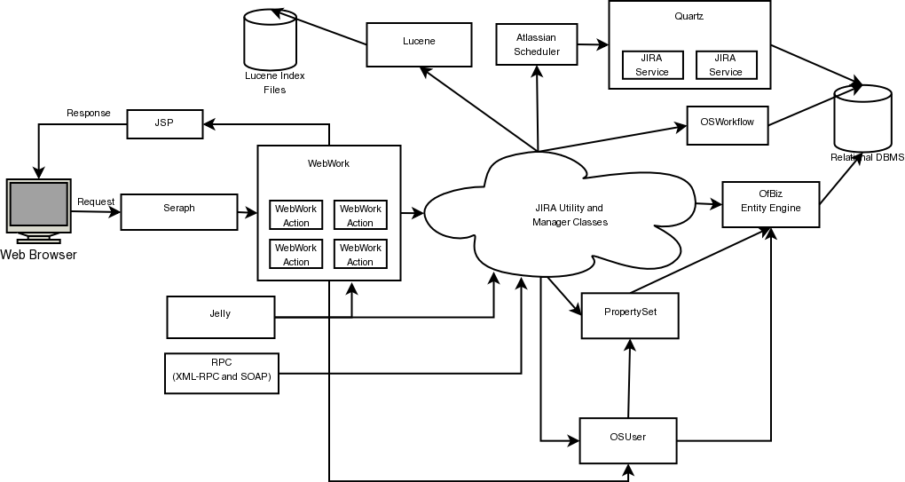
Architecture of JIRA

Slide 4
Windows installation
https://confluence.atlassian.com/adminjiraserver/installing-jira-applications-on-windows-938846835.html https://www.atlassian.com/software/jira/download/data-center
Step 1: Type "Download JIRA software"
Step 2: Select the correct OS version and download the software.
Step 3: Get started.
Step 4: Select the default installation.
Step 5: Select the home directory and continue with the installation.
Step 6: Generate the temp license.
Step 7: Finish.

Slide 5
Linux installation
Step 1: Create AWS Linux instance
Step 2: Create resource folder to keep everything in one folder.
Step 3: Wget https://www.atlassian.com/software/jira/downloads/binary/atlassian-jira-software-8.0.2-x64.bin
Step 4: chmod a+x atlassian-jira-software-8.0.2-x64.bin
Step 5: sudo ./atlassian-jira-software-8.0.2-x64.bin
Step 5: Follow the step from console.

Slide 6
Terminologies in JIRA
Backlog
Issues
Task
Work Flow
Sprint
Stories
Feature
Epic
Task
Bug
Scrum Master
Team member
Product Owner
Stake Holder
Refining
Spring planning
Stand-up
Demo
Retrospect

Slide 7
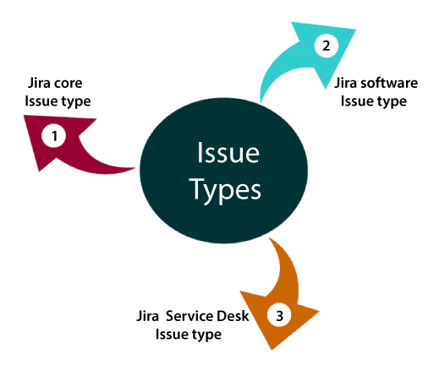
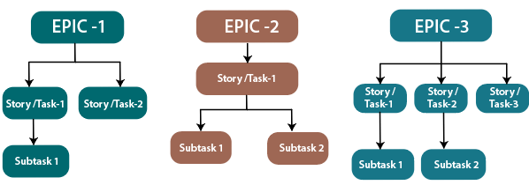
Issues
JIRA core isssues:-
Task
Subtask
JIRA Software issues type:
Story
Bug
Epic
JIRA service Desk issue type:
Incident
Service Request
Change
Problem

Slide 8
Dashboard
When you log in to JIRA, the first screen that will appear is Dashboard. The Dashboard can only be customized by the Admin, and based on the roles, an admin can access to Jira.
An admin can even change the color and the JIRA logo.
You can create multiple dashboards that help you to organize your projects, assignments, and achievements in different charts
You can add multiple gadgets to dashboards.
You can create your own dashboard.

Slide 9
JIRA Github integration
Step 1. Create an OAuth access token for your GitHub Enterprise account
The DVCS Connector requires an OAuth access token, which you create in your GitHub Enterprise account. You should create the access token in the GitHub Enterprise account that owns the repositories you want to link. If you are linking repositories for a team, you should generate this token using the team account.
Create the OAuth token as follows:
Log in to GitHub Enterprise as a user with admin permissions on the account.
Setting>Developer Setting.
Select OAuth Applications.
Select the Developer Applications tab.
Choose Register new OAuth application.
Enter a name for Application Name.
Enter the JIRA Software URL for both the URL and Callback URL fields. Use lower case. Press Register Application.
Make sure you enter the JIRA Software Base URL (for example, https://myjiracloud.atlassian.net/) for both the Homepage URL and Authorization callback URL fields. Don't use the dashboard URL, such as https://myjiracloud.atlassian.net/secure/Dashboard.jspa.
Keep your browser open in your GitHub Enterprise account while you go on with the next step.

Slide 10
Step 2. Add the OAuth token in Jira Software
After you create a key and secret in GitHub Enterprise, you go back to Jira Software and enter the account, the OAuth key, and secret as follows:
Log in to Jira Software as a user with admin permissions.
Settings > Applications
From the Applications section on the left, choose DVCS accounts.
Enter a your GitHub User Account name.
Enter your GitHub Enterprise site URL as the Host URL.
Copy the Client ID and Client Secret values from your GitHub Enterprise site into the dialog.
Leave the default auto link and Smart Commits (recommended) as is or change them:
Click Add. If you get redirected to a blank page at this point, see DVCS connection to GitHub produces blank page.
Grant access when prompted.
When Jira connects successfully, you'll see your account on the 'DVCS accounts' page.

Slide 11
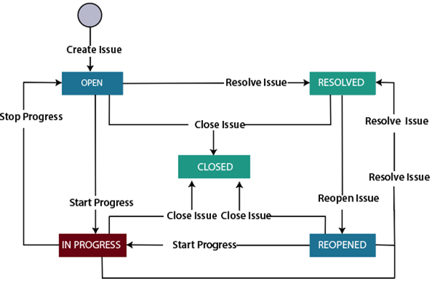
JIRA Work Flow
Todo State-
Activities performed in to do state are Issue Creation and Summary and Additional details
In progress state-
We performed following actvities :-Assignee, Work review and Quality Analyst.
Done state
We make sure its available in production.

Slide 12
JIRA Report
Reports are used to track and analyze the team's performance throughout a project.
JIRA has a range of reports that shows the information about your project, versions, sprints, epics, and issues.
Average Age report.
Pie chart Report.
Created vs Resolved issue report.

Slide 13
Thank You

