Slide 1

What is DevOps
Hexaware Technologies

Slide 2
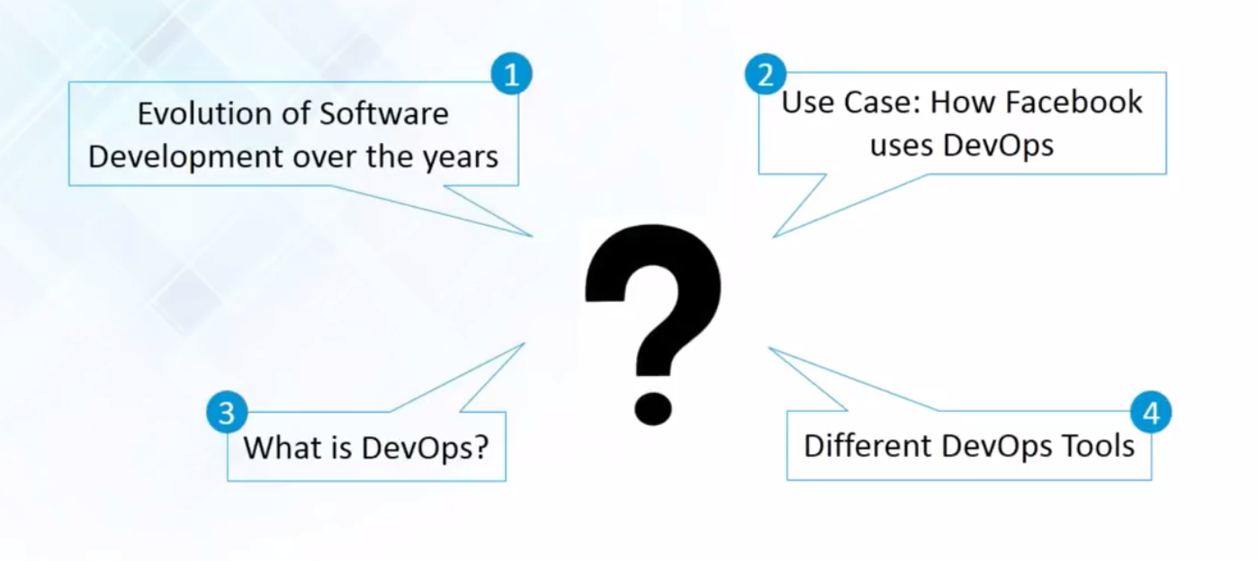
Do you know the following :

Slide 3
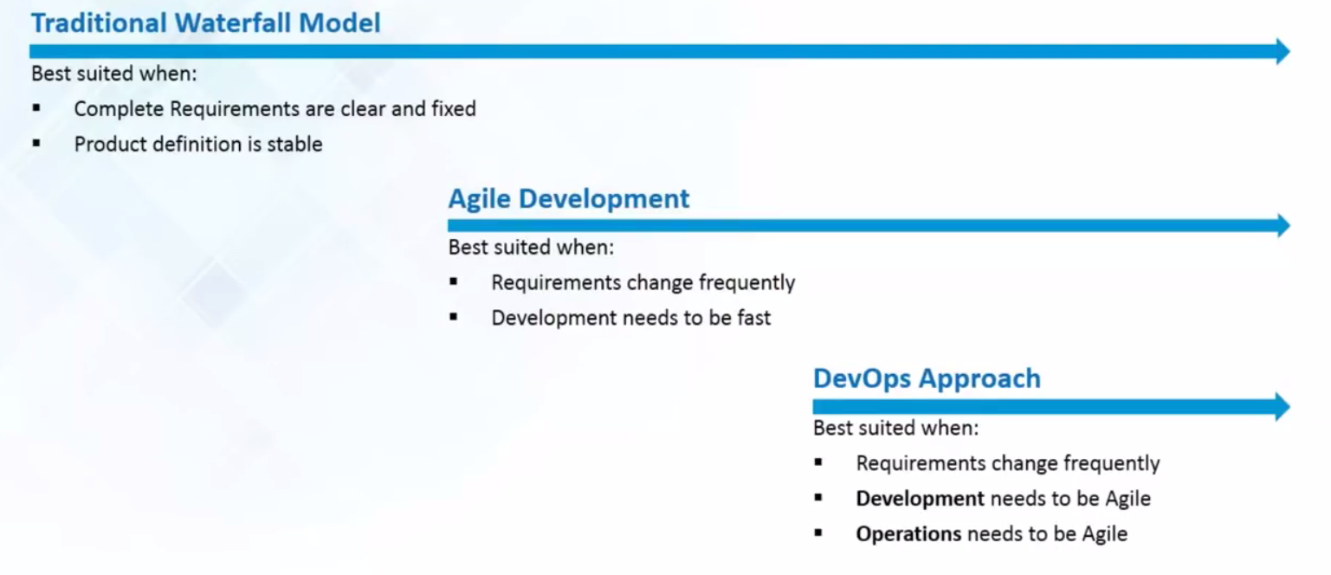
Evolution of Software Development

Slide 4
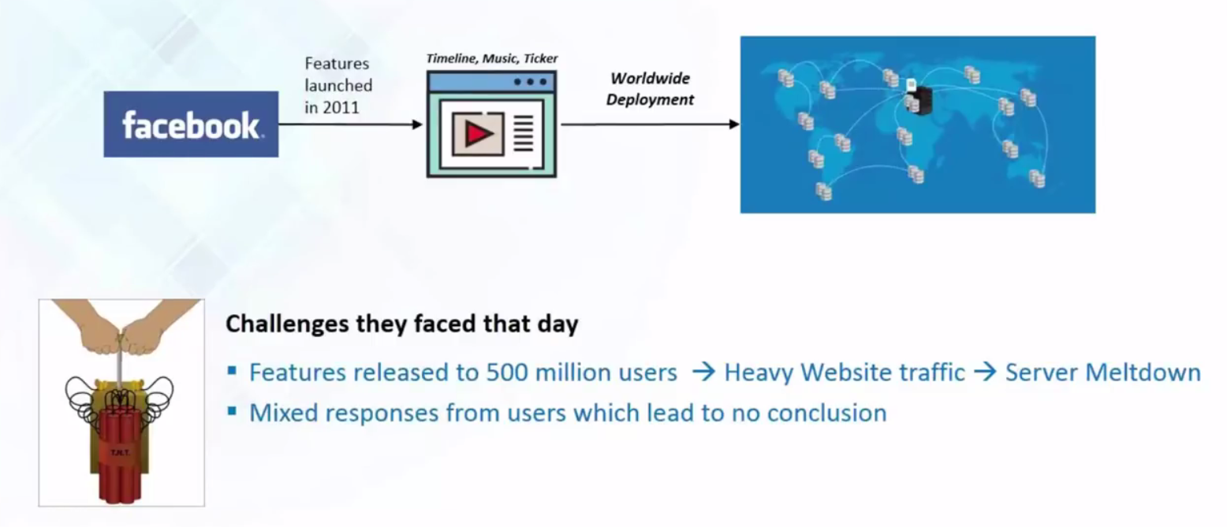
Use Case 2011 : FaceBook

Slide 5
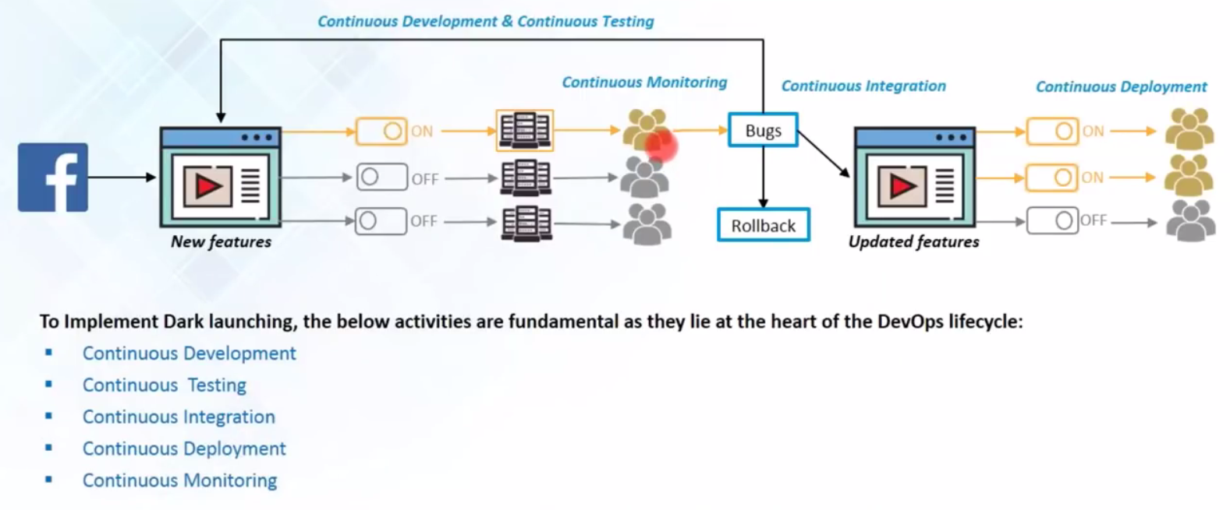

Slide 6
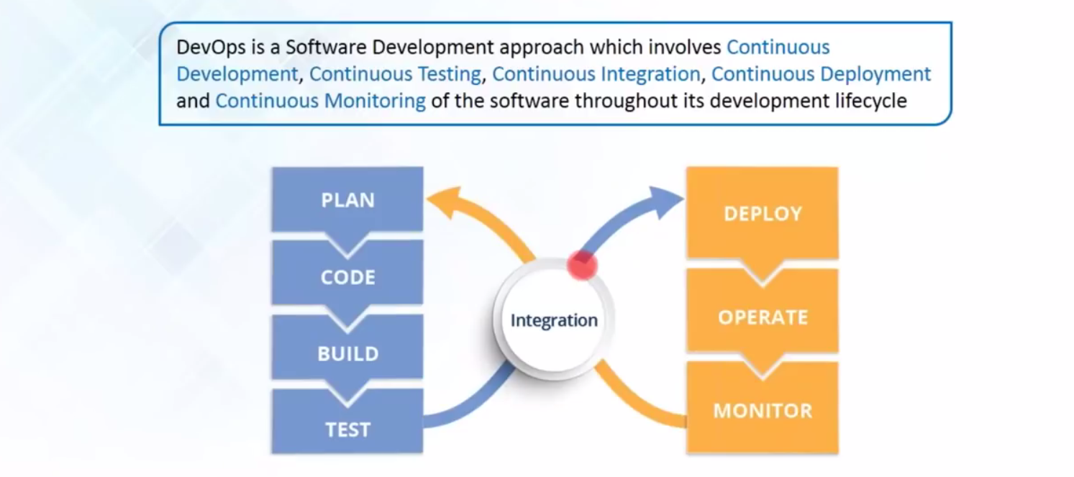
What is DevOps ?

Slide 7
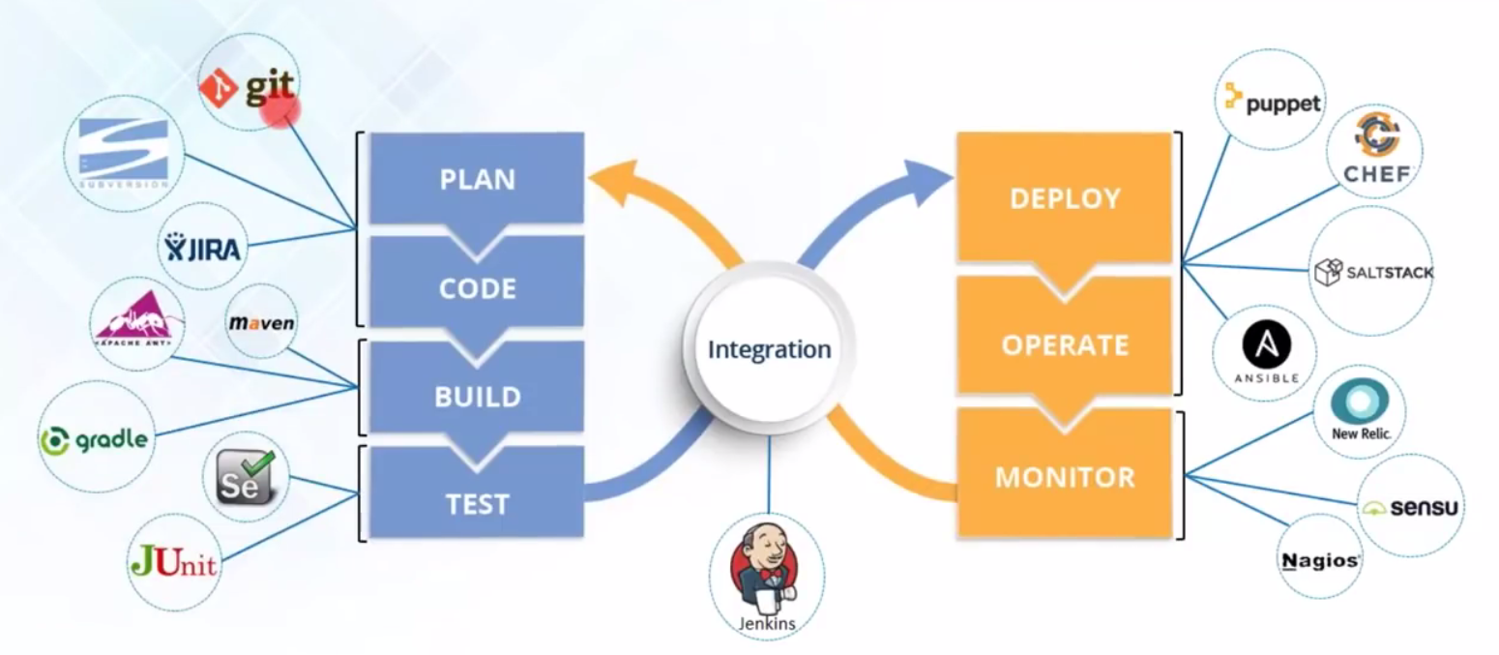
DevOps Tools

Slide 8


