Slide 1
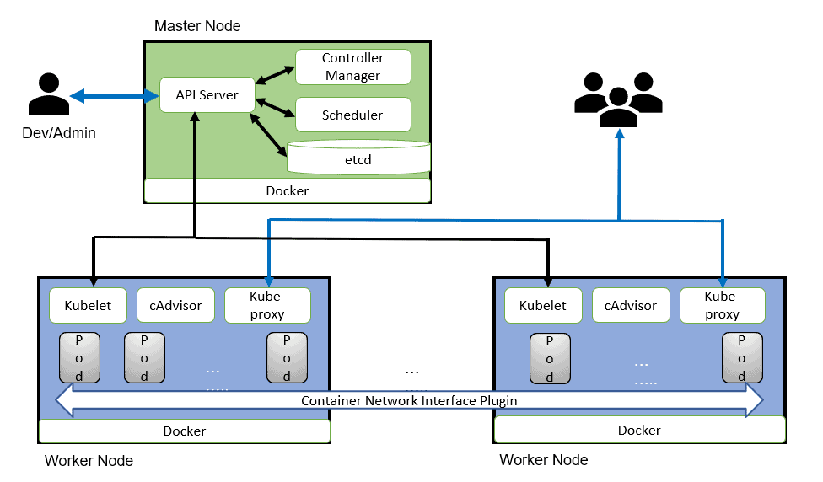
kubernetes architecture

Slide 2
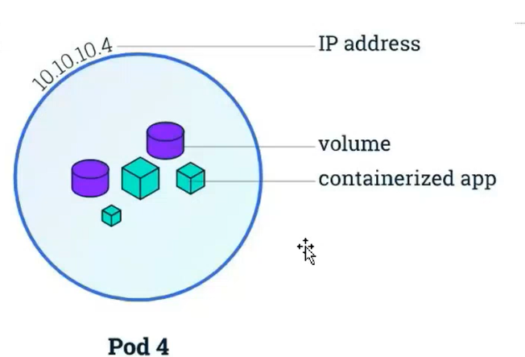
Pods are the smallest deployable units of computing that you can create and manage in Kubernetes

Slide 3
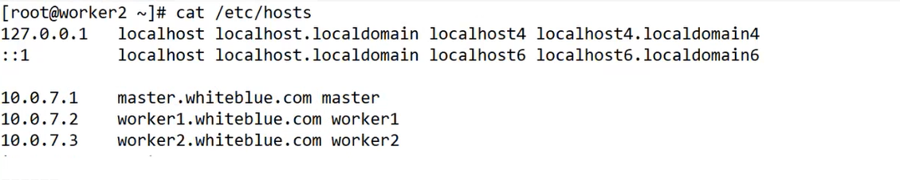
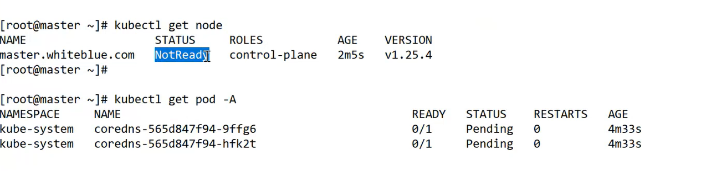

Slide 5
Prerequisites
Before diving into the installation, ensure that your environment meets the following prerequisites:
An Ubuntu 22.04 system.
Privileged access to the system (root or sudo user).
Active internet connection.
Minimum 2GB RAM or more.
Minimum 2 CPU cores (or 2 vCPUs).
20 GB of free disk space on /var (or more).
Step 1: Update and Upgrade Ubuntu (all nodes)
Begin by ensuring that your system is up to date. Open a terminal and execute the following commands:
sudo apt update sudo apt upgrade
Step 2: Disable Swap (all nodes)
To enhance Kubernetes performance, disable swap and set essential kernel parameters. Run the following commands on all nodes to disable all swaps:
sudo swapoff -a sudo sed -i '/ swap / s/^\(.*\)$/#\1/g' /etc/fstab

Slide 6
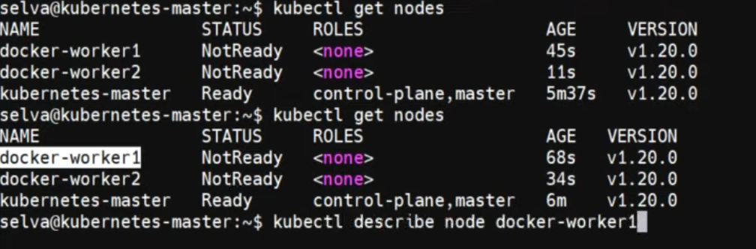

Slide 7
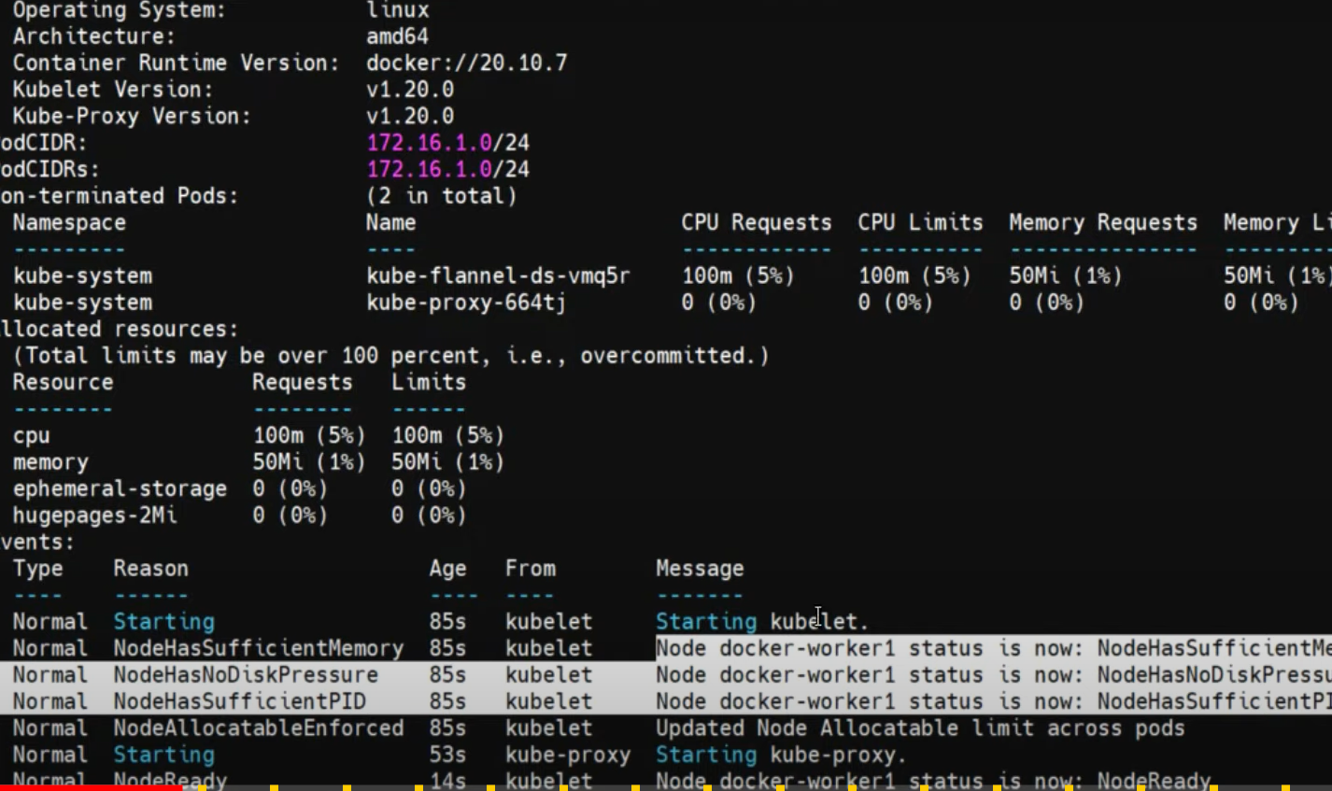

Slide 8
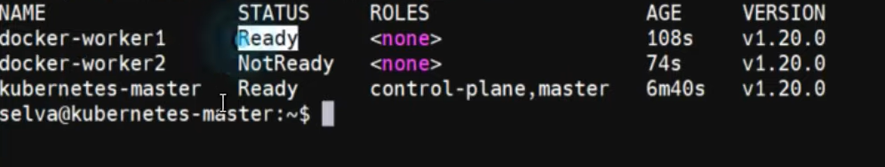

Slide 9
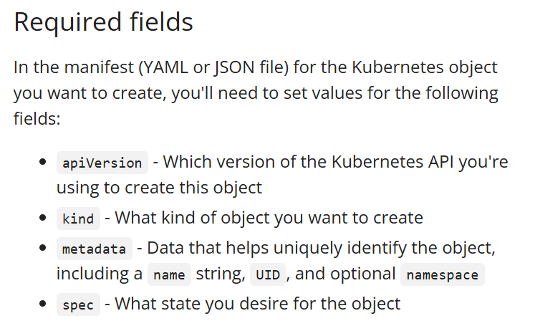
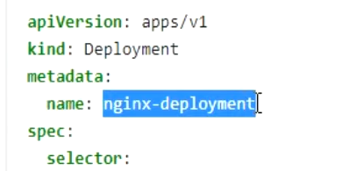
Kubernetes Resource Object

Slide 10
