Slide 1
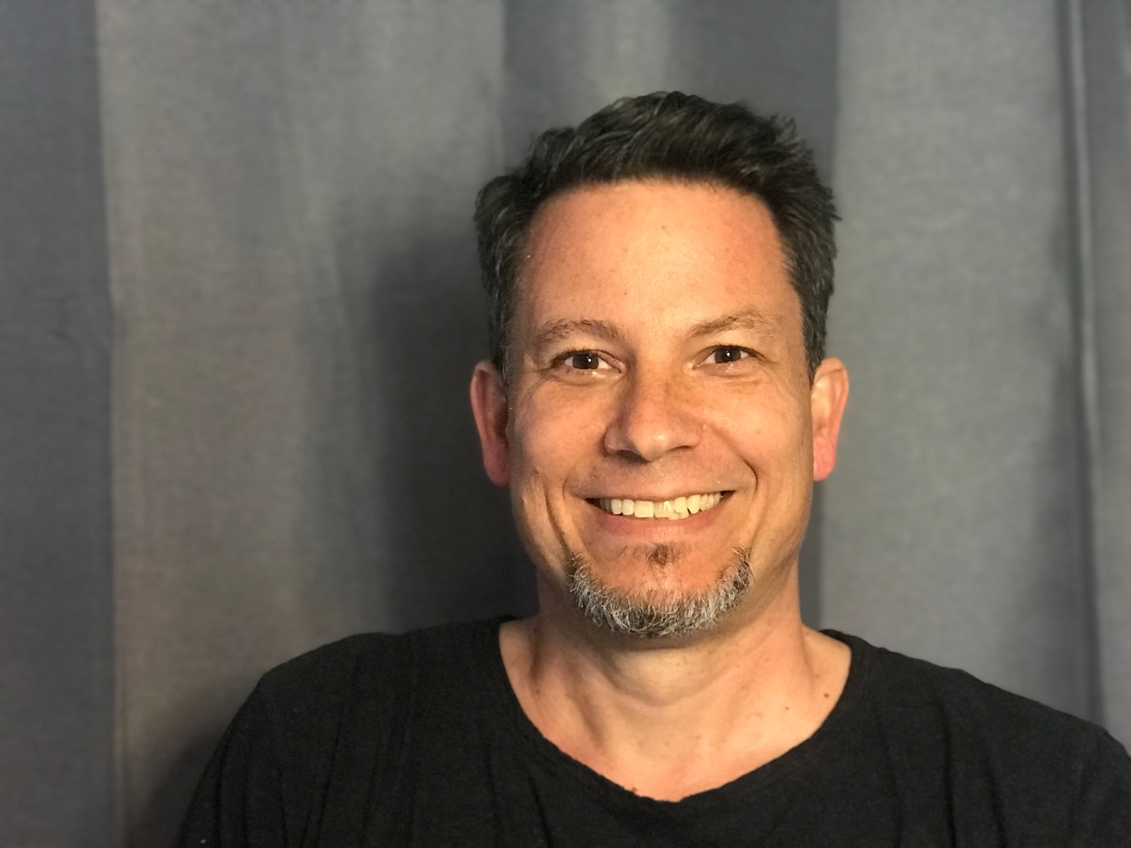
AWS Certified DevOps Engineer Professional Crash Course
Robert Jordan

Slide 2
About Me
Over 25 years in the IT industry
10 years primary focus in cloud technologies
Networking and HPC operations background

Slide 3
Certification Overview
Professional level certification
Broad knowledge requirement
Foundation for many advanced specializations
Very high demand
Notes:
https://d1.awsstatic.com/training-and-certification/docs/AWS_certification_paths.pdf

Slide 4
Exam Overview
AWS Certified DevOps Engineer - Professional (DOP-C02)
Updated March 2023
75 questions.
Questions may be multiple choice or multi response.
10 Questions unscored.
3 hour time limit
Notes:
https://d1.awsstatic.com/training-and-certification/docs-devops-pro/AWS-Certified-DevOps-Engineer-Professional_Exam-Guide.pdf

Slide 5
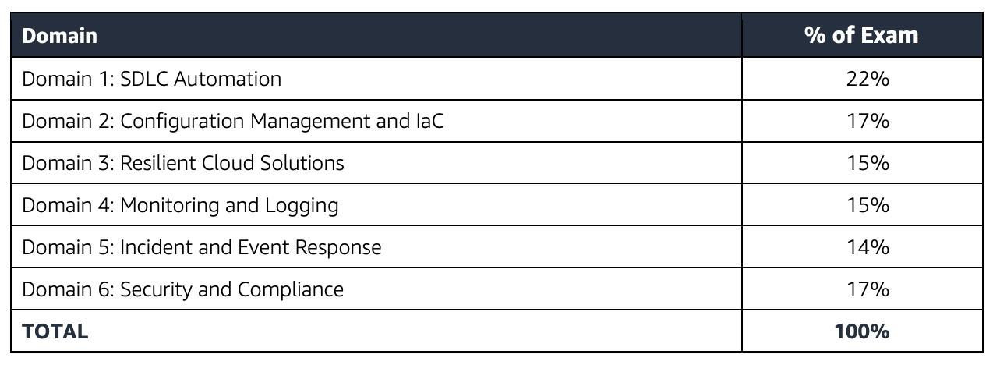
Exam Overview

Slide 6
Exam Overview
What’s not tested
Advanced networking knowledge (ex. BGP, IP Anycast)
Advanced security
Database design, query, and performance optimization
Application development

Slide 7
Exam Overview
Keep in mind:
Domains may be mixed.
Beware dummy answers.

Slide 8
About the course
2 four hour sessions
Breaks at (approximately) the top of the hour.
Demo based
Hands on DevOps with example application.
Live demos sometimes don’t go as planned! We may or may not do some live troubleshooting.
Mixed domains

