Slide 1
Code-to-Cloud
Insight DevOps Fellowship, New York
Wen Gong
Notes:
I am Wen Gong, an Insight DevOps fellow. My project title is “code-to-cloud”, it is about streamlining development and release processes
Hello, we are from the Insight DevOps program.
Insight is designed for people with strong knowledge of computer science fundamentals transition to DevOps.
We are given resource to get hands-on experience building demo on AWS in only three weeks!

Slide 2
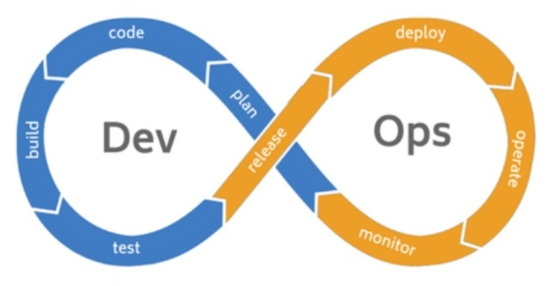
Motivation
Problems
Promise
monolithic app
dev not test-driven
lack of tests
build not automated
slow approval
Faster time-to-market cycle
Productivity gain
Cost savings
Notes:
There are 2 aspects to the problem that I am interested in:
First, how to automate the development process from code, test, build, and deploy to cloud? Its business value is to achieve faster time-to-market speed
Second, how can DevOps help business move to cloud to gain productivity and save costs?
Both aspects are challenges faced by many companies today.

Slide 3
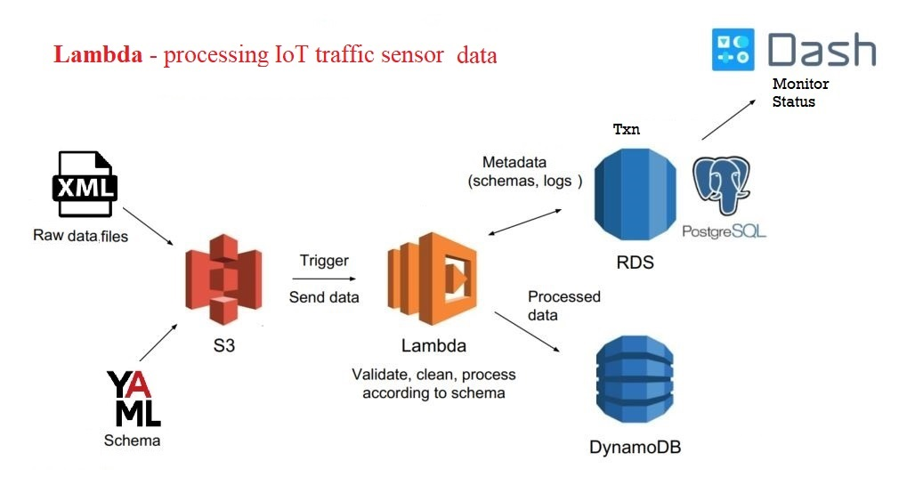
Data Engineering Pipeline
1) enhanced logging
2) added E2E test
3) included in CI
Notes:
An important aspect of DevOps is collaboration between Dev and Ops teams.
The first part of my project is to include Data Engineer’s project into build process.
Here is a DE pipeline that uses Lambda to process IoT traffic sensor data:
XML upload to S3 triggers the Lambda function, which validate, clean and process XML, The schema and logs are saved to RDS/PostgreSQL, the unstructured traffic data are stored in DynamoDB. Dash is the monitor.
This pipeline is very nice but lacked an integration test, without test case, it cannot be added to a build job.
TO IMPROVE: build E2E test case
run CI pipeline

Slide 4
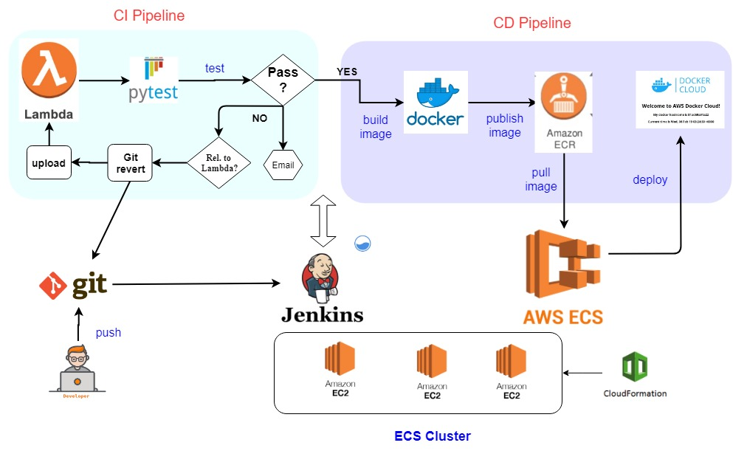
DevOps Pipelines: CI + CD
Notes:
Next I built a complete CI/CD pipeline.
An ECS cluster of 3 instances was built using cloudformation template
I installed Jenkins server in one instance, other two are for deploying apps.
It starts with git push by developer, this event triggers a Jenkins pipeline, which uploads lambda function, runs test.
If test fails and code is related to lambda function, the job will revert last commit, and rollback lambda.
If test is successful, it proceeds to build docker image, publish to container registry, and deploy to a test instance.
In contrast to Data Engineering pipeline that moves and processes data,
DevOps pipeline moves codes.
TO IMPROVE:
divide into CI and CD 2 blocks

Slide 5
Challenge 1 - Improved DE pipeline
added pytest: test_lambda_function_xml.py
enhanced logging by adding new table: xml_txns
improved XML parsing
fixed issue when uploading 2 files within the same minute.
Notes:
Building a demo in 3 weeks is very challenging.
Specifically,
1) I have to know the DE pipeline well and very quickly.
2) write bash workaround when Jenkins plugin not working
3) pickup new tech stacks and tools quickly
Overcoming each challenge is a rewarding experience
TO IMPROVE:
split challenges into separate slides
improve DE pipeline + pytest with python codes
Jenkins plugin not working, show my workaround bash code
handling DB secrets : env var to Vault API

Slide 6
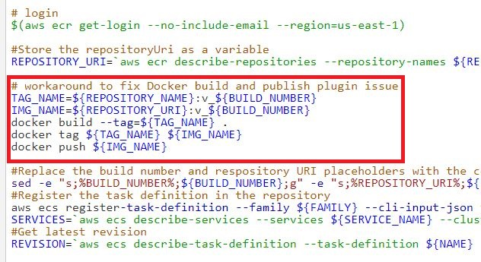
Challenge 2 - worked-around Jenkins plugin error
Notes:
Building a demo in 3 weeks is very challenging.
Specifically,
1) I have to know the DE pipeline well and very quickly.
2) write bash workaround when Jenkins plugin not working
3) pickup new tech stacks and tools quickly
Overcoming each challenge is a rewarding experience
TO IMPROVE:
split challenges into separate slides
improve DE pipeline + pytest with python codes
Jenkins plugin not working, show my workaround bash code
handling DB secrets : env var to Vault API

Slide 7
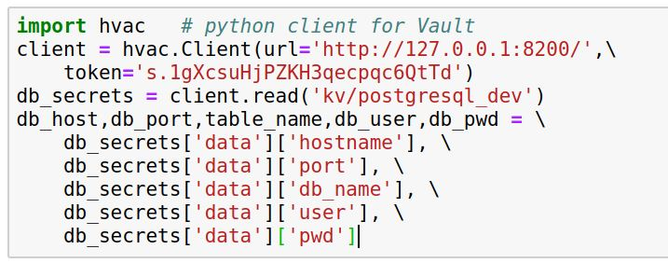
Challenge 3 - DB secrets in Lambda + Docker
evaluated python client for Vault (hvac)
Notes:
Building a demo in 3 weeks is very challenging.
Specifically,
1) I have to know the DE pipeline well and very quickly.
2) write bash workaround when Jenkins plugin not working
3) pickup new tech stacks and tools quickly
Overcoming each challenge is a rewarding experience
TO IMPROVE:
split challenges into separate slides
improve DE pipeline + pytest with python codes
Jenkins plugin not working, show my workaround bash code
handling DB secrets : env var to Vault API

Slide 8
Demo
CD | walk through from git push to service deployed in AWS (https://youtu.be/dxnUyEwXZhw)
CI | walk through from git push to docker push (https://youtu.be/rKY6u4Z6AzM)
DE | walk through DE pipeline (https://youtu.be/qpPLTKGVnkc)
Notes:
I am very thrilled to see that a streamlined process completed in a few mins going from code check-in to cloud deployment. Similar process took days in my current workplace.
TO IMPROVE:
create a table with 2 columns
CD
CI
DE

Slide 9


Wen Gong
Ph.D. in nuclear physics
20 years of experience as Software Engineer & Consultant
CRM & master data management
data quality
integration bridges
ETL
Passionate about STEM
teach py4kids
student named 2019 Regeneron STS Scholar
Notes:
I am Wen Gong, had a Ph.D. in nuclear physics, and have 20 years of software development and consulting experience in customer master data management. I am taking a 7 weeks’ leave from Oracle. With newly learnt DevOps and cloud computing skills. I am very excited to explore new opportunities in this area.
Thanks for your attention, Any question?
TO IMPROVE:
add my profile picture + Oracle logo

Slide 10
Questions

Slide 11
Links
http://jenkins.s8s.cloud/
https://github.com/wgong/code2cloud

Slide 12
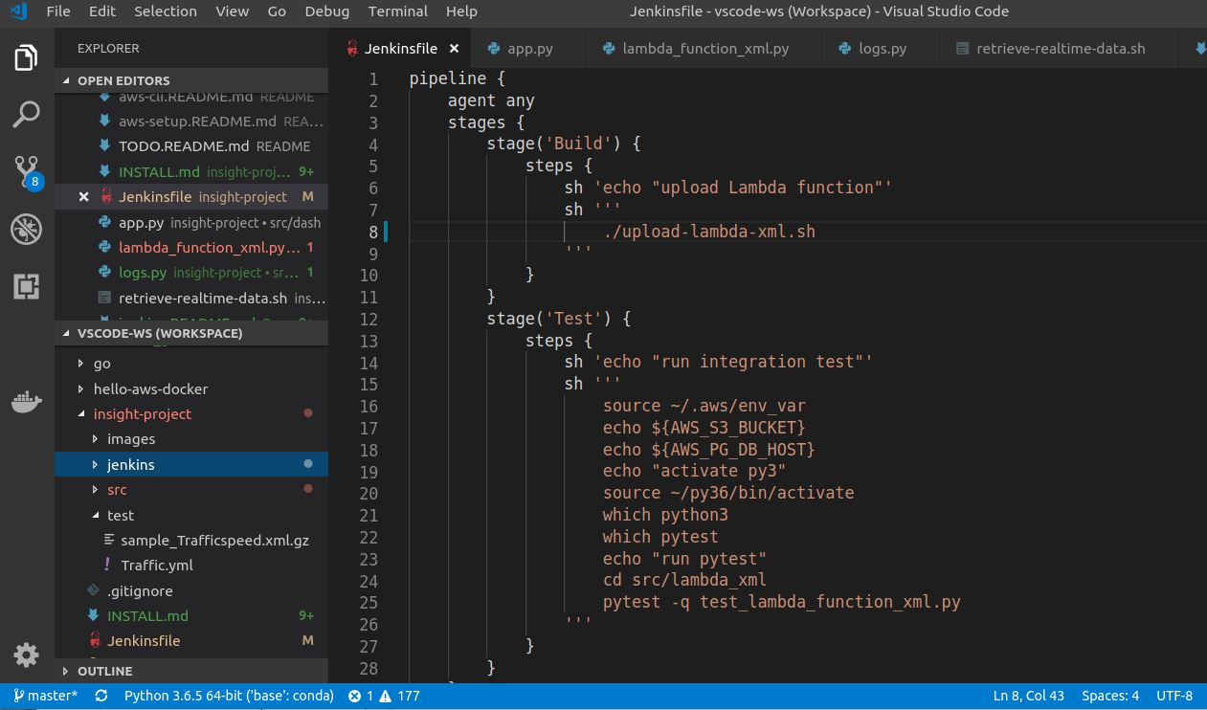
Jenkins: Pipeline/Jenkinsfile

Slide 13
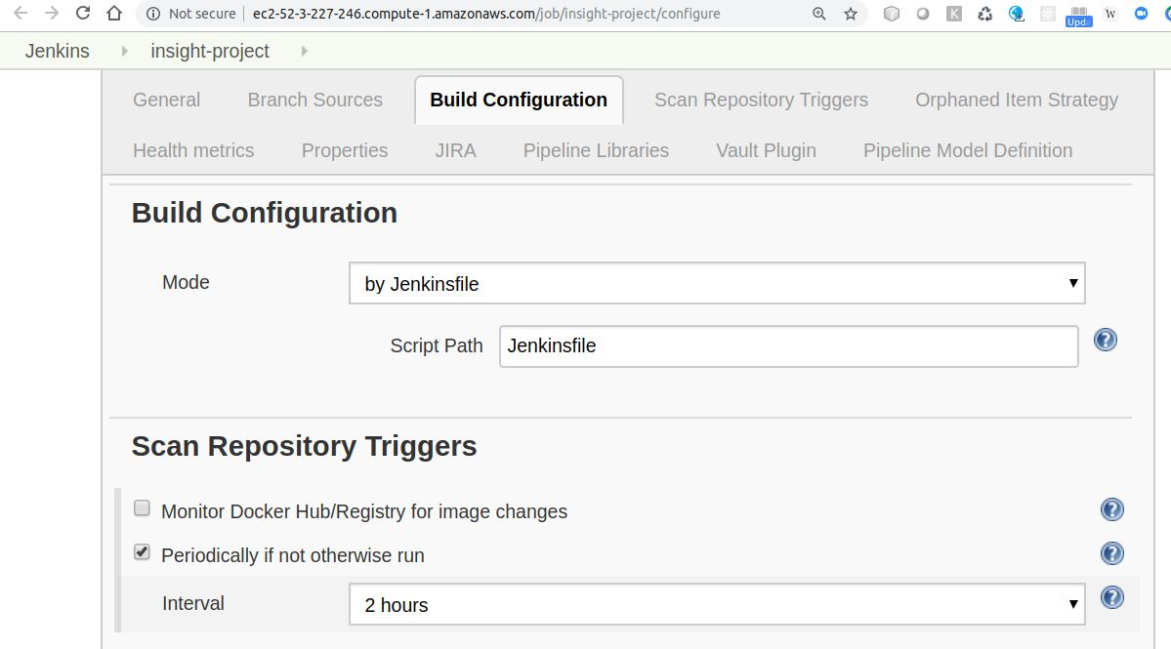
Jenkins: Build Config

Slide 14
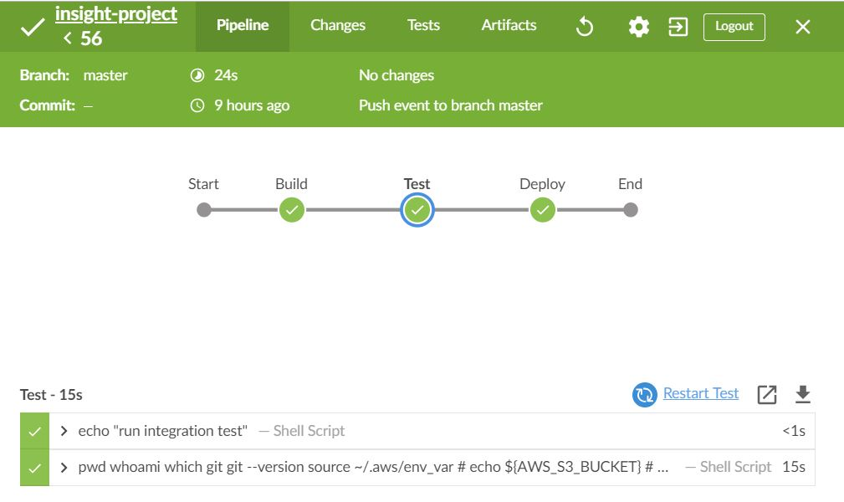
Jenkins: Dashboard
Notes:
I used Jenkins Blue Ocean plugin to monitor build, here is a screenshot.

