Slide 1
Code-to-Cloud
Insight DevOps Fellowship, New York
Wen Gong
Notes:
I am Wen Gong, an Insight DevOps fellow. My demo project is called “code-to-cloud”, It is about streamlining app development and release processes
Hello, we are from the Insight DevOps program.
Insight is designed for people with strong knowledge of computer science fundamentals transition to DevOps.
We are given resource to get hands-on experience building demo on AWS in only three weeks!

Slide 2
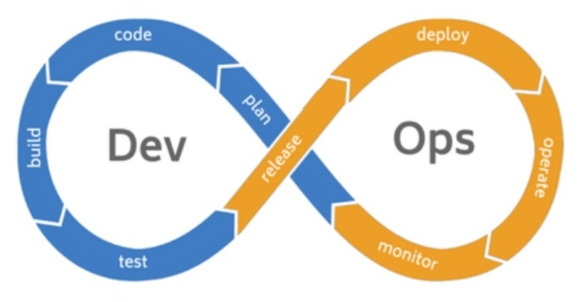
Motivation
Problems
Promise
monolithic app
dev not test-driven
lack of tests
build not automated
slow approval
faster time-to-market cycle
productivity gain
cost savings
Notes:
DevOps is a new trend in IT. By tightly integrating Dev and Ops processes, it has great promises such as
1) faster time-to-market speed
2) gain productivity
3) large cost savings
But reality is quite different, many companies are still facing problems list below.
My interest is to explore a path forward.

Slide 3
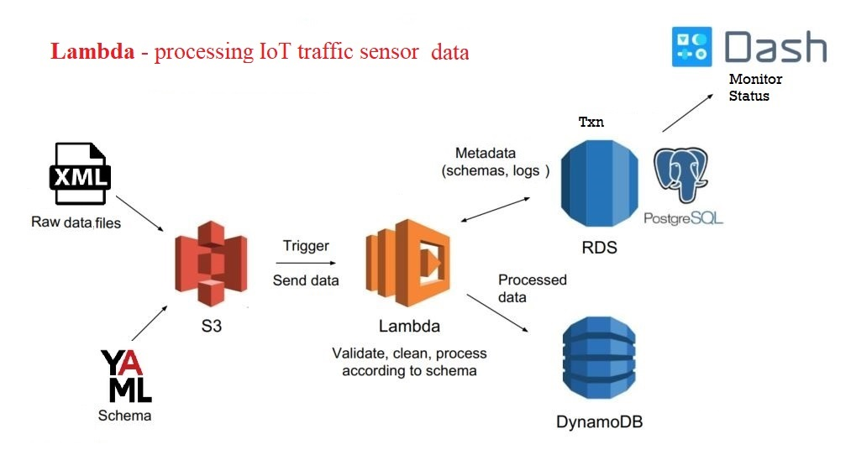
Data Eng. Pipeline
1) enhanced logging
2) added E2E test
3) included in CI
Notes:
Collaboration between Dev and Ops teams is an important theme of DevOps.
The first part of my project is to incorporate a DE pipeline into build process.
DE pipeline that uses Lambda to process IoT traffic sensor data:
XML upload to S3 triggers the Lambda function, which validate, clean and process XML, The schema and logs are saved to RDS/PostgreSQL, the unstructured traffic data are stored in DynamoDB. Dash is the monitor.
This pipeline is very nice but lacked an integration test, without test case, it cannot be added to a build job.

Slide 4
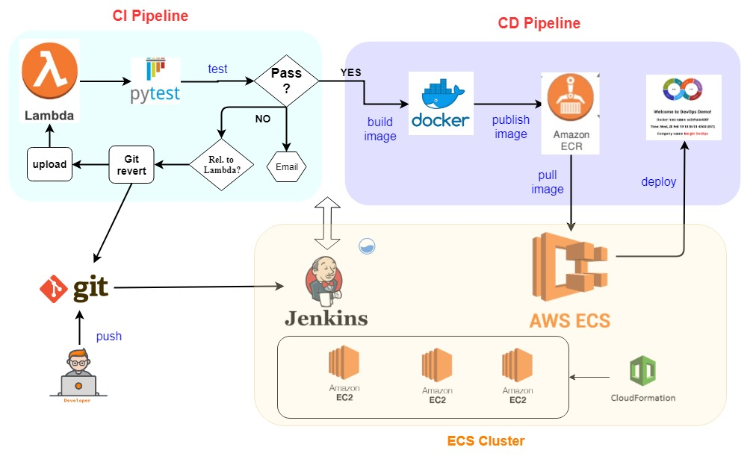
DevOps Pipeline: CI + CD
Notes:
Next I built a complete CI/CD pipeline.
An ECS cluster of 3 instances was built using cloudformation template
I installed Jenkins server in one instance, other two are for deploying apps.
It starts with git push by developer, this event triggers a Jenkins pipeline, which uploads lambda function, runs test.
If test fails and code is related to lambda function, the job will revert last commit, and rollback lambda.
If test is successful, it proceeds to build docker image, publish to container registry, and deploy to a test instance.
In contrast to Data Engineering pipeline that moves and processes data,
DevOps pipeline moves codes.

Slide 5
Challenge - Improved DE pipeline
added pytest: test_lambda_function_xml.py
enhanced logging by adding new table: xml_txns
improved XML parsing
fixed issue when uploading 2 files within the same minute
Notes:
Building a demo in 3 weeks is very challenging.
Specifically,
1) improve DE pipeline + pytest with python codes
2) Jenkins plugin not working, show my workaround bash code
3) handling DB secrets : env var to Vault API
Overcoming each challenge is a rewarding experience

Slide 6
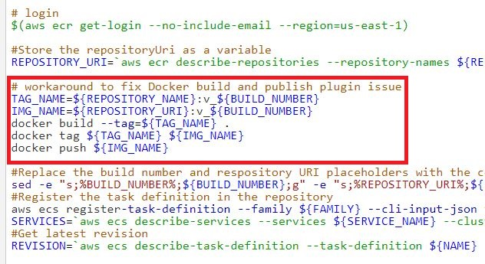
Challenge - Worked around Jenkins plugin error

Slide 7
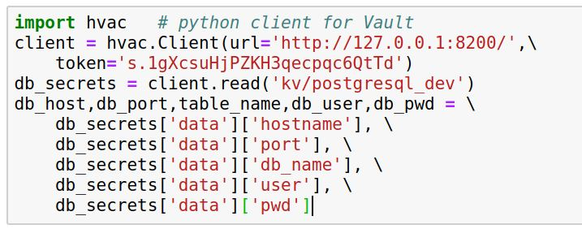
Challenge - DB secrets in Lambda/Docker
used python client for Vault (hvac)

Slide 8
Demo
CD | walk through from git push to service deployed in AWS (https://youtu.be/dxnUyEwXZhw)
CI | walk through from git push to docker build ready (https://youtu.be/rKY6u4Z6AzM)
DE | walk through DE pipeline (https://youtu.be/qpPLTKGVnkc)
Notes:
Due to lack of time, I have recorded demo in 3 videos, focusing on each area of the project.
To summarize, I am very thrilled to see that a streamlined process completed in a few mins going from code check-in to cloud deployment. Similar process took days in my current workplace.

Slide 9


Wen Gong
Ph.D. in nuclear physics
20 years of experience as Software Engineer & Consultant
CRM & master database applications
data quality
integration bridges
ETL
Passionate about STEM
teach py4kids
Notes:
I am Wen Gong, had a Ph.D. in nuclear physics, and have 20 years of software development and consulting experience in database applications. After coming to Insight, I am very excited to explore new opportunities in DevOps space.
Thanks for your attention, Any question?

Slide 10
Questions

Slide 11
Links
https://github.com/wgong/code2cloud
http://jenkins.s8s.cloud/

Slide 12
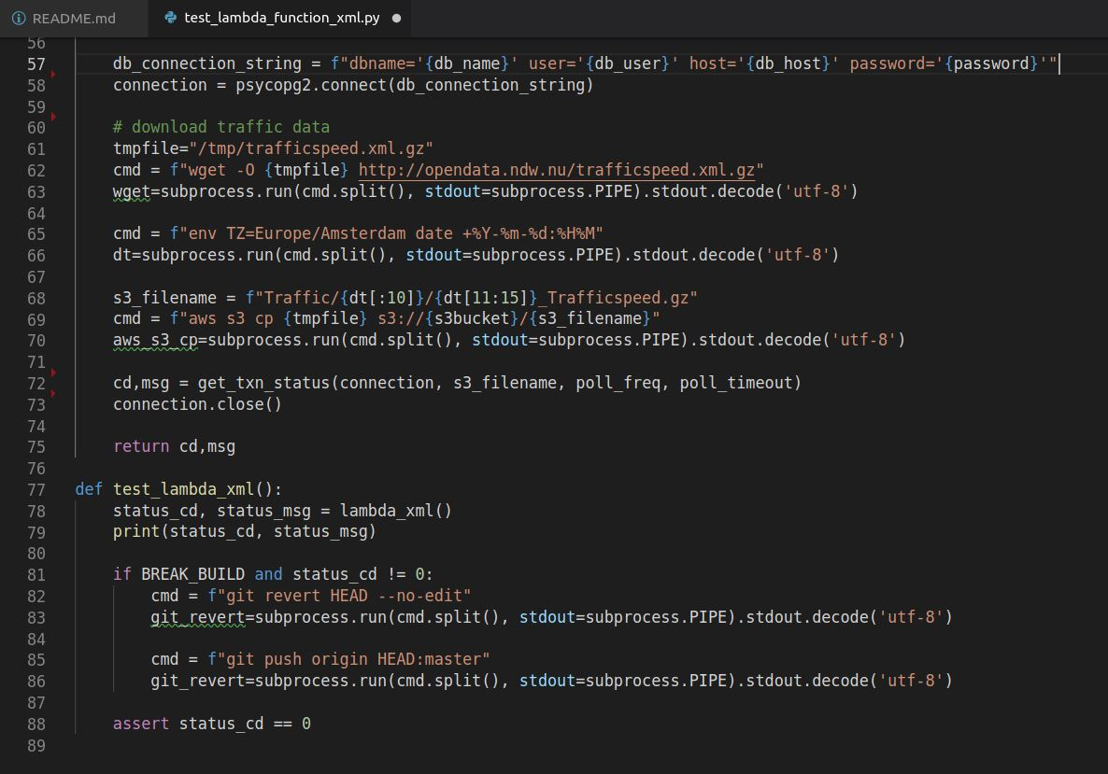
PyTest

Slide 13
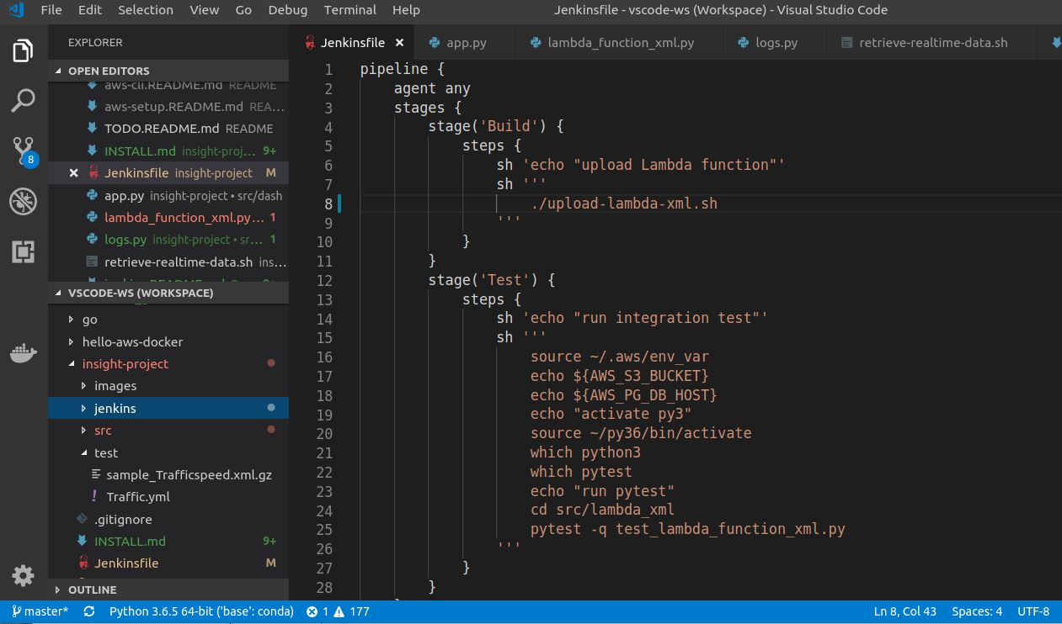
Jenkins: Pipeline/Jenkinsfile

Slide 14
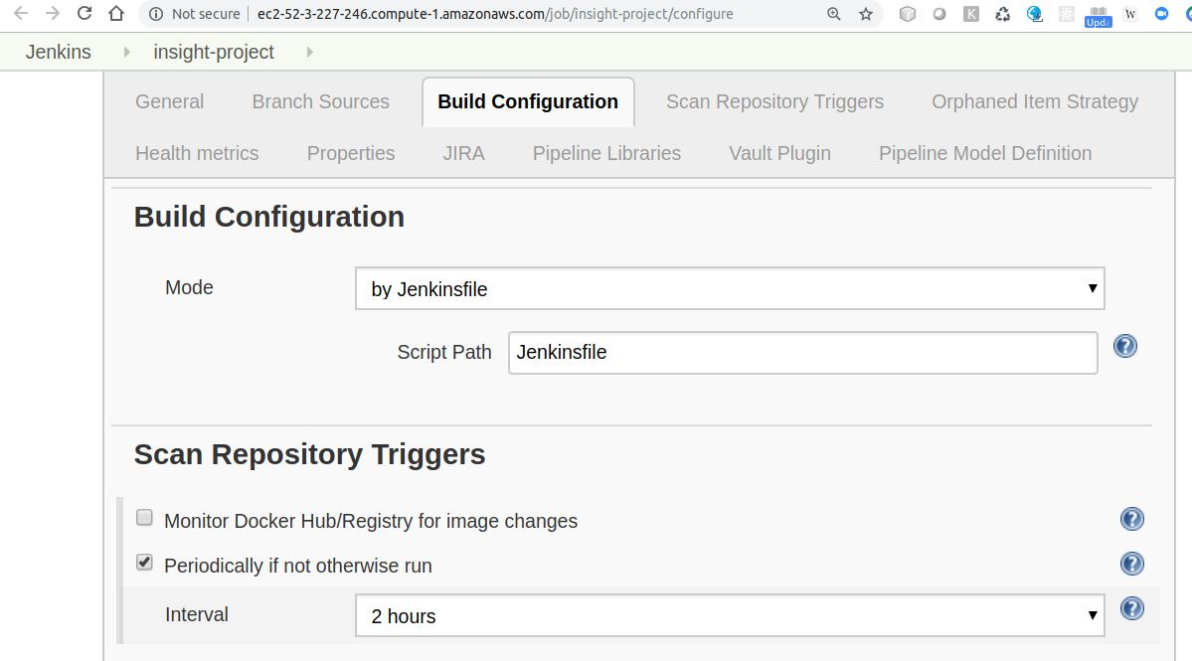
Jenkins: Build Config

Slide 15
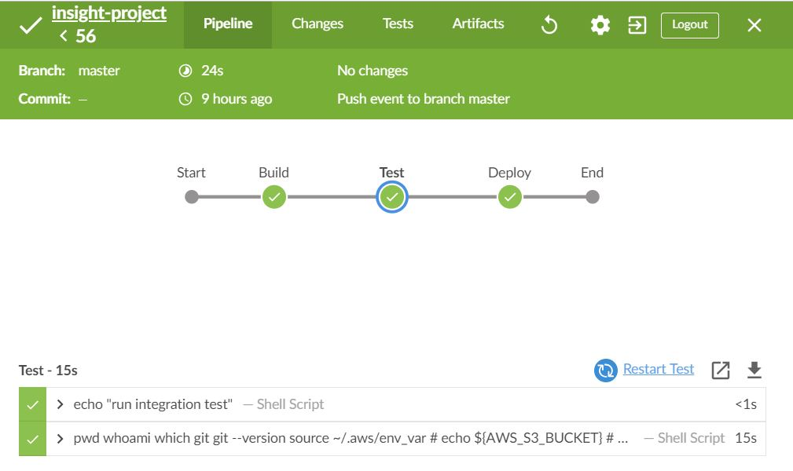
Jenkins: Dashboard
Notes:
I used Jenkins Blue Ocean plugin to monitor build, here is a screenshot.

Slide 16
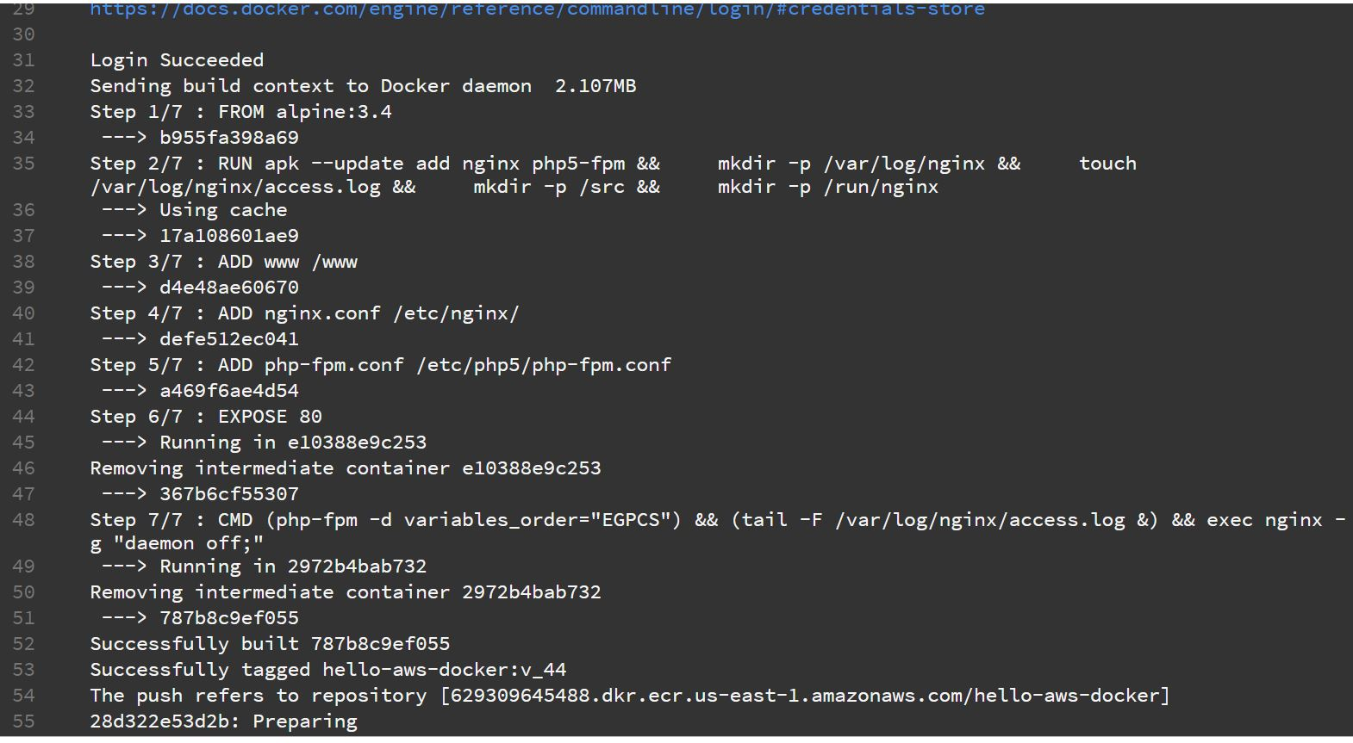
Docker-build-and-publish
Notes:
I used Jenkins Blue Ocean plugin to monitor build, here is a screenshot.

