Slide 1
Code-to-Cloud
Insight DevOps Fellowship, New York
Wen Gong
Notes:
I am Wen Gong, an Insight DevOps fellow. Thanks for the opportunity to share my devops experience at Insight. My project title is “code-to-cloud”, it is about streamlining development and release processes
Hello, we are from the Insight DevOps program.
Insight is designed for people with strong knowledge of computer science fundamentals transition to DevOps.
We are given space to get hands-on experience building distributed platforms on AWS.
The projects we are about to present were built in only three weeks!

Slide 2
Business Problem
Streamline processes: code > test > build > deploy to cloud
=> Faster time-to-market speed
Migrate business to cloud
=> Gain productivity and save cost
Notes:
There are 2 aspects to the problem:
First, how to automate the application development process from code, test, build, and deploy to cloud?
Its business value is to achieve faster time-to-market speed
Second, How to migrate business to cloud in order to gain productivity and save costs?
I attended a virtual transformation conference by Amazon on Feb 6, above problem is high on the list facing many business today.
DevOps is an emerging field with promise to solve above problems

Slide 3
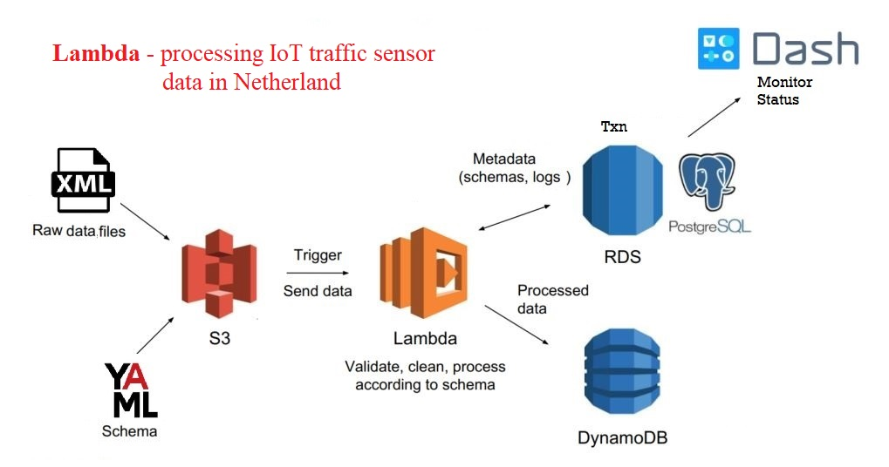
Data Engineering Pipeline
Notes:
An essential aspect of DevOps is collaboration where Dev and Ops teams work together.
The first part of my project is to include Data Engineer’s project into build process.
Here is a DE pipeline which uses Lambda to process IoT traffic sensor data: XML upload to S3 triggers the Lambda function, which validate, clean and process XML,
The schema and logs are saved to RDS/PostgreSQL, the unstructured traffic data are stored in DynamoDB. Dash as the monitor.
This pipeline is very nice but lacked an integration test, without such a test case, we cannot add it to any build job.

Slide 4
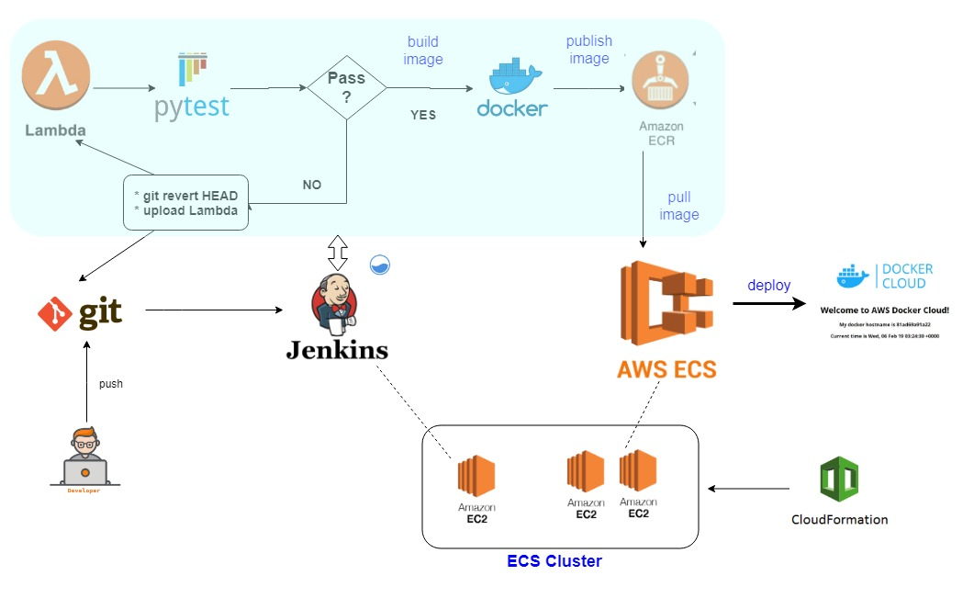
DevOps CI/CD Pipeline
Notes:
Next I built a DevOps CI/CD pipeline.
In contrast to Data Engineering pipeline which moves and processes data, DevOps pipeline moves codes:
I built an ECS cluster stack using cloudformation template with 3 EC2 instances: one dedicated for Jenkins server, other two for deploying apps.
It starts with git push by developer, this event triggers a Jenkins pipeline, which uploads lambda function, runs test.
If test fails and code is related to lambda, it will revert last commit, and rollback lambda.
If test is successful, the job proceeds to build docker image, publish to container registry, and deploy to an acceptance testing instance.

Slide 5
Challenges
Write pytest on Data Engineer’s pipeline
=> added new table and wrote new code for schema changes
=> improved DE pipeline for dealing with parallel tests
Jenkins plugin (Docker build and publish) not working in ECS
=> Wrote workaround code in bash
Handle secrets when deploying pipeline to container
=> enhanced code to use Vault
Notes:
Building a demo in 3 weeks is challenging. Specifically,
1) I have to know the DE pipeline well and very quickly.
2) write bash workaround when Jenkins plugin not working
3) pickup new tech stacks and tools quickly
Overcoming each challenge is a rewarding learning experience

Slide 6
Demo
video link

Slide 7


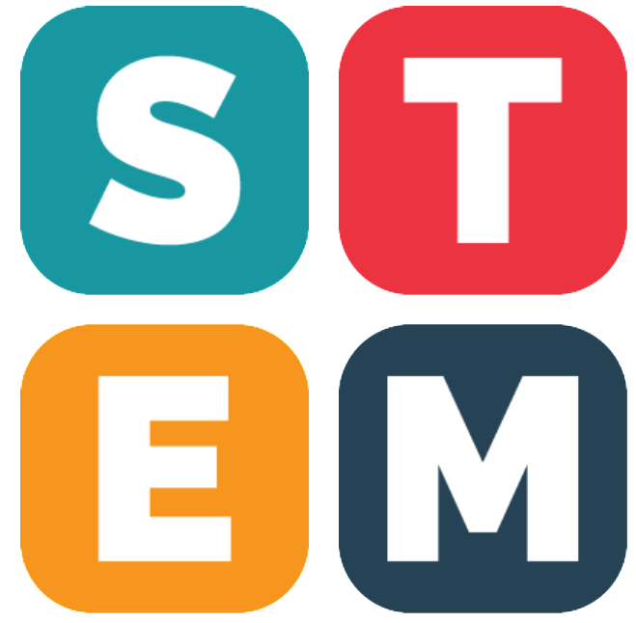
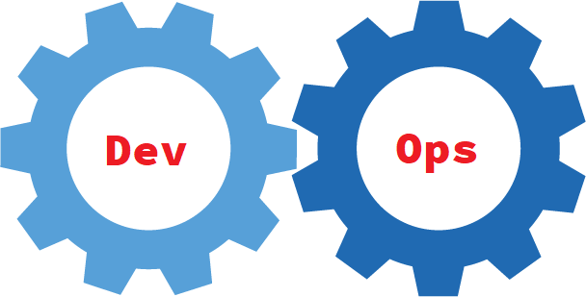
Wen Gong
20 years of experience as Software Engineer / Consultant
=> Built customer master, integration bridges, ETL & data quality tools
Interested in new opty in DevOps
Passionate about STEM edu
=> Teach py4kids
=> One student selected as 2019 Regeneron STS Scholar
Ph.D. in nuclear physics
Notes:
To wrap up, I am Wen Gong, had a Ph.D. in nuclear physics, and have 20 years of software engineering and consulting experience in customer master data management. I take a 7 weeks’ leave to attend Insight program to learn DevOps and cloud computing. I am very interested in exploring new opportunities in DevOps.
Thanks for your attention, Any question?

Slide 8
Questions

Slide 11
Links
http://jenkins.s8s.cloud/
https://github.com/wgong/code2cloud

Slide 12
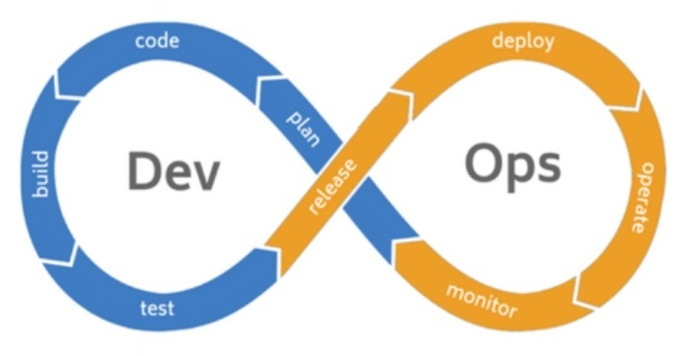
Solution: Dev + Ops
Notes:
My devops journey started last Nov when I was accepted to Insight program. Since then I have learned a lot about this emerging field.
We not only write codes for application, but also write codes for build process (Jenkinsfiles) and infrastructure (Dockerfiles, playbook).
The close collaboration between dev team and ops team and continuous automation in devops offer us promising solutions to our problem.

Slide 13
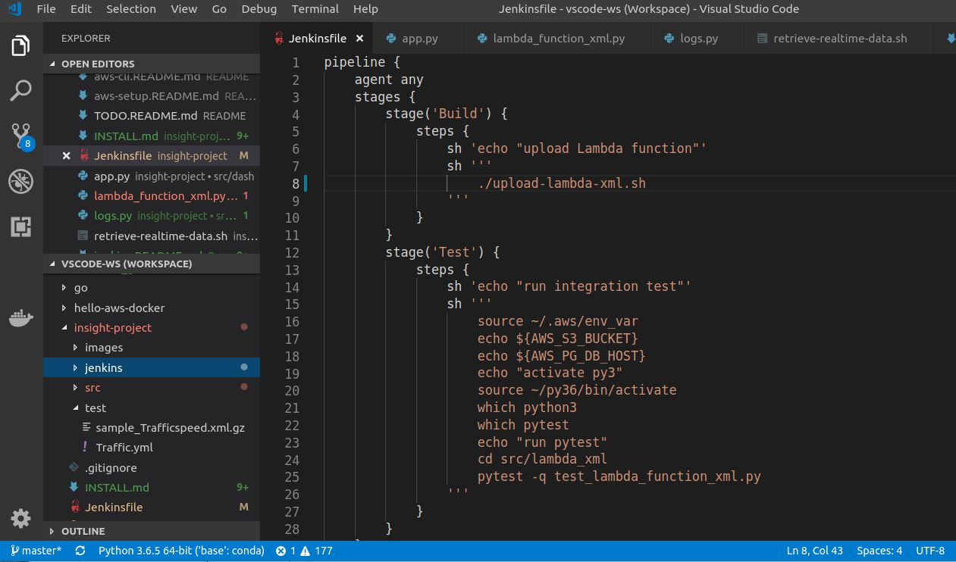
Jenkins: Pipeline/Jenkinsfile

Slide 14
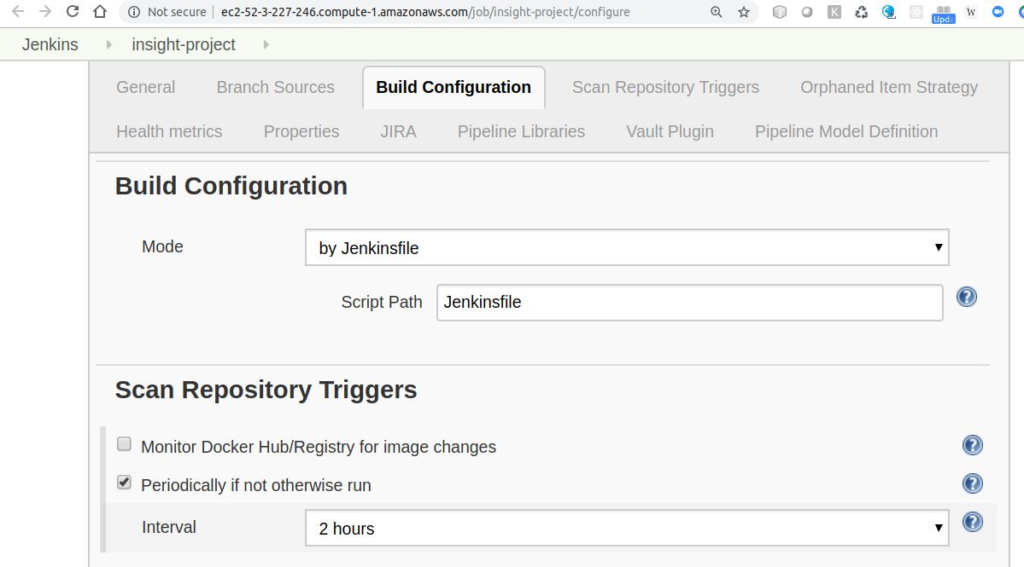
Jenkins: Build Config

Slide 15
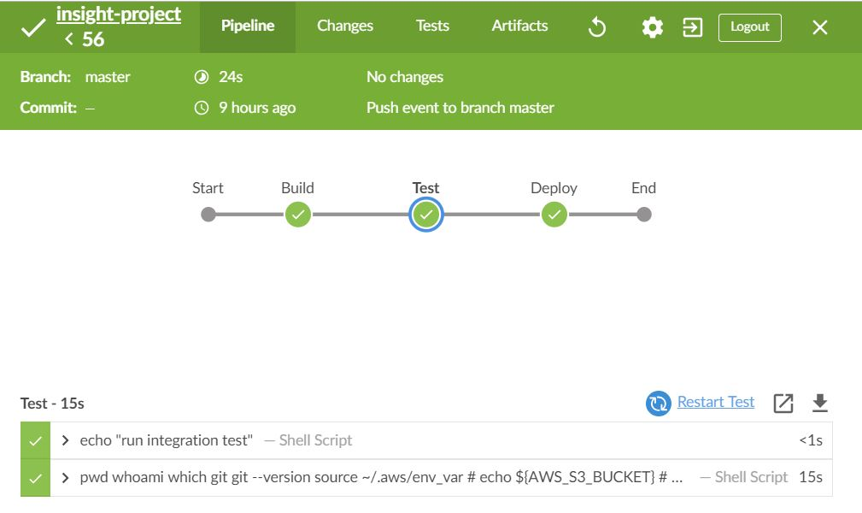
Jenkins: Dashboard
Notes:
I used Jenkins Blue Ocean plugin to monitor build, here is a screenshot.

