Slide 1


TICK Stack

Slide 2


Overview
What is time series data?
Why TICK Stack?
Where could it be used?
Notes:
Fully integrated with Gitlab
Integrated since v. 8.0
Build scripts hosted in repo
Git hooks - Hosted (free) or on premise
Actively maintained
Code and build scripts in the same repo
Easy to start
Scalable
Isolated test environment

Slide 3
Why TICK Stack
Notes:
Fully integrated with Gitlab
Integrated since v. 8.0
Build scripts hosted in repo
Git hooks - Hosted (free) or on premise
Actively maintained
Code and build scripts in the same repo
Easy to start
Scalable
Isolated test environment

Slide 4
Use Case
Infrastructure monitoring.
Network Monitoring
Application Monitoring
Container Monitoring
Work with sensors (i.e. interacting with IoT).
Anomaly detection.
Notes:
Fully integrated with Gitlab
Integrated since v. 8.0
Build scripts hosted in repo
Git hooks - Hosted (free) or on premise
Actively maintained
Code and build scripts in the same repo
Easy to start
Scalable
Isolated test environment

Slide 5




Work Flow of Tick
visualization
Chronograf
Agent for collecting metrics and data
Telegraf
InfluxDB
Kapaciotor
Alerting and data processing engine
To store the data
Notes:
Fully integrated with Gitlab
Integrated since v. 8.0
Build scripts hosted in repo
Git hooks - Hosted (free) or on premise
Actively maintained
Code and build scripts in the same repo
Easy to start
Scalable
Isolated test environment

Slide 6
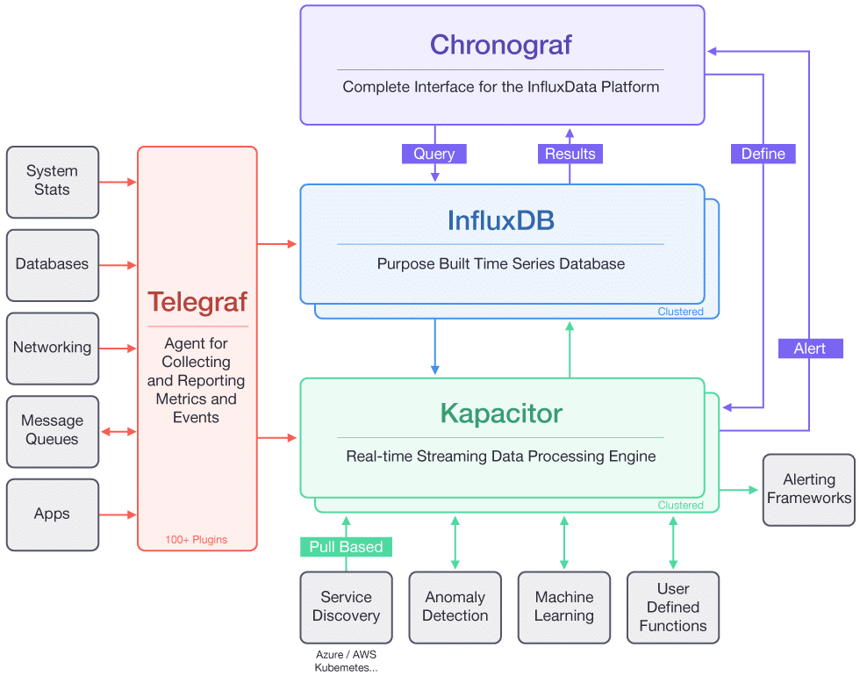
Work Flow of Tick
Notes:
Fully integrated with Gitlab
Integrated since v. 8.0
Build scripts hosted in repo
Git hooks - Hosted (free) or on premise
Actively maintained
Code and build scripts in the same repo
Easy to start
Scalable
Isolated test environment

Slide 7
Telegraf
Open source solution for data collection, pulling data, collect from Linux and windows.
Telegraf is an open-source agent that collects metrics and data on the system it's running on, or from other services. Telegraf then writes the data to InfluxDB or other outputs.
Metric collection daemon
Plugin-Driven
Written in Go, no need for external dependencies, no npm, pip , gem
Over 100 plugins (Docker,Apache,Kubernetes,radis..etc.)
Parse the input data Formats
Notes:
Fully integrated with Gitlab
Integrated since v. 8.0
Build scripts hosted in repo
Git hooks - Hosted (free) or on premise
Actively maintained
Code and build scripts in the same repo
Easy to start
Scalable
Isolated test environment

Slide 8
Telegraf
[agent]
interval = "10s"
round_interval = true
metric_batch_size = 1000
metric_buffer_limit = 10000
[[outputs.influxdb]]
urls = ["http://influxdb:8086"]
database = "telegraf"
[[inputs.system]]
[inputs.system.tags]
n_cpus = "%N_CPUS%"
[[inputs.net]]
[[inputs.cpu]]
Notes:
Fully integrated with Gitlab
Integrated since v. 8.0
Build scripts hosted in repo
Git hooks - Hosted (free) or on premise
Actively maintained
Code and build scripts in the same repo
Easy to start
Scalable
Isolated test environment

Slide 9
InfluxDB
InfluxDB is an open-source database optimized for fast, high-availability storage and retrieval of time series data.
InfluxDB is great for operations monitoring, application metrics, and real-time analytics.
High performance datastore written specifically for time series data.
Simple, high performing write and query HTTP(S) APIs.
Plugins support for other data sources such as Graphite, and collectd.
SQL-like query language to easily query aggregated data
Notes:
Fully integrated with Gitlab
Integrated since v. 8.0
Build scripts hosted in repo
Git hooks - Hosted (free) or on premise
Actively maintained
Code and build scripts in the same repo
Easy to start
Scalable
Isolated test environment

Slide 10
InfluxDB
● Query example:
>SELECT "host", "env", "load1" as "load" FROM "cpu" WHERE "host" = 'tux’ LIMIT 1
name: cpu
---------
time host env load
2017-11-01T01:11:00.000000000Z tux prod 1.25
Notes:
Fully integrated with Gitlab
Integrated since v. 8.0
Build scripts hosted in repo
Git hooks - Hosted (free) or on premise
Actively maintained
Code and build scripts in the same repo
Easy to start
Scalable
Isolated test environment

Slide 11
Chronograf
Visualizing your data and configuring monitoring and alerting rules in Kapacitor.
Complete Dashbording solution.
Visual administrative tool for your influx Data deployments.
User interface for Kapacitor.
Provides User Management and user authentication.
Notes:
Fully integrated with Gitlab
Integrated since v. 8.0
Build scripts hosted in repo
Git hooks - Hosted (free) or on premise
Actively maintained
Code and build scripts in the same repo
Easy to start
Scalable
Isolated test environment

Slide 12
Kapacitor
Kapacitor is a data processing engine. It lets you plug in your own custom logic to process alerts with dynamic thresholds, match metrics for patterns, or identify statistical anomalies.
We will use Kapacitor to read data from InfluxDB, generate alerts, and send those alerts to a specified email address.
Open source stream and batch processing engine for monitoring and transforming your time series data.
Designed to process streaming data in real time.
Call user defined functions
More than just dash boarding and operator alerts.
User interface for Kapacitor.
Provides User Management and user authentication.
Notes:
Fully integrated with Gitlab
Integrated since v. 8.0
Build scripts hosted in repo
Git hooks - Hosted (free) or on premise
Actively maintained
Code and build scripts in the same repo
Easy to start
Scalable
Isolated test environment

Slide 13
Kapacitor
● TICKscript DSL example:
stream
|from()
.measurement('app')
|eval(lambda: "errors" / "total")
.as('error_percent')
// Write the transformed data to InfluxDB.
|influxDBOut()
.database('app')
.retentionPolicy('15D')
.measurement('errors')
.tag('kapacitor', 'true')
.tag('version', '0.2')
Notes:
Fully integrated with Gitlab
Integrated since v. 8.0
Build scripts hosted in repo
Git hooks - Hosted (free) or on premise
Actively maintained
Code and build scripts in the same repo
Easy to start
Scalable
Isolated test environment

Slide 14
Installation of Tick Stack
Installation of influxDB
#sudo vim /etc/yum.repos.d/influxdata.repo
[influxdb] name = InfluxData Repository - RHEL $releasever
baseurl = https://repos.influxdata.com/rhel/$releasever/$basearch/stable enabled = 1 gpgcheck = 1 gpgkey =https://repos.influxdata.com/influxdb.key
#sudo yum install influxdb
# sudo systemctl start influxdb
Notes:
Fully integrated with Gitlab
Integrated since v. 8.0
Build scripts hosted in repo
Git hooks - Hosted (free) or on premise
Actively maintained
Code and build scripts in the same repo
Easy to start
Scalable
Isolated test environment

Slide 15
Installation of Tick Stack
Installation of Telegraf
#sudo yum install telegraf
#vi /etc/telegraf/telegraf.conf
# sudo systemctl start telegraf
Notes:
Fully integrated with Gitlab
Integrated since v. 8.0
Build scripts hosted in repo
Git hooks - Hosted (free) or on premise
Actively maintained
Code and build scripts in the same repo
Easy to start
Scalable
Isolated test environment

Slide 16
Installation of Tick Stack
Installation of chronograf
#sudo yum install telegraf
# sudo systemctl start telegraf
Installation of kapacitor:
#sudo yum install kapacitor
# sudo systemctl start kapacitor
Notes:
Fully integrated with Gitlab
Integrated since v. 8.0
Build scripts hosted in repo
Git hooks - Hosted (free) or on premise
Actively maintained
Code and build scripts in the same repo
Easy to start
Scalable
Isolated test environment

Slide 17
Questions?
Thanks :-)
Notes:
Fully integrated with Gitlab
Integrated since v. 8.0
Build scripts hosted in repo
Git hooks - Hosted (free) or on premise
Actively maintained
Code and build scripts in the same repo
Easy to start
Scalable
Isolated test environment

