Slide 1


TICK Stack

Slide 2


Why TICK Stack
Notes:
Fully integrated with Gitlab
Integrated since v. 8.0
Build scripts hosted in repo
Git hooks - Hosted (free) or on premise
Actively maintained
Code and build scripts in the same repo
Easy to start
Scalable
Isolated test environment

Slide 3
Use Case
Notes:
Fully integrated with Gitlab
Integrated since v. 8.0
Build scripts hosted in repo
Git hooks - Hosted (free) or on premise
Actively maintained
Code and build scripts in the same repo
Easy to start
Scalable
Isolated test environment

Slide 4
Pros & cons
Notes:
Fully integrated with Gitlab
Integrated since v. 8.0
Build scripts hosted in repo
Git hooks - Hosted (free) or on premise
Actively maintained
Code and build scripts in the same repo
Easy to start
Scalable
Isolated test environment

Slide 5




Work Flow of Tick
Chronograf
Telegraf
InfluxDB
Kapaciotor
Notes:
Fully integrated with Gitlab
Integrated since v. 8.0
Build scripts hosted in repo
Git hooks - Hosted (free) or on premise
Actively maintained
Code and build scripts in the same repo
Easy to start
Scalable
Isolated test environment

Slide 6
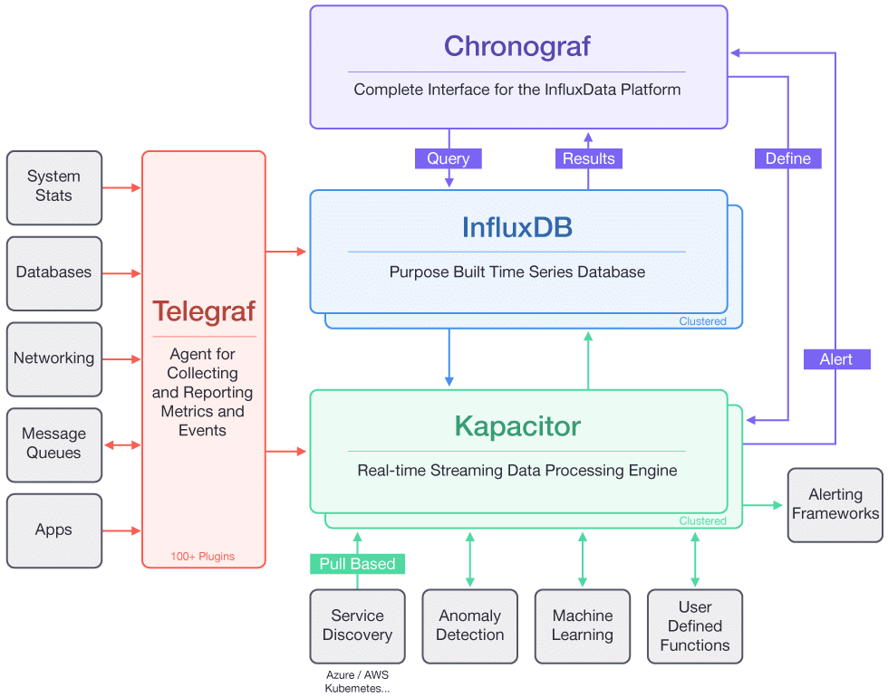
Work Flow of Tick
Notes:
Fully integrated with Gitlab
Integrated since v. 8.0
Build scripts hosted in repo
Git hooks - Hosted (free) or on premise
Actively maintained
Code and build scripts in the same repo
Easy to start
Scalable
Isolated test environment

Slide 7
Telegraf
Open source solution for data collection, pulling data, collect from Linux and windows.
Telegraf is an open-source agent that collects metrics and data on the system it's running on, or from other services. Telegraf then writes the data to InfluxDB or other outputs.
Metric collection daemon
Plugin-Driven
Written in Go, no need for external dependencies, no npm, pip , gem
Over 100 plugins (Docker,Apache,Kubernetes,radis..etc.)
Parse the input data Formats
Notes:
Fully integrated with Gitlab
Integrated since v. 8.0
Build scripts hosted in repo
Git hooks - Hosted (free) or on premise
Actively maintained
Code and build scripts in the same repo
Easy to start
Scalable
Isolated test environment

Slide 8
InfluxDB
InfluxDB is an open-source database optimized for fast, high-availability storage and retrieval of time series data.
InfluxDB is great for operations monitoring, application metrics, and real-time analytics.
Notes:
Fully integrated with Gitlab
Integrated since v. 8.0
Build scripts hosted in repo
Git hooks - Hosted (free) or on premise
Actively maintained
Code and build scripts in the same repo
Easy to start
Scalable
Isolated test environment

Slide 9
Chronograf
Visualizing your data and configuring monitoring and alerting rules in Kapacitor.
Complete Dashbording solution.
Visual administrative tool for your influx Data deployments.
User interface for Kapacitor.
Provides User Management and user authentication.
Notes:
Fully integrated with Gitlab
Integrated since v. 8.0
Build scripts hosted in repo
Git hooks - Hosted (free) or on premise
Actively maintained
Code and build scripts in the same repo
Easy to start
Scalable
Isolated test environment

Slide 10
Kapacitor
Kapacitor is a data processing engine. It lets you plug in your own custom logic to process alerts with dynamic thresholds, match metrics for patterns, or identify statistical anomalies.
We will use Kapacitor to read data from InfluxDB, generate alerts, and send those alerts to a specified email address.
Open source stream and batch processing engine for monitoring and transforming your time series data.
Designed to process streaming data in real time.
Call user defined functions
More than just dash boarding and operator alerts.
User interface for Kapacitor.
Provides User Management and user authentication.
Notes:
Fully integrated with Gitlab
Integrated since v. 8.0
Build scripts hosted in repo
Git hooks - Hosted (free) or on premise
Actively maintained
Code and build scripts in the same repo
Easy to start
Scalable
Isolated test environment

Slide 11
Installation of Tick Stack
Notes:
Fully integrated with Gitlab
Integrated since v. 8.0
Build scripts hosted in repo
Git hooks - Hosted (free) or on premise
Actively maintained
Code and build scripts in the same repo
Easy to start
Scalable
Isolated test environment

