Slide 1
Mental Health Analysis in Tech Field
Presented by Darya Naymon and Devorah Zweig
Dataset Information:
This dataset is from a 2014 survey that measures attitudes towards mental health and frequency of mental health disorders in the tech workplace.

Slide 2
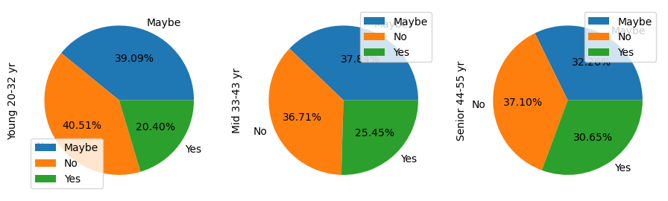
Correlation between age and mental health consequence
We wished to examine how open employees to discuss mental health issues with their employers in different age stages. Step one was to split data in three age categories - Young (20-32), Middle (33-43), and Senior (44-55). Analysis shows the direct effect of age on mental health . We can conclude that additional 5% of tech professionals believe that admitting mental health problems to their employer will affect their job

Slide 3
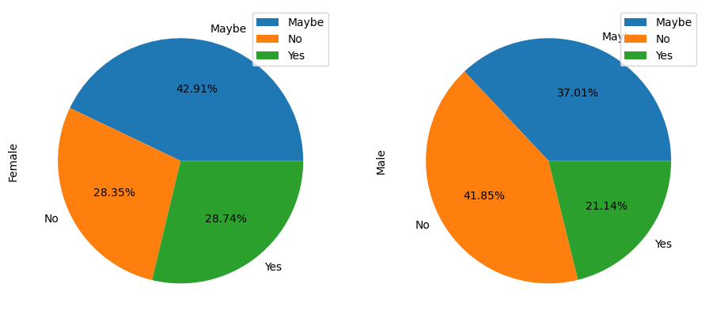
Correlation between gender and mental health consequence
Analysis shows that gender is correlated with the prevalence of mental disorders in tech. Women are more likely to believe that admitting mental health issues - 28.35% will have consequences; for men - 21.14%.

Slide 4
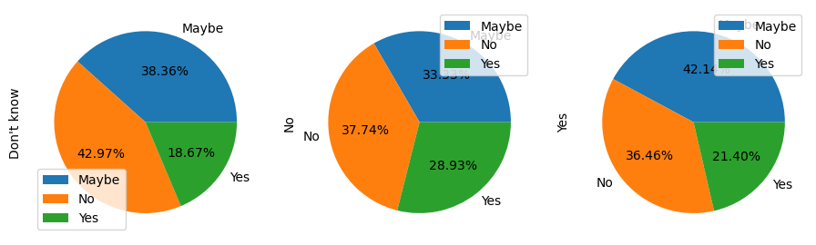
Correlation between benefits and mental health
The hypothesis is that company health benefits lower mental health issues in tech. Data analysis show insignificant difference of tech professionals who are not afraid of mental health consequences between companies that offer benefits and companies that do not - 36.46% vs 37.74%. Percentage of tech specialists who confirmed mental health consequence is lower in companies that offer benefits and/or unsure (don’t know) comparing to companies who do not offer benefits - 21.4% and 18.67% vs 28.93%.

Slide 5
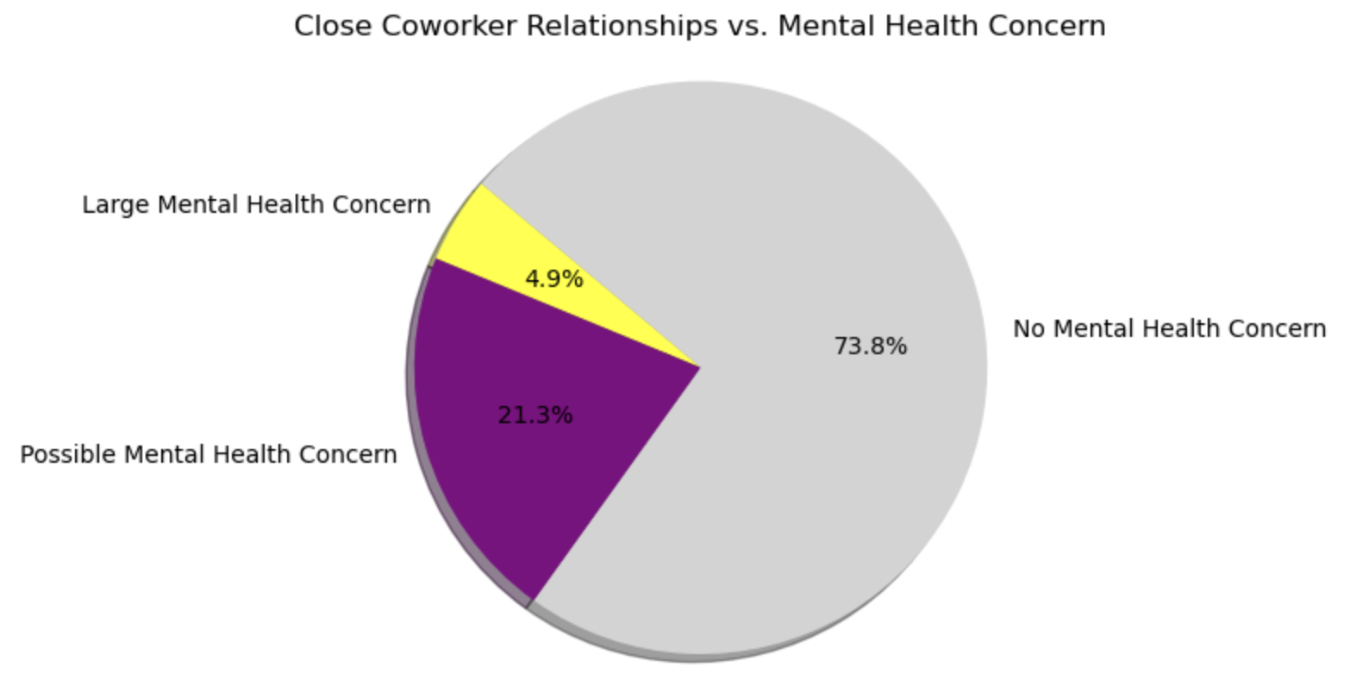
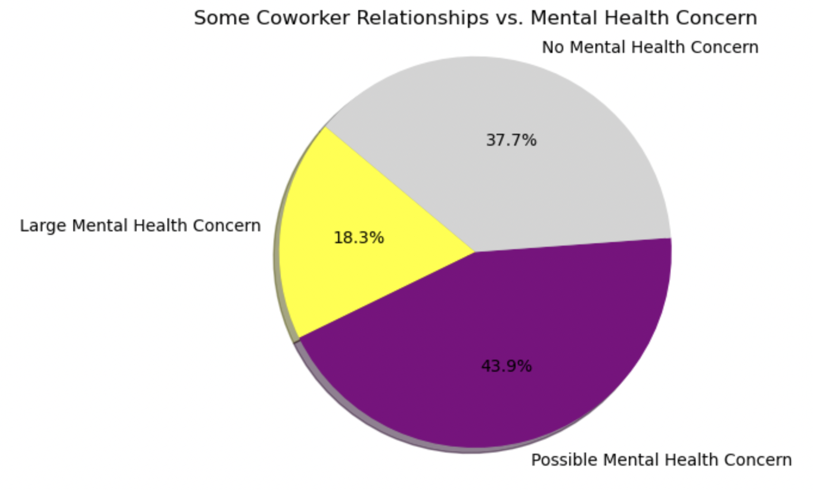
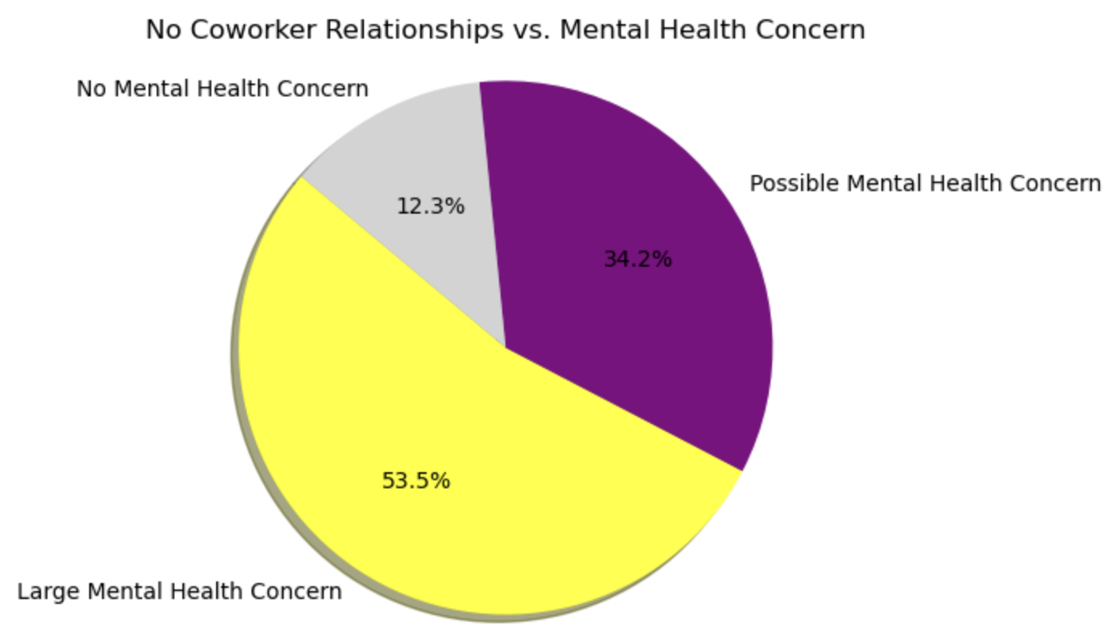
Correlation Between Colleague Relationships and Mental Health Consequences
How do interpersonal relationships affect an employees mental health?
The data was reduced by whether or not an employee felt comfortable opening up to their colleagues, and if they also suffered mental health consequences. Shown below are the percentages of different levels of colleague relationships and their consequences.

Slide 6
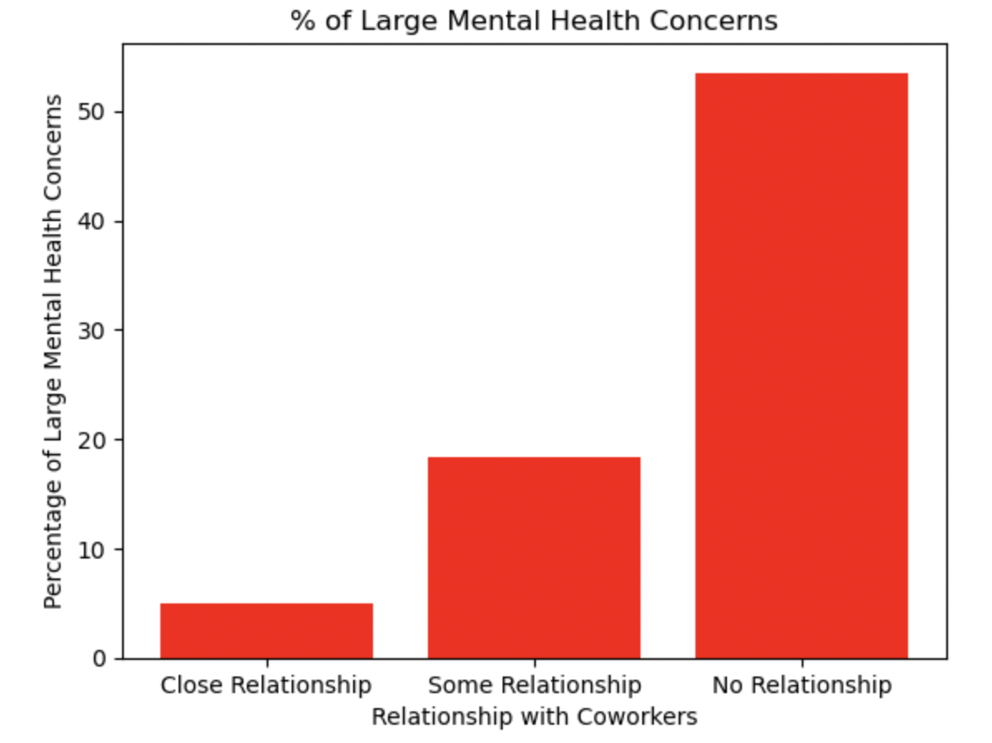
Colleague Relationships, cont.
After comparing the results of the analysis for the different levels of work relationships, it was found that only 4.9% of people who had close relationships reported mental health issues, while 53.5% of people who did not have any work relationships had severe mental health consequences.
This analysis proves that there is an incredibly strong correlation between coworker relationships and mental health.

Slide 7
Where to Build Relationships?
Would it be conducive to build strong coworker relationships in a large company or in a small one? On one hand, large companies have more employees, which provide more opportunities and more people to develop relationships with. On the other hand, however, a small company will provide a more close-knit environment, which may be better for developing relationships with colleagues. So which one should you choose?
From the 2014 survey, 62 people in tiny companies reported that they developed close relationships with their coworkers.
In larger companies, only 34 people reported that they developed close relationships with their coworkers.

Slide 8
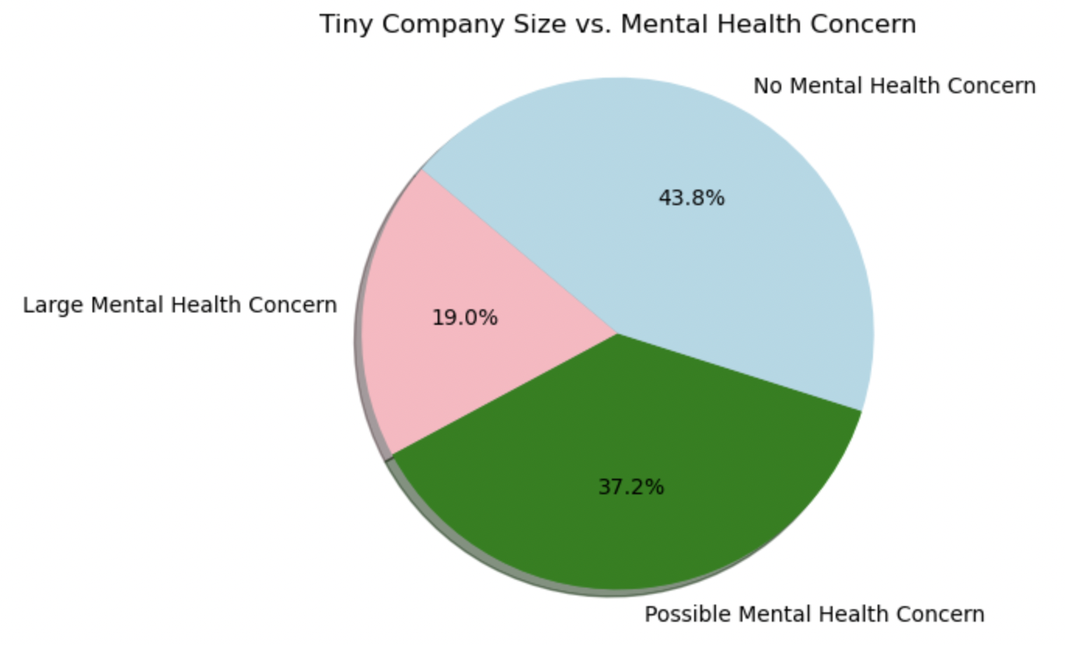
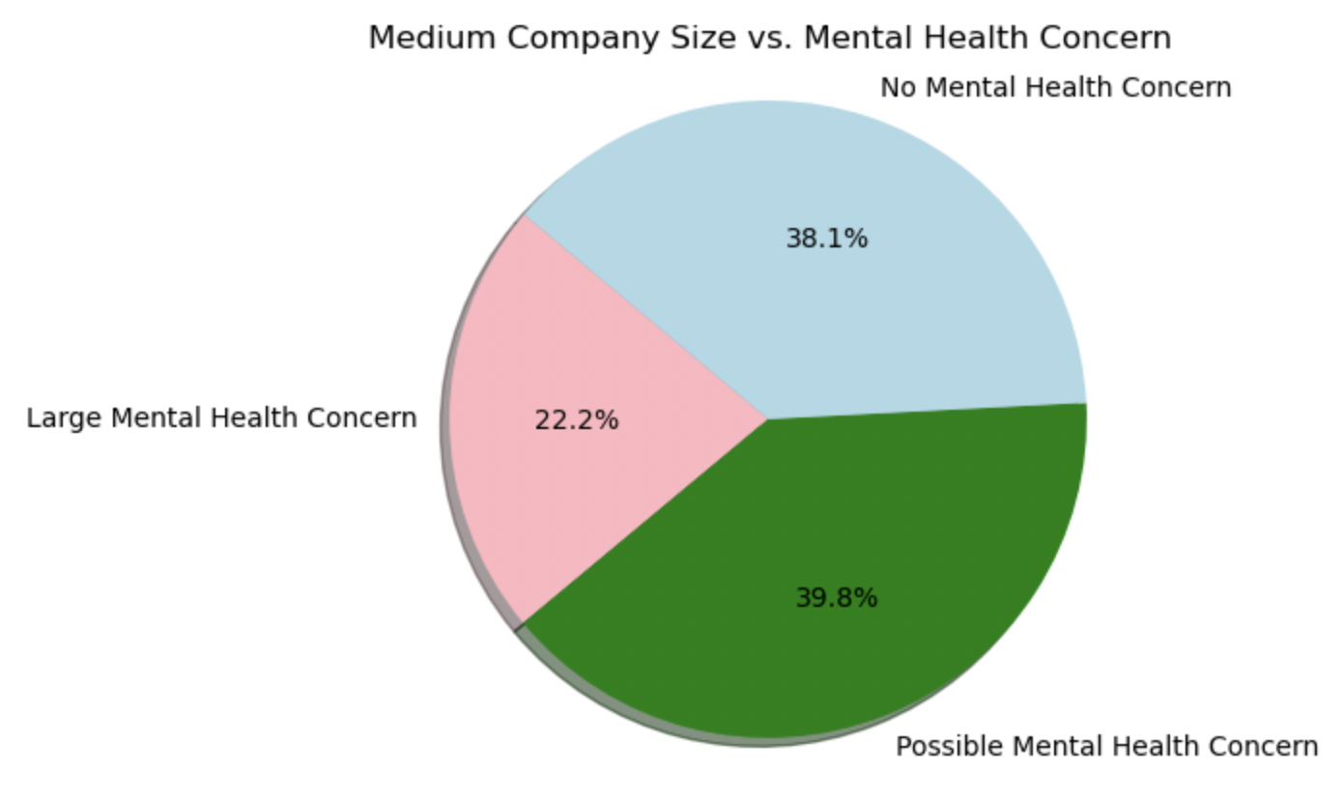
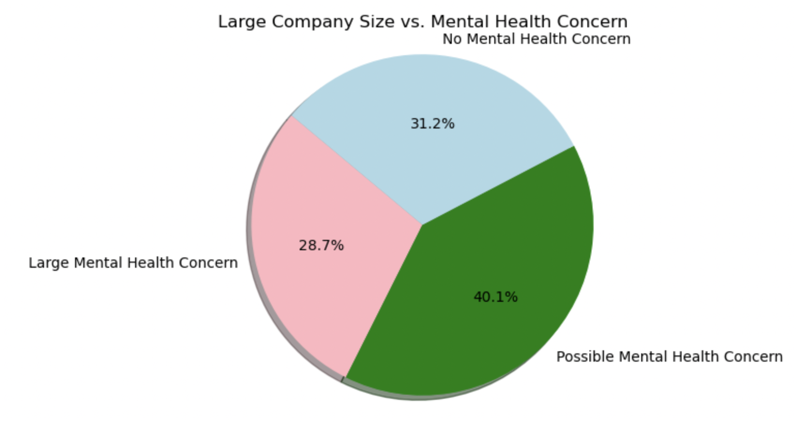
Correlation Between Company Size and Mental Health Consequences
Being in a bustling work environment lends itself to a multitude of benefits, but how does the size of a company impact the mental health of its employees?
After splitting the data by company sizes ranging from tiny, (6-25 employees), to large, (>1000 employees), it was further reduced by mental health condition. Shown are the percentages of employees with mental health effects, organized by company size.

Slide 9
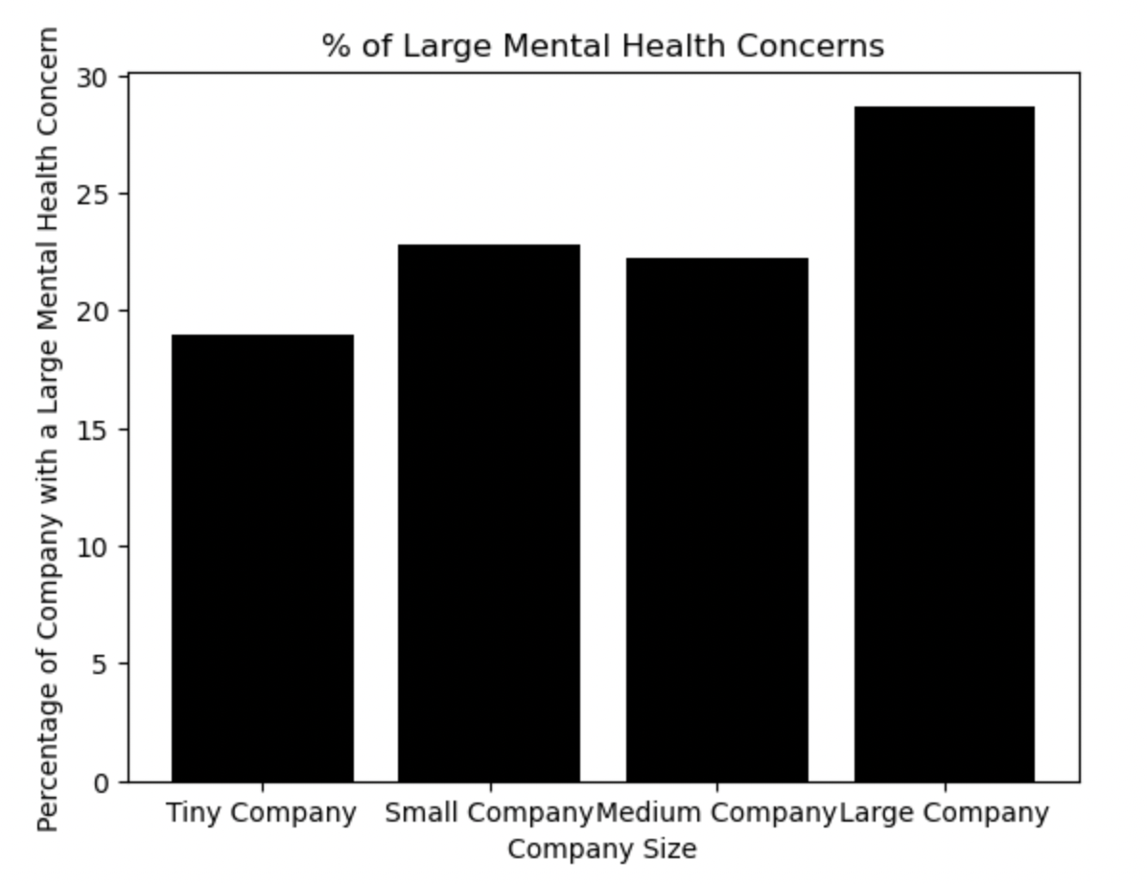
Company Size vs. Mental Health, cont.
After calculating the number of people who developed mental health issues in each size company, it was found that the greatest percentage of workers in small companies had no mental health issues, while the greater percentage of employees in large companies suffered critical mental health consequences. 19% of tiny companies had large effects, while 28.7% large companies had those same effects.
Analysis shows that there is a strong correlation between a company’s size and the mental health of its employees.

Slide 10
Large vs. Small Companies: How to Choose?
Following the analysis of the 2014 dataset, one can find themselves facing an important question: Would it be better for my mental health to work in a small company or a large one?
While the studies shown above have proved that an employee in a larger firm is more susceptible to suffer from mental health issues, employees with minimal coworker relationships suffered the same consequences.
After observing these statistics, one may find that a smaller company will provide more benefits towards the mental health of its employees.

