Slide 1
Final Presentation of British Airline Customer Reviews
Key Topics
The frequency chart below shows that the key topics within the reviews include “flight”, “London”, “service” and “crew”, showing that people are actively talking about their experience and staff.
The word cloud also showed similar words and key topics within the reviews. This includes “flight”, “BA”, “seat” and “time”, showing that people are actively talking about their experience and staff.

Slide 2
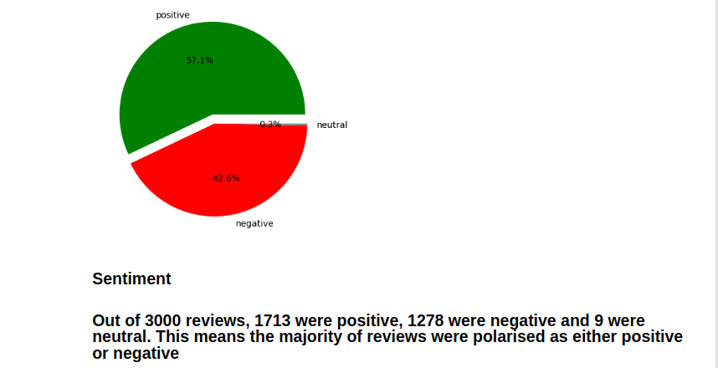
Sentiment

Slide 3
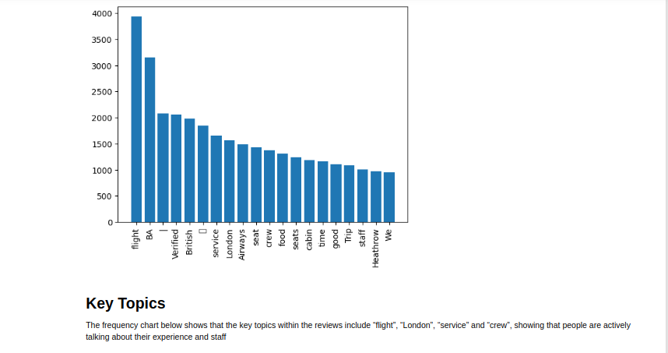
This work is licensed under a Creative Commons Attribution-ShareAlike 3.0 Unported License. It makes use of the works of Mateus Machado Luna.

