Slide 1

Portfolio Quality Analysis: Credit Risk, Recovery & Profitability
From portfolio diagnostics to an economically informed risk-management framework
Portfolio Scale
Risk Concentration
Substantial lending volume with significant credit-risk exposure across two product types in the Kenyan market
Default and delinquency concentrated in specific products and larger loan segments — not uniformly distributed
Delinquency Maturity
Recovery Limits
Outstanding exposure is heavily concentrated in very old delinquency; fresh 1–90 DPD is minimal
Recovery after default is limited, especially post-write-off; product economics diverge sharply
Predictive Signal
Analytical Mandate
Audience
Origination-only model AUC ~0.63 — useful but modest; not production-grade as a standalone credit decision tool
Analysis supports targeted early collections, controlled experimentation, risk-band prioritization, and data infrastructure investment
Senior lending, credit, and portfolio leadership — findings are diagnostic and directional, not prescriptive policy
All findings are based on origination-time variables and payment-linked analytics on the usable loan subset. Association findings do not establish causation. Profitability figures are proxies, not accounting NIM.

Slide 2



Data Quality Determines the Reliability of Risk Metrics
Portfolio Coverage
Critical Data-Quality Issue: ~15% Loan-Code Ambiguity
221K
Approximately 15% of loans carry ambiguous or non-unique loan codes. These records have been excluded from all payment-linked risk metrics to prevent silent misallocation of payments across loan accounts.
Initial Loans
Metrics Affected by Exclusion
Total loan records in the raw dataset
Default rate, DPD, PAR, recovery, write-offs, profitability proxy, and ML model features
188K
Records Retained For
Analytical Loans
Portfolio volume counts and disbursement totals only — not risk analytics
Usable for payment-linked risk analytics (84.9% coverage)
Analytical Implication
35,855
This is a coverage constraint, not data corruption. Transparent exclusion enables reliable metrics on the usable 84.9% subset
Unique Customers
Distinct borrowers across the portfolio
The ~15% data-quality limitation must be disclosed in any downstream risk reporting. Fixing the loan_code collision at source is an immediate operational priority.
2
Product Types
CASH_SALES and VERIFIED_SALES
Analysis cutoff: 25 February 2026

Slide 3
Portfolio Health: High Default Exposure Despite Strong Settlement by Count
KES 85.9B
KES 457K
Total Disbursed
Average Loan Size
Across 187,936 analytical loans
Loan-level average disbursement
63.0%
66.9%
Default Rate (Count)
Default Rate (KES)
Point-in-time; does not equal permanent loss
By exposure value — higher than count rate
87.5%
27.0%
Settlement Rate
Gross Interest Yield
Loans eventually settled post-default
As % of disbursed amount
Understanding the Default Rate
Why Exposure-Weighted Default Exceeds Count-Weighted
The 63.0% technical default rate measures loans that missed their due date — it is a point-in-time performance measure, not a permanent-loss estimate. The notebook explicitly distinguishes initial default-by-due-date from subsequent settlement and recovery. With an 87.5% settlement rate and an average time-to-settlement of 28.7 days on settled loans, a significant portion of defaulted loans do eventually resolve.
The default rate by KES exposure (66.9%) exceeds the count-based rate (63.0%), indicating that larger loans default at higher rates than smaller ones. This is a critical risk-concentration signal: the portfolio's worst-performing loans are also its largest, amplifying absolute loss exposure beyond what count-based metrics suggest.

Slide 4


The Residual Book Is Extremely Mature in Delinquency
Delinquency & Write-off Metrics
Key Finding: The Delinquency Cliff
149.1
The portfolio exhibits a stark delinquency cliff: very little fresh delinquency exists in the 1–90 day window. Once loans remain unpaid past maturity, residual exposure tends to harden rapidly into severe delinquency (PAR120+). This is not a gradual aging curve — it is a near-binary outcome.
Avg DPD (Days)
Average days past due across the portfolio
What This Means
~13%
The window for effective intervention is narrow. Loans that do not settle quickly tend not to settle at all without active collections engagement
Loans with Balance
Early-Collections Gap
Share of loans still carrying an outstanding balance
Intervention before delinquency hardens (days 1–90) likely has greater economic value than late-stage recovery efforts on PAR120+ exposure
~99.9%
Methodological Note
PAR120+ Share
DPD and PAR calculated at loan-maturity level. Source data lacks installment-level repayment schedules, which limits intra-period delinquency tracking
Of outstanding exposure — severely delinquent
KES 13.0B
The delinquency cliff is the single most actionable structural finding in this analysis. It directly motivates the immediate recommendation to stand up early-collections infrastructure.
Write-off Exposure
99.5% write-off rate by value on matured loans
Median DPD: 0 days — reflects the high overall settlement rate masking the severity of the residual book.
Write-off rate by count: 12.5% on matured loans.

Slide 5

Recovery Is Limited — and Product Economics Diverge Sharply
23.4%
0.24%
Gross Recovery Rate
Post-Write-off Recovery
After due date on defaulted exposure
Near-zero recovery once loans are written off
KES 14.0B
17.0%
Portfolio Net Income Proxy
Avg NIM Proxy
Aggregate across all analytical loans
Loan-level average profitability proxy
CASH_SALES Economics
VERIFIED_SALES Economics
NIM Proxy
Net Income Proxy
NIM Proxy
Net Income Proxy
+19.1% average loan-level
~KES 14.89B aggregate
-8.4% average loan-level — negative
~KES -893M aggregate loss
Write-off Rate
Write-off Rate
11.8% by count
21.4% by count — nearly 2× CASH_SALES
CASH_SALES generates positive economics at scale despite a 62.4% default rate — interest yield and recovery together outpace credit losses on this product.
VERIFIED_SALES shows negative economics in aggregate. The 21.4% write-off rate combined with a -8.4% NIM proxy indicates credit losses are outpacing interest income on this product.
Caveat: This is a profitability proxy, not accounting NIM. The dataset lacks funding-cost and average-earning-asset data. Product differences may reflect borrower segments or policies — not causation.

Slide 6
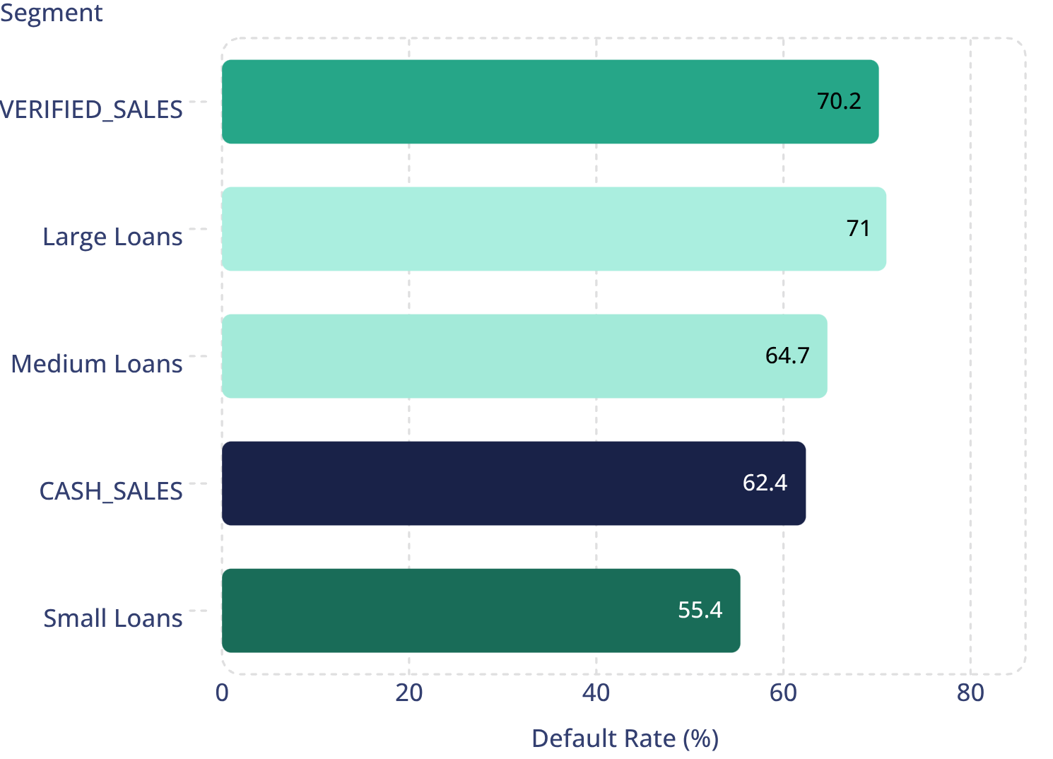

Risk Is Concentrated in Larger Loans and Specific Product Segments
Default Rate by Product & Loan Size
Highest Risk × Exposure Segments
Segment | Disbursed | Default Exposure | Default Rate
CASH_SALES + Large | KES 39.4B | KES 36.6B | 71.0%
VERIFIED_SALES + Large | KES 10.0B | KES 7.7B | 71.2%
Both large-loan segments carry default rates above 71% and represent the largest absolute exposure concentrations in the portfolio. CASH_SALES + Large alone accounts for KES 36.6B in default exposure.
Critical insight: Portfolio action must consider both default rate and absolute exposure. A segment with a high rate but small volume is less urgent than one with a high rate and large absolute KES exposure.

Slide 7



Origination Variables Show Statistically Detectable Risk Signals
Statistical Testing Approach
Key Statistical Findings
01
Product Type vs. Default
Disbursed Amount (Median)
Chi-Square Test
Used for categorical variable association (e.g., product type vs. default outcome)
χ² = 339.4, p = 8.74 × 10⁻⁷⁶ — highly significant association. Product type is among the strongest categorical predictors of default at origination
Defaulted loans: KES 360K vs. non-defaulted: KES 300K. Larger loans are associated with higher default probability
02
Mann-Whitney U Test
Used for skewed continuous variables (e.g., disbursed amount, gross interest) — non-parametric, appropriate for this data distribution
Gross Loan Interest (Median)
Initiation Fee
03
Not statistically significant at the reported level — does not independently predict default in this analysis
Origination-Only Variables
Defaulted: KES 108K vs. non-defaulted: KES 81K. Higher-interest loans are associated with elevated default risk
No post-default information used. All features are known at loan origination time only
Association does not establish causation. Statistical significance indicates a detectable relationship, not a causal mechanism.
Interpretation: Larger and higher-interest loans are associated with greater default risk. These variables may reflect borrower segments, product policies, loan size, or other underlying factors — not a direct causal relationship.

Slide 8



Origination-Only Model Provides a Useful but Modest Risk Signal
Model Design & Validation
What AUC ~0.63 Means in Practice
Features Used
No Post-Default Leakage
Meaningfully Above Random
Disbursed amount, gross loan interest, tenor, origination fees, product type — all known at origination only
AUC of 0.633 is statistically and practically above the 0.5 random baseline — the model does rank higher-risk loans above lower-risk loans with useful frequency
No post-default information included. Model is a true origination-time predictor
Not Production-Grade Standalone
AUC ~0.63 is not strong enough for a standalone production credit decision model. It should not be used as the sole basis for loan approval or rejection
Train/Test Split
Why Logistic Regression Was Retained
Temporal 80/20 split based on disbursement date — prevents look-ahead bias
Both models perform nearly identically. Logistic Regression is preferred for transparency, regulatory explainability, and coefficient interpretability in a credit context
Model Performance Comparison
Metric | Logistic Regression | Random Forest
ROC-AUC | 0.633 | 0.632
PR-AUC | 0.605 | 0.604
Brier Score | 0.239 | 0.240
Path to Stronger Performance
Behavioral features (repayment history, account activity) and bureau data are needed to materially improve predictive performance beyond the current ~0.63 AUC ceiling
The model's appropriate near-term use is as an advisory risk-banding tool to prioritize collections and flag high-risk originations — not as a blocking credit decision engine.

Slide 9

Move From Statistical Significance to Economic Decision-Making
Economic Threshold Analysis
Proposed Verified-Sales A/B Experiment
Classification threshold selection should be driven by portfolio economics, not the conventional 0.5 default. The analysis estimates asymmetric misclassification costs:
Hypothesis: Verified-Sales loans with high initiation fees show elevated default and penalty behavior. A targeted intervention may reduce PAR30 without material revenue loss.
KES 186K
01
Population
False-Negative Cost
New eligible Verified-Sales borrowers — prospective, not retrospective
Approving a loan that defaults — estimated loss per misclassified bad loan
02
KES 122K
Random Assignment
Control: existing policy. Treatment: reduced/restructured initiation fee OR pre-due repayment reminder
False-Positive Cost
03
Declining a loan that would have repaid — estimated foregone revenue per misclassified good loan
Primary Outcome
Because false-negative cost exceeds false-positive cost, the economically optimal threshold is lower than 0.5 — the model should flag more loans as high-risk to minimize expected loss.
30-day default / PAR30. Secondary: PAR90, recovery rate, revenue, repayment completion, complaints
Important: The calculated threshold is not a universal production policy. It depends on validated cost assumptions, model calibration, operating constraints, and business objectives. Validate before deployment.
04
Sample Size
1,372 per arm — sized to detect a 5-percentage-point absolute reduction at α=0.05, 80% power. Baseline default rate: 70.2%
Critical principle: Experiment before portfolio-wide policy change. The statistical associations observed do not justify blanket product restrictions without causal evidence from a controlled trial.

Slide 10




From Analysis to Action: A Risk-Management Roadmap
Immediate
Medium Term
Long Term
0–1 Month
1–6 Months
6+ Months
Immediate — 0–1 Month
Medium Term — 1–6 Months
1
Early-Delinquency Collections
1
Run the A/B Experiment
Stand up collections infrastructure for days 1–90 past due. The delinquency cliff finding shows this window is where intervention has the highest expected value
Execute the Verified-Sales initiation-fee / pre-due reminder experiment (1,372 per arm) to generate causal evidence before any pricing or product policy change
2
Underwriting Scrutiny
2
Deploy PD Scorecard (Advisory)
Increase scrutiny for large, high-interest Verified-Sales loans without automatically excluding the product — await causal evidence from the experiment
Deploy the Logistic Regression PD scorecard in non-blocking advisory mode; use risk bands to prioritize collections queues
3
Fix Loan-Code Collisions
3
Revisit Pricing & Limits
Resolve the loan_code ambiguity problem at source to restore full analytical coverage and eliminate the ~15% data-quality exclusion
After causal evidence is available from the experiment, revisit pricing, limits, and product eligibility criteria with an evidence base
Long Term — 6+ Months
1
Installment-Level Data
Build an installment-level repayment schedule to enable intra-period DPD tracking and more granular PAR reporting
2
ECL Framework
Develop a formal expected-credit-loss framework (PD × LGD × EAD) for provisioning and IFRS 9 alignment
3
Behavioral & Bureau Features
Add behavioral and bureau data to improve predictive performance materially beyond the current ~0.63 AUC ceiling
Monitoring Framework: Data quality → Risk analytics → Experimentation → PD scorecard → Monitoring → Better credit decisions. Track: data drift, prediction drift, calibration, ROC-AUC/PR-AUC, recall at operating threshold, and outcome drift by product, cohort, and risk band.

