Slide 1

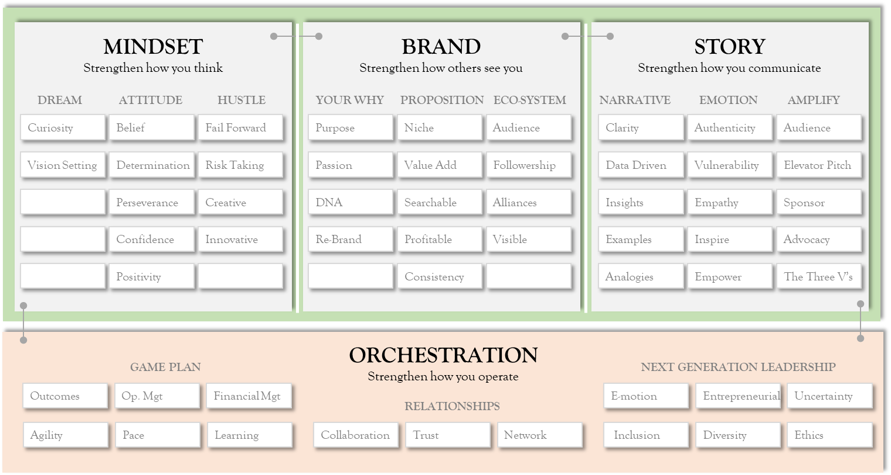
Believers. Storytellers. Go-Getters.
WE ARE FULLY BOSSED.
Advancing careers using soft-skills.
Ready to be a stand out performer in your career or accelerate your business game?
Let’s help you get
Fully Bossed.
Copyright © 2021. Advancing careers using soft-skills

Slide 2
The Goodies
In this pack…
Fully Bossed Blueprint – pg 3
Fully Bossed Academy – pg 4-7

Slide 3
Fully Bossed – The Blueprint
Bringing you the ‘how’…
MINDSET
Strengthen how you think
BRAND
Strengthen how others see you
STORY
Strengthen how you communicate
DREAM
ATTITUDE
HUSTLE
YOUR WHY
PROPOSITION
ECO-SYSTEM
NARRATIVE
EMOTION
AMPLIFY
Ambition
Discipline
Fail Forward
Purpose
Niche
Audience
Clarity
Authenticity
Audience
Curiosity
Determination
Risk Taking
Passion
Value Add
Followership
Data Driven
Vulnerability
Elevator Pitch
Belief
Perseverance
Creativity
DNA
Searchable
Alliances
Insights
Empathy
Sponsor
Seriousness
Confidence
Innovative
Re-Brand
Profitable
Visible
Examples
Inspire
Advocacy
Vision Setting
Positivity
Entrepreneurial
Consistency
Analogies
Empower
The Three V’s
ORCHESTRATION
Strengthen how you operate and deliver results
GAME PLAN
RELATIONSHIPS
NEXT GENERATION LEADERSHIP
Results
Op. Mgt
Financial Mgt
Collaboration
Trust
Network
E-motion
Entrepreneurial
Uncertainty
Agility / Pace
Proactivity
Learning
Influence
Comms
Inclusion
Diversity
Ethics
Copyright © 2021. Advancing careers using soft-skills

Slide 4
Want to take it further?

Slide 5
Fully Bossed – The Academy
Bringing you practical and actionable solutions
This Academy is aimed at:
Career Professionals looking to kick start their career or take it to the next level
 |  | Your Ambition (examples) | Your Ambition (examples)
 |  | Your Challenge | Career Professional | Start-up
Soft Skill | Mindset | Creating ambitious goals without selling yourself short due to disbelief, self-doubt or low confidence. | Confidence in a doing something unfamiliar, complex or challenging and perseverance to complete it Develop and adopt an entrepreneurial mindset, challenge the norm and take smart risks | Put the consumer/clients at the forefront and maintain perseverance towards your mission Innovate solutions to real life problems and disrupt markets, industries and sectors
 |  | Building influence, robustness and gravitas.
 |  | Gaining comfort exploring new territories where you may be uncomfortable, learning in a safe space.
 | Brand | Understanding your purpose and your why, as well as knowing how/when to re-brand. | Develop a personal band with clarity on what you’re famous for and why Know your audience of influencers with intimacy and consistently serve them | Inspire a vision that passionately motivates others towards your mission Monetise priority opportunities within your market using an irresistible value proposition
 |  | Developing a searchable niche that is adding value and profitable.
 |  | Developing content that does the work for you.
 | Story | Create a killer message that matches exactly what you want to convey. | Communicate a winning story for promotion readiness, hiring into a new role and important business meetings Communicate an effective business case | Influence investment opportunities by demonstrating investor readiness Form emotional connections and brand loyalty through consistent and connected storytelling leading to sell-ons
 |  | Creating a lasting memory that makes others want to hear more and then act.
 |  | Amplify your story by getting others to cheerlead for you and highlight the value you bring.
 | Orchestration | Juggle effectively whilst delivering meaning results | Be a highly effective ‘conductor’ who can be trusted to seamlessly, and effectively, make it happen Lead teams effectively who are inspired and committed to your goals | Build and collaborate effectively with all networks
 |  | Know your eco-system and get them working for you and advocating for you
 |  | Lead (not just manage) teams or campaigns effectively to succeed
Copyright © 2021. Advancing careers using soft-skills

Slide 6
Fully Bossed – The Academy
With lasting results
What you’ll get.
Actionable Fully Bossed Blueprint for you to follow – in accessible and digestible format for when you’re on the move
Detailed Fully Bossed toolkit with ‘let’s get practical’ pull-out templates to help continue developing mindset, brand, storytelling and orchestration skills
Access to our Fully Bossed network of Bosses
Help refining your own brand statement
Help refining your own career milestone story or message
Access to all workshop materials
10% discount off any coaching package or future Fully Bossed Academy session for ongoing learnings
Copyright © 2021. Advancing careers using soft-skills

Slide 7
Fully Bossed – The Academy
Get ready to be transformed in our 3-day workshop
Utilising our Fully Bossed Blueprint, our Academy aims to help you get vital tips, tools and insights to help you advance in your career by focusing on our 4 core topics. We'll bring this to you over a 3 day period.
Agenda
Topic | Topics covered | Timings
Introductions & Context Setting | Demystifying obtaining success in business. | Day 1
Topic 1: Mindset Strengthening how you think | Creating ambitious goals without selling yourself short due to disbelief, self-doubt or low confidence. Building influence, robustness and gravitas. Gaining comfort exploring new territories where you may be uncomfortable, learning in a safe space. | Day 1
Topic 2: Brand Strengthening how others see you | Understanding your purpose and your why, as well as knowing how/when to re-brand. Developing a searchable niche that is adding value and profitable. Developing content that does the work for you. | Day 2
Topic 3: Story Strengthening how you communicate | Create a killer message that matches exactly what you want to convey. Creating a lasting memory that makes others want to hear more and then act. Amplify your story by getting others to cheerlead for you and highlight the value you bring.
Topic 4: Orchestration Strengthening how you deliver results | Juggle effectively whilst delivering meaning results. Know your eco-system and get them working for you and advocating for you. Lead (not just manage) teams or campaigns effectively to succeed. | Day 3
Re-play, accountability and actionable steps | Actionable recaps and suggested next steps.
Copyright © 2021. Advancing careers using soft-skills

