Slide 1
Project -2
RETAILS SALES AND PROMOTIONS
GROUP-1 :
DEV PATEL
HITAXI LETHWALA
JAIMIN SORATHIYA

Slide 2
OBJECTIVE
To analyze investment trends, sales performance, and ROI efficiency across different producers and sub-channels from 2012 to 2015.
To identify seasonal patterns, investment inefficiencies, and market share disparities among producers.
To provide recommendations for optimizing future investment decisions based on historical data insights.

Slide 3
PROBLEM STATEMENT
"How can companies optimize their investment strategies across different sub-channels and sub-categories to maximize ROI while minimizing inefficiencies in promotional spending?"
This problem statement encapsulates the core issue observed across all dashboards:
Misaligned investment and sales performance
Market share disparity among producers
Seasonal or strategic fluctuations affecting ROI
Potential outliers or inefficiencies in investment allocation
By addressing this, companies can achieve sustainable revenue growth while minimizing wasted expenditures.

Slide 4
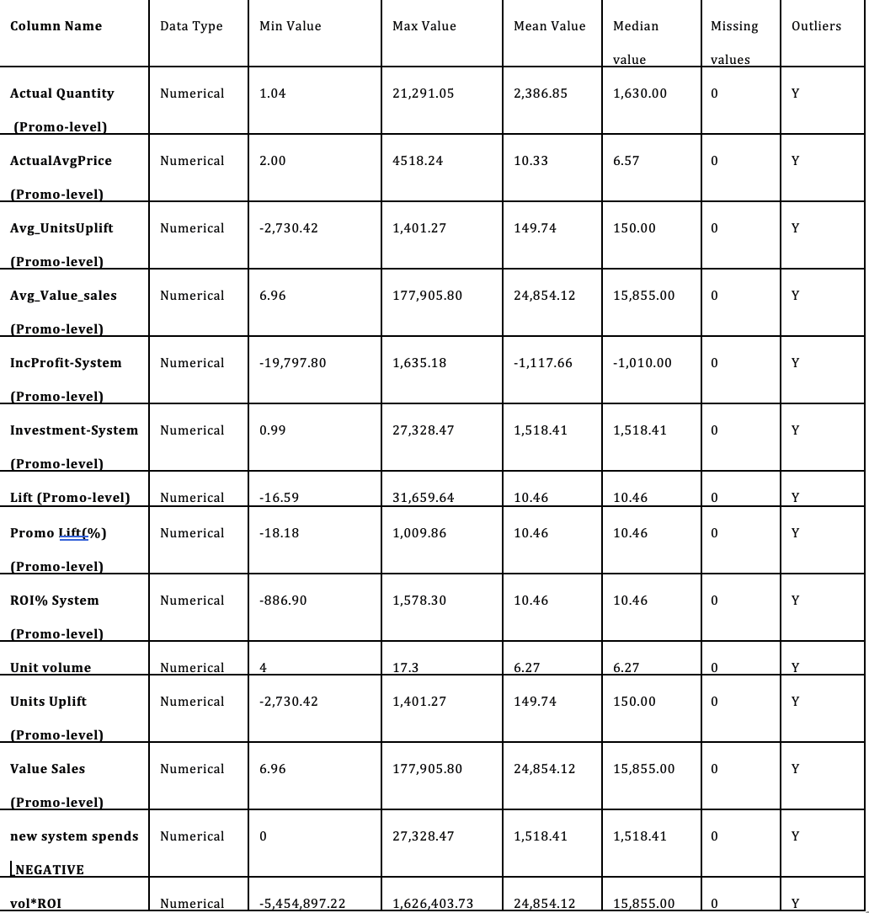
DATASET INFORMATION

Slide 5
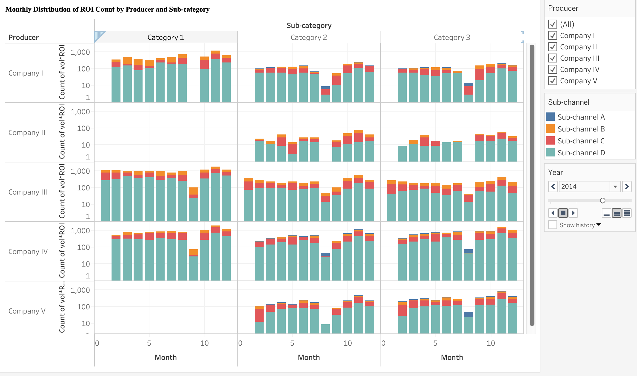
Monthly Distribution of ROI Count by Producer and Sub-category
Description:
This stacked bar chart displays the count of vol*ROI over different months for various producers across three sub-categories.
Each producer is analyzed individually across months, and different sub-channels are represented in different colors.
The chart enables a comparison of ROI trends over time, allowing us to determine seasonal patterns and variations in sales performance.

Slide 6
KEY INSIGHTS:
- Some companies have a consistent trend of ROI count throughout the months, while others display fluctuations.
- The sub-channel composition (stacked colors) varies across producers, suggesting different market strategies.
- Some producers show a drop-in activity in certain months, which could be attributed to seasonality, lack of promotions, or demand fluctuations.

Slide 7
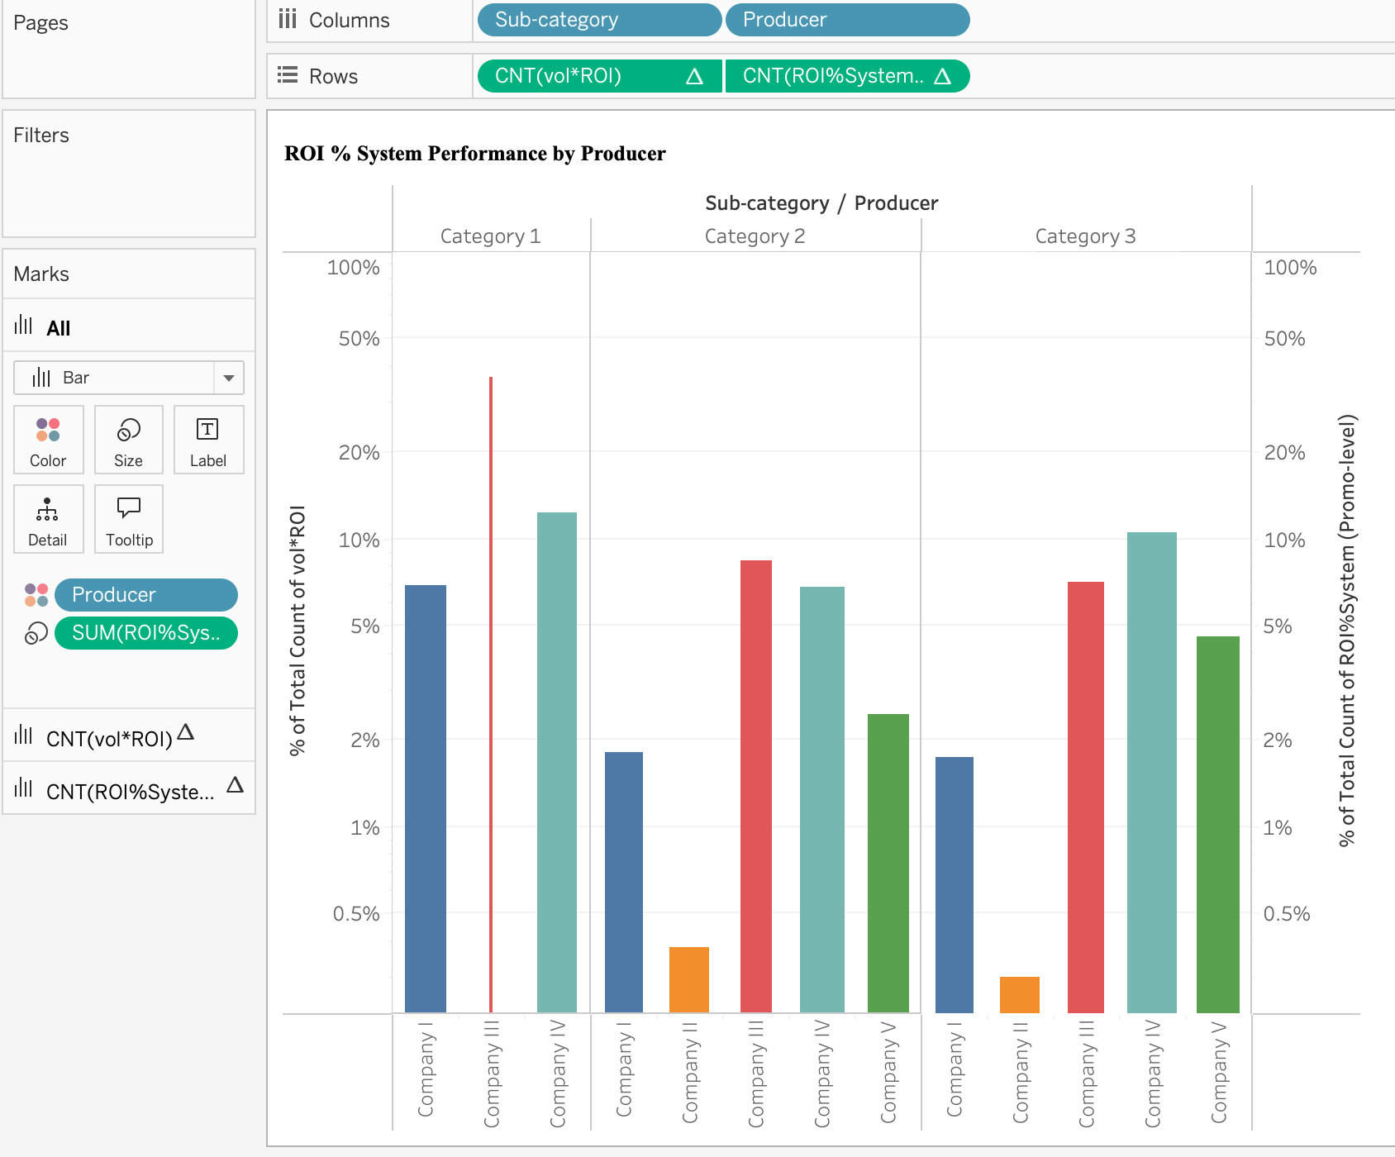
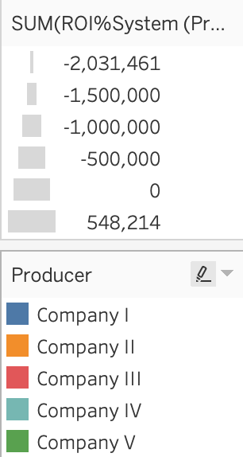
ROI % System Performance by Producer
Description:
This bar chart compares different producers' contributions to the total ROI percentage.
The ROI% System metric is represented, highlighting the share of each company in different sub-categories.
The Y-axis represents % of total count of vol*ROI, meaning this chart showcases market share distribution.

Slide 8
KEY INSIGHTS:
- Some companies (e.g., Company III, Company IV) have a higher share of ROI across different sub- categories.
- Company II has low contributions, possibly indicating a weaker market presence or inefficient promotional strategies.
- The significant variation between companies implies different levels of investment efficiency and sales strategy effectiveness.
- The presence of negative ROI values suggests that some companies are experiencing financial losses or inefficient marketing investments.

Slide 9
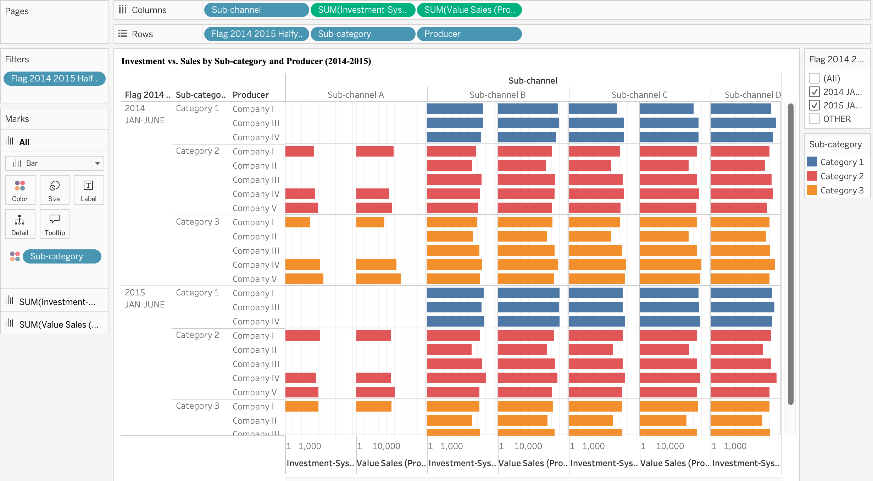
Investment vs. Sales by Sub-category and Producer (2014-2015)
Description:
This stacked bar chart visualizes the total investment and value sales for different producers, sub-channels, and sub-categories.
Data is split into 2014 and 2015, allowing for a comparative analysis of investment and sales over time.
Each producer's performance is broken down by sub-category and sub-channel, helping in understanding investment efficiency.

Slide 10
KEY INSIGHTS :
- Some producers invested heavily in 2015, while others maintained a similar level from 2014.
- The distribution of sales and investment varies across sub-channels, indicating different market penetration strategies.
- A mismatch between investment and sales in some cases suggests that high spending does not always correlate with higher revenue.
- Identifying the best-performing sub-channels can help companies optimize their future promotional efforts.

Slide 11
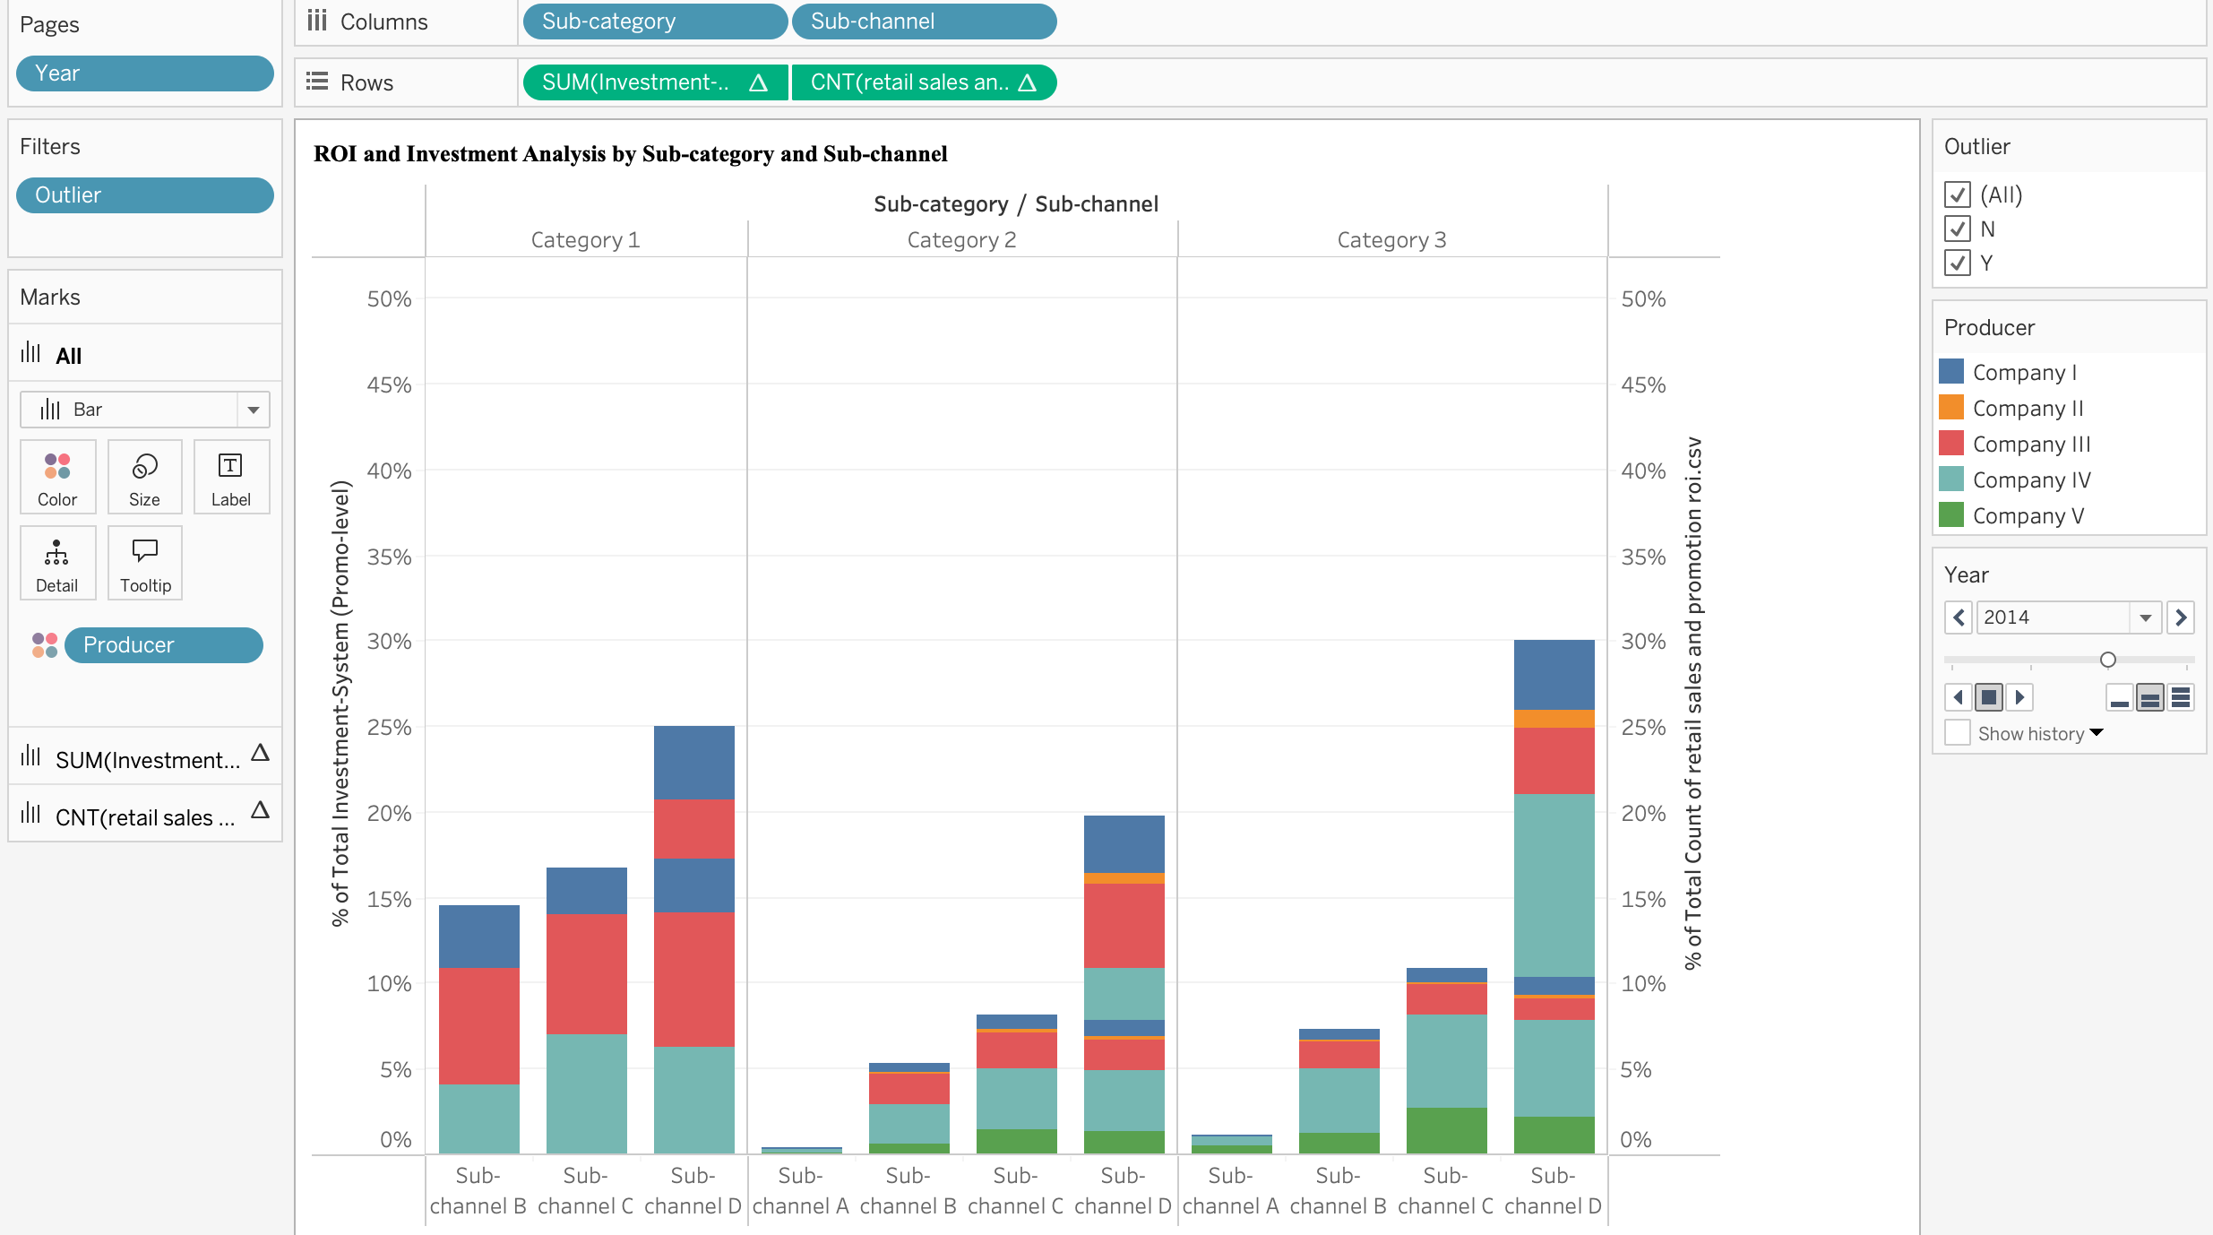
ROI and Investment Analysis by Sub-category and Sub-channel
Description:
This bar chart highlights the percentage of total investment per system across different sub-channels and sub-categories.
The rightmost bar shows an anomaly, indicating either an outlier or a significant data skew.
The Outlier filter is applied, meaning only data marked as N/Y is displayed.

Slide 12
KEY INSIGHTS:
- Sub-channel D has an unusually high investment proportion, making it a potential high-cost, high-risk channel.
- The disproportionate investment in certain sub-channels suggests strategic misallocation or heavy reliance on specific channels.
- The presence of extreme values (outliers) in earlier years suggests potential data inconsistencies, operational inefficiencies, or market shocks.
- Comparing this data to more recent years could help determine if these inefficiencies persisted or improved over time.

Slide 13
CONCLUSION:
ROI Variations Across Producers and Sub-channels:
- ROI trends differ significantly among producers and sub-channels.
- Some companies achieve consistent returns, while others show fluctuations due to seasonality or inconsistent promotions.
Market Share Distribution:
- Company III and IV dominate in terms of ROI.
- Company II has lower contributions, indicating weaker market presence or inefficient promotional strategies.
Investment Inefficiencies:
- Higher spending does not always lead to higher revenue.
- This reveals the need for better allocation strategies to maximize ROI.
Outliers and Anomalies:
- Certain sub-channels show operational inefficiencies or irregular spending patterns.
- Addressing these issues can help companies optimize future investments, reduce financial losses, and improve profitability.

