Slide 1

ECE 501
Explainable Multi-Label Content-Based Image Retrieval for Aerial Images using Classical Computer Vision
Group 16
Dhruvi Faldu - AU2440216
Dev Patel - AU2440252
Aashi Bhimjiyani - AU2440027
Aastha Gandhi - AU2440107

Slide 2

Motivation
  Large aerial-image collections are difficult to search manually
  Images may contain multiple scene types
  Similar-looking images can have different meanings
Problem
  Retrieve the most relevant images for a query
  Explain visual similarity and retrieval reliability

Slide 3

Literature review: what existing methods do
  Colour histograms - colour-based image retrieval
  LBP - local texture patterns
  HOG - gradient and shape information
  Our approach - fuse handcrafted features for multi-label retrieval and explanations

Slide 4
Proposed Methodology
Query Aerial Image
Colour
HSV
LBP-1
Texture
Shape
HOG
LBP-2
Multi-scale Texture
Feature fusion → similarity scores → ranked images
Top-K results + visual evidence + reliability

Slide 5
Experimental results
FINAL TEST SET COMPARISON
Metric | Week 1 best | Final V2
Class Precision@10 | 33.45% | 38.67%
Multi-label Precision@10 | 34.83% | 36.50%
Jaccard@10 | 0.627 | 0.649
nDCG@10 | 0.653 | 0.674

Slide 6
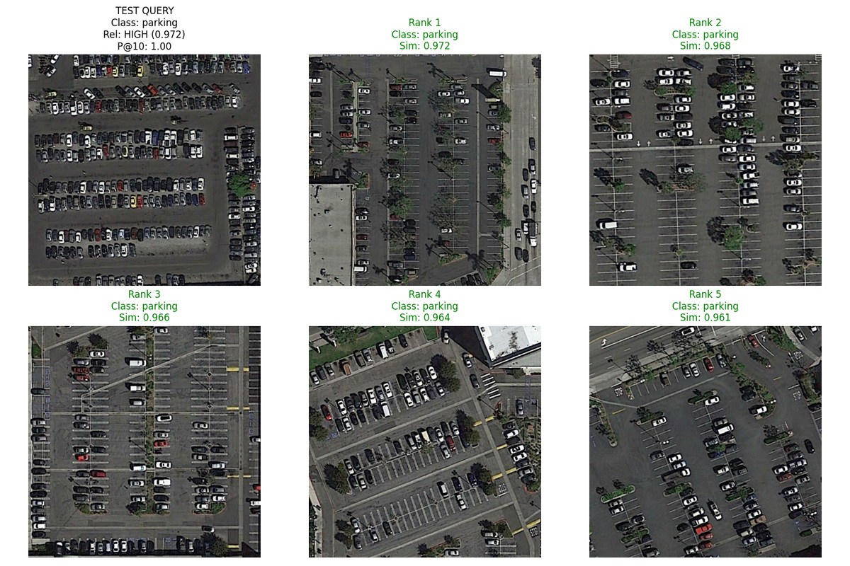
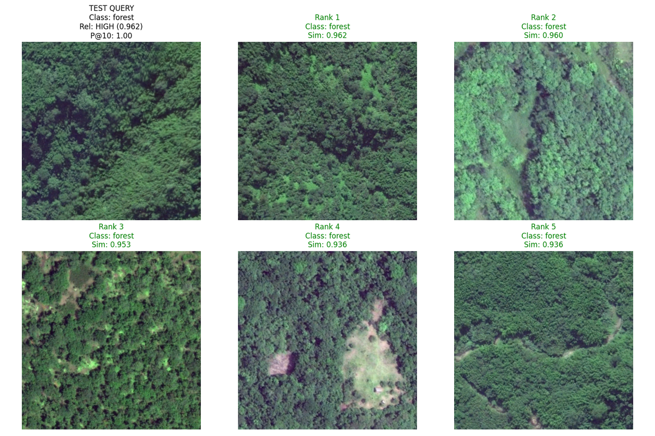

Slide 7
Explainability and reliability
  Visual comparison of query and retrieved images
  Feature-based evidence for similarity
  High / medium / low retrieval-reliability groups
  Difficult cases: airport, bridge, playground, river, square, stadium

Slide 8
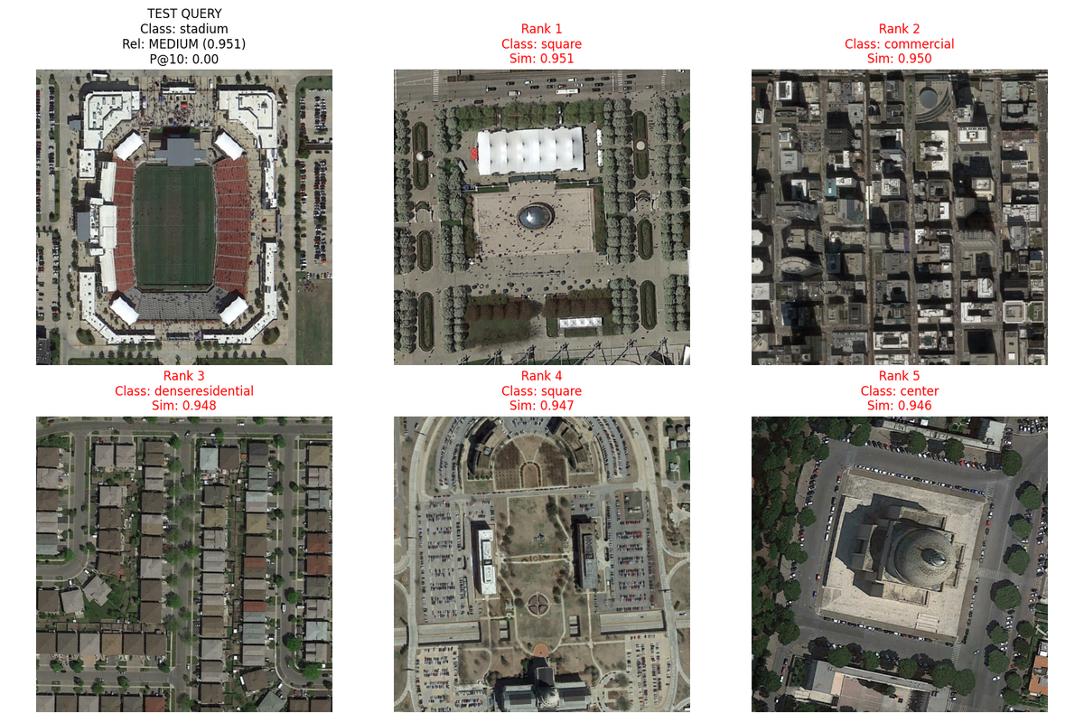
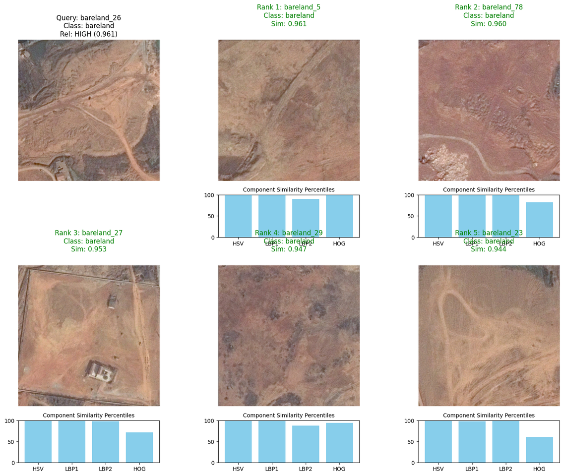

Slide 9
Next plan and limitations
  Improve retrieval for confusing scene classes
  Strengthen explanation and reliability validation
  Analyze failure cases and multi-label errors
  Evaluate robustness across different image conditions

Slide 10
Individual contributions
  Dev: Data handling and processing
  Aashi: Feature extraction - color, texture and shape
  Aastha: Similarity calculation and ranking
  Dhruvi: Explainability, evaluation and documentation

Slide 11
THANK YOU!

