Slide 1
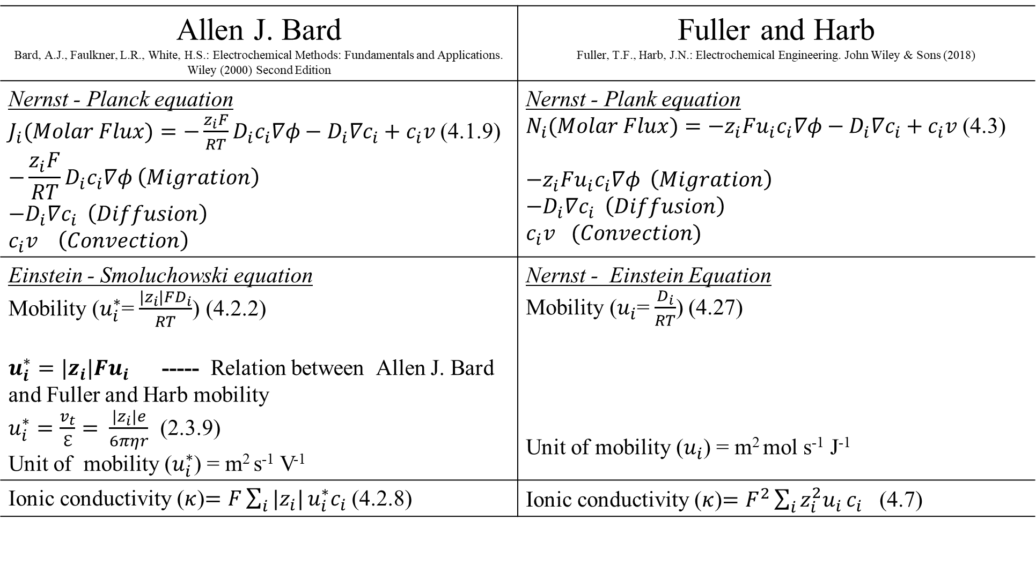
Approaches for defining mobility
Allen J. Bard Bard, A.J., Faulkner, L.R., White, H.S.: Electrochemical Methods: Fundamentals and Applications. Wiley (2000) Second Edition | Fuller and Harb Fuller, T.F., Harb, J.N.: Electrochemical Engineering. John Wiley & Sons (2018)
Nernst - Planck equation $J_{i}(Molar Flux)=−{\frac{z_{i}F}{RT}D}_{i}c_{i}∇φ−D_{i}{∇c}_{i}+c_{i}v$(4.1.9) $$−{\frac{z_{i}F}{RT}D}_{i}c_{i}∇φ \left(Migration\right)$$ $$−D_{i}{∇c}_{i} \left(Diffusion\right)$$ $$c_{i}v \left(Convection\right)$$ | Nernst - Plank equation $N_{i}(Molar Flux)=−{{z_{i}Fu}_{i}c}_{i}∇φ−D_{i}{∇c}_{i}+c_{i}v$(4.3) $$−{{z_{i}Fu}_{i}c}_{i}∇φ \left(Migration\right)$$ $$−D_{i}{∇c}_{i} \left(Diffusion\right)$$ $c_{i}v$ $(Convection)$
Einstein - Smoluchowski equation Mobility ($u_{i}^{∗}$= $\frac{{|z}_{i}|FD_{i}}{RT}$) (4.2.2) $u_{i}^{∗}={|z}_{i}|Fu_{i}$ ----- Relation between Allen J. Bard and Fuller and Harb mobility $u_{i}^{∗}=\frac{v_{t}}{ℇ}= \frac{|z_{i}|e}{6πηr}$ (2.3.9) Unit of mobility ($u_{i}^{∗}$) = m² s⁻¹ V⁻¹ | Nernst - Einstein Equation Mobility ($u_{i}$=$\frac{D_{i}}{RT}$) (4.27) Unit of mobility ($u_{i}$) = m² mol s⁻¹ J⁻¹
Ionic conductivity ($κ$)$=F\sum_{i}{|z_{i}|}u_{i}^{∗}c_{i}$ (4.2.8) | Ionic conductivity ($κ$)$=F^{2}\sum_{i}{z_{i}^{2}u_{i}}c_{i}$ (4.7)

Slide 2
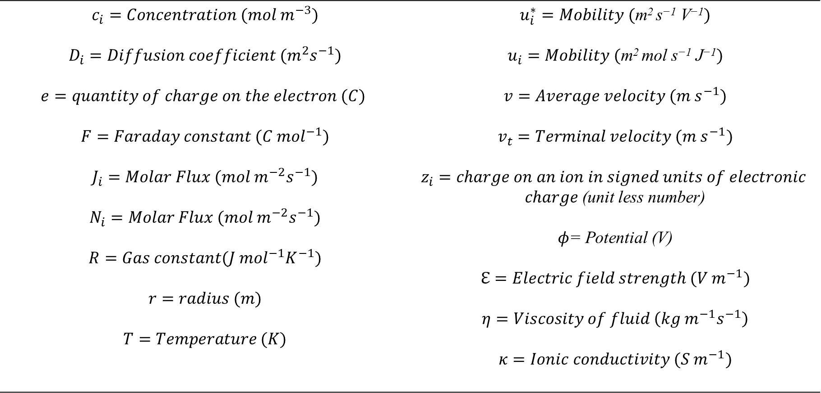
List of symbols
$$c_{i}=Concentration (mol m^{−3})$$ $$D_{i}=Diffusion coefficient (m^{2}s^{−1})$$ $$e=quantity of charge on the electron (C)$$ $$F=Faraday constant (C {mol}^{−1})$$ $$J_{i}=Molar Flux (mol m^{−2}s^{−1})$$ $$N_{i}=Molar Flux (mol{ m}^{−2}s^{−1})$$ $$R=Gas constant(J {mol}^{−1}K^{−1})$$ $$r=radius (m)$$ $$T=Temperature (K)$$ | $$u_{i}^{∗}=Mobility (\text{m}\text{2 }\text{s}\text{−1} \text{V}\text{−1})$$ $$u_{i}=Mobility (\text{m}\text{2 }\text{mol} \text{s}\text{−1} \text{J}\text{−1})$$ $$v=Average velocity (m s^{−1})$$ $$v_{t}=Terminal velocity (m s^{−1})$$ $$z_{i}=charge on an ion in signed units of electronic$$ $charge$(unit less number) $φ$= Potential (V) $$ℇ=Electric field strength (V m^{−1})$$ $$η=Viscosity of fluid \left(kg m^{−1}s^{−1}\right)$$ $$κ=Ionic conductivity (S m^{−1})$$

