Slide 1
Structured Streaming
Methods for Writing Continuous Applications

Slide 2
Aggregation With Watermarking
Structured Streaming Method

Slide 3
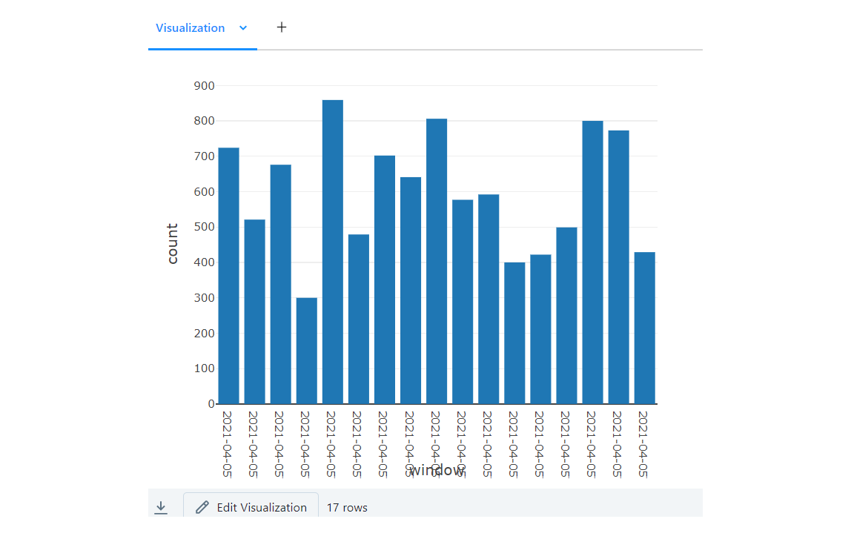
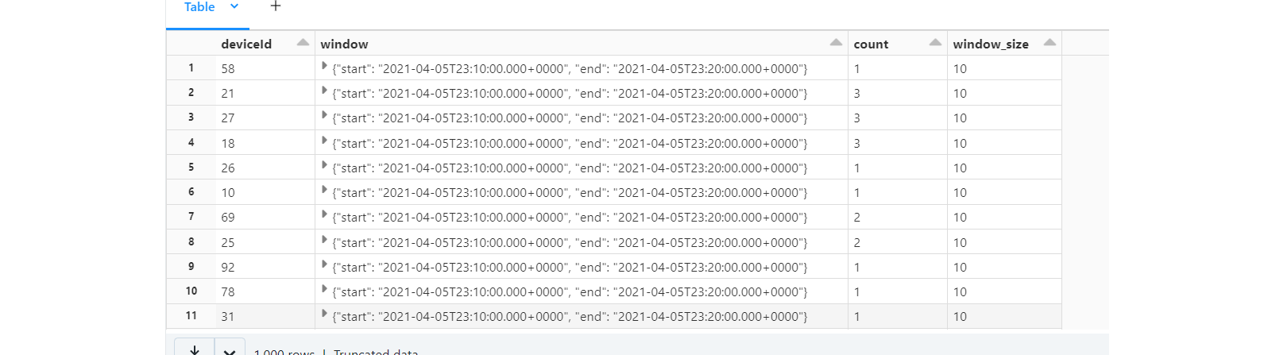
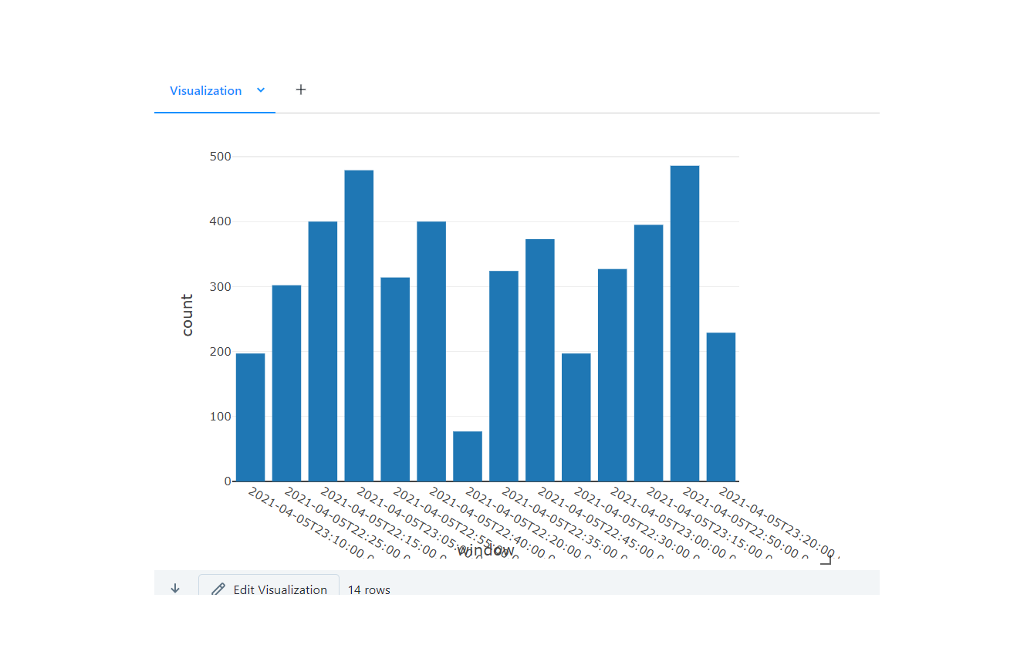
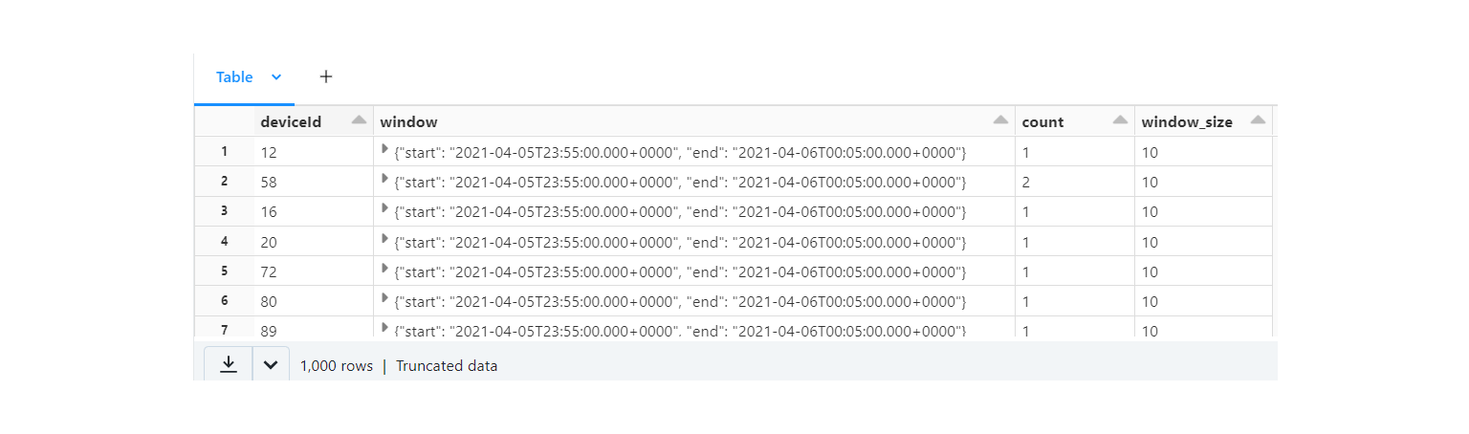
Aggregation With Watermarking
Example of Sub-Header #1
Example of Sub-Header #2

Slide 4
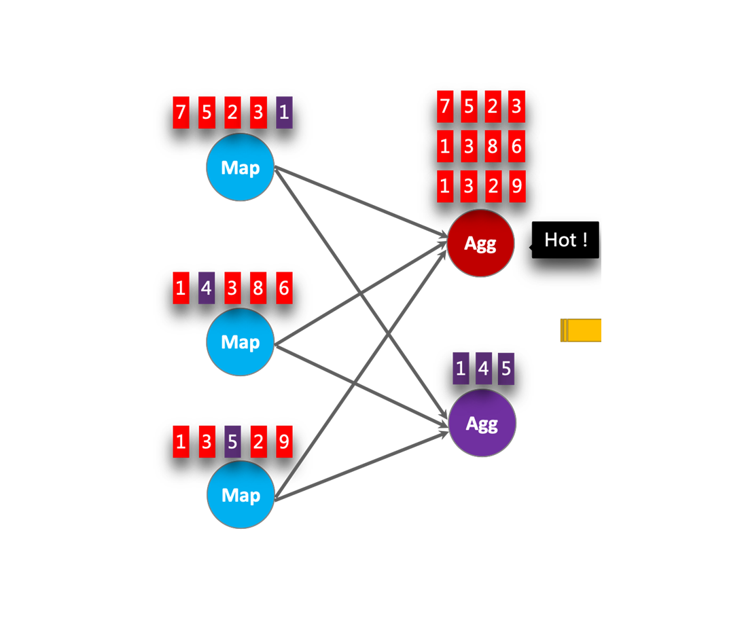
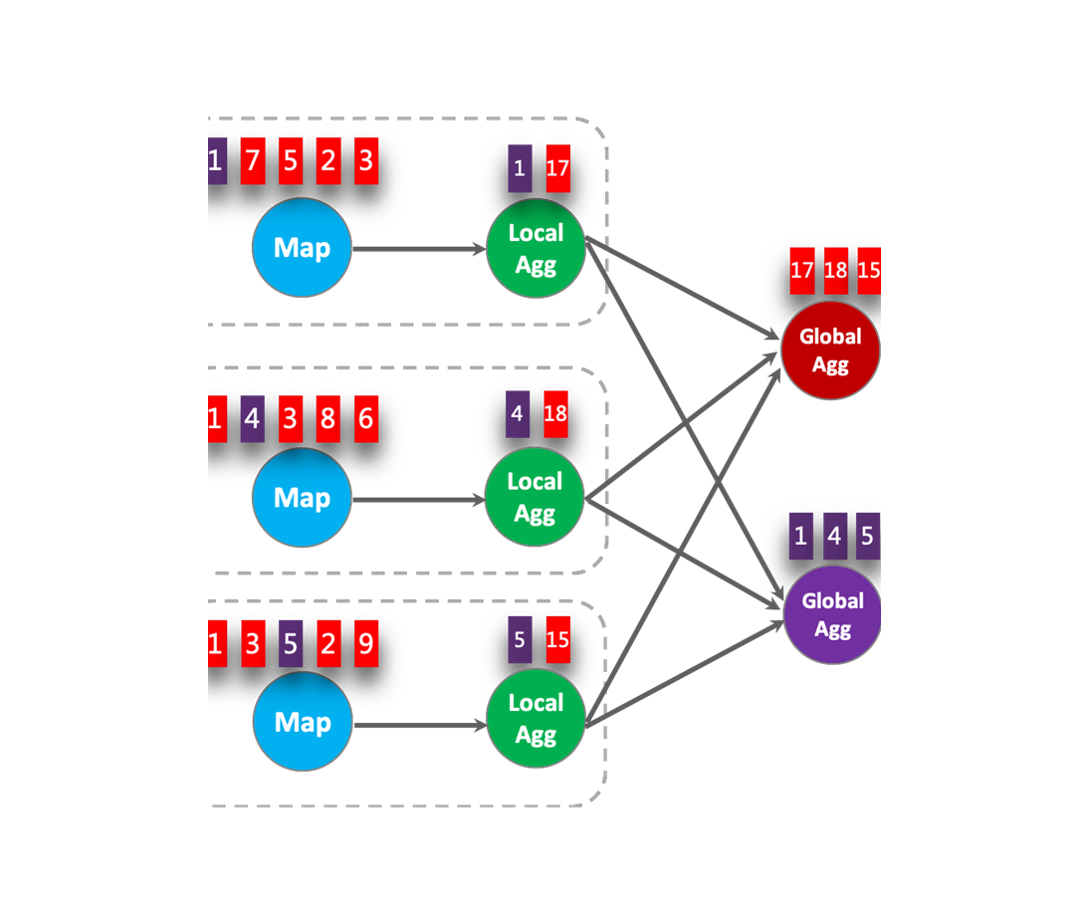
Aggregation With Watermarking

Slide 5
Streaming Sensor Data
Structured Streaming Method

Slide 6
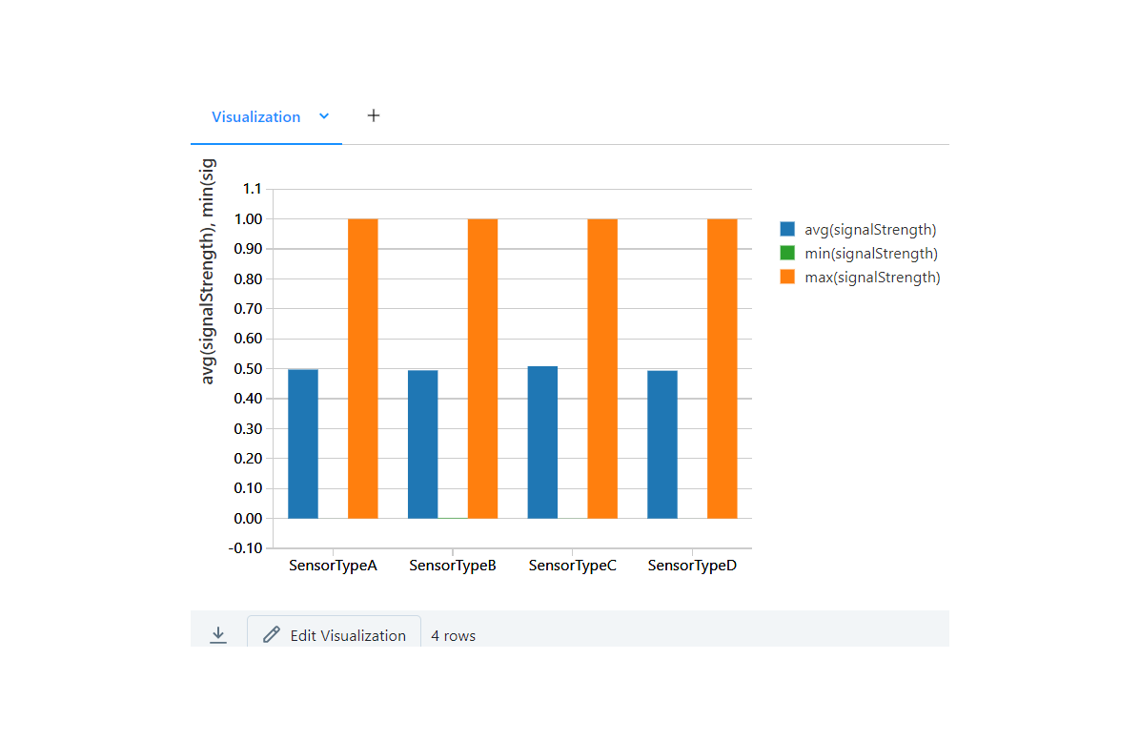
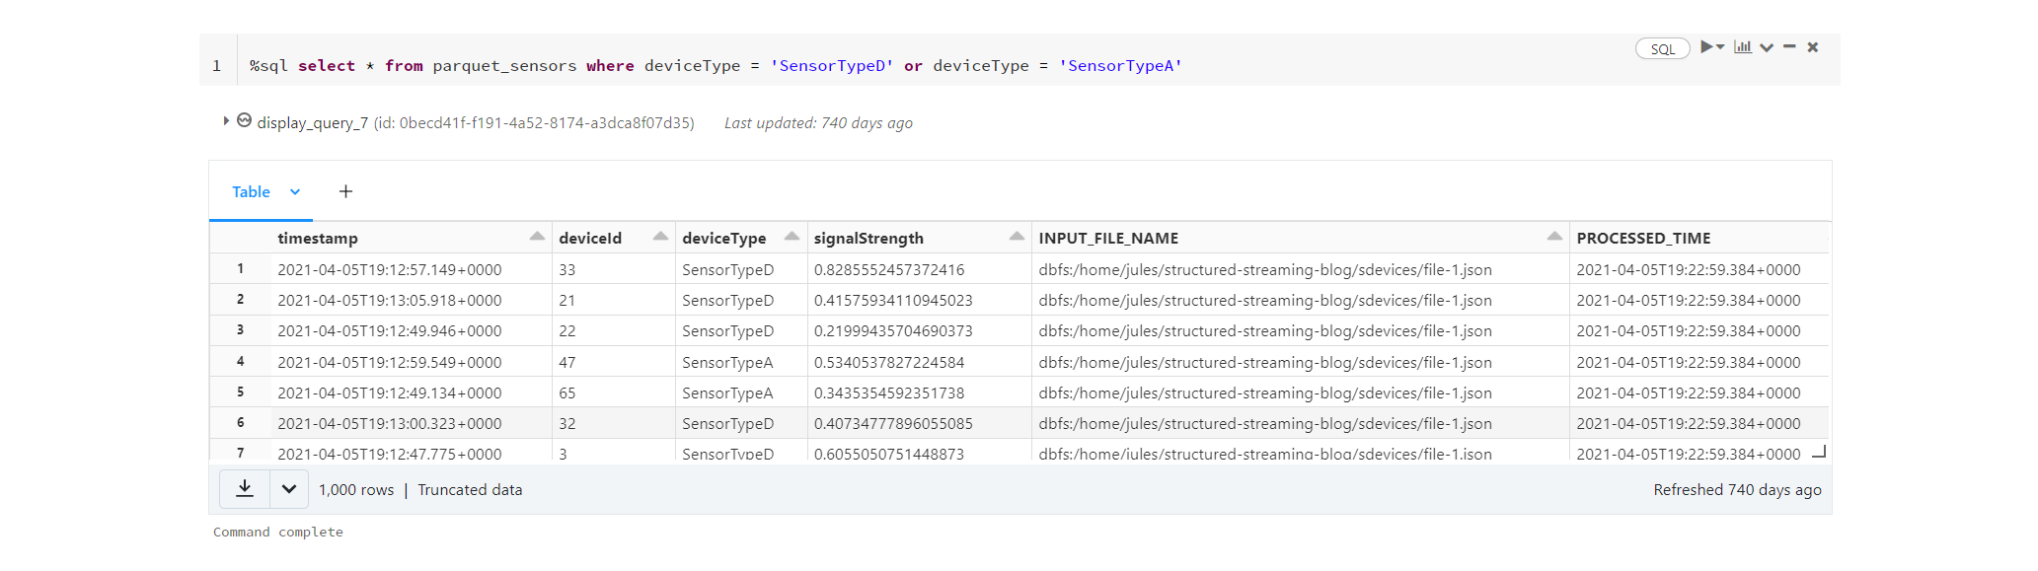
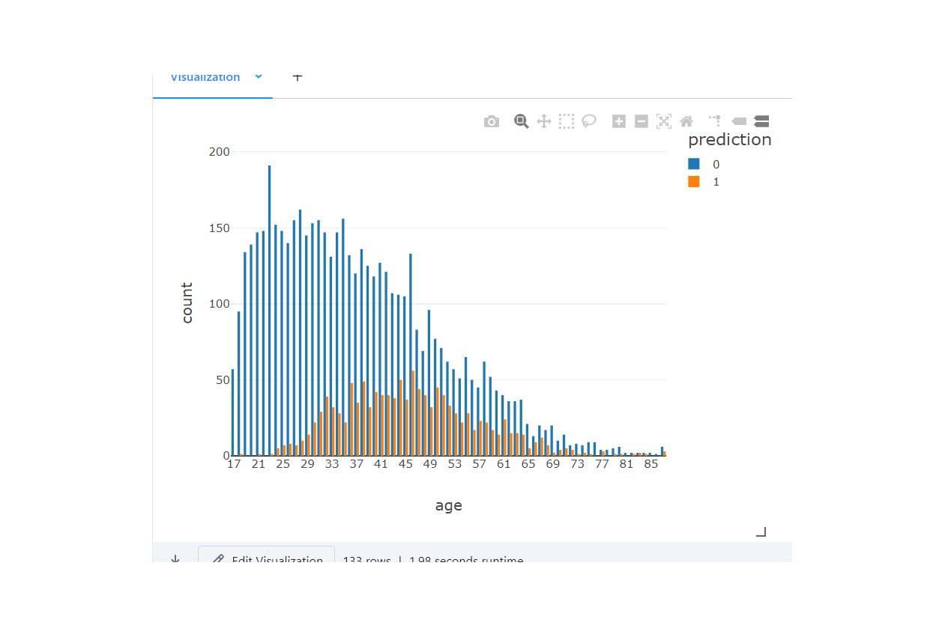
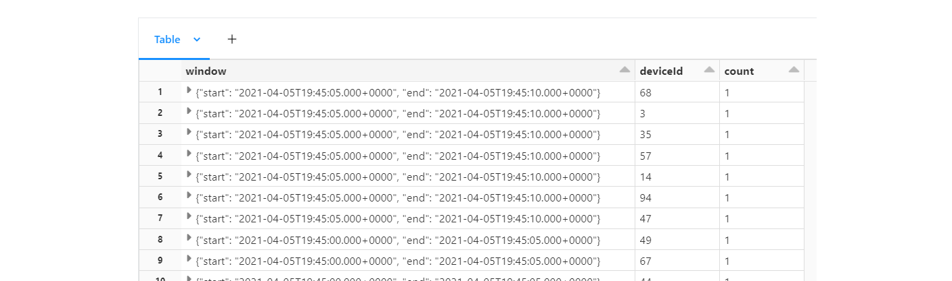
Streaming Sensor Data
Example of Sub-Header #1
Example of Sub-Header #2

Slide 7
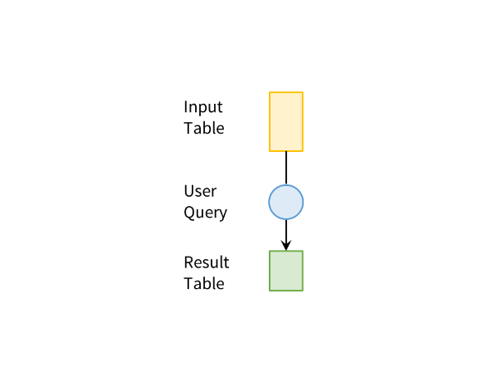
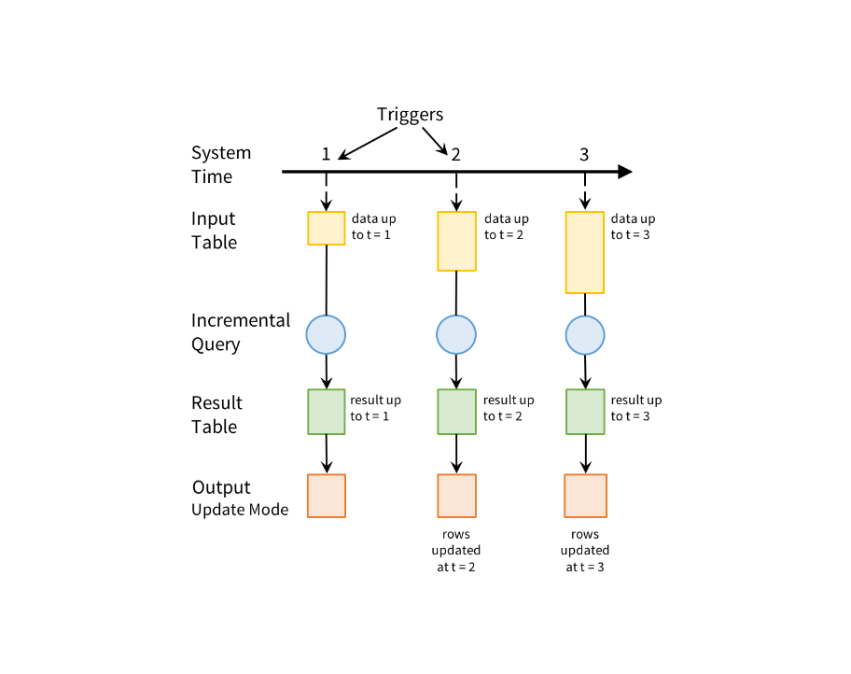
Streaming Sensor Data

Slide 8
Using Spark MLlib
Structured Streaming Method

Slide 9
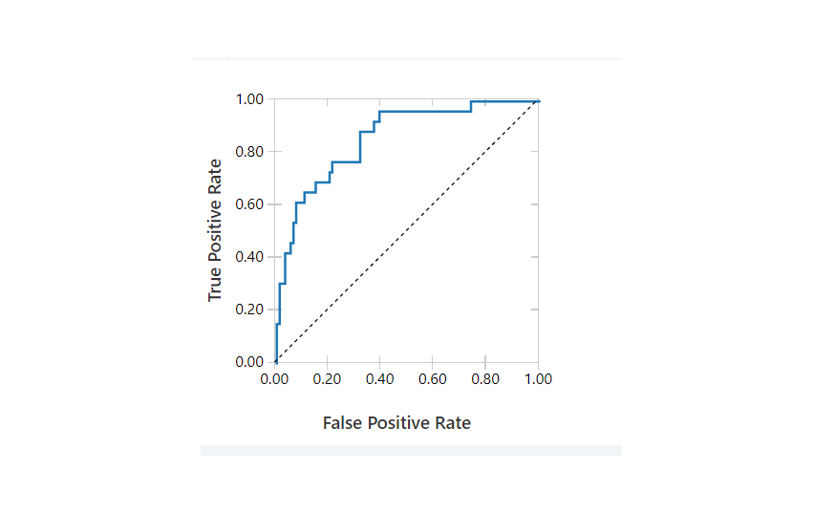
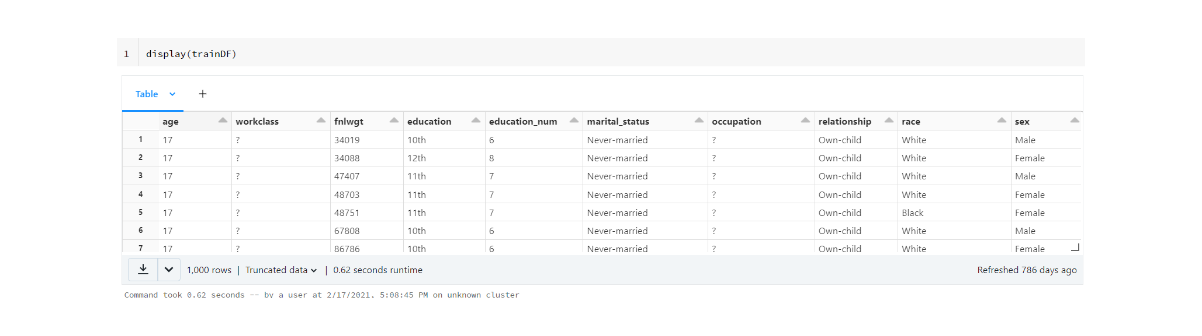
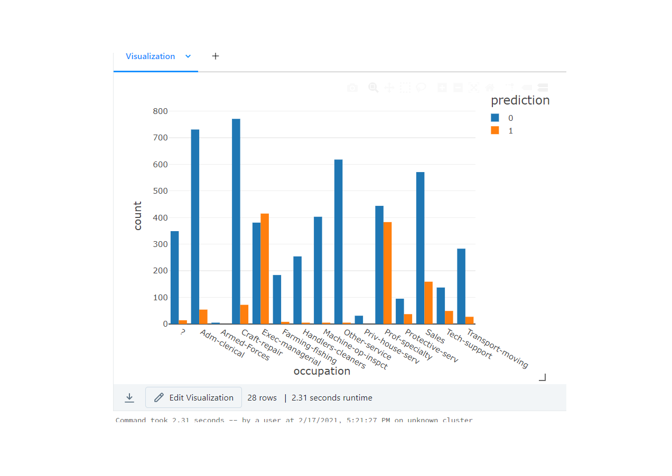
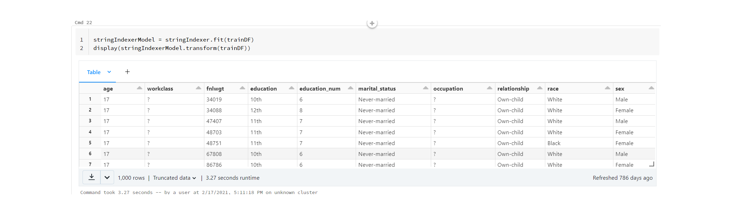
Using Spark MLlib
Example of Sub-Header #1
Example of Sub-Header #2

Slide 10
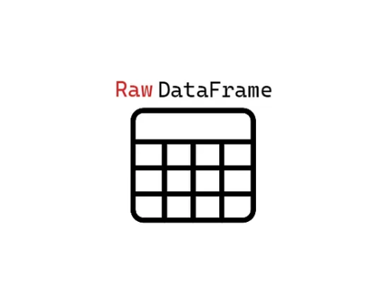
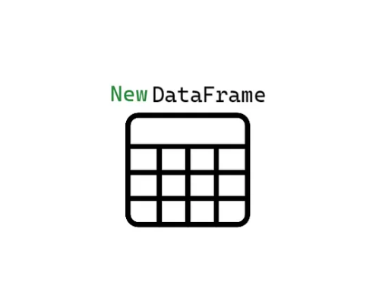
Using Spark MLlib

