Slide 1
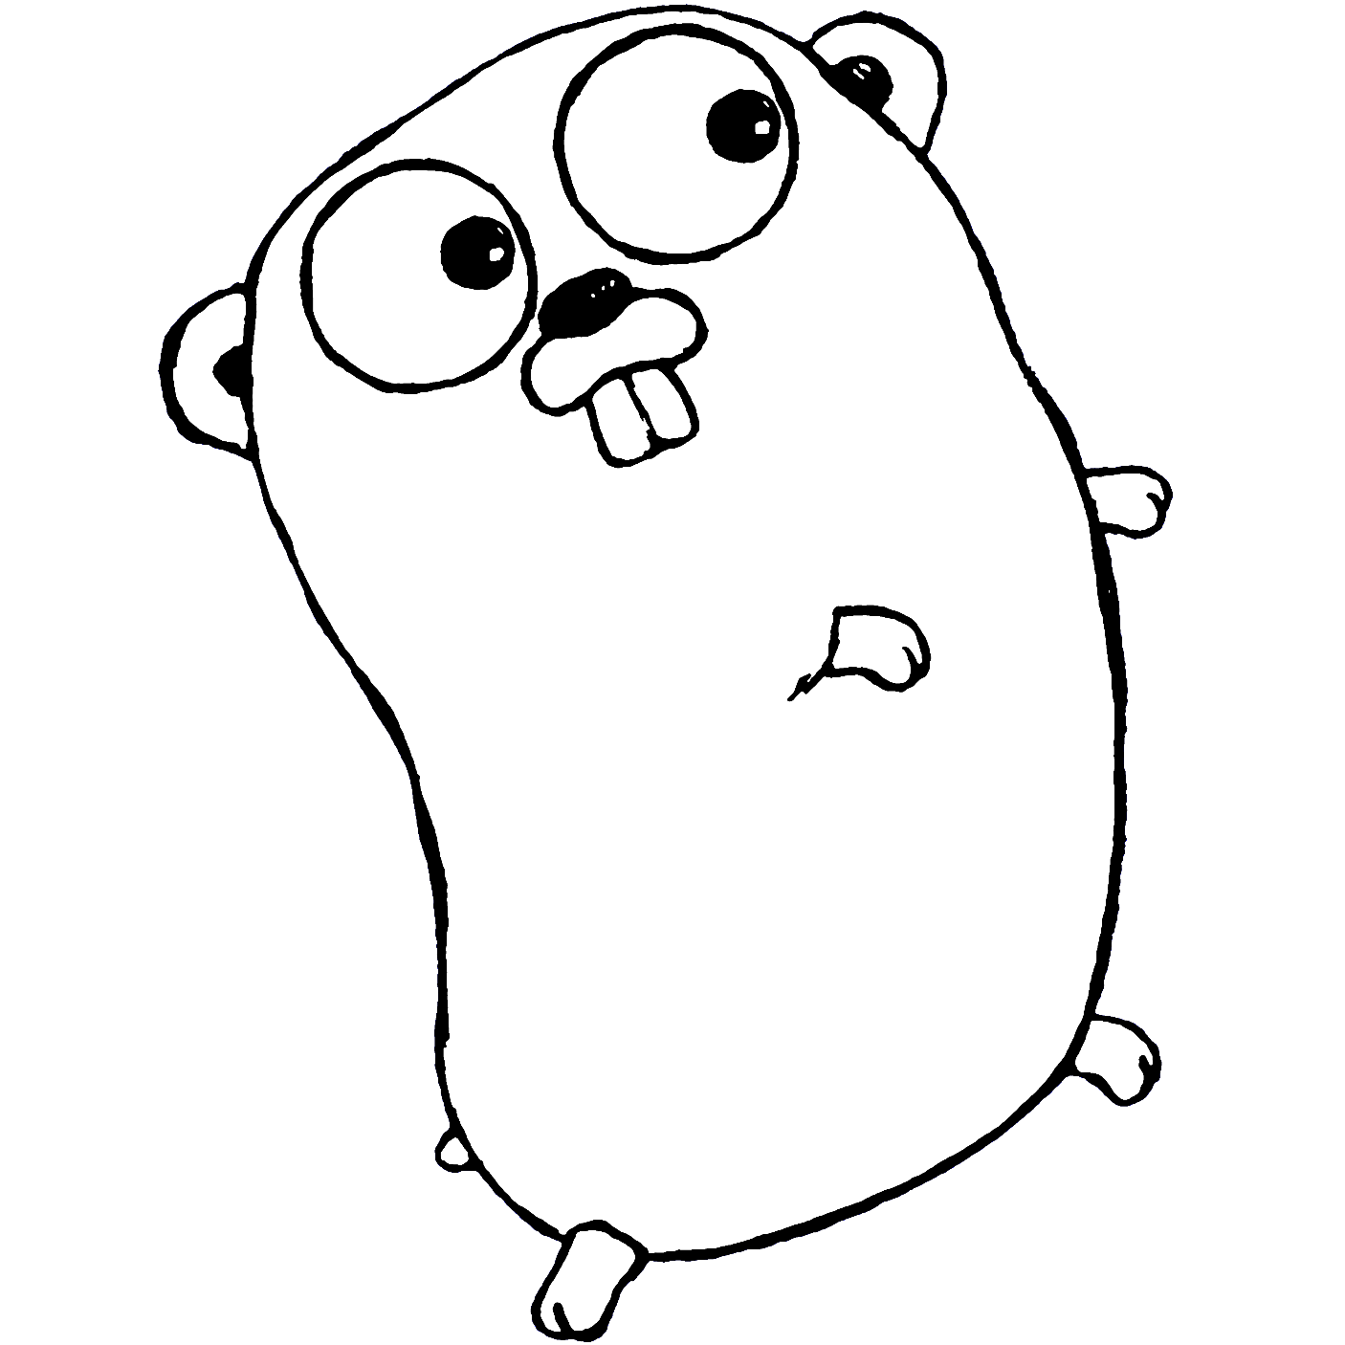

BACKUP
BACKUP
Golang
Golang
Wattup
Wattup

