Slide 1
Cloud Security Posture Management (CSPM) with Endpoint Detection & Response (EDR)

Slide 2

PROJECT PRESENTATION ON: Web Application Vulnerability Scanner
SUBMITTED BY:
DEV PANCHAL(23082291066)
BRIJESH PARMAR(23082291071)
PROJECT GUIDE:
DR. KASHYAP PATEL
SUBMITTED TO:
Department of Computer Science
GANPAT UNIVERSITY
2025-26

Slide 3
PROJECT PROFILE
PROJECT TITLE: | Cloud Security Posture Management (CSPM) with Endpoint Detection & Response (EDR)
OBJECTIVE: | The main objective of this project is to develop a centralized security platform that monitors and protects cloud infrastructure and endpoint devices from potential cyber threats. The system aims to automatically identify cloud misconfigurations, security vulnerabilities, and exposed resources that may lead to data breaches. It also provides real-time monitoring of endpoints to detect malware, suspicious activities, and unauthorized access. Another objective is to ensure compliance with industry security standards such as CIS, NIST, and ISO frameworks.
SUPPORT TOOLS: | Python, Flask Framework, SQLite Database, Chart.js, HTML, CSS, JavaScript, ReportLab, Boto3 (AWS SDK for Python)
OPERATING SYSTEM: | WINDOWS
GUIDE: | DR. KASHYAP PATEL
SUBMITTED BY: | Dev Panchal BRIJESH PARMAR
SUBMITTED BY: | Dev Panchal- 23082291066 BRIJESH PARMAR- 23082291071
SUBMITTED TO: | Department Of Computer Science

Slide 4
Introduction
Cloud computing has become the backbone of modern IT infrastructure, enabling organizations to deploy applications rapidly, scale resources efficiently, and reduce operational costs. However, as organizations increasingly migrate sensitive data and workloads to cloud environments, security challenges have grown significantly. Misconfigurations, unauthorized access, insecure APIs, and endpoint attacks are among the most common causes of cloud security breaches. To address these challenges, organizations adopt advanced security solutions such as Cloud Security Posture Management (CSPM) and Endpoint Detection & Response (EDR).

Slide 5
Cloud Security Posture Management (CSPM)
Cloud Security Posture Management is a security approach designed to continuously monitor cloud environments and ensure that configurations follow security best practices and regulatory standards. CSPM solutions analyze cloud resources such as virtual machines, storage services, databases, networking components, and identity access policies across public, private, and hybrid clouds.
One of the main objectives of CSPM is to detect misconfigurations. Examples include publicly accessible databases, unrestricted firewall rules, unused but active credentials, and lack of encryption for sensitive data. These misconfigurations are often accidental but can lead to severe data breaches if not addressed promptly.

Slide 6
Endpoint Detection & Response (EDR)
Endpoint Detection & Response is a cybersecurity solution designed to detect, investigate, and respond to threats on endpoints in real time. In cloud environments, endpoints include virtual machines, cloud servers, containers, and employee devices accessing cloud resources. Attackers often target these endpoints using malware, ransomware, phishing attacks, or credential theft techniques.

Slide 7
Integration of CSPM with EDR
The integration of Cloud Security Posture Management with Endpoint Detection & Response creates a comprehensive cloud security architecture. While CSPM focuses on identifying and fixing cloud configuration issues, EDR focuses on detecting and responding to active threats at the endpoint level. Together, they provide end-to-end security visibility.
CSPM can identify risky configurations such as exposed virtual machines or overly permissive access controls. These findings can be correlated with EDR data to determine whether endpoints associated with those configurations are actively under attack. For example, if CSPM detects an exposed server and EDR detects suspicious activity on that server, security teams can immediately prioritize the incident.

Slide 8
1. What is Cloud Security?
Cloud security refers to a set of technologies, policies, controls, and practices designed to protect cloud-based systems, data, and infrastructure from cyber threats. It ensures that data stored in the cloud remains confidential, secure, and available only to authorized users.
➡️Example: If a company stores customer data on Amazon Web Services and does not configure access rules properly, attackers can access sensitive data over the internet. Cloud security tools help prevent such incidents.

Slide 9
2. Why is Cloud Security Important?
Cloud security is important because organizations store highly sensitive information in the cloud, such as personal data, financial records, intellectual property, and business-critical applications. Any security breach can lead to financial loss, legal penalties, and damage to reputation.
Unlike traditional on-premises systems, cloud resources are accessible from anywhere. This increases flexibility but also increases security risks. Cloud security ensures safe usage of cloud services while maintaining performance and scalability.
➡️Example: A healthcare organization storing patient records in the cloud must follow strict security laws. Without cloud security controls, patient data could be leaked, leading to legal action and loss of trust.

Slide 10
3. What Are the Major Threats in Cloud Environments?
Cloud environments face multiple security threats due to their open and dynamic nature. Some of the major threats include:
Data Breaches Unauthorized access to sensitive data stored in cloud storage or databases.
Misconfiguration Incorrect cloud settings such as open storage buckets or unrestricted network access.
Account Hijacking Attackers steal login credentials and gain control over cloud resources.
Malware and Ransomware Malicious software that infects cloud servers or endpoints.

Slide 11
3. What Are the Major Threats in Cloud Environments?
Insider Threats
Employees or users misusing access permissions intentionally or accidentally.
➡️Example: An attacker exploits weak passwords of a cloud administrator account and deletes critical cloud data, causing service outage.

Slide 12
4. How Does Cloud Security Protect Data?
Cloud security protects data using multiple layers of security controls. These controls ensure that data remains protected both at rest and in transit.
Key data protection methods include:
Encryption: Converts data into unreadable format
Access Control: Limits data access to authorized users

Slide 13
4. How Does Cloud Security Protect Data?
Backup and Recovery: Prevents data loss
Monitoring and Logging: Tracks suspicious activity
➡️Example: Even if attackers gain access to encrypted cloud storage, they cannot read the data without encryption keys.

Slide 14
5. Why Is Identity and Access Management (IAM) Important in Cloud Security?
Identity and Access Management (IAM) ensures that only authorized users can access cloud resources. IAM controls who can log in, what resources they can access, and what actions they can perform.
IAM is important because cloud platforms are accessed remotely. Weak identity controls can lead to unauthorized access.

Slide 15
Key IAM features:
Multi-Factor Authentication (MFA)
Multi-Factor Authentication (MFA) is a security method that requires users to verify their identity using two or more authentication factors before accessing an account or system.
It usually combines something you know (password), something you have (OTP or mobile device), or something you are (fingerprint/biometric) to provide stronger security.
MFA helps protect systems from unauthorized access even if a password is stolen.

Slide 16
• Role-Based Access Control (RBAC)
Role-Based Access Control (RBAC) is a security method where access to systems or resources is granted based on a user’s role within an organization.
Each role (such as admin, manager, or user) has specific permissions and access rights. RBAC helps improve security by ensuring users can only access the data and functions needed for their job.

Slide 17
Least Privilege Access
Least Privilege Access is a security principle where users are given only the minimum permissions needed to perform their tasks.
This helps reduce the risk of unauthorized access, data breaches, or system misuse. By limiting permissions, organizations can improve overall system security.
Example:
For example, in a company system, a regular employee can only view and edit their own documents, but they cannot delete system files or access admin settings.

Slide 18
6. How Do Misconfigurations Affect Cloud Security?
Misconfigurations are one of the leading causes of cloud security breaches. They occur when cloud resources are incorrectly set up due to lack of knowledge or human error.
Common misconfigurations include:
• Publicly accessible storage
• Open firewall ports
• Over-permissive access roles
• Disabled logging

Slide 19
• Publicly Accessible Storage: This occurs when cloud storage (like buckets or databases) is configured so that anyone on the internet can access it. This can expose sensitive data and lead to data breaches.
• Open Firewall Ports: Open ports allow network traffic to enter a system. If too many ports are open or not properly secured, attackers may exploit them to gain unauthorized access.
• Over-Permissive Access Roles: This happens when users or applications are given more permissions than necessary. It increases the risk of misuse or security breaches.
• Disabled Logging: Logging records system activities and security events. If logging is disabled, it becomes difficult to detect, investigate, or respond to security incidents.

Slide 20
Uses of Cloud Security Posture Management (CSPM) with Endpoint Detection & Response (EDR)?
1. What is the main use of CSPM with EDR in cloud environments?
The main use of CSPM with EDR is to provide complete security visibility and protection across cloud infrastructure and endpoints. CSPM ensures that cloud resources are securely configured, while EDR detects and responds to threats occurring on servers, virtual machines, and user devices.
Example: A company hosts its application on Amazon Web Services. CSPM detects that a database is publicly accessible, while EDR monitors the server and detects suspicious login attempts.

Slide 21
2. How does CSPM with EDR help in preventing cloud misconfigurations?
One of the most important uses of CSPM is identifying and correcting cloud misconfigurations. CSPM continuously scans cloud environments to ensure security best practices are followed. When combined with EDR, endpoints affected by misconfigurations are actively monitored for malicious activity.
Example: A cloud storage bucket is mistakenly made public. CSPM raises an alert, and EDR monitors systems accessing the bucket. If a malicious IP attempts data download, EDR blocks the activity.

Slide 22
3. How does CSPM with EDR improve threat detection and response?
CSPM provides environmental context, such as exposed assets and risk severity, while EDR provides behavioral analysis by monitoring endpoint activities. This combined information allows security teams to detect threats faster and respond more accurately.
Example: CSPM identifies a cloud VM exposed to the internet. EDR detects malware execution on that VM. The system automatically isolates the VM and prevents further spread.

Slide 23
4. How is CSPM with EDR used for compliance management?
Many organizations must follow regulatory standards such as data protection laws. CSPM ensures that cloud configurations meet compliance requirements, while EDR ensures endpoints are not compromised.
Example: A finance company must protect transaction data. CSPM verifies encryption and access policies, while EDR ensures no unauthorized processes access sensitive data.

Slide 24
5. How does CSPM with EDR protect cloud workloads and servers?
Cloud workloads such as virtual machines, containers, and databases are frequent attack targets. CSPM secures these workloads by enforcing correct configurations, and EDR protects them by monitoring runtime behavior.

Slide 25
6. How is CSPM with EDR used in multi-cloud environments?
Many organizations use multiple cloud platforms. CSPM provides centralized visibility across all cloud environments, while EDR ensures endpoint protection across different platforms.
This unified approach reduces complexity and security gaps.

Slide 26
7. How does CSPM with EDR help in ransomware prevention?
Ransomware attacks often start at the endpoint level and spread to cloud resources. EDR detects ransomware behavior early and stops it, while CSPM ensures cloud backups and access controls are properly configured.
Together, they minimize damage and ensure fast recovery.

Slide 27
Types of Web Application Vulnerability Scanner website
❖ SaaS-Based Secure Web Applications Security Description SaaS-based CSPM applications are hosted and managed by third-party cloud vendors. Organizations access the security dashboard via secure web browsers using HTTPS protocols.
These platforms are designed with:
• Strong encryption (SSL/TLS)
• Multi-Factor Authentication (MFA)
• Role-Based Access Control (RBAC)
• Secure API integrations

Slide 28
Logical Security Example
An organization using Amazon Web Services connects its cloud account to a SaaS CSPM platform. The web application detects that an S3 storage bucket is publicly accessible.

Slide 29
❖ On-Premise Secure Web Applications
Security Description
On-premise CSPM web applications are installed within an organization’s internal network or private cloud. These systems do not rely on external SaaS vendors. Security control remains fully under the organization.
Security Features
• Internal hosting behind firewall
• Data encryption at rest
• Custom security policy enforcement
• Restricted network access
• Integration with internal SIEM systems

Slide 30
Logical Security Example
A government organization handling classified data cannot allow external SaaS access. It deploys an internal CSPM web system.
If a firewall rule exposes a sensitive server:
The internal dashboard alerts the security team.
Logs remain within the secure data center.
No data leaves the organization.

Slide 31
❖ Hybrid Security Web Applications
• Security Description •
Hybrid CSPM web applications combine SaaS based and on-premise models. Sensitive data is stored internally, while non-sensitive analytics are processed in the cloud.
• Security Advantages
• Balanced data protection
• Scalable security operations
• Centralized web-based visibility
• Flexible compliance management

Slide 32
Logical Security Example
A multinational company uses:
Microsoft Azure for applications
• Internal private cloud for confidential logs
• The hybrid CSPM dashboard correlates both environments securely.
• If an exposed virtual machine is detected:
• SaaS layer flags the misconfiguration.
• On-premise logs confirm suspicious activity.
• Immediate remediation is triggered.

Slide 33
❖ Role-Based Secure Web Applications
Security Description
Role-Based CSPM web applications restrict user permissions according to job responsibilities. This minimizes insider threats and prevents unauthorized changes.
Security Features
• Role-Based Access Control (RBAC)
• Multi-level authentication
• Audit logging
• Activity tracking

Slide 34
What is a Web Application for Cloud Security Website?
Introduction
A web application for cloud security is an online software system designed to protect cloud-based infrastructure, applications, and data from cyber threats. It operates through a web browser and provides centralized access to security tools, monitoring dashboards, compliance reports, and threat detection systems.
As organizations increasingly use cloud platforms such as Amazon Web Services, Microsoft Azure, and Google Cloud Platform, managing cloud security has become complex. A cloud security web application helps administrators monitor risks, detect misconfigurations, manage user access, and respond to threats from a single interface.

Slide 35
Definition of Web Application in Cloud Security
A web application for cloud security is a browser-based platform that provides tools and features to:
• Monitor cloud configurations
• Detect security vulnerabilities
• Enforce compliance policies
• Manage identity and access
• Respond to cyber threats
• Generate security reports
It acts as a centralized management system where security teams can view the health and posture of their cloud environment in real time.

Slide 36
Why Web Applications Are Used for Cloud Security
Web applications are preferred because cloud infrastructure itself is internet-based. Security administrators may work remotely, and cloud environments may span multiple regions or providers.
Using a web-based system offers:
• Remote access from anywhere
• Real-time monitoring
• Multi-user access control
• Centralized dashboards
• Easy scalability
A web interface makes security management simpler and more efficient compared to manual or local tools.

Slide 37
How a Cloud Security Web Application Works
Below is a simplified working flow:
The web application connects securely to cloud accounts via APIs.
It collects configuration data and security logs.
It analyzes data against predefined security policies.
It detects vulnerabilities or suspicious activities.

Slide 38
How a Cloud Security Web Application Works
It displays alerts and suggests remediation steps.
It may automatically fix certain issues.

Slide 39
7. Technical Features
Cloud security refers to the technologies, policies, and technical controls used to protect cloud infrastructure, applications, and data from cyber threats. As organizations increasingly rely on cloud platforms such as Amazon Web Services, Microsoft Azure, and Google Cloud Platform, advanced technical security mechanisms are required to maintain confidentiality, integrity, and availability (CIA triad).
Cloud security is implemented using multiple layers of protection, including encryption, identity management, network security, monitoring systems, and automated response mechanisms.

Slide 40
2.1 Identity and Access Management (IAM)
Identity and Access Management is a core technical feature that controls who can access cloud resources and what actions they can perform.
Technical Capabilities:
• Role-Based Access Control (RBAC)
• Multi-Factor Authentication (MFA)
• Single Sign-On (SSO)
• Least Privilege Principle
• Temporary credential tokens

Slide 41
2.2 Data Encryption (At Rest and In Transit)
Encryption is one of the most critical technical features in cloud security.
Types:
Encryption at Rest – Protects stored data in databases and storage.
Encryption in Transit – Protects data moving between systems using SSL/TLS.
End-to-End Encryption – Data remains encrypted throughout communication.
Advanced encryption standards such as AES-256 are commonly used.
Example: Even if an attacker gains access to cloud storage, encrypted files cannot be read without the decryption key.

Slide 42
2.3 Network Security Controls
Cloud security includes strong network-level protection mechanisms.
Technical Components:
• Virtual Private Cloud (VPC)
• Firewalls and Security Groups
• Network Access Control Lists (ACLs)
• Intrusion Detection Systems (IDS)
• Intrusion Prevention Systems (IPS)
These controls prevent unauthorized traffic from entering cloud systems.
Example: A firewall rule blocks all traffic except HTTPS (port 443), preventing attackers from exploiting open ports.

Slide 43
2.4 Continuous Monitoring and Logging
Continuous monitoring ensures real-time visibility of cloud activities.
Technical Features:
• Log aggregation
• Event correlation
• Behavioral analytics
• Real-time alerting
• Security dashboards
Logs are collected from servers, applications, and network devices to detect suspicious activities.

Slide 44
2.5 Cloud Security Posture Management (CSPM)
CSPM tools automatically scan cloud environments for misconfigurations.
Technical Capabilities:
• Automated compliance checks
• Configuration scanning
• Risk scoring
• Policy enforcement
• Auto-remediation scripts
CSPM prevents issues such as public storage exposure or weak access policies.

Slide 45
Auto-remediation scripts
CSPM prevents issues such as public storage exposure or weak access policies.

Slide 46
2.6 Endpoint Detection and Response (EDR)
EDR protects endpoints like virtual machines and cloud servers.
Technical Features:
• Behavioral threat detection
• Malware analysis
• Process monitoring
• File integrity monitoring
• Automated isolation of infected systems
EDR detects advanced threats that bypass traditional antivirus systems.

Slide 47
2.7 API Security
Cloud services heavily rely on APIs (Application Programming Interfaces). Securing APIs is essential.
Technical Controls:
• API authentication tokens
• OAuth 2.0 authorization
• Rate limiting
• API gateways
• Input validation
API security prevents attackers from exploiting cloud service integrations.

Slide 48
2.8 Security Automation and Orchestration
Modern cloud security platforms use automation to reduce response time.
Technical Features:
• Automated incident response
• Security playbooks
• Policy-based remediation
• Integration with DevOps pipelines
• Infrastructure-as-Code scanning
Automation ensures faster detection and containment of threats.

Slide 49
8. Advantages of project
Cloud security plays a vital role in protecting cloud-based infrastructure, applications, and sensitive data from cyber threats. As businesses increasingly adopt cloud platforms such as Amazon Web Services, Microsoft Azure, and Google Cloud Platform, implementing a cloud security system has become essential.
A cloud security project, especially one integrating Cloud Security Posture Management (CSPM) and Endpoint Detection & Response (EDR), offers multiple technical, operational, and business advantages. These advantages not only protect digital assets but also improve efficiency and trust.

Slide 50
1 Centralized Security Management
A cloud security project provides a centralized dashboard to manage multiple cloud accounts and endpoints.
Benefits:
• Single control panel
• Unified visibility
• Simplified security operations
This reduces complexity in multi-cloud environments.

Slide 51
2 Improved Compliance Management
Organizations must follow legal standards such as GDPR, ISO, or PCI-DSS.
Benefits:
• Automatic compliance checks
• Audit-ready reports
• Reduced risk of legal penalties
The system continuously ensures that security configurations meet regulatory requirements.

Slide 52
3 Reduced Downtime
By detecting threats early and responding quickly, cloud security minimizes system downtime.
Benefits:
• Faster recovery
• Business continuity
• Reduced service interruptions
This ensures smooth organizational operations.

Slide 53
Financial Advantages
1 Cost Savings from Breach Prevention Cyberattacks can cause heavy financial loss. A cloud security project prevents data breaches and reduces recovery costs.
Benefits:
• Avoids legal fines
• Prevents customer compensation expenses
• Reduces incident response costs
Preventing a breach is much cheaper than recovering from one.

Slide 54
2 Scalability Without High Investment
Cloud security systems are scalable and grow with the organization.
Benefits:
• No need for large hardware investments
• Flexible subscription models
• Pay-as-you-grow approach
This makes it suitable for startups and enterprises alike.

Slide 55
Strategic Advantages
1 Increased Customer Trust
Customers prefer organizations that protect their data properly.
Benefits:
• Strong reputation
• Improved brand image
• Customer confidence
Security builds trust in digital services.

Slide 56
2 Competitive Advantage
Organizations with strong cloud security systems gain an advantage over competitors.
Benefits:
• Secure digital transformation
• Faster innovation
• Better risk management
Secure systems allow businesses to innovate without fear of cyber threats.
3 Support for Remote Work
Cloud security enables secure access to cloud resources from anywhere.
Benefits:
• Secure VPN access
• Identity-based authentication
• Endpoint protection

Slide 57
This is essential in modern remote working environments.
Technical Architecture Advantage
Cloud security projects follow a layered architecture approach:
1. Identity Layer
2. Network Security Layer
3. Application Security Layer
4. Data Encryption Layer
5. Monitoring & Response Layer
This multi-layered defense reduces the risk of single-point failure.

Slide 58
7. Educational and Project-Level Advantages
For academic purposes, a cloud security project offers:
Practical understanding of cybersecurity
Knowledge of cloud platforms
Hands-on experience with security tools
Industry-relevant skills
Better career opportunities
It prepares students for roles such as:
• Cloud Security Engineer
• Security Analyst
• DevSecOps Engineer
• Cybersecurity Consultant

Slide 59
Limitation of project
1 False Positives and False Negatives
One of the common limitations of automated cloud security systems is the occurrence of false positives and false negatives.
A false positive occurs when the security system incorrectly identifies a normal activity as a threat. This can lead to unnecessary alerts and wasted investigation time.
A false negative occurs when the system fails to detect an actual security threat. This is more dangerous because attackers may remain undetected within the system.
For example, a cloud monitoring system may flag legitimate administrator activity as suspicious, creating a false alarm.

Slide 60
2 Limited Scope
Cloud security projects sometimes focus only on specific areas of security, such as configuration monitoring or endpoint protection. As a result, certain parts of the cloud environment may remain unprotected.
For example, a Cloud Security Posture Management system may detect misconfigurations but may not monitor real-time user behavior or advanced malware activity.
Because cloud environments include many components such as applications, databases, networks, and APIs, covering every possible security risk is extremely challenging.
Therefore, organizations often need multiple security tools to achieve complete protection.

Slide 61
3 Authentication Challenges
Authentication plays a critical role in cloud security. However, managing authentication systems can become complicated in large organizations.
Problems may include:
Weak passwords
Poor identity management
Improper access control policies
Misconfigured authentication systems
If authentication mechanisms are not properly implemented, attackers may gain unauthorized access to cloud resources.
For example, if a cloud administrator account does not use multi-factor authentication, attackers could potentially access sensitive systems using stolen credentials.

Slide 62
4 Performance Impact
Security tools such as monitoring systems, encryption mechanisms, and vulnerability scanners can sometimes affect system performance.
Continuous scanning and logging require computing resources, which may increase processing time and network traffic.
For example:
Encryption may slow down data processing
Real-time monitoring may consume CPU and memory resources
Security logging may generate large volumes of data

Slide 63
5 Dynamic Content Issues
Cloud environments are highly dynamic. Resources such as virtual machines, containers, and applications are frequently created, modified, and deleted.
Because of this dynamic nature, security systems may struggle to keep track of rapidly changing environments.
For example, a newly deployed cloud server may not immediately be included in the security monitoring system. During this gap, the server may remain vulnerable to attacks.
Dynamic cloud environments require highly adaptive and automated security tools.

Slide 64
6 Incomplete Coverage
Another limitation of cloud security projects is incomplete security coverage. Some security systems may not monitor all parts of the infrastructure.
For example:
• Certain APIs may not be scanned
• Some network components may lack monitoring
• Third-party integrations may not be fully protected
Attackers often exploit these unmonitored areas to gain access to cloud systems.
Achieving complete visibility across complex cloud environments remains a significant challenge.

Slide 65
7 Lack of Human Intelligence
Many cloud security tools rely heavily on automation and machine-based analysis. While automation improves efficiency, it cannot fully replace human intelligence.
Human security analysts can recognize unusual patterns, understand business context, and make strategic decisions that automated systems may miss.
For example, a security system may fail to recognize subtle insider threats that a trained analyst might detect through behavioral analysis.
Therefore, human expertise remains essential in cloud security operations.

Slide 66
8 Configuration Dependent Security
Cloud security systems depend heavily on proper configuration. If the security tools themselves are configured incorrectly, they may fail to detect threats or enforce policies.
For example:
• Incorrect firewall rules
• Improper logging configuration
• Disabled monitoring features
Such configuration mistakes can weaken the effectiveness of the entire security system.
Regular audits and configuration reviews are necessary to ensure proper security implementation.

Slide 67
9 Legal and Compliance Restrictions
Different countries have different data protection laws and regulations. These legal restrictions can limit how organizations implement cloud security systems.
For example:
• Data may need to remain within specific geographic regions
• Certain monitoring activities may raise privacy concerns
• Logging user activities may require legal approval
These legal requirements can complicate security operations and limit the ability to perform certain security actions.

Slide 68
10 Report Overload
Cloud security systems generate large volumes of security reports, alerts, and logs. Managing and analyzing this data can become overwhelming for security teams.
This issue is commonly referred to as report overload or alert fatigue.
When security teams receive too many alerts, they may struggle to prioritize critical threats. Important warnings may be overlooked among less significant notifications.
To address this problem, organizations must implement effective alert prioritization and automated filtering mechanisms.

Slide 69
10. Importance of Cloud Security Posture Management (CSPM) in Modern Cloud Environments
Cloud computing has become an essential part of modern information technology infrastructure. Organizations across the world are increasingly using cloud services to store data, run applications, and manage digital operations. Cloud platforms such as Amazon Web Services, Microsoft Azure, and Google Cloud Platform provide flexible and scalable environments that allow businesses to grow rapidly.

Slide 70
Understanding Cloud Security Posture Management
Cloud Security Posture Management refers to a set of automated tools and processes used to identify and fix security risks in cloud environments. It focuses mainly on detecting misconfigurations, enforcing compliance policies, and improving the overall security posture of cloud systems.

Slide 71
Importance of CSPM in Modern Cloud Environments
Prevention of Cloud Misconfigurations
One of the most important roles of CSPM is preventing cloud misconfigurations. Many cloud security breaches occur due to incorrect configuration settings.
Examples of common misconfigurations include:
Publicly accessible storage buckets
Unrestricted firewall rules

Slide 72
Continuous Security Monitoring
Modern cloud environments are dynamic and constantly changing. New resources such as servers, containers, and databases are frequently created and modified.
Improved Visibility and Control
Large organizations often use multiple cloud platforms and services. Managing security across such environments can be complex.

Slide 73
Compliance with Security Regulations Organizations must comply with various security standards and regulations to protect user data and maintain trust. Examples include data protection laws and industry-specific security frameworks.
Risk Identification and Prioritization
Cloud environments may contain hundreds or thousands of resources. Not all security risks have the same level of impact. CSPM systems analyze risks and prioritize them based on severity. This allows security teams to focus on the most critical vulnerabilities first.
Integration with Other Security Systems
CSPM can integrate with other security solutions such as Endpoint Detection and Response (EDR), Security Information and Event Management (SIEM), and identity management systems.

Slide 74
Faster Incident Response
When a security risk or misconfiguration is detected, CSPM systems generate alerts and notifications. Security teams can quickly investigate and resolve the issue.
Some CSPM tools also support automated remediation, which reduces the time required to fix security problems.
Benefits of CSPM in Modern Cloud Environments The use of CSPM provides several important benefits:
• Reduces risk of cloud misconfigurations
• Improves visibility across cloud infrastructure
• Ensures continuous compliance with regulations
• Enables automated security monitoring
• Enhances incident response capabilities
• Supports multi-cloud environments
• Strengthens overall security posture

Slide 75
Importance of cloud data Scanning
Protection of Sensitive Data
One of the main reasons cloud security is important is to protect sensitive information stored in the cloud. Organizations store large amounts of confidential data, including customer records, financial information, and business documents.
Prevention of Cyberattacks
Cloud systems are connected to the internet, which makes them potential targets for cyberattacks. Attackers may attempt to exploit vulnerabilities in cloud applications or infrastructure.

Slide 76
Secure Access Control
Another important aspect of cloud security is controlling who can access cloud resources. Identity and Access Management (IAM) systems allow organizations to manage user identities and permissions.
Compliance with Regulations
Many organizations must follow strict legal and regulatory requirements related to data protection and privacy. Cloud security helps organizations meet these compliance standards.

Slide 77
Business Continuity and Disaster Recovery
Cloud security also helps organizations maintain business continuity. Security solutions include backup systems and disaster recovery mechanisms that allow organizations to recover data and restore services quickly in case of cyberattacks or system failures.
This ensures that business operations continue with minimal disruption.

Slide 78
Continuous Monitoring and Threat Detection
Modern cloud environments are dynamic and constantly changing. New applications, servers, and users are added regularly.Cloud security systems provide continuous monitoring of cloud activities. They analyze logs, network traffic, and system behavior to detect suspicious activities in real time.
Prevention of Misconfigurations
Many cloud security incidents occur due to configuration errors. For example, leaving storage systems publicly accessible or allowing unrestricted network access can expose sensitive data.

Slide 79
Support for Remote Access
Modern organizations often allow employees to work remotely. Cloud systems enable remote access to applications and data. Cloud security ensures that remote connections are secure through authentication systems, encryption, and endpoint protection. This allows employees to work safely from any location.

Slide 80
12. Data Protection & Privacy Measures
Data Encryption
Encryption is one of the most important techniques used to protect cloud data. Encryption converts readable data into an unreadable format that can only be accessed using a decryption key.
2. Identity and Access Management (IAM)
Identity and Access Management controls who can access cloud resources and what actions they can perform.
• Important IAM features include:
• Role-Based Access Control (RBAC)
• Multi-Factor Authentication (MFA)
• Single Sign-On (SSO)
• Least privilege access principle

Slide 81
3. Data Backup and Recovery
Data protection also includes backup and disaster recovery mechanisms.
Cloud systems automatically create backups of important data to prevent loss caused by cyberattacks, system failures, or accidental deletion.
Backup systems allow organizations to restore their data quickly and continue operations without major disruptions.
4. Data Masking and Tokenization
• Data masking and tokenization techniques help protect sensitive information by replacing real data with anonymized or masked values.
• For example:
• Credit card numbers may be partially hidden
• Personal identifiers may be replaced with tokens

Slide 82
5. Secure Data Storage Cloud providers implement secure storage systems that protect data from unauthorized access.
Security features may include:
• Secure storage containers
• Access control policies
• Encryption keys management
• Data integrity verification
Privacy Protection Measures
1 Data Privacy Policies Organizations must implement clear privacy policies that define how personal data is collected, stored, and used. Privacy policies ensure transparency and inform users about how their data is handled.
2 Compliance with Privacy Regulations Cloud security systems must comply with various data protection regulations. These regulations ensure that organizations handle personal data responsibly.

Slide 83
Objectives of a Web Application in Cloud Security
Monitoring Cloud Infrastructure
One of the main objectives of a cloud security web application is to continuously monitor cloud infrastructure. This includes servers, storage systems, networks, databases, and applications.
The system collects security logs and configuration information from cloud resources and displays them in a centralized dashboard. Continuous monitoring helps security teams detect suspicious activities and vulnerabilities quickly.
Detecting Security Vulnerabilities
Cloud security web applications are designed to identify vulnerabilities that may expose cloud systems to cyberattacks.
Examples of vulnerabilities include:
• Publicly accessible storage systems
• Weak identity access policies
• Open firewall ports

Slide 84
Protecting Sensitive Data
Another important objective is protecting sensitive data stored in the cloud. Cloud environments often contain confidential information such as customer data, financial records, and business documents.
Security web applications help protect this data through:
• Encryption mechanisms
• Access control policies
• Data monitoring tools
Managing Identity and Access Control
Controlling user access to cloud resources is a critical part of cloud security. A web application helps manage identity and access policies.
Key access management features include:
• Role-Based Access Control (RBAC)
• Multi-Factor Authentication (MFA)
• User authentication systems
• Permission management

Slide 85
Ensuring Compliance with Security Standards Organizations must comply with various legal and regulatory requirements related to data protection and cybersecurity.
Cloud security web applications help organizations maintain compliance by checking whether cloud configurations follow security guidelines and regulatory standards.
Providing Centralized Security Management
Cloud environments may include multiple services and platforms. Managing security across these systems can be complicated.
A web-based security application provides a centralized interface where administrators can view the security status of all cloud resources.

Slide 86
Automating Security Responses
Modern cloud security systems include automation features that allow them to respond to certain threats automatically.
For example:
• Blocking suspicious IP addresses
• Fixing configuration errors
• Isolating compromised systems
Improving Visibility and Reporting
Security teams need clear visibility into cloud operations. A cloud security web application provides dashboards and reports that display security metrics and system activity.
These reports help organizations analyze risks, identify trends, and make informed security decisions.

Slide 87
Improving Visibility and Reporting
Security teams need clear visibility into cloud operations. A cloud security web application provides dashboards and reports that display security metrics and system activity.
These reports help organizations analyze risks, identify trends, and make informed security decisions.

Slide 88
Scope of web Application in Cloud Security
The scope of web applications in cloud security is broad and continues to expand with the increasing adoption of cloud technologies. These applications are used in various areas of cloud infrastructure management and cybersecurity.
One important scope is cloud infrastructure monitoring. Security web applications continuously monitor cloud resources such as virtual machines, databases, storage systems, and networks. This monitoring helps detect suspicious activities and identify potential security risks in real time.

Slide 89
Scanning Process
Cloud Environment Data Collection
The first step in the scanning process is collecting data from cloud resources. CSPM tools connect to cloud environments through secure APIs provided by cloud platforms.
During this stage, the system gathers information about:
• Cloud servers and virtual machines
• Storage services and databases
• Network configurations
• Identity and access policies
• Security group settings
Configuration Assessment
Once the data is collected, CSPM tools analyze cloud configurations and compare them with recommended security standards and best practices.
The system checks for common security issues such as:
• Publicly accessible storage buckets
• Unrestricted firewall rules

Slide 90
Vulnerability Scanning
After configuration assessment, the system performs vulnerability scanning. This step focuses on identifying weaknesses in software, operating systems, and cloud services.
The scanning process examines:
• Outdated software versions
• Missing security patches
• Weak authentication mechanisms
• Known security vulnerabilities
Endpoint Monitoring with EDR
While CSPM scans cloud configurations, EDR focuses on monitoring endpoint devices connected to the cloud environment.
Endpoints may include:
• Cloud servers
• Virtual machines
• Employee computers
• Container environments

Slide 91
Automated Remediation
Many modern CSPM and EDR systems include automated remediation capabilities. These systems can automatically fix certain security issues without human intervention.
Examples of automated responses include:
• Blocking malicious IP addresses
• Isolating compromised endpoints
• Correcting insecure cloud configurations
• Applying security patches
Continuous Monitoring
Cloud environments are dynamic and constantly changing. Therefore, the scanning process is not a one time activity. CSPM and EDR systems continuously scan cloud resources and endpoints to detect new risks and threats.

Slide 92
Proposed solution for Cloud Security Posture Management (CSPM) with Endpoint Detection & Response (EDR)
Frontend Interface (Flask + HTML/CSS)
A user-friendly web dashboard that allows administrators to monitor cloud security posture, start scans, configure policies, and view alerts.
Cloud Resource Scanner (CSPM Engine) This module scans cloud resources and configurations to detect security misconfigurations.
Endpoint Monitoring Agent (EDR Module)
The EDR module monitors endpoints such as cloud servers, virtual machines, and user devices. It collects system activity data including processes, file changes, login attempts, and network traffic to detect suspicious behavior.

Slide 93
Threat Detection Engine
This component analyzes collected data from both cloud configurations and endpoints. It identifies potential threats such as malware, unauthorized access, abnormal system activity, and policy violations.
Risk Analysis & Classification Module
Detected issues are evaluated and categorized based on severity levels such as Low, Medium, High, and Critical. The system prioritizes risks to help administrators respond quickly to the most serious threats.

Slide 94
Security Report Generator
The system generates detailed security reports that include vulnerability findings, endpoint alerts, and remediation recommendations. Reports can be exported in JSON, CSV, and HTML formats with timestamps and scan IDs.
Database Layer
Stores scan history, security findings, system logs, endpoint alerts, and configuration data. This database helps track security trends and provides historical records for audits and analysis.

Slide 95
Enhancements & Future Scope
AI-Based Threat Detection
Artificial intelligence can be integrated to detect unknown threats and analyze complex attack patterns in cloud environments.
Real-Time Security Dashboard
A live monitoring dashboard showing cloud posture status, endpoint alerts, and security heatmaps for better visualization of risks.
Multi-Cloud Security Support
Support for multiple cloud platforms such as Amazon Web Services, Microsoft Azure, and Google Cloud Platform.

Slide 96
Automated Compliance Monitoring
Automatic verification of cloud configurations against security standards and compliance frameworks.
DevSecOps Integration
Integration with CI/CD pipelines to scan cloud infrastructure and applications during the development process.
Role-Based Access Control (RBAC)
Allows multiple users with different roles such as administrators, security analysts, and auditors to access the system with controlled permissions.

Slide 97
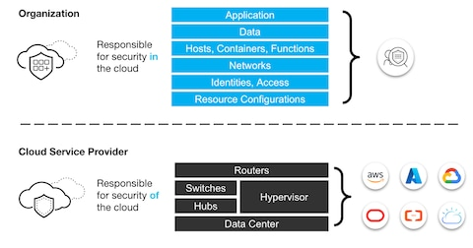
Flowchart

Slide 98
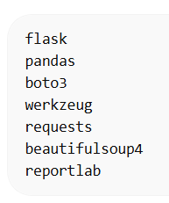
requirements.txt

Slide 99
How to run the slide
Opening the Project Folder
Creating Virtual Environment
Activating Virtual Environment

Slide 100
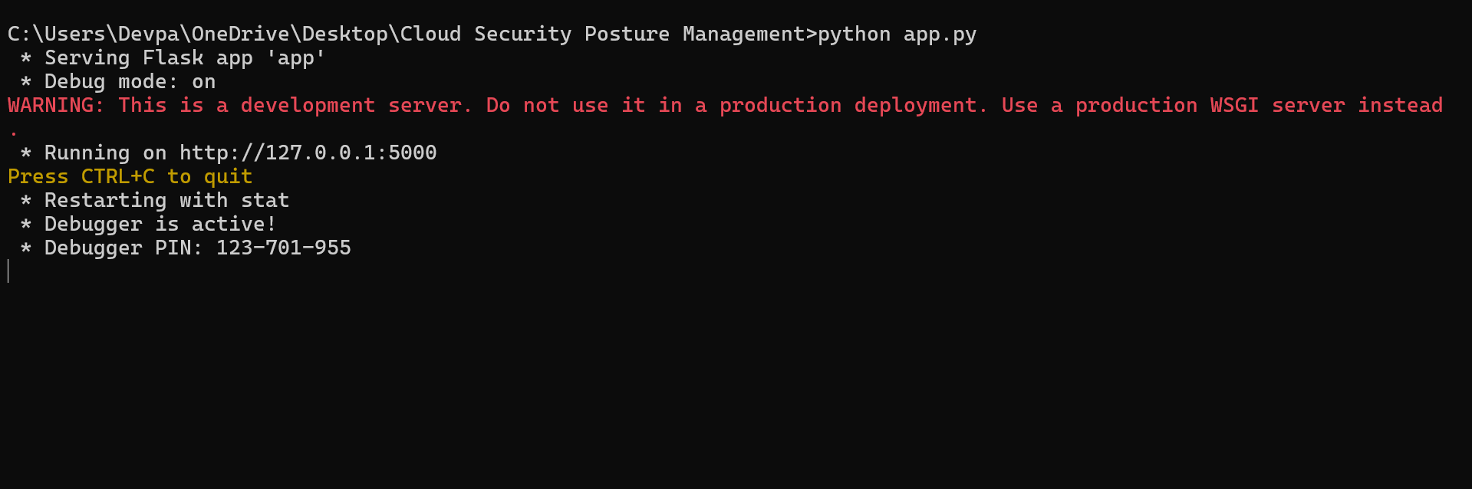
Running the Flask App
\

Slide 101

Start the Web Server
Open the browser at http://127.0.0.1:5000

Slide 102
Sign in page
The Nexus Security Login Interface serves as the primary authentication gateway for accessing the Cloud Security Posture Management (CSPM) and Endpoint Detection and Response (EDR) platform. This interface ensures that only authorized users can access the enterprise security dashboard and system resources.
The login screen is designed with a modern minimalistic user interface, providing both usability and security. It includes fields for user credentials and integrates with the backend authentication system implemented using Flask session management and password hashing.

Slide 103
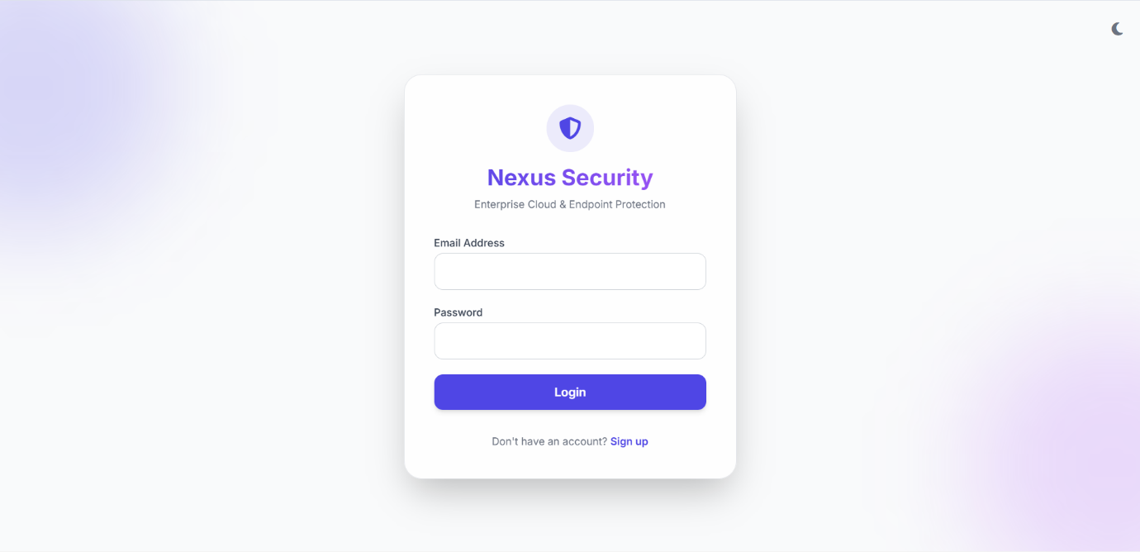

Slide 104
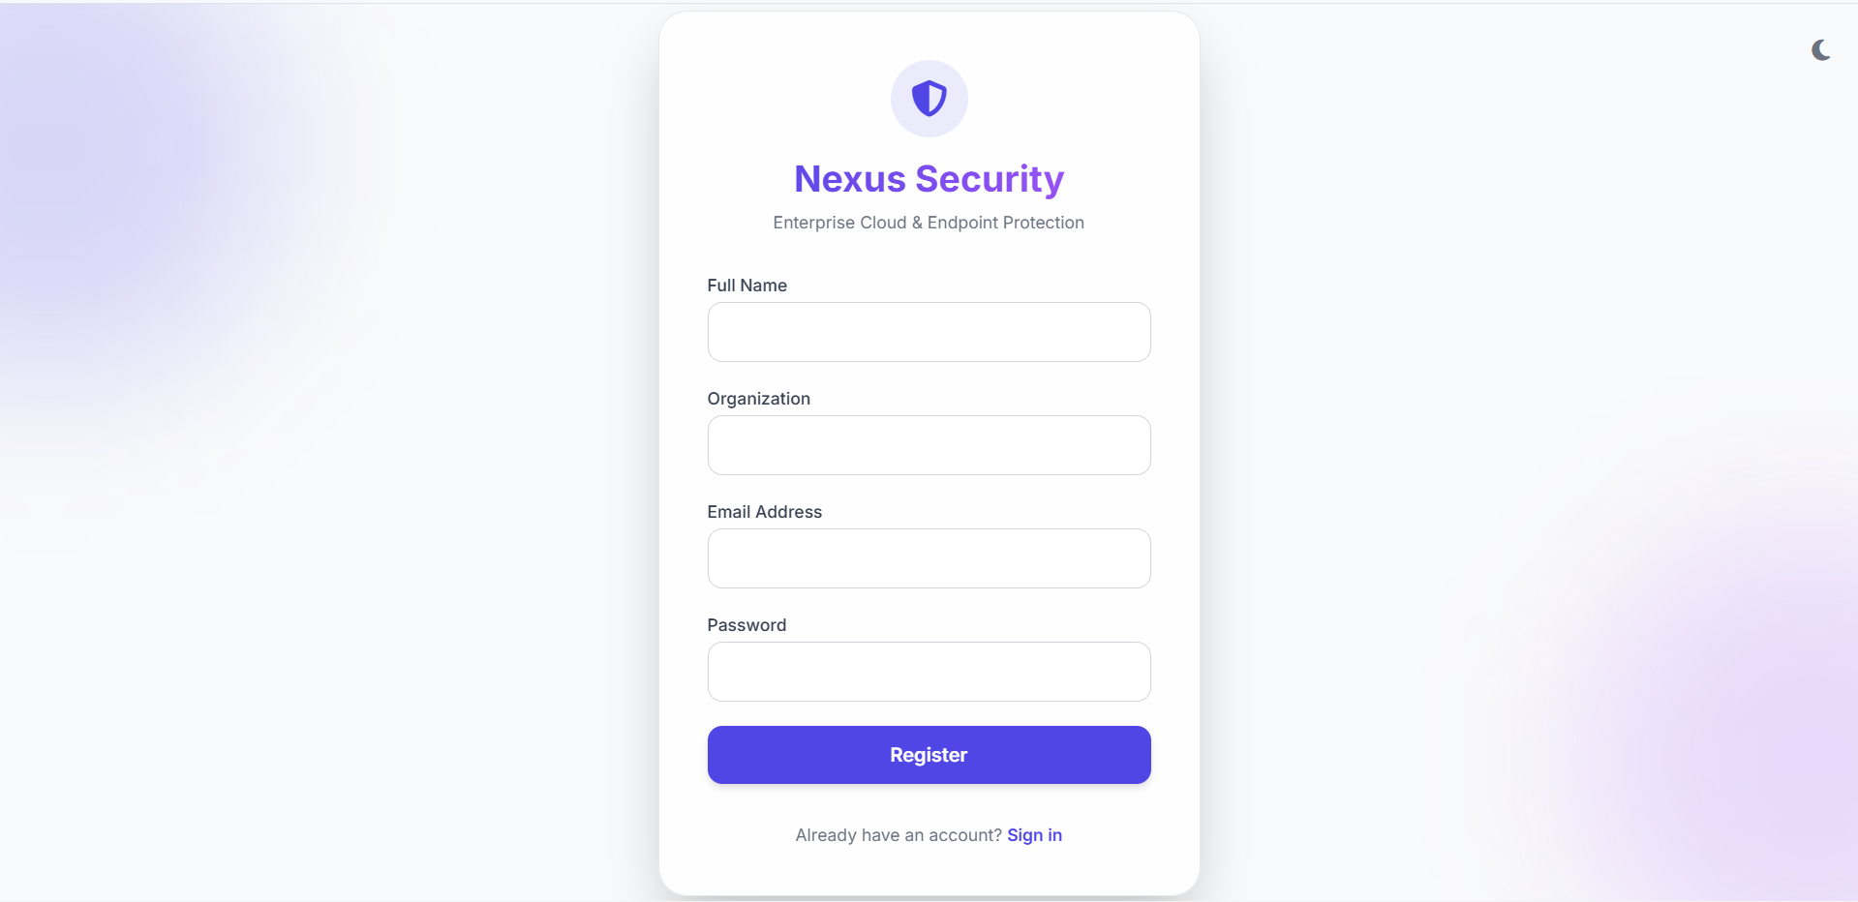

Slide 105

Run Scan Button
The Run Scan button is used to initiate a security scan of the cloud environment and connected endpoints. When the user clicks this button, the system starts analyzing resources to detect vulnerabilities, misconfigurations, and potential security threats. The scan collects data from services such as compute, storage, identity management, and databases. The results are then displayed on the dashboard with risk scores, alerts, and security recommendations.

Slide 106
Security Posture Analysis Dashboard
The Security Posture Analysis Dashboard provides a comprehensive overview of the organization's cloud security health and threat landscape. It highlights key indicators such as Critical Issues, AI Risk Score, Active Endpoint Agents, and Dark Web Hits, allowing administrators to quickly identify security risks.
The dashboard includes analytical visualizations like Risk by Service charts and 30-Day Trend graphs to monitor security performance over time. The Severity Distribution chart categorizes vulnerabilities into Critical, High, Medium, and Low levels for better prioritization.
Additionally, the Compliance Status panel shows the organization's adherence to security policies and frameworks. The Threat Intelligence Feed displays information gathered from external threat sources such as TOR nodes, forums, and paste sites.
Together, these components help security teams detect threats early, assess risks, and maintain a strong cloud security posture.

Slide 107
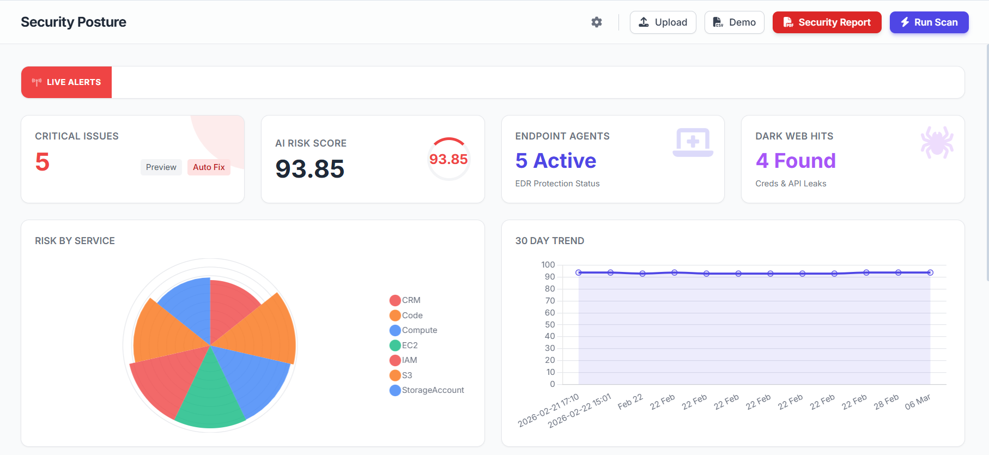
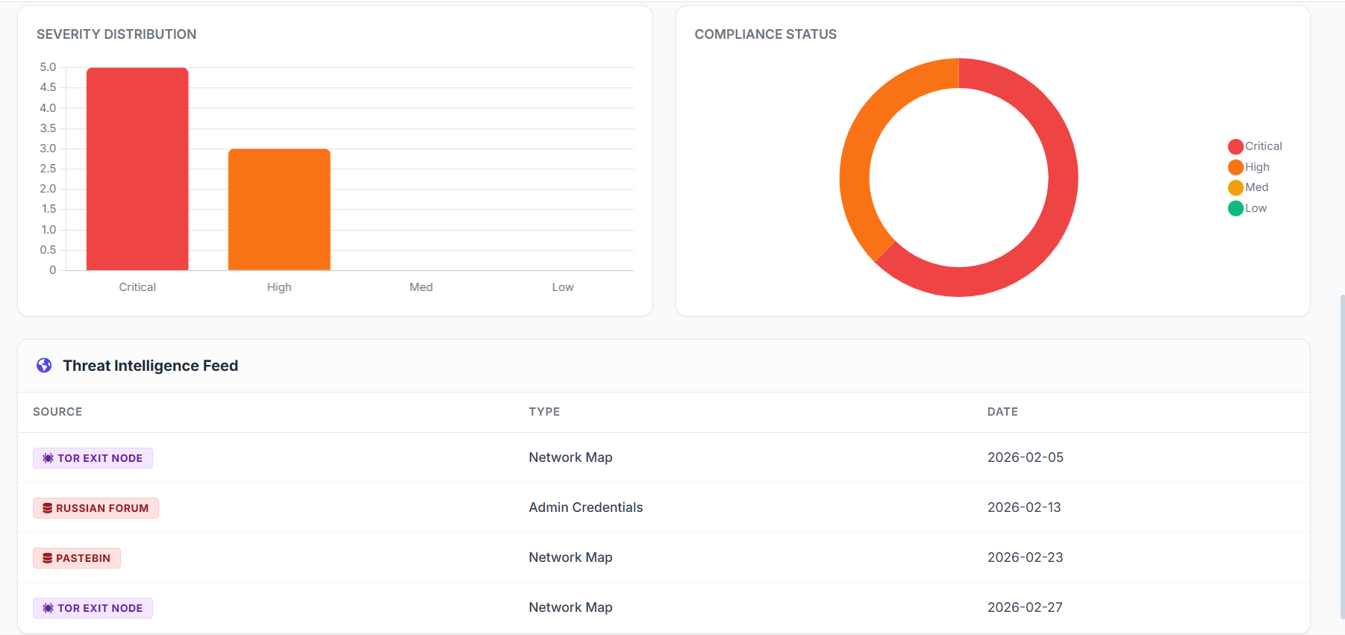

Slide 108
Detailed Security Findings
The Detailed Findings section displays a list of security vulnerabilities detected during the cloud security scan. It shows important information such as the affected resource, identified security issue, and recommended remediation steps. Examples of detected issues include exposed ports, missing multi-factor authentication (MFA), public S3 bucket access, weak firewall rules, and unencrypted storage. Each finding is analyzed by the system and presented with a suggested security action, such as restricting firewall rules, enabling encryption, or revoking exposed keys.

Slide 109
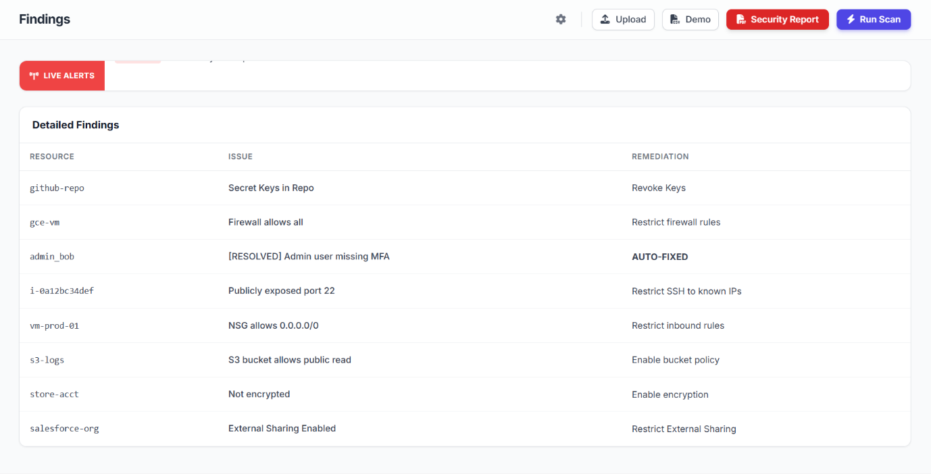

Slide 110
Asset Inventory Dashboard
The Asset Inventory section provides a detailed list of all cloud resources monitored by the security platform. It displays important information such as the cloud provider, resource ID, resource type, and associated risk score for each asset. Resources may include services like AWS EC2 instances, S3 storage buckets, RDS databases, Azure virtual machines, and Google Cloud compute instances.

Slide 111
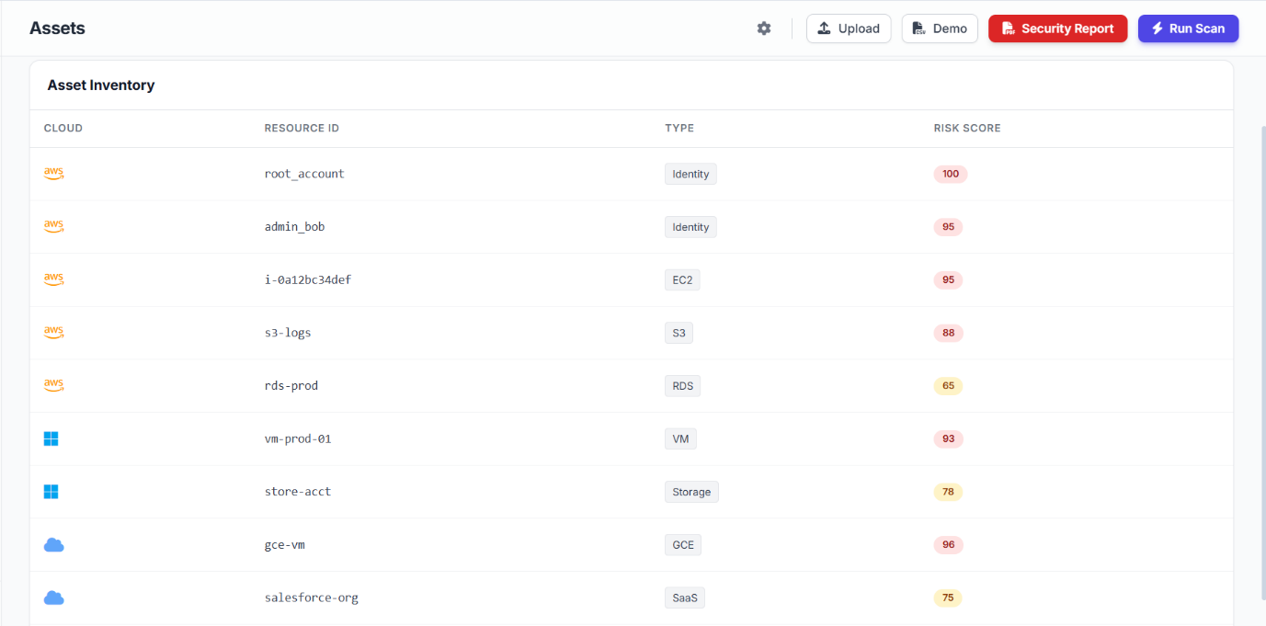

Slide 112
Endpoint Fleet Monitoring
The Endpoint Fleet dashboard provides an overview of all connected devices monitored by the Endpoint Detection and Response (EDR) system. It displays important security information such as antivirus status, disk encryption level, host firewall configuration, and application control activity.
The platform tracks active agents and blocked threats to ensure endpoint protection across the organization. The Endpoint Inventory table lists devices with details like hostname, operating system, IP address, antivirus status, firewall status, and overall health.

Slide 113
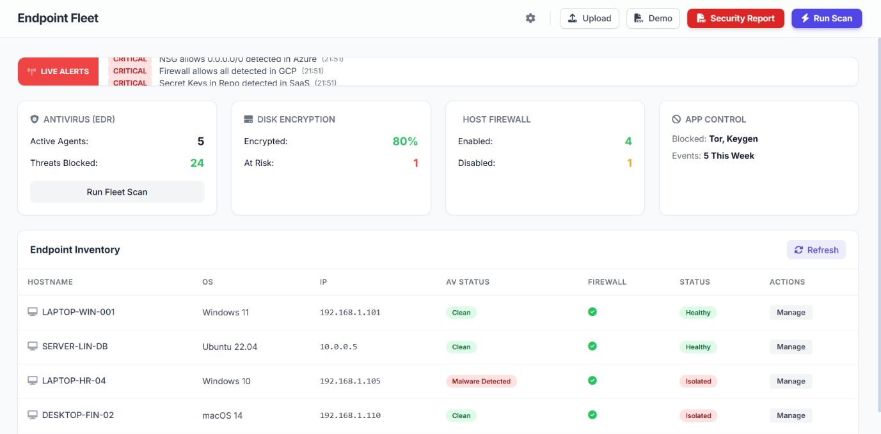

Slide 114
Live Monitoring Dashboard
The Live Monitoring Dashboard provides real-time visibility into the system’s operational status and security activity. It displays important performance metrics such as CPU usage, RAM utilization, and network traffic, helping administrators monitor system health.
The dashboard also shows whether the security platform is operational and actively protecting the environment. A Real-Time Events Stream records ongoing activities such as user logins, endpoint scans, blocked threats, and security updates.

Slide 115
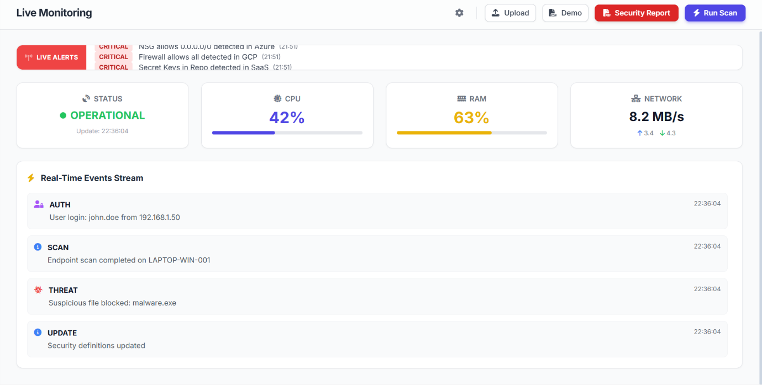

Slide 116
Threat Detection Dashboard
The Threat Detection Dashboard provides real-time visibility into malware and suspicious activities detected across the system. It displays key statistics such as the number of active threats, blocked attacks, quarantined files, and false positives.
The Recent Detections table lists details including the detection time, affected host device, type of threat, severity level, and recommended action. Examples of detected threats include malware like Trojan.Win32.Emotet, suspicious PowerShell activity, and potential keyloggers.

Slide 117
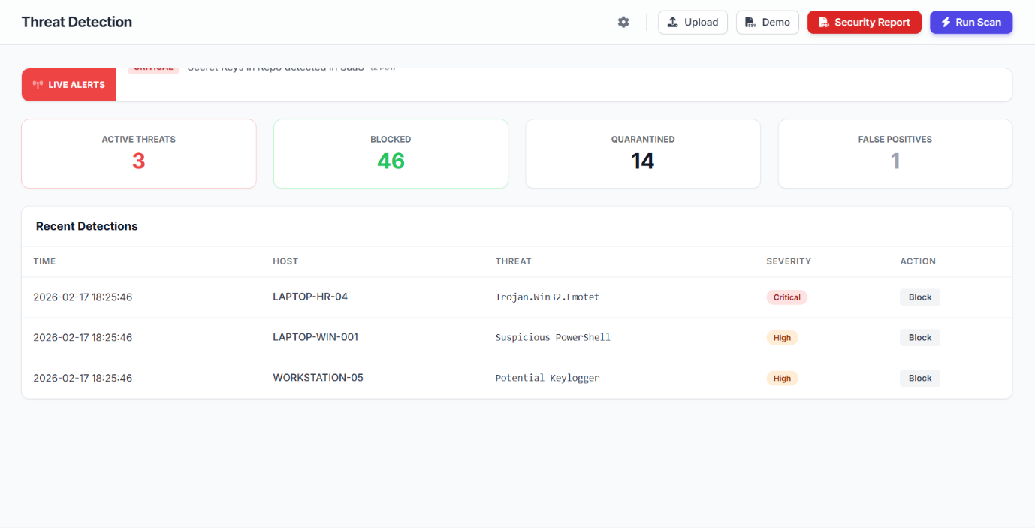

Slide 118
Dark Web Monitoring Dashboard
The Dark Web Monitoring Dashboard tracks potential security risks originating from hidden online sources such as Tor networks, underground forums, and paste sites. It identifies critical issues including credential leaks, exposed API keys, domain mentions, and stealer logs related to the organization.
The dashboard displays statistics that help security teams quickly assess the scale of data exposure. A Live Intelligence Feed shows detailed information about detected leaks, including the source, type of breach, and recommended remediation action.

Slide 119
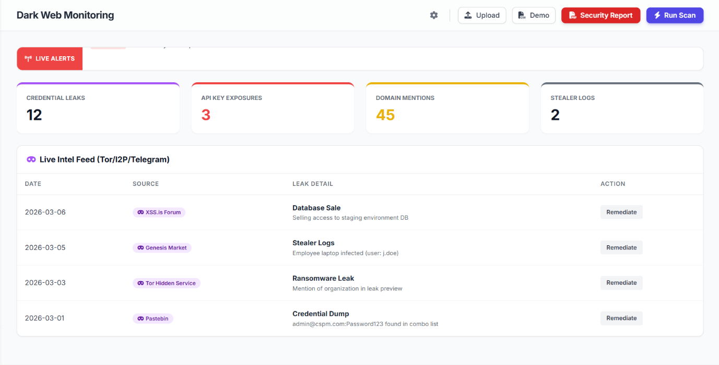

Slide 120
Attack Graph Visualization
The Attack Graph module visualizes potential attack paths within the cloud environment and connected systems. It displays relationships between resources such as virtual machines, storage services, identities, SaaS applications, and internet access points.
Each node represents a resource, while the connecting lines show how attackers might move through the infrastructure if vulnerabilities exist. Critical assets and high-risk components are highlighted to help security teams understand possible attack routes. This visual representation allows administrators to quickly identify weak points in the network.

Slide 121
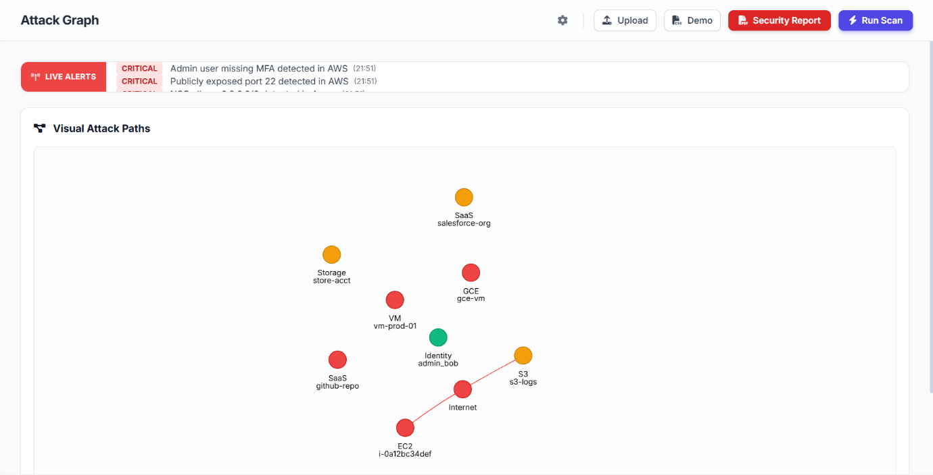

Slide 122
Compliance Monitoring Dashboard
The Compliance Dashboard monitors the organization’s adherence to major security and regulatory frameworks. It performs automated security checks against standards such as SOC 2 Type II, PCI DSS v4.0, HIPAA, and ISO 27001.
Each framework is displayed with a compliance status and percentage score indicating how well the organization meets the required controls. A passing status shows that the system follows the recommended security policies, while a failing status highlights areas needing improvement.
These compliance scorecards help security teams identify gaps in policies and configurations.

Slide 123
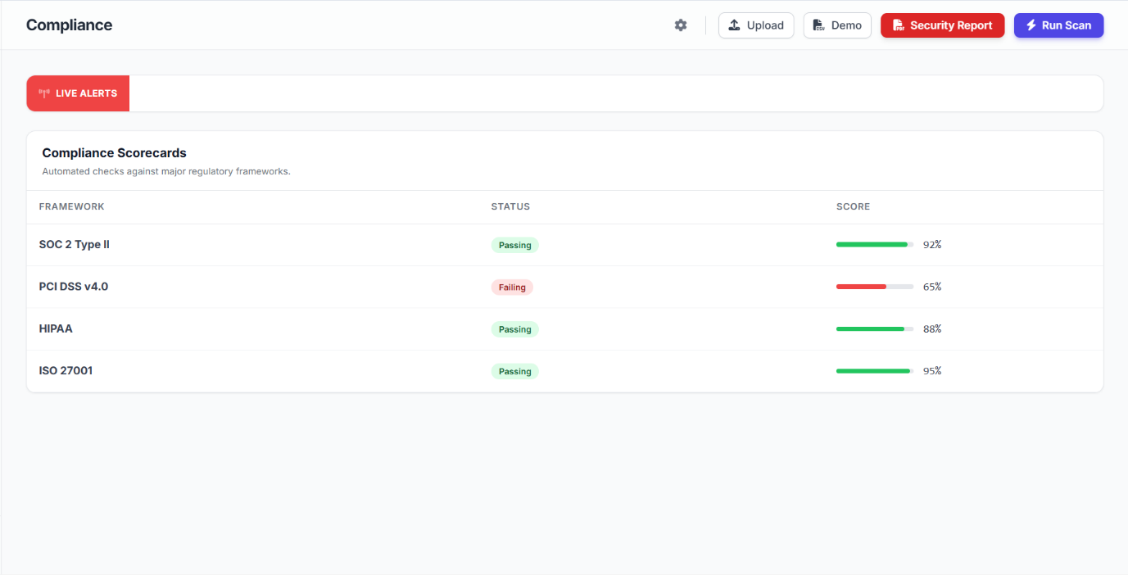

Slide 124
Identity Governance Dashboard
The Identity Governance (CIEM) dashboard manages and monitors user identities and access permissions across the cloud environment. It identifies potential risks related to user accounts, roles, and privileged access.
The system analyzes identity configurations and detects issues such as missing multi-factor authentication (MFA) or excessive permissions. Each identity is evaluated with a security score to measure its risk level.
The dashboard also tracks whether detected issues have been resolved or still require action.

Slide 125
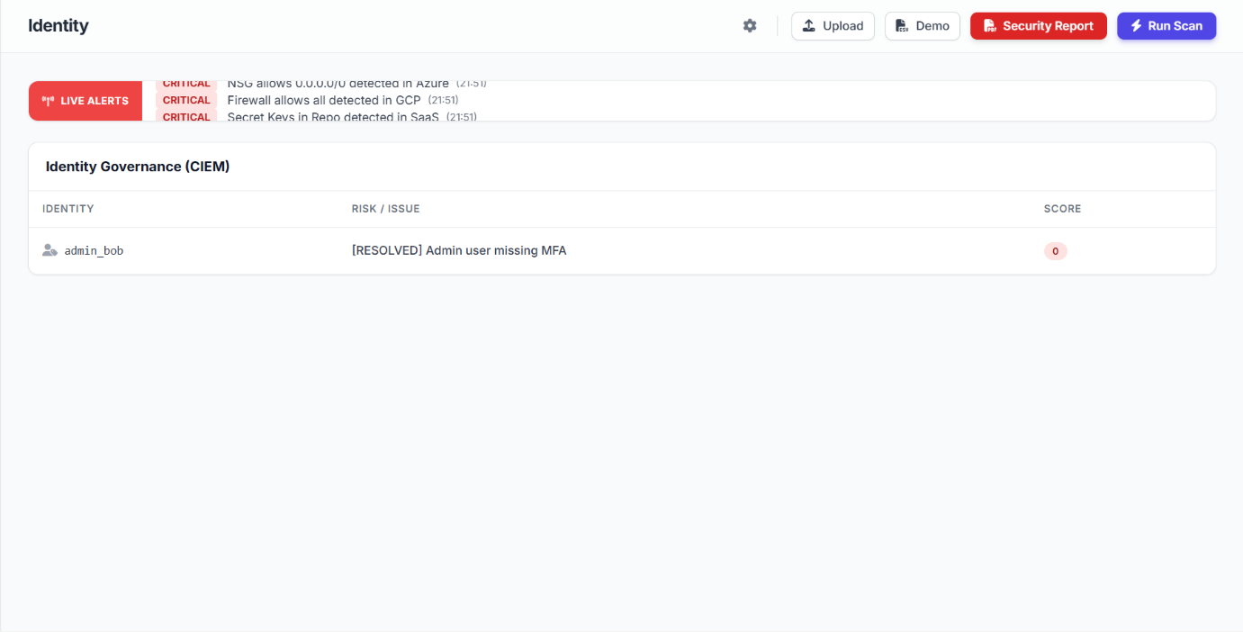

Slide 126
Kubernetes Security Posture
The Kubernetes Posture (KSPM) dashboard monitors the security configuration of Kubernetes clusters and containerized workloads. It identifies vulnerabilities and misconfigurations within cluster resources such as pods, services, and ingress controllers.
The system highlights issues like containers running as root, privileged containers, or missing network security policies. Each detected issue is categorized by severity levels such as Critical, High, or Medium to help prioritize remediation.

Slide 127
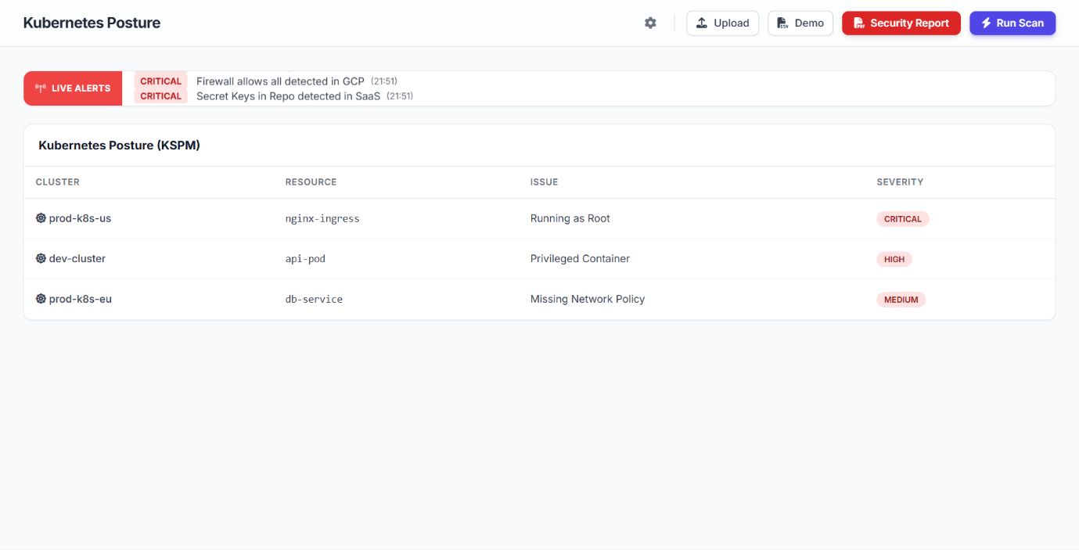

Slide 128
Platform Integrations Dashboard
The Integrations Dashboard allows organizations to connect their cloud platforms and security tools with the security monitoring system. It supports integrations with services such as AWS, Microsoft Azure, Splunk, and Jira to enable centralized security management.
By connecting these platforms, the system can automatically collect logs, monitor cloud resources, and generate security alerts. Integration with SIEM tools like Splunk helps in advanced threat analysis and log management.
Ticketing systems such as Jira allow security teams to track and manage incident responses efficiently.

Slide 129
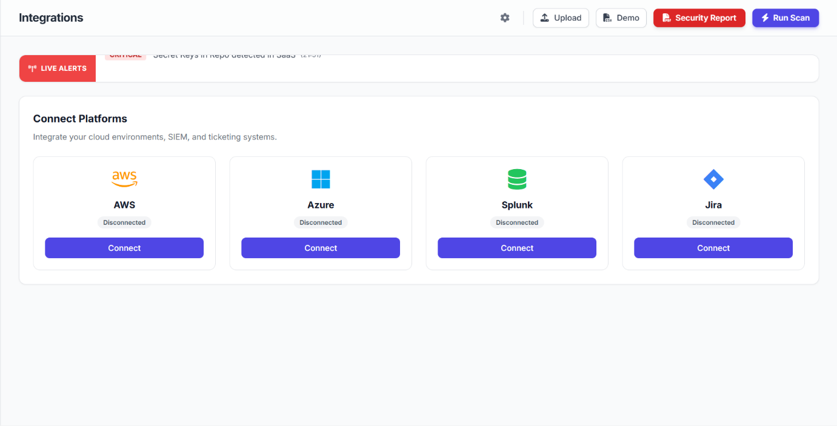

Slide 130
Security Policies and Frameworks
The Security Policies & Frameworks Dashboard allows administrators to manage and enforce security policies across the cloud environment. It displays policy controls based on well-known security standards such as CIS benchmarks, PCI DSS, and NIST frameworks.
Each policy includes a control code, description, and status indicating whether the rule is enabled or disabled. Examples include enabling MFA for root accounts, restricting public access to S3 buckets, and enforcing least privilege access.
Administrators can easily toggle policies to enforce security best practices.

Slide 131
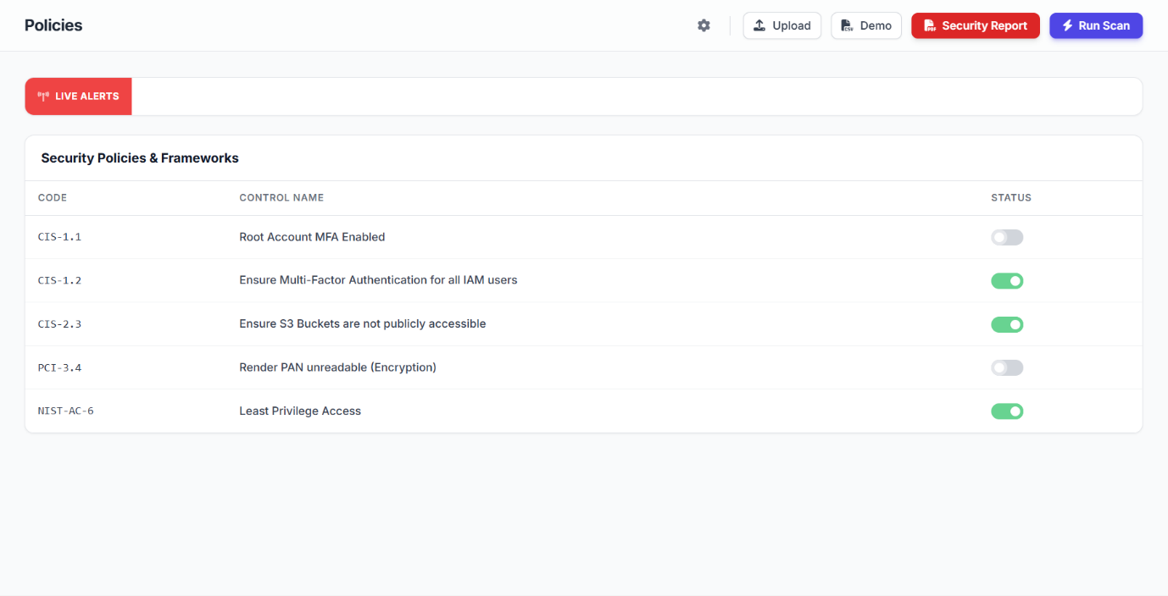

Slide 132
Security Automation
The Automation Dashboard manages automatic security remediation within the cloud security platform. It includes an Auto-Remediation Engine that automatically fixes critical security misconfigurations such as public S3 buckets, exposed ports, or disabled multi-factor authentication (MFA).
Administrators can enable or disable the Auto-Fix feature to allow the system to automatically correct detected issues. The Action Log records every automated remediation activity with details such as time, action performed, and affected resource.
This helps security teams track how vulnerabilities were resolved without manual intervention.

Slide 133
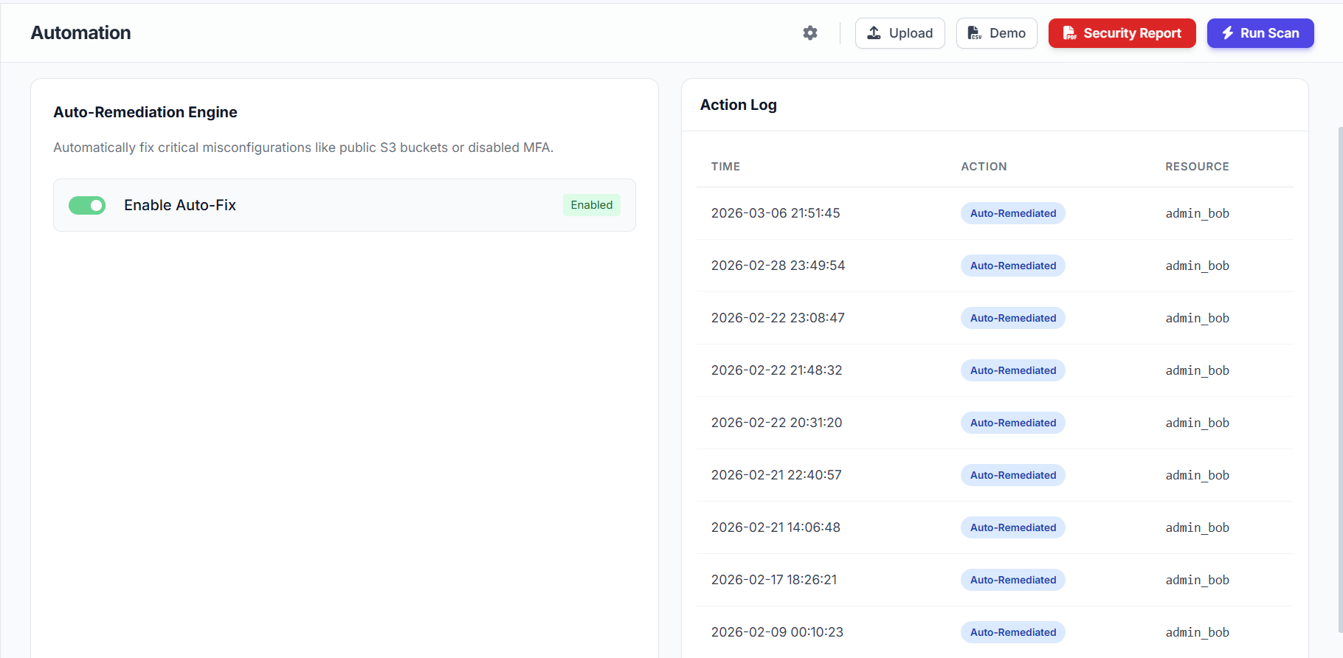

Slide 134
System Health Monitoring
The System Health Monitoring panel displays the operational status and performance metrics of the security engine. It provides real-time information about CPU usage and RAM utilization, helping administrators monitor system performance.
These indicators ensure that the security platform is running efficiently without performance issues.
The panel also includes a System Health status indicator that shows whether the platform is functioning normally.
Monitoring these metrics helps detect resource overload or system instability early.

Slide 135
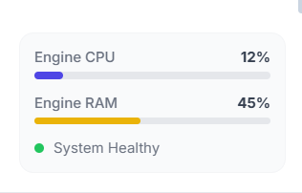

Slide 136
User Profile and API Access Management
The User Profile and Settings Dashboard allows administrators to manage their account information and platform access. It displays user details such as name, email address, role, and subscription plan within the security platform.
Users can update their personal information and organization details through the profile settings panel. The dashboard also provides an API Access section where users can generate secure access tokens for integrating external applications and services.
These tokens enable secure communication between the security platform and other systems.

Slide 137
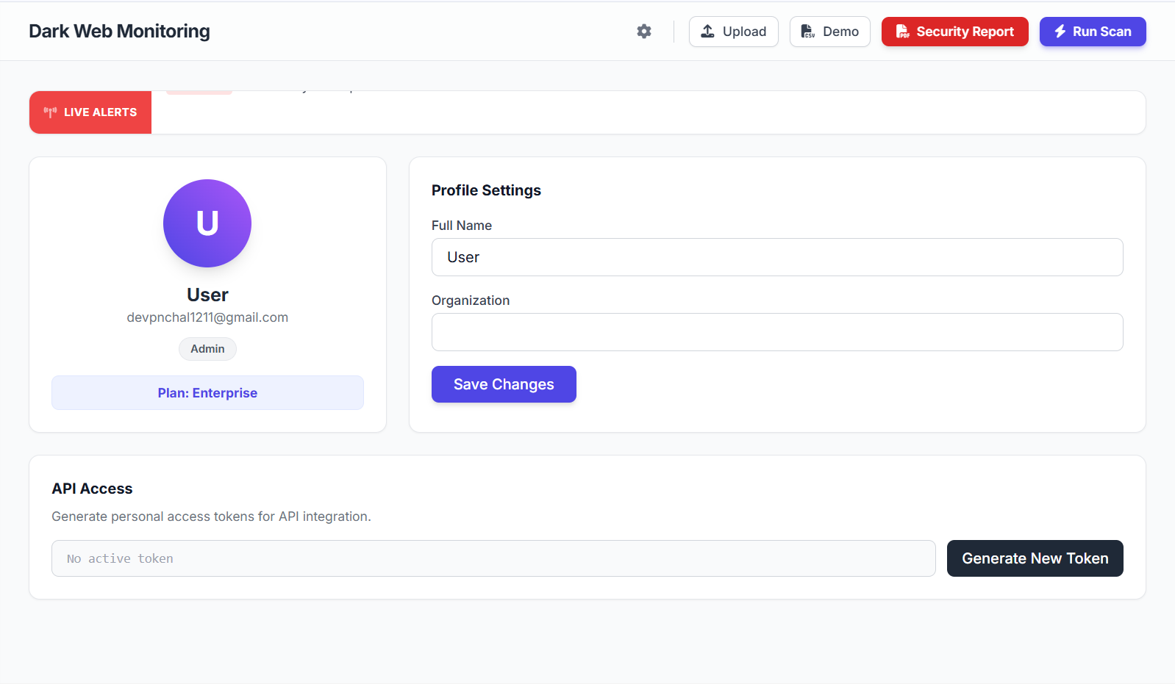

Slide 138

Security Report and Scan Controls
The Security Control Panel provides quick action buttons for managing security operations within the platform. The Upload button allows users to upload security logs or datasets for analysis.
The Demo option provides sample data to demonstrate the system’s functionality and features. The Security Report button generates a detailed report containing detected vulnerabilities, risk scores, and security insights.
The Run Scan button initiates a comprehensive security scan across cloud resources and endpoints.

Slide 139
Scanner Configuration Settings
The Scanner Configuration panel allows administrators to define how frequently the security system performs automated scans. Users can choose different scan intervals such as Continuous, every 15 minutes, 1 hour, or 24 hours depending on their monitoring requirements.
Continuous scanning ensures real-time detection of vulnerabilities and configuration issues in cloud resources.
Scheduled scan intervals help organizations balance system performance with security monitoring

Slide 140
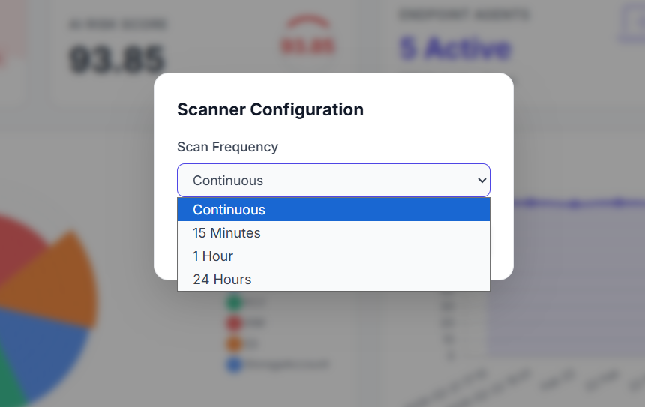

Slide 141
Security Report Generation
The Security Report feature generates a detailed executive report summarizing the organization’s overall security posture. It includes important information such as the current risk score, active endpoints, and key security findings detected during system scans.
The report highlights critical vulnerabilities, affected resources, and recommended remediation actions.
It also contains a Threat Intelligence Summary that provides insights into potential threats identified from external sources.
19. Future Enhancements of Cloud Security Posture Management (CSPM) with Endpoint Detection & Response (EDR)

Slide 142
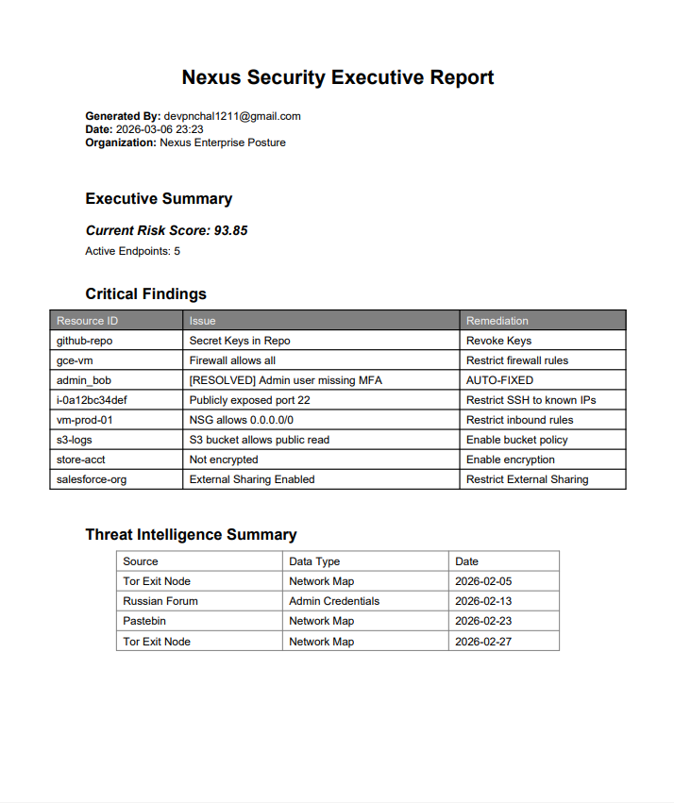


Slide 143
Future Enhancements of Cloud Security Posture Management (CSPM) with Endpoint Detection & Response (EDR)
1.What role will Artificial Intelligence play in future CSPM and EDR systems?
Artificial Intelligence (AI) will play an important role in improving threat detection and security analysis. AI-based security systems can analyze large volumes of cloud data and detect unusual patterns that may indicate cyber threats.
2. How will automation improve cloud security in the future?
Automation will allow cloud security systems to respond to threats without human intervention. Future CSPM and EDR solutions may automatically detect security misconfigurations and fix them instantly.

Slide 144
3. Why is multi-cloud security an important future enhancement?
Many organizations use multiple cloud service providers to run their applications and services. Managing security across different cloud platforms can be difficult.
4. How will integration with DevSecOps improve security?
DevSecOps integrates security practices into the software development lifecycle. Future CSPM and EDR systems will be integrated with DevOps tools to scan applications and infrastructure during the development process.
5. What is behavioral analysis and how will it improve EDR systems?
Behavioral analysis involves monitoring the activities of users and systems to detect unusual behavior.
Future EDR systems will use advanced behavioral analytics to identify suspicious actions such as unusual login attempts, abnormal file access, or unexpected network traffic.

Slide 145
6. How will real-time dashboards improve cloud security management?
Future cloud security platforms will include advanced real-time dashboards that provide detailed visual insights into the security status of cloud environments.
These dashboards may include security graphs, risk heatmaps, and attack visualization tools

Slide 146
Examples of Cloud Security Posture Management (CSPM) with Endpoint Detection & Response (EDR)
1. Public Cloud Storage Detection
CSPM detects a publicly accessible storage bucket in the cloud, while EDR monitors endpoints attempting to download sensitive data from that bucket.
2. Misconfigured Firewall Rules
CSPM identifies an open firewall port in the cloud environment, and EDR detects suspicious endpoint activity trying to exploit the open port.
3. Unauthorized Access Attempts
CSPM monitors identity and access management configurations, while EDR detects repeated failed login attempts from endpoint devices.

Slide 147
4. Malware Activity on Cloud Servers
CSPM ensures the cloud server is configured securely, while EDR detects malware processes running on the server endpoint.
5. Suspicious Network Traffic
CSPM monitors network configuration policies, and EDR detects abnormal network traffic generated by compromised endpoints.
6. Data Leakage Prevention
CSPM detects misconfigured cloud storage permissions, while EDR identifies endpoints attempting to transfer sensitive files outside the network.

Slide 148
7. Outdated Cloud Software
CSPM detects outdated software versions on cloud resources, and EDR monitors endpoint activities attempting to exploit those vulnerabilities.
8. Unauthorized Cloud Resource Creation
CSPM detects unauthorized creation of virtual machines in the cloud, while EDR tracks the endpoint that initiated the deployment.
9. Privilege Escalation Detection
CSPM detects changes in cloud access permissions, and EDR identifies suspicious endpoint processes attempting privilege escalation.
10. API Security Monitoring
CSPM analyzes cloud API configurations, while EDR detects malicious scripts running on endpoints that attempt to misuse the APIs.

Slide 149
11. Container Security Monitoring
CSPM scans container configurations in the cloud, while EDR monitors the container host systems for abnormal behavior.
12. Ransomware Detection
CSPM verifies cloud backup configurations, while EDR detects ransomware activity on endpoint devices before data is encrypted.
13. Cloud Compliance Monitoring
CSPM checks cloud environments for compliance violations, while EDR monitors endpoints for actions that may violate security policies.
14. Insider Threat Detection
CSPM monitors user access permissions in cloud systems, while EDR tracks suspicious actions performed by internal users on endpoints.

Slide 150
15. Cloud Configuration Change Monitoring
CSPM detects unauthorized changes in cloud configuration settings, and EDR identifies the endpoint responsible for those changes.

Slide 151
Future Enhancements (AI-based detection, CI/CD integration)
AI-Based Threat Detection
Artificial Intelligence (AI) is expected to play a significant role in the future of cloud security systems. AI-based detection systems can analyze large amounts of security data generated from cloud infrastructure and endpoint devices.
Machine learning algorithms can identify unusual patterns and behaviors that may indicate cyber threats such as malware infections, unauthorized access attempts, or data exfiltration.
For example, AI-based CSPM systems can automatically detect abnormal changes in cloud configurations or suspicious network activity. Similarly, AI-powered EDR systems can analyze endpoint behavior to detect previously unknown threats that traditional signature-based systems may fail to identify.

Slide 152
CI/CD Integration (DevSecOps)
Another important future enhancement is the integration of CSPM and EDR with Continuous Integration and Continuous Deployment (CI/CD) pipelines. CI/CD pipelines are widely used in modern software development to automate the process of building, testing, and deploying applications.
By integrating security tools into CI/CD pipelines, organizations can implement DevSecOps, which means incorporating security practices directly into the development lifecycle.
In this approach, security scans are performed automatically during each stage of application development. For example:
When developers commit code, security tools scan the code for vulnerabilities.
During the build process, CSPM tools check cloud infrastructure configurations.

Slide 153
Before deployment, EDR systems verify endpoint security conditions.
This ensures that security issues are detected early in the development process, reducing the risk of vulnerabilities being introduced into production environments.

Slide 154
Real-World Cloud Attack Examples
Capital One Data Breach (2019)
One of the most famous cloud security incidents occurred in 2019 when Capital One experienced a major data breach affecting over 100 million customers.
The attack was caused by a misconfigured firewall in the cloud environment hosted on Amazon Web Services. The attacker exploited the vulnerability to access sensitive customer data stored in cloud storage.

Slide 155
The stolen data included:
Names
Addresses
Credit scores
Social security numbers (in some cases)
This attack highlighted the importance of monitoring cloud configurations and implementing strong access controls.

Slide 156
Tesla Cloud Data Exposure (2018)
In 2018, Tesla experienced a cloud security issue when attackers gained access to a misconfigured cloud server. The server was running on a cloud platform and contained sensitive internal data.
The attackers also installed cryptocurrency mining software on Tesla’s cloud infrastructure, using company resources for unauthorized activities.
This incident was caused by:
Weak authentication
Exposed cloud management interface
Lack of proper monitoring

Slide 157
Uber Cloud Data Breach (2016)
Uber suffered a cloud-related data breach in 2016 when attackers accessed private credentials stored in a code repository. These credentials allowed attackers to access Uber’s cloud storage environment.
The attackers downloaded personal information of approximately 57 million users and drivers.
The breach occurred because sensitive access keys were stored insecurely.
Lesson Learned: Proper identity and access management policies and secure credential storage are essential for protecting cloud environments.

Slide 158
Microsoft Azure Cosmos DB Exposure (2021)
In 2021, a vulnerability in Microsoft Azure’s Cosmos DB database service exposed sensitive customer data belonging to thousands of organizations.
Researchers discovered that the vulnerability allowed attackers to access database credentials and potentially gain access to stored data.
Although the vulnerability was quickly patched, it demonstrated how cloud service vulnerabilities can affect multiple organizations.
Lesson Learned: Continuous vulnerability monitoring and rapid security updates are essential for maintaining cloud security.

Slide 159
Code Spaces Cloud Attack (2014)
Code Spaces was a company that relied entirely on cloud infrastructure to host its services. In 2014, attackers gained access to the company's cloud management console.
The attackers deleted critical data, backups, and server configurations from the cloud environment. As a result, the company lost most of its operational data and was forced to shut down.
This attack demonstrated the devastating impact of compromised cloud administrator credentials.
Lesson Learned: Strong authentication, multi-factor authentication (MFA), and access monitoring are critical for protecting cloud management accounts.

Slide 160
Snapchat Cloud Data Leak
Snapchat also experienced a cloud-related security incident when attackers accessed employee information stored in the cloud.
The attackers used phishing techniques to trick an employee into revealing login credentials. This allowed them to access sensitive payroll information.
Lesson Learned: Security awareness training and endpoint protection are important for preventing phishing-based attacks.

Slide 161
Importance of CSPM and EDR in Preventing Cloud Attacks
Many of these real-world cloud attacks occurred due to:
Misconfigured cloud settings
Weak access controls
Lack of continuous monitoring
Compromised endpoint devices
Security solutions such as CSPM and EDR help prevent these attacks by:
Monitoring cloud configurations for vulnerabilities
Detecting suspicious endpoint activities
Alerting administrators about security risks
Automating threat detection and response
These technologies play a crucial role in protecting modern cloud environments from cyber threats.

Slide 162
Cloud Security Posture Management (CSPM) with Endpoint Detection & Response (EDR) – Quiz
1. What is Cloud Security Posture Management (CSPM)? Answer. Cloud configuration monitoring
2. What is Endpoint Detection and Response (EDR)? Answer. Endpoint threat detection
3. How does CSPM help improve cloud security? Answer. CSPM improves cloud security by continuously scanning cloud resources and detecting misconfigurations.
4. What types of security risks can CSPM detect in cloud environments? Answer. Cloud misconfigurations detection
5. How does EDR monitor endpoint devices for threats? Answer. EDR monitors system behavior, processes, and network activity on endpoint devices to detect suspicious actions.

Slide 163
6. Why is configuration monitoring important in cloud security? Answer. Prevent security risks
7. How does CSPM help organizations maintain compliance with security standards? Answer. Compliance monitoring tools
8. What types of cyber threats can EDR detect on endpoint devices? Answer. EDR can detect threats such as malware, ransomware, unauthorized access, and suspicious processes.
9. How does the integration of CSPM and EDR improve overall cloud security? Answer. Integrated threat protection

Slide 164
10. What is the role of real-time monitoring in CSPM systems? Answer. Continuous security monitoring
11. How can misconfigured cloud storage create security vulnerabilities? Answer. Misconfigured cloud storage can expose sensitive data to unauthorized users or the public.
12. What is the importance of vulnerability scanning in cloud environments? Answer. Identify security weaknesses
13. How does EDR respond when suspicious activity is detected on an endpoint? Answer. Endpoint threat isolation

Slide 165
14. Why is endpoint security important in modern cloud infrastructures? Answer. Endpoint security prevents compromised devices from being used to access cloud systems.
15. How can CSPM help prevent unauthorized access to cloud resources? Answer. Access policy monitoring
16. What role does automation play in cloud security posture management? Answer. Automated threat detection
17. How can behavioral analysis improve threat detection in EDR systems? Answer. Behavioral analysis identifies unusual activities that may indicate cyber attacks.

Slide 166
18. What types of cloud services can be monitored using CSPM tools? Answer. Cloud infrastructure services
19. How does CSPM help organizations identify compliance violations? Answer. Security compliance checks
20. Why is combining CSPM and EDR important for modern cybersecurity strategies? Answer. Comprehensive security protection

Slide 167
Conclusion
Cloud computing has become an essential part of modern information technology infrastructure. Organizations across various industries rely on cloud platforms to store data, run applications, and manage business operations efficiently. While cloud computing offers numerous benefits such as scalability, flexibility, and cost efficiency, it also introduces significant security challenges.
This project focused on implementing a cloud security solution by integrating Cloud Security Posture Management (CSPM) with Endpoint Detection & Response (EDR) technologies. The main objective of the project was to design and develop a system capable of monitoring cloud infrastructure, detecting configuration vulnerabilities, identifying endpoint threats, and improving the overall security posture of cloud environments.

Slide 168
Endpoint Detection & Response, on the other hand, focuses on monitoring endpoint devices such as servers, virtual machines, and user systems connected to cloud infrastructure. EDR systems analyze endpoint behavior and detect suspicious activities such as malware infections, unauthorized access attempts, and abnormal network traffic.
The integration of CSPM and EDR provides a comprehensive cloud security framework. While CSPM focuses on configuration-level security and compliance monitoring, EDR focuses on runtime threat detection and endpoint protection.
Throughout the development of this project, several important cloud security concepts were explored, including vulnerability scanning, configuration monitoring, threat detection, compliance management, and automated security reporting.

Slide 169


