Slide 1
Caching

Slide 2


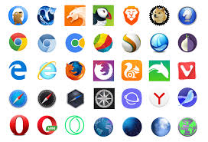


Application
Mobile Applications
get()
Application UI
update()
Service
Layer
Network
Database
delete()
Network
3rd party integrations

