Slide 1

CHRONOS
A FRESHNESS FIREWALL FOR THE BIFROST AI GATEWAY
YOUR CACHE REMEMBERS.
CHRONOS CHECKS.
A Go plugin compiled into the Bifrost gateway. It checks every answer, fresh or replayed from the semantic cache, sets the cache TTL from how fast the answer's facts move, and deletes the cache entry behind any answer that has gone stale.
A REAL CACHE HIT
x-bifrost-cache-hit: true
x-chronos-verdict: outdated
x-chronos-score: 39
x-chronos-class: version
x-chronos-ttl: 21600
LIVE DEMO
CODE
chronos-sable-one.vercel.app
github.com/devprashant19/Chronos
→ DELETE /api/cache/clear/610663b3…
Notes:
Chronos is a freshness firewall for the Bifrost AI gateway. Semantic caching replays a stored answer; Chronos checks the facts inside it and deletes the cache entry when they have gone stale. The card on the right is real: request 2 of the README's cycle, a cache hit scored 39 and marked outdated, followed by the eviction call. Live demo at chronos-sable-one.vercel.app; code at github.com/devprashant19/Chronos.

Slide 2
YOUR CACHE REPLAYS FACTS AFTER THEY EXPIRE
THE PROBLEM · STALE MODELS, FROZEN CACHES
Semantic caching is the cheapest win in an LLM stack, and the easiest way to serve a confidently wrong answer.
ONE ANSWER CAN HOLD ALL THREE · SHELF LIFE
A stock price
MINUTES
A model's per-token price
WEEKS
A model answers from what it knew when it was trained. The cache, keyed on what the user asked, has no idea what that answer contains.
So it replays the answer, identically, until a timer runs out: a timer picked without looking at any fact inside it.
The name of a chief executive
UNTIL SOMEONE RESIGNS
THE CACHE'S ANSWER: one flat TTL for all three, by default a day
Notes:
Facts age at different speeds: a stock price in minutes, a model's per-token price in weeks, a chief executive's name until someone resigns. A semantic cache is keyed on the question, not the answer, so it gives all three one flat TTL and replays them identically until it runs out. That is how a cache serves a confidently wrong answer.

Slide 3
NOBODY RE-CHECKS THE ANSWER A CACHE REPLAYS
WHY EXISTING TOOLS MISS IT
 | Semantic cache | Fact-checker in front | Chronos, inside Bifrost
Reads what the answer claims | No — keyed on the question | Yes | Yes — claims with exact spans
Re-checks a cache hit | No — replays it as stored | No — it sits outside the gateway, not at the cache | Yes — inline, after the cache serves it
Sets the TTL from the facts | No — one flat TTL | No — it cannot reach the cache | Yes — per volatility class, 15 min to 7 d
Removes a stale entry | Only when its timer runs out | No | Yes — DELETE /api/cache/clear/{id}
A cache hit is the only answer that can be stale, so it is the one Chronos waits for. A fresh answer is checked in the background and waits for nothing.
Notes:
Caches have one flat TTL and never re-check what they stored. A fact-checker in front of the gateway can read an answer, but it is not at the cache: it cannot set the TTL and cannot remove the entry. Chronos is compiled into Bifrost, and its PostLLMHook runs after the semantic cache's, so it sees the cache outcome and can act on it. A miss already paid for a fresh answer; a hit cost nothing and was written in the past, so the hit is the one worth waiting for.

Slide 4
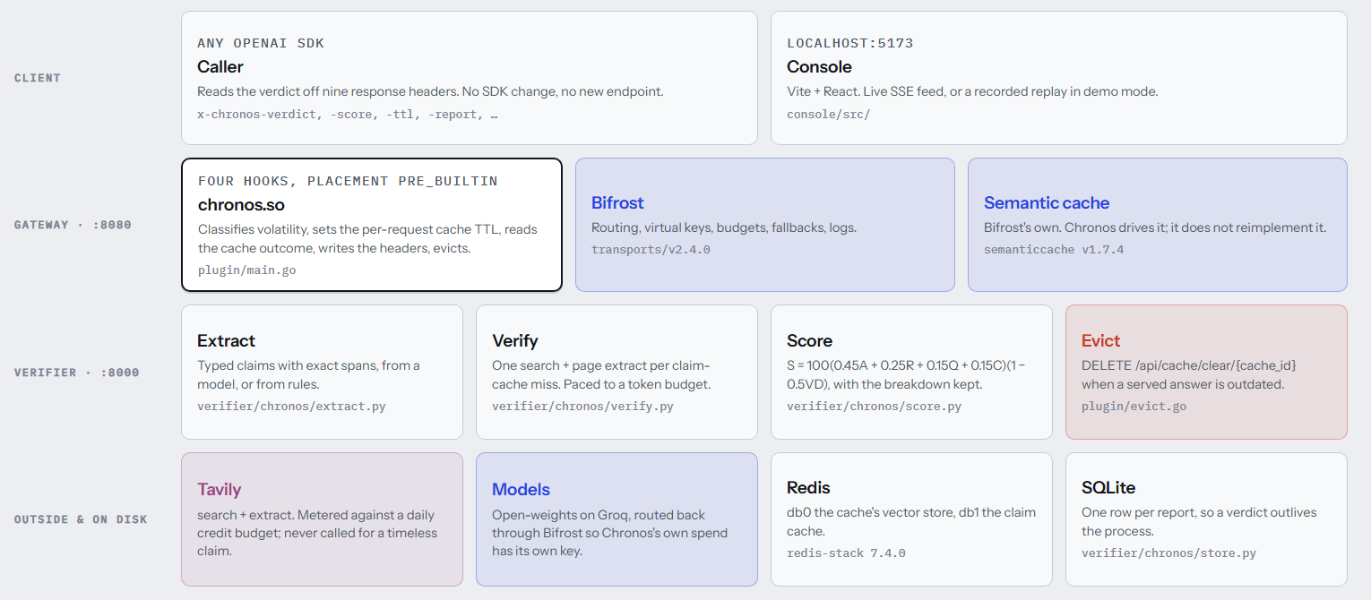
ONE PLUGIN, COMPILED INTO THE GATEWAY
CHRONOS IN ONE PICTURE · docs/architecture.png
Fresh answer: verified in a goroutine, waits for nothing. Cache hit: verified inline, evicted if outdated.
Notes:
The decision that shapes everything: chronos.so is compiled as a package of Bifrost's own transports module, same go.mod, toolchain and flags, so a Go plugin ABI mismatch is structurally impossible. It sits on four hooks with placement pre_builtin, order 0, which is the only arrangement in which its PostLLMHook runs after the semantic cache's. The slow work (extraction, Tavily search and extract, scoring) lives in a Python verifier. Eviction goes through Bifrost's own cache API.

Slide 5
EVERY CLAIM GETS A SCORE YOU CAN ARGUE WITH
HOW A CLAIM IS SCORED
S = 100 · (0.45A + 0.25R + 0.15Q + 0.15C)
· (1 − 0.5 · V · D)
WORKED EXAMPLE · docs/api.md
“The latest stable release of Python is 3.11, which came out in October 2022.”
39.2
A
agreement net supporting share of the sources that addressed the claim
OUTDATED
STATED 3.11 CURRENT 3.14.x SOURCE 2026-02-01
R
recency 1.0 under 7 days, falling to 0 at 365
A
0.00
Q
quality official 1.0, major news 0.7, other 0.4
R
0.40
Q
1.00
C
confidence the judge's own confidence
C
0.95
V
volatility market 1.0 … timeless 0.0
V
0.70
D
0.0043
D
decay time since last check ÷ re-check interval, capped at 1
0.45·0 + 0.25·0.40 + 0.15·1.00 + 0.15·0.95 = 0.3925
× (1 − 0.5·0.70·0.0043) = × 0.9985 → S = 39.2
80+ CURRENT
50–79 CHECK
<50 OUTDATED
No usable evidence is unverifiable, never outdated, so it never evicts.
0 supporting · 2 contradicting · 3 said nothing either way
Notes:
Every term goes into the report's breakdown, so no number is unexplained. The example is the real report in docs/api.md: the claim says Python 3.11; the evidence says 3.14.x. Agreement is 0 because the two sources that addressed it both contradicted it; A divides by the sources that addressed the claim, not all five returned. Recency 0.40, an official source, judge confidence 0.95, volatility 0.7 for a version, and almost no decay. Base 0.3925, times 0.9985, gives 39.2: outdated. Absent evidence would have been unverifiable, which never evicts.

Slide 6
THE CACHE TTL FOLLOWS HOW FAST THE FACTS MOVE
GATEWAY FEATURES · TTL, HEADERS, EVICTION, MODES, GUARDS
CLASS
RE-CHECK
MAX TTL · DASHED = FLAT 24 H
REQUEST 2 · A REAL CACHE HIT, HEADERS AS SENT
market
1 h
15 min
x-bifrost-cache-hit: true
x-chronos-verdict: outdated
x-chronos-score: 39
x-chronos-stale: 1
x-chronos-class: version
x-chronos-ttl: 21600
x-chronos-latency-ms: 1524
pricing
3 d
6 h
version
3 d
6 h
leadership
14 d
24 h
law
14 d
24 h
events
7 d
12 h
→ DELETE /api/cache/clear/610663b3…
timeless
never
7 d
Nine x-chronos-* headers, CORS-exposed for browsers.
An answer's TTL is the minimum across its claims.
An unknown prompt is events, never timeless.
THREE MODES · SETTABLE PER VIRTUAL KEY
THREE GUARDS · ADDED 8 NOV
observe
annotate · default
guard
Injection a page that tries to instruct the judge is set aside as evidence
Verifies out of band; never touches the response
Headers, and evicts stale cache entries
Inline: regenerates once with evidence, or blocks with 409
Ambiguous subject “the CEO”, “it” bypass the claim cache: no verdict crosses companies
Retention reports pruned after 30 days; lifetime counts kept
Notes:
Lead with the cache. On a miss, the pre-hook classifies the prompt by rules only and sets the cache TTL from the class: 15 minutes for market, 6 hours for pricing and version, a day for leadership and law, 12 hours for events, a week for timeless, instead of one flat day. On a hit, the post-hook checks the answer inline, writes the verdict into nine x-chronos headers, and on an outdated claim calls DELETE /api/cache/clear on the gateway's own API. Three modes: observe, annotate (the default) and guard. Since 8 November there are three guards: pages that try to instruct the judge are disqualified, ambiguous subjects like 'the CEO' bypass the claim cache, and reports older than 30 days are pruned without losing lifetime counts.

Slide 7
BIFROST RUNS IT. TAVILY BRINGS THE EVIDENCE.
HOW BIFROST AND TAVILY EACH CONTRIBUTE
BIFROST · THE GATEWAY CHRONOS IS COMPILED INTO
TAVILY · THE EVIDENCE
HTTPTransportPreHook
Rules-only volatility class → x-bf-cache-ttl
search
One advanced search per claim-cache miss; topic: news for fast-moving classes
PreLLMHook
Sets the semantic cache's TTL context value
PostLLMHook
Sees the answer after the cache served it
extract
Full page text for the top three results, so the judge reads pages
HTTPTransportResponseHeadersHook
Writes x-chronos-* before headers commit
credit budget
pre_builtin · order 0
Reverse post-hooks: the only way to see a hit
Every call metered; when spent, degrades to observe and says so
Semantic cache
Driven, not rebuilt: per-request TTL in
claim cache
DELETE /api/cache/clear/{id}
The eviction; never touches the vector store
Tavily only on a claim-cache miss; timeless claims never reach it
Virtual keys
Chronos's own model spend has its own budget
0
90 → 55
Fallbacks
A 429 becomes a fallback call, not unverifiable
credits for a timeless claim
credits on a repeat pass, claim cache
Custom providers
mockllm registered for the keyless demo
Chronos dogfoods the gateway: every model call it makes goes back out through Bifrost, under its own virtual key and fallbacks.
Notes:
Bifrost: Chronos is a plugin on four hooks, not a proxy. Placement pre_builtin, order 0, is what lets it see a cache hit, because post-hooks run in reverse. It drives the built-in semantic cache with a per-request TTL and evicts through DELETE /api/cache/clear. Its own model calls use a virtual key and fallbacks. Tavily: one advanced search per claim-cache miss, extract for full page text from the top three results, a metered credit budget that degrades to observe mode when spent, and no Tavily call at all for timeless claims. The claim cache took a repeat pass from 90 credits to 55.

Slide 8
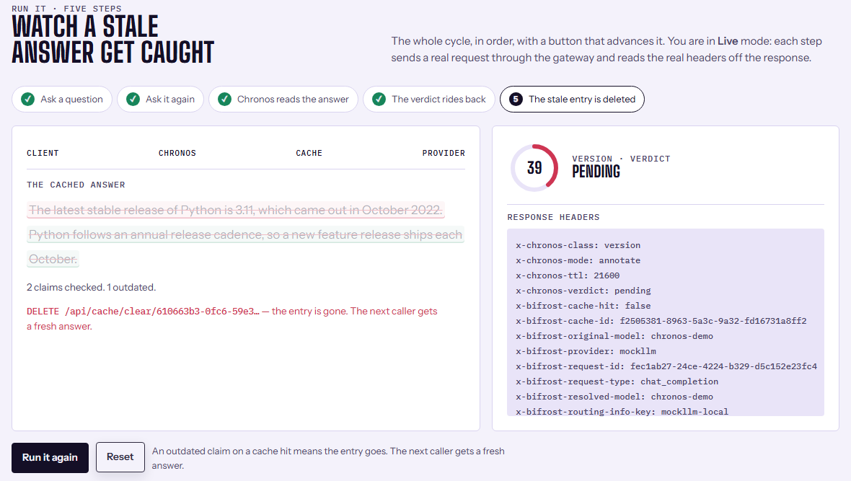
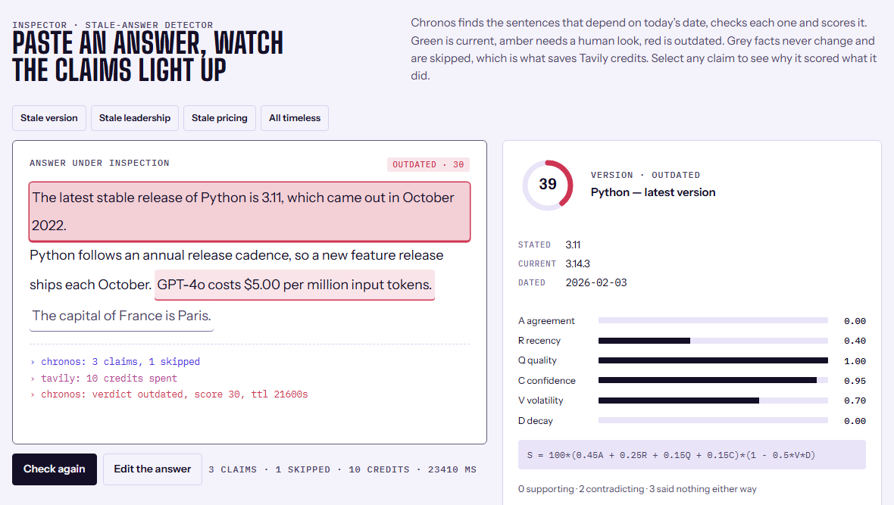
A STALE CACHE HIT, CAUGHT LIVE
THE CONSOLE · CAPTURED AGAINST THE LIVE STACK
Run it, step five. A real cache hit, verdict outdated, and the entry deleted through the gateway's own cache API.
Inside one answer. The Python claim scored 39 with every term visible, and the sources that contradicted it.
TRY IT chronos-sable-one.vercel.app the same console, replaying a recorded log and labelled as one.
Notes:
Both screenshots were captured from the console running live against the local stack: real gateway, real verifier, real Tavily searches. Left: the five-step Run it cycle: ask, ask again, Chronos reads the cached answer, the verdict rides back, and the stale entry is deleted. Right: the inspector, with every term of the score shown and the contradicting sources quoted. The hosted demo is the same console replaying a recorded log, and says so on the page.

Slide 9
STALEBENCH: MEASURED, NOT PROMISED
RESULTS · bench/runner.py AGAINST LIVE TAVILY
100%
timeless skip rate on both paths: no timeless claim ever cost a Tavily credit
28 ms
inline check on a cache hit, with a warm claim cache
841 → 5.4 ms
p50 verification once the claim cache is warm
Read the subset carefully. The model figure is 18 claims, all leadership (the hardest class), not a whole-dataset figure. The rule-engine bars come from a 30-claim subset; the 28 ms and 841 → 5.4 ms figures were measured on the rule-engine path. Live search varies between runs.
Notes:
All numbers are from bench/results-model.json and bench/results.json, run against live Tavily. With Groq's gpt-oss-120b extracting and gpt-oss-20b judging, precision on outdated goes from 0.40 to 0.80, recall from 0.20 to 0.667, F1 from 0.27 to 0.727. But that run is 18 claims, all leadership, twelve of them checkable: the hardest class, so it is not a cross-class average. The one false positive, 'Tim Cook is the CEO of Apple', is the label decaying; both misses came back unverifiable, not wrong, which never evicts. Timeless claims cost no credit. A warm cache-hit check measured 28 ms, and the claim cache took p50 from 841 ms to 5.4 ms.

Slide 10
NEXT: UPSTREAM INTO BIFROST
WHAT'S NEXT · WHO BUILT IT
UPSTREAM · plugin/README.md IS THE PR
NEXT · FROM THE OPEN LIST IN DESIGN.md
Written as the pull request it would be to maximhq/bifrost, with three findings worth fixing there:
A full 120-claim model run, for a cross-class figure (roughly 400 Tavily credits)
A model-based injection classifier, measured against red-team pages
Guard mode end to end, through a gateway set to guard
Telling apart two entities that share a name in the claim cache
A browser-level test suite, for what jsdom cannot see
Expose the header hook's context as a descendant of the transport context, and Chronos's verdict map goes away
Document that cache-clear needs X-Bifrost-Setup-Token, or it returns 403
ctx.Log from a .so plugin never reached the gateway's log stream
BUILT BY DEV PRASHANT
chronos-sable-one.vercel.app
github.com/devprashant19/Chronos
Your cache remembers. Chronos checks.
With Claude Code (Anthropic) doing the implementation, debugging and measurement, directed by the author. All 52 checks in verify-all.sh pass.
Notes:
The plugin's README is written as the pull request it would be to maximhq/bifrost, including three findings that are not in Bifrost's docs: context values propagate downward only, the cache-clear API needs the setup token, and ctx.Log from a .so plugin did not reach the gateway's logs. Next, from the open decisions: a full 120-claim model run, a model-based injection classifier, guard mode run end to end through a gateway configured for it, disambiguating same-name entities, and a browser-level test suite. Built by Dev Prashant, with Claude Code doing the implementation, debugging and measurement under the author's direction.

