Slide 1
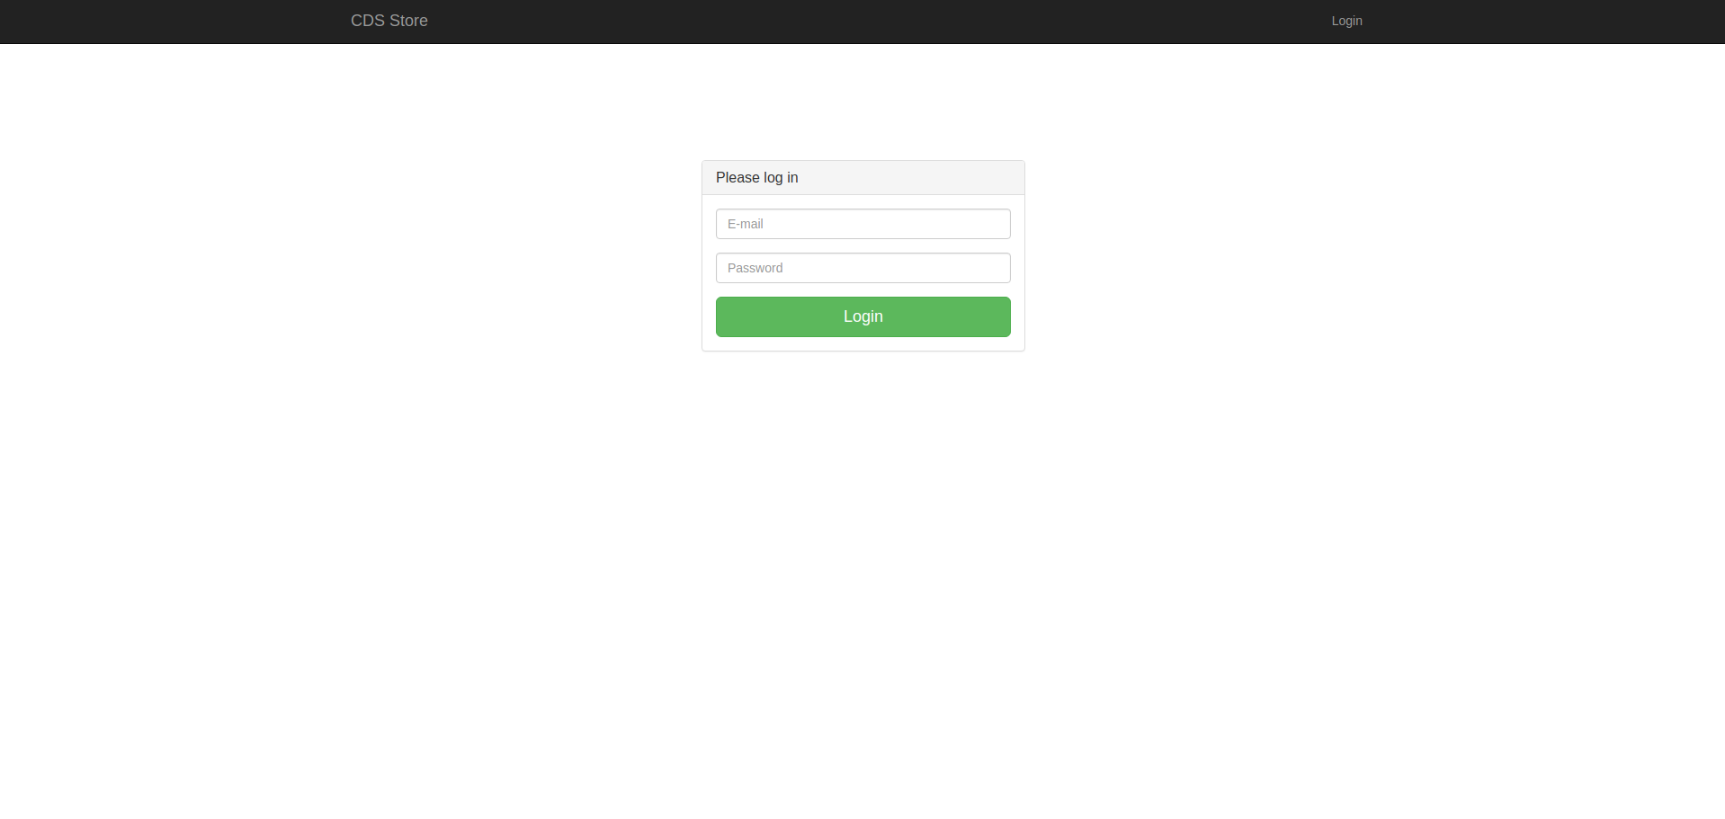
CDS Store
Mini store that shows the use of Play framework and the akka libraries in a web application.

Slide 2

Why play framework?
Built on Akka, Play provides minimal resource consumption
(CPU, memory, threads) for highly – scalable applications.

Slide 3
Why Play Framework?
Calls are asynchronous internally, allowing to use the
Concurrent libraries from Java 8 : Promises through
CompletionStage<Result>
CompletionStage<Integer> promiseOfInt = CompletableFuture.supplyAsync(() -> intensiveComputation());

Slide 4
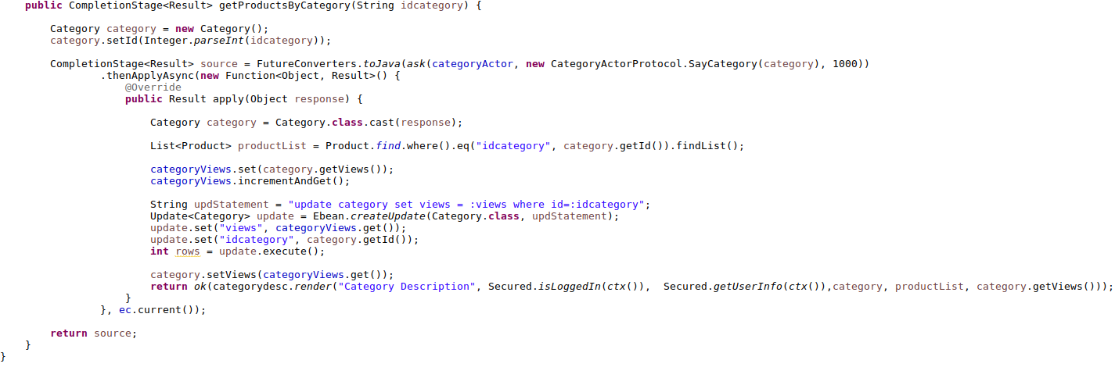
Java 8 libraries: Use of CompletionStage in a Controller

Slide 5
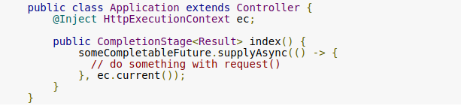
Use of CompletionStage in a Controller

Slide 6
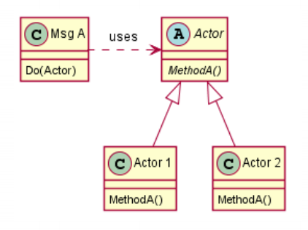
Akka libraries: using an actor based system
Using Actors to handle
intensive computations.

Slide 7
Akka libraries: using an actor based system

Slide 8
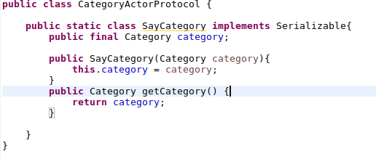
Akka libraries: using an actor based system
1. Create the protocol
2. Create the actor
3. Call the actor and send the message to handle intensive
computation.

Slide 9
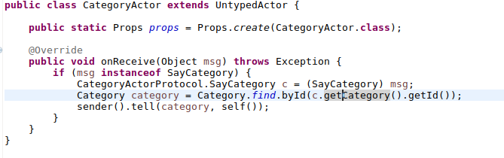
Akka libraries: using an actor based system

Slide 10
Akka libraries: using an actor based system

Slide 11
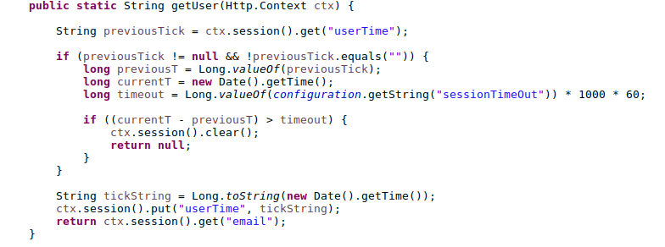
Handling the session: logIn, logOut, AsyncLogOut

Slide 12
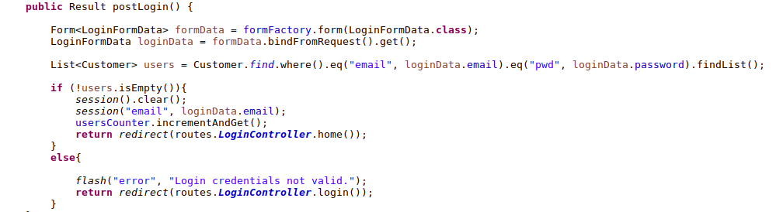
Handling the session: logIn, logOut, AsyncLogOut

Slide 13
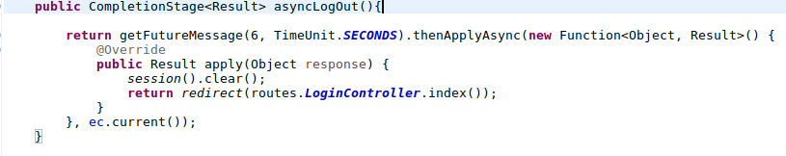
Handling the session: logIn, logOut, AsyncLogOut
Asynchronous requests: AsyncLogOut

Slide 14
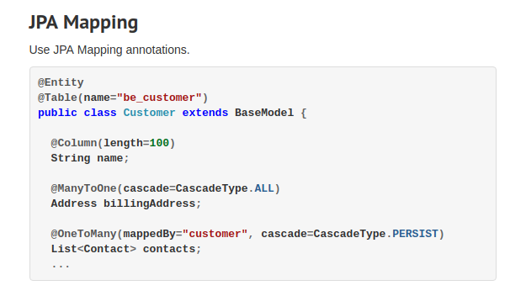

For the database distribution: Ebean ORM
Manage the process of distributing the database Schema. All DDLs are auto generated from the POJOs beans specified in the models.

Slide 15
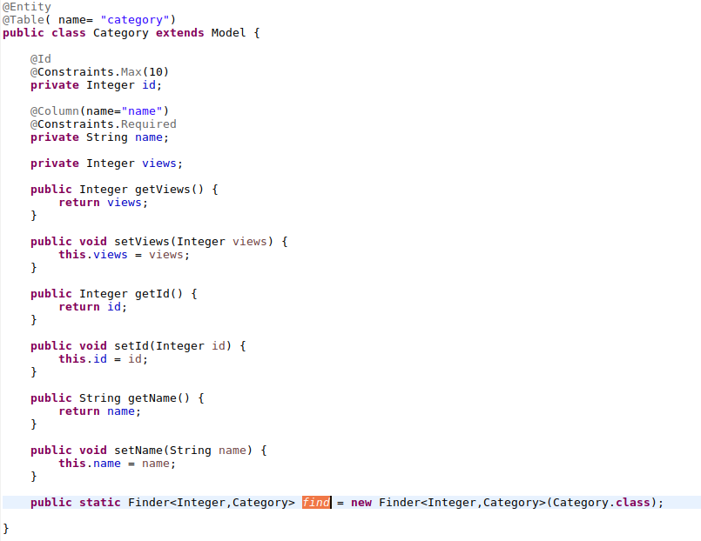
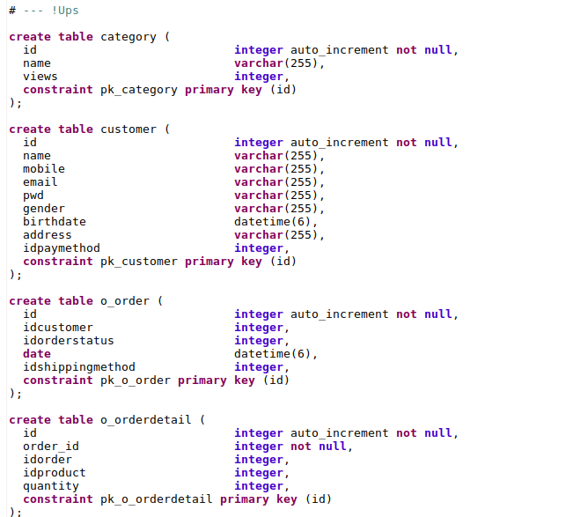
For the database distribution: Ebean ORM

Slide 16

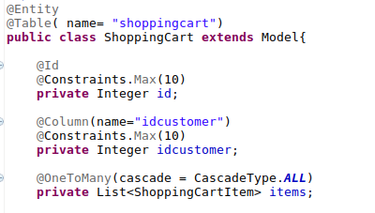
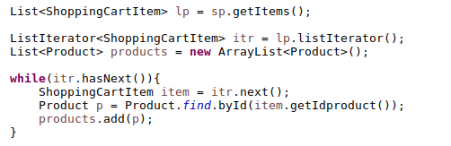
For the database distribution: Ebean ORM

Slide 17
The good and the bad : The good
Akka based: asynchronous calls, non blocking application handling intensive computations by many threads (clients).
Easy to deploy, runs with Netty server which comes inside the project. Saves time in server configuration.
Easy to distribute in case of using Ebean ORM and evolutions.

Slide 18
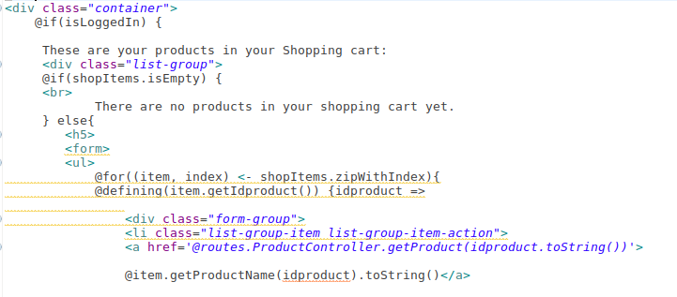
The good and the bad : The bad
Some libraries, native from Scala/Akka need to use their own libraries.
The use of twirl/Scala based templates.
Eclipse configuration / Poor Netbeans IDE support

Slide 19


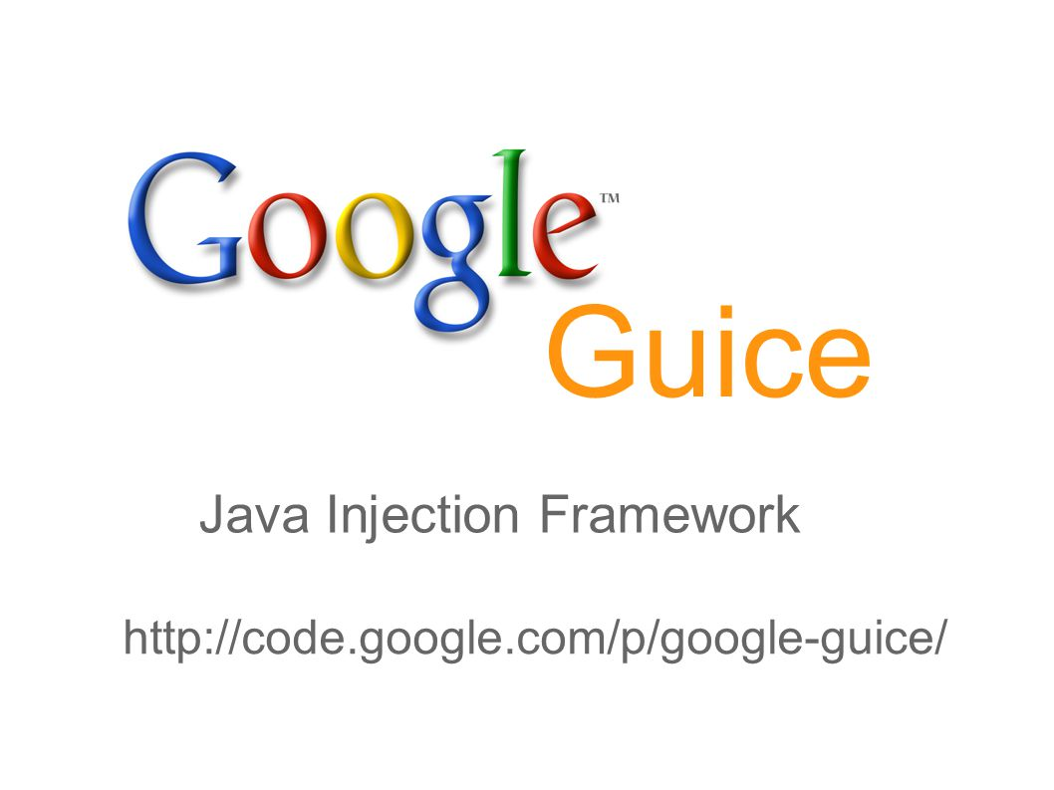
Finally: Another technologies used in the project
- Java 8: Concurrency libraries: CompletionStage,
AtomicInteger.
- Java Generics
- Java Framework Collection (JFC)
- MVC project based
- Akka libraries
- Maven to handle dependencies
- MySQL for the DB
- Ebean ORM: communication with the DB
- Guice for class injection

