Slide 1
Part B: Web3

Slide 2
Part B: Web3
Web3 Integration: Reading
Our mobile app will allow users to interact with the web3 ecosystem, for the purpose of this challenge, you can use any EVM-compatible tools. Create functionalities and flows for the following use cases:

Slide 3
Part B: Web3
Web3 Integration: Reading
create a functionality to verify that a user owns a wallet address
allow users to connect their wallet and then display their token balances, and NFTs ( even better if you can even retrieve the metadata/traits and media content of the NFTs)
add filter functionality to only display NFTs from a list of contracts (for example, you can only choose to display Axie Infinity and Genopets NFTs)
play to earn backend, that is, allowing the minting of tokens (when player wins) and burning of tokens (when player uses tokens to buy in-game items, for example)

Slide 4
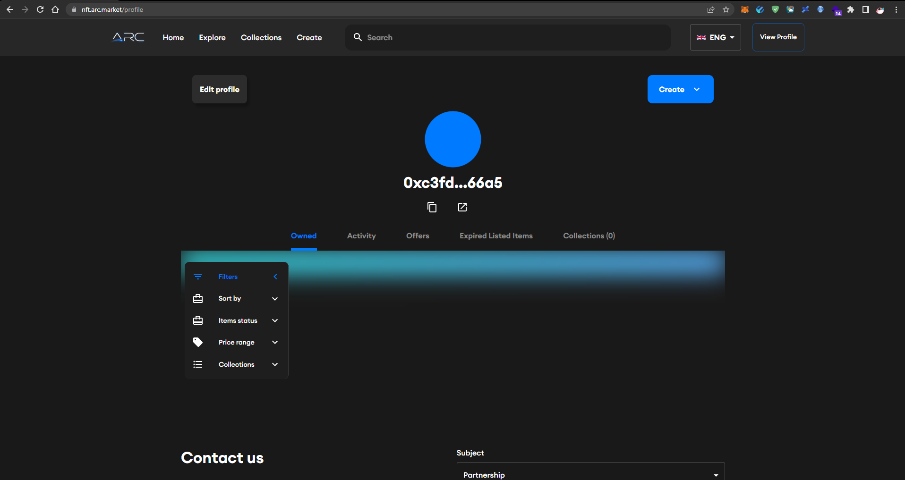
Part B: Web3
Web3 Integration: Reading

Slide 5
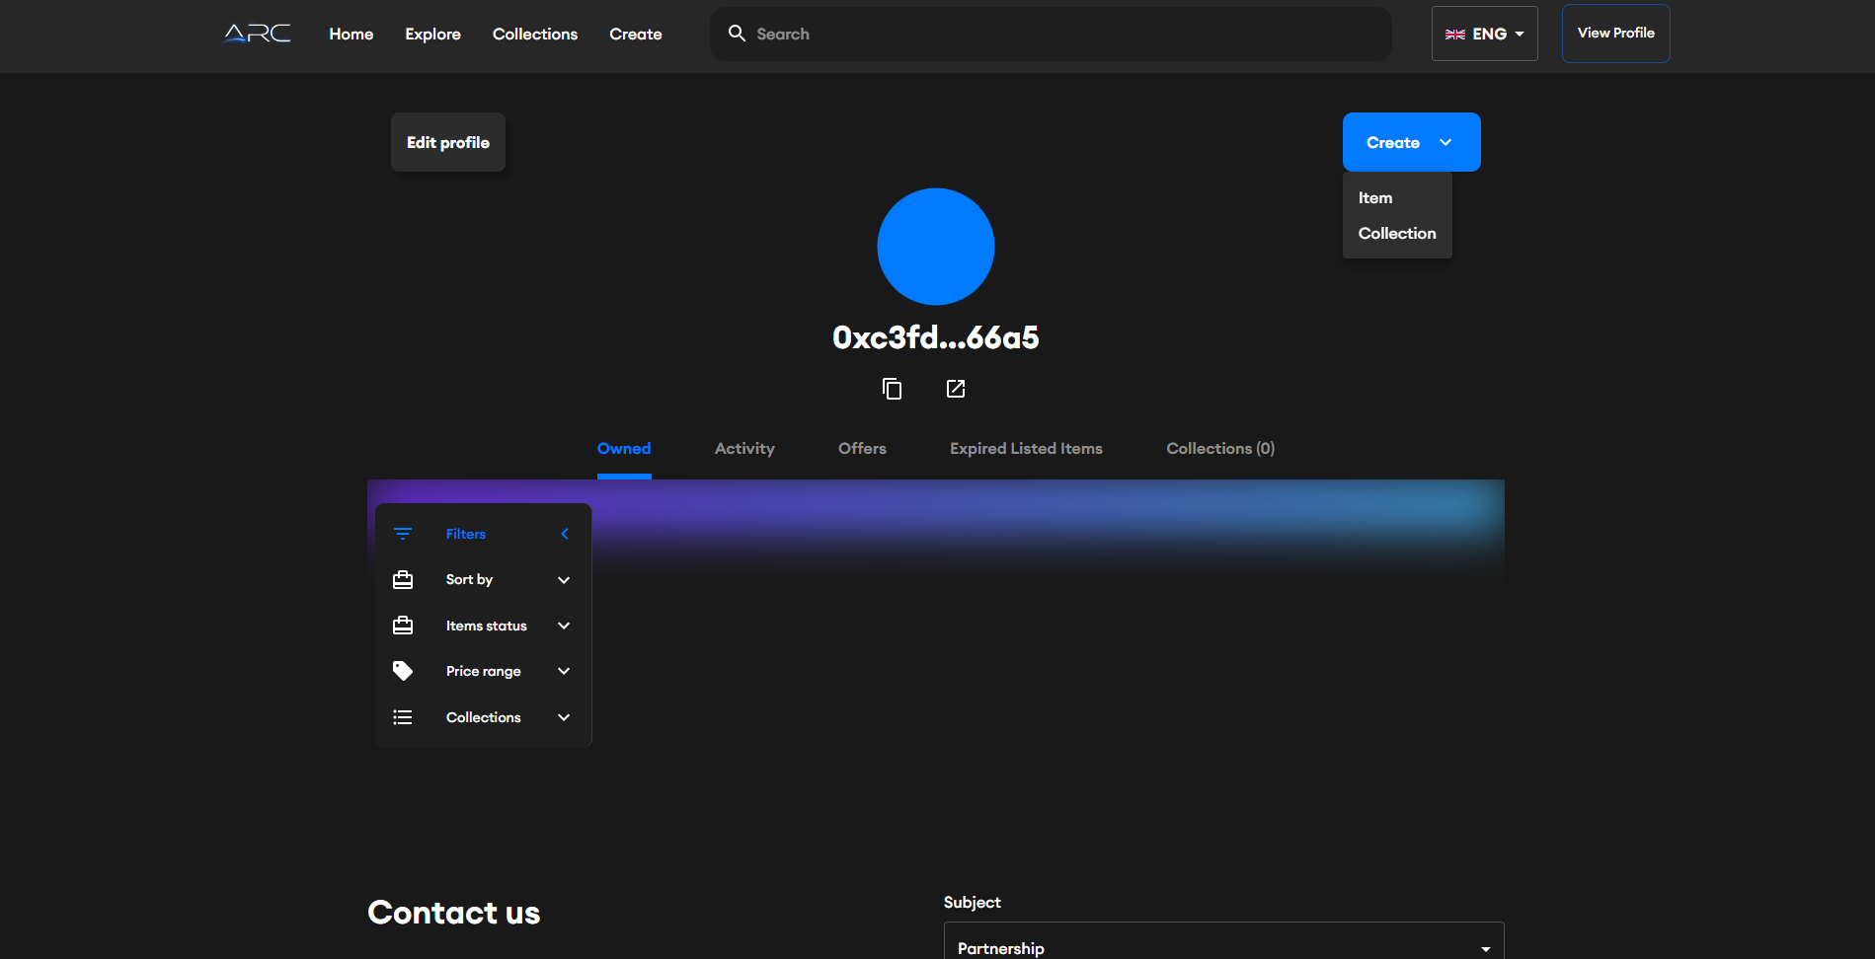
Part B: Web3
Web3 Integration: Reading

Slide 6
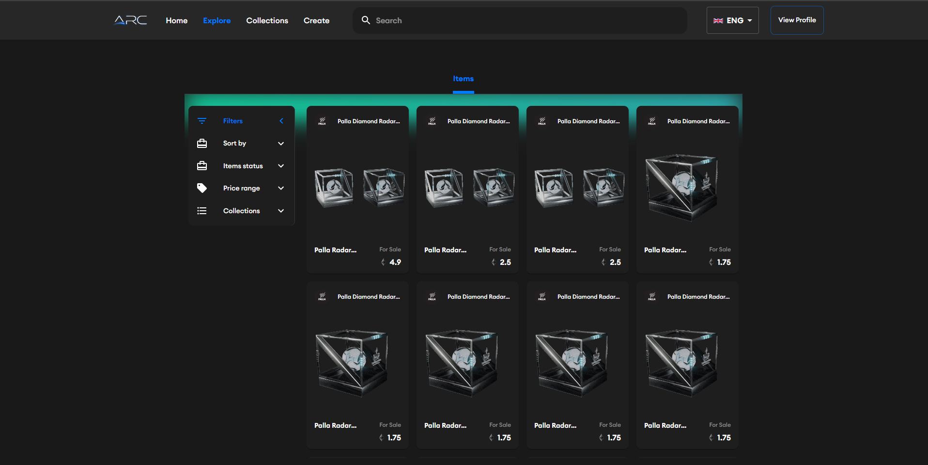
Part B: Web3
Web3 Integration: Reading

Slide 7
Part B: Web3
Smart Contracts
create an ERC20 token smart contract, call it your name or a unique id such as $JOHN123
create a staking smart contract, that is able to accept deposits of tokens and NFTs
create a marketplace smart contract, that is able to allow users to trade and swap tokens and NFTs
create a bridge contract
deploy the smart contracts, write tests, and demonstrate that they work on testnet or mainnet

Slide 8
Part B: Web3
Smart Contracts
create an ERC20 token smart contract, call it your name or a unique id such as $JOHN123
I uploaded USDT.sol

Slide 9
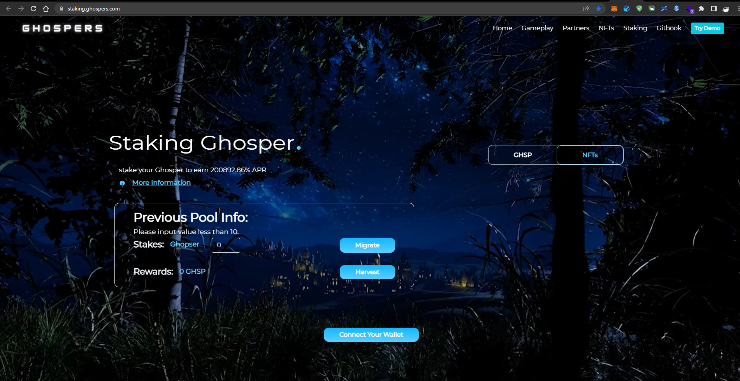
Part B: Web3
Smart Contracts
create a staking smart contract, that is able to accept deposits of tokens and NFTs (https://staking.ghospers.com/)

Slide 10
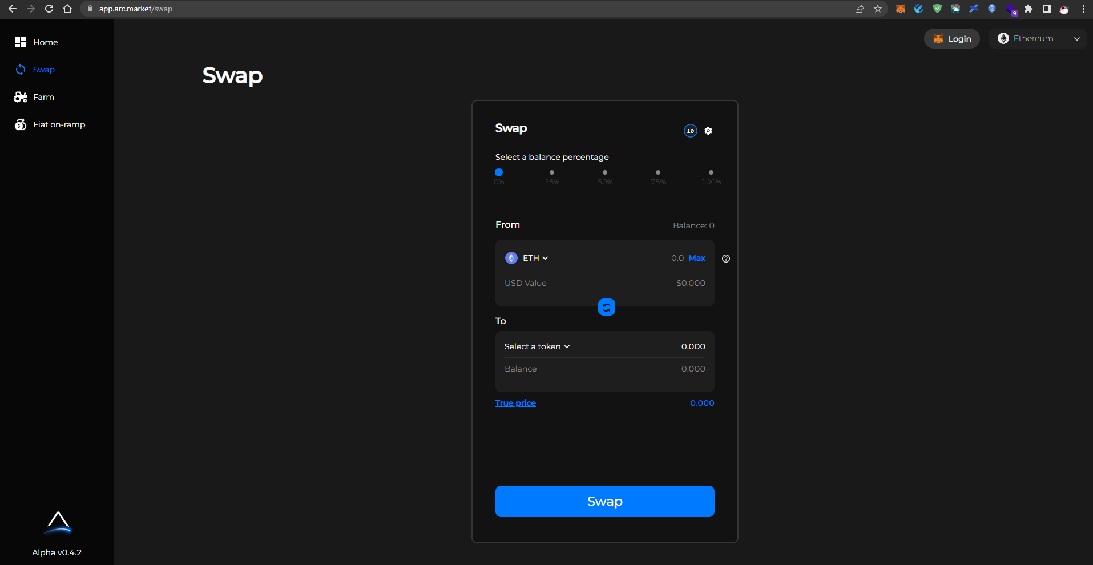
Part B: Web3
Smart Contracts
create a marketplace smart contract, that is able to allow users to trade and swap tokens and NFTs (https://app.arc.market/swap)

Slide 11
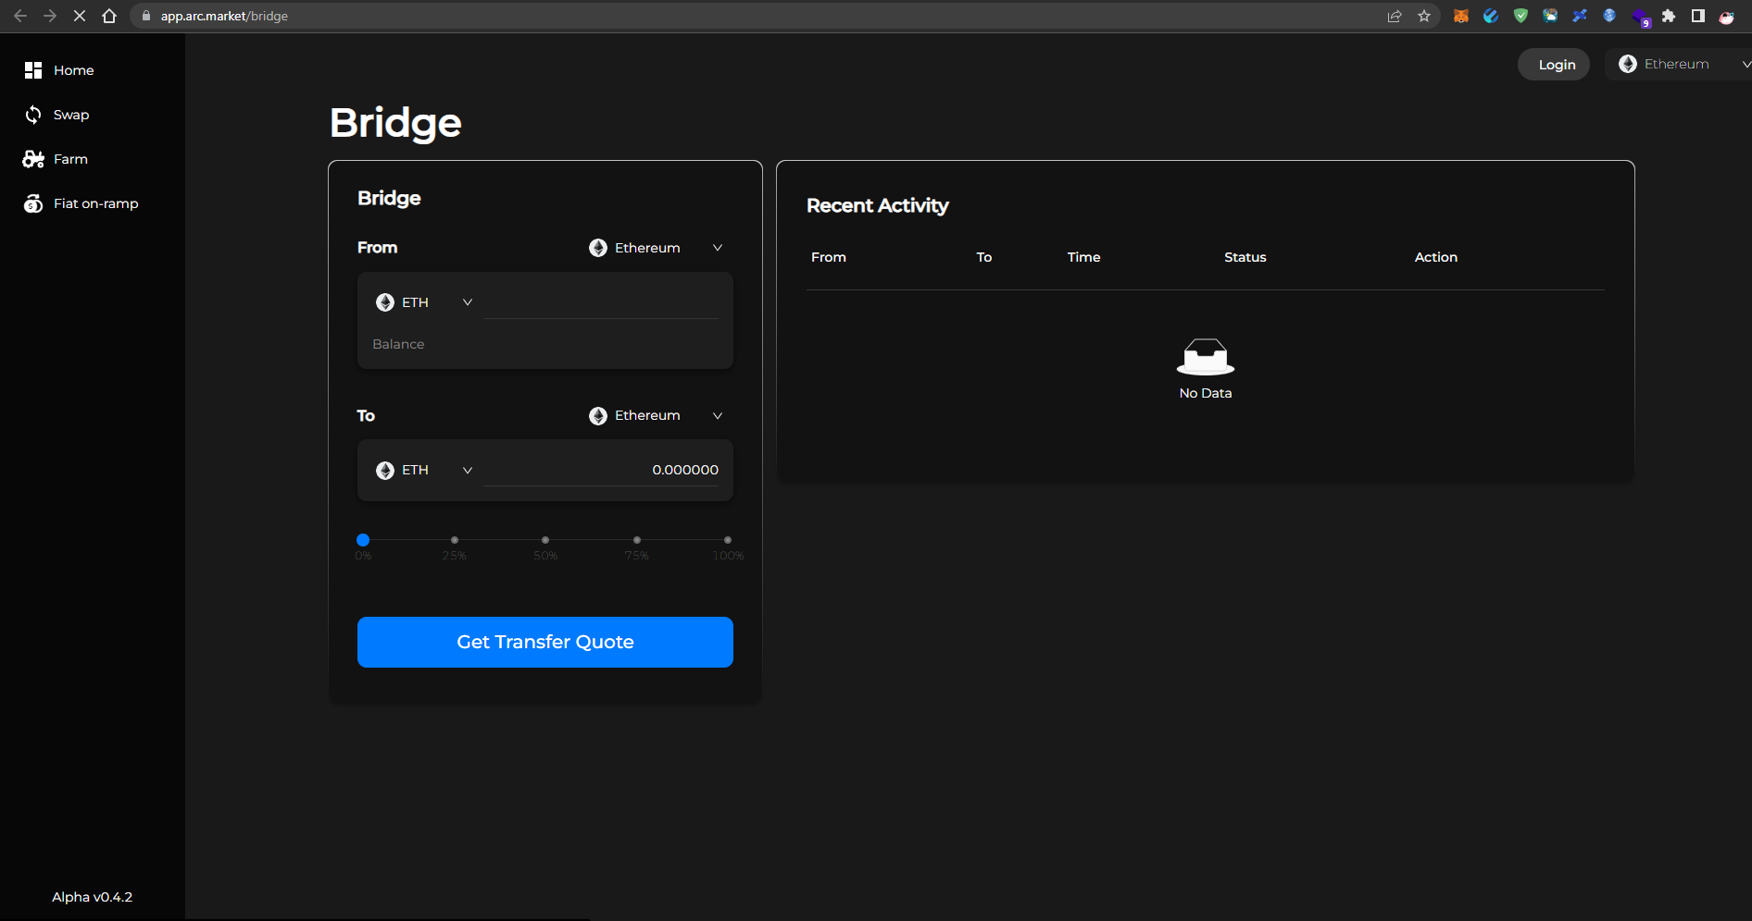
Part B: Web3
Smart Contracts
create a bridge contract (https://app.arc.market/bridge)

Slide 12
Part C: Infrastructure and Devops

Slide 13
Part C
Deployment to cloud
Demonstrate the tasks above can be deployed end to end on cloud (preferably on AWS)
dockerise the app
set up CI/CD pipelines or automated unit testing
host the app on serverless hosting on AWS e.g. container / cluster hosting services
connect to a database that is hosted on the cloud

Slide 14
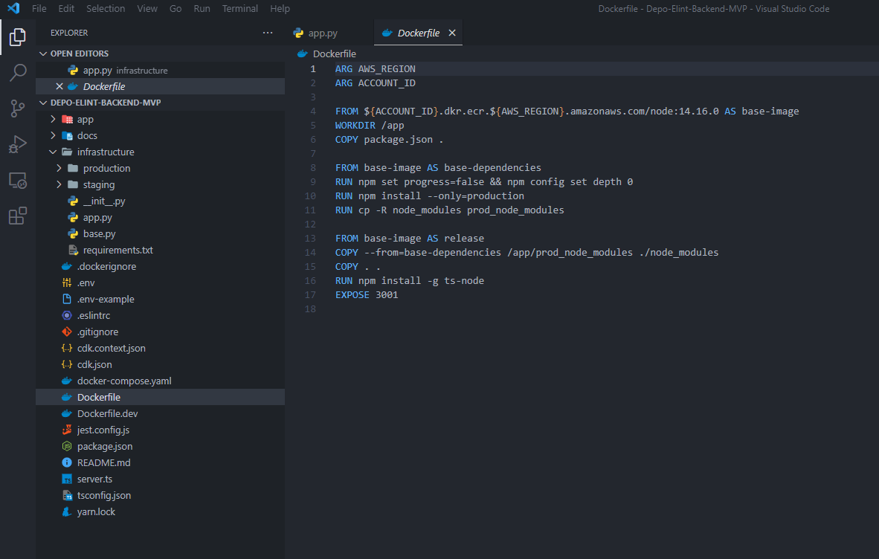
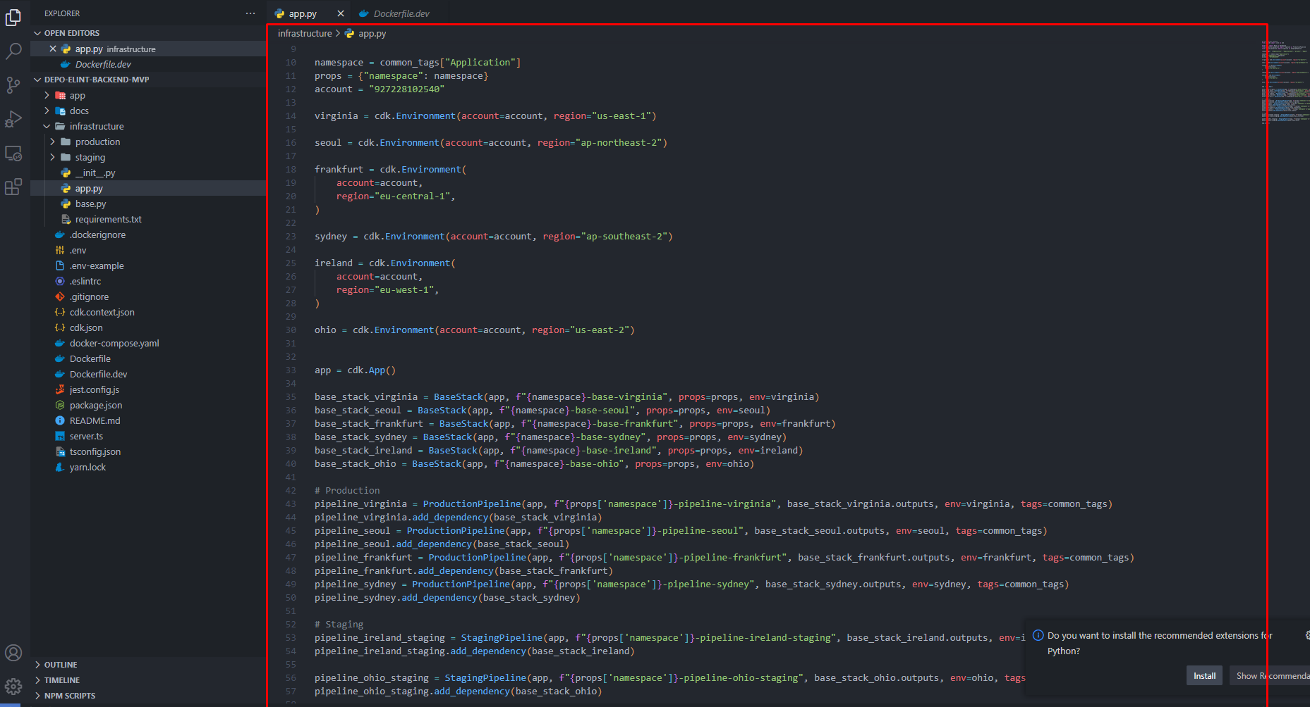
Part C
Deployment to cloud
I uploaded Depo-Elint-Backend-MVP project.

Slide 15
Part C
Bonus Task: Data Pipeline
We are also creating data pipelines, for storing audio recordings, and also other wearable device data e.g. Fitbit, Oura Ring, Apple Healthkit
create a data processing pipeline (ETL pipeline) where data stored in a cloud DataLake (e.g. s3 bucket) is processed by an ETL pipeline (e.g. PySpark) and finally ingested into a Data Warehouse (e.g. Amazon Redshift)
even better if the entire pipeline is deployed to the cloud, and has a serverless, autoscaling architecture

Slide 16
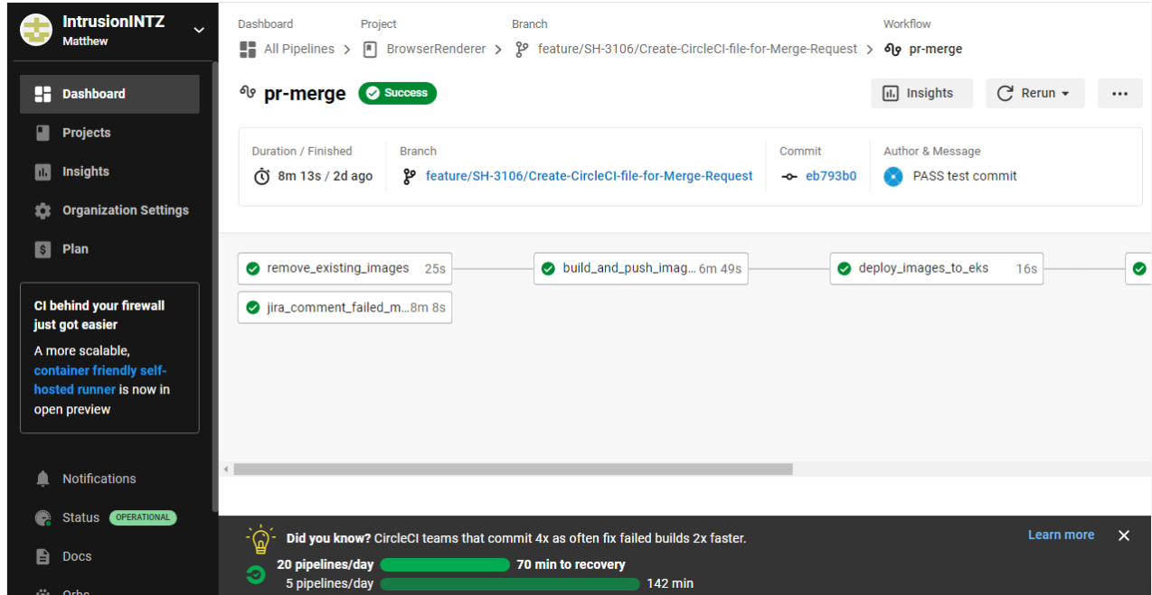
Part C
Bonus Task: Data Pipeline

Slide 17
Part C
Bonus Task: Infrastructure optimisation
Implement infrastructure features to the whole backend stack
cybersecurity measures
or some kind of monitoring tool / alert / disaster recovery method
proxy servers, firewalls, load-balancers etc

Slide 18
Part C
Bonus Task: Infrastructure optimisation
cybersecurity measures
Use strong passwords. Strong passwords are vital to good online security.
Control access to data and systems.
Put up a firewall.
Use security software.
Update programs and systems regularly.
Monitor for intrusion.
Raise awareness.

Slide 19
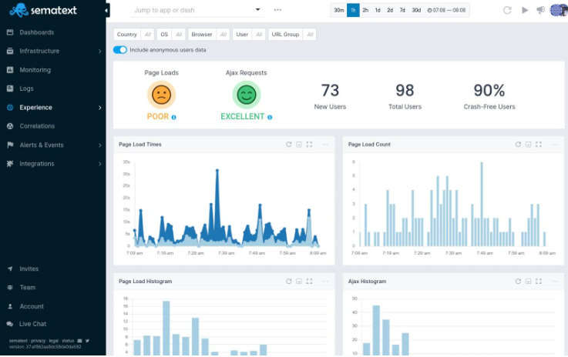
Part C
Bonus Task: Infrastructure optimisation
some kind of monitoring tool / alert / disaster recovery method
Sematext [freemium: free trial available]

Slide 20
Part C
Bonus Task: Open-ended!
If you have specific strengths in certain areas, feel free to demonstrate it. We are a company that incorporates games, data, and web3. There of opportunities to expand
upon your work!

Slide 21
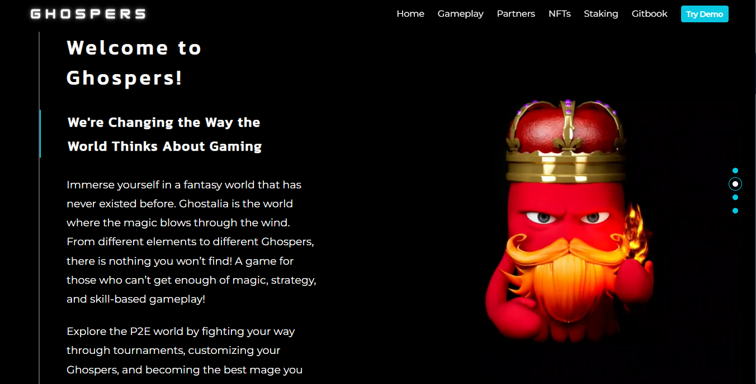
Part C
Bonus Task: Open-ended!

