Slide 2
Pandas Introduction
Python Pandas is defined as an open-source library that provides high-performance data manipulation in Python.
It is used for data analysis in Python and developed by Wes McKinney in 2008.
The name of Pandas is derived from the word Panel Data, which means an Econometrics from Multidimensional data.
Data analysis requires lots of processing, such as restructuring, cleaning or merging, etc.
There are different tools are available for fast data processing, such as Numpy, Scipy, Cython, and Panda.

Slide 3
Pandas Introduction
But we prefer Pandas because working with Pandas is fast, simple and more expressive than other tools.
Pandas is built on top of the Numpy package, means Numpy is required for operating the Pandas.
It can perform five significant steps required for processing and analysis of data irrespective of the origin of the data, i.e., load, manipulate, prepare, model, and analyze.

Slide 4
Key Features of Pandas
It has a fast and efficient DataFrame object with the default and customized indexing.
Used for reshaping and pivoting of the data sets.
Group by data for aggregations and transformations.
It is used for data alignment and integration of the missing data.
Provide the functionality of Time Series.
Process a variety of data sets in different formats like matrix data, tabular heterogeneous, time series.
Handle multiple operations of the data sets such as subsetting, slicing, filtering, groupBy, re-ordering, and re-shaping.

Slide 5
Benefits of Pandas
Data Representation:
It represents the data in a form that is suited for data analysis through its DataFrame and Series.
Clear code:
The clear API of the Pandas allows you to focus on the core part of the code.
So, it provides clear and concise code for the user.

Slide 6
Python Pandas Data Structure
The Pandas provides two data structures for processing the data, i.e., Series and DataFrame,
1) Series
It is defined as a one-dimensional array that is capable of storing various data types.
The row labels of series are called the index.
We can easily convert the list, tuple, and dictionary into series using "series' method.
A Series cannot contain multiple columns.

Slide 7
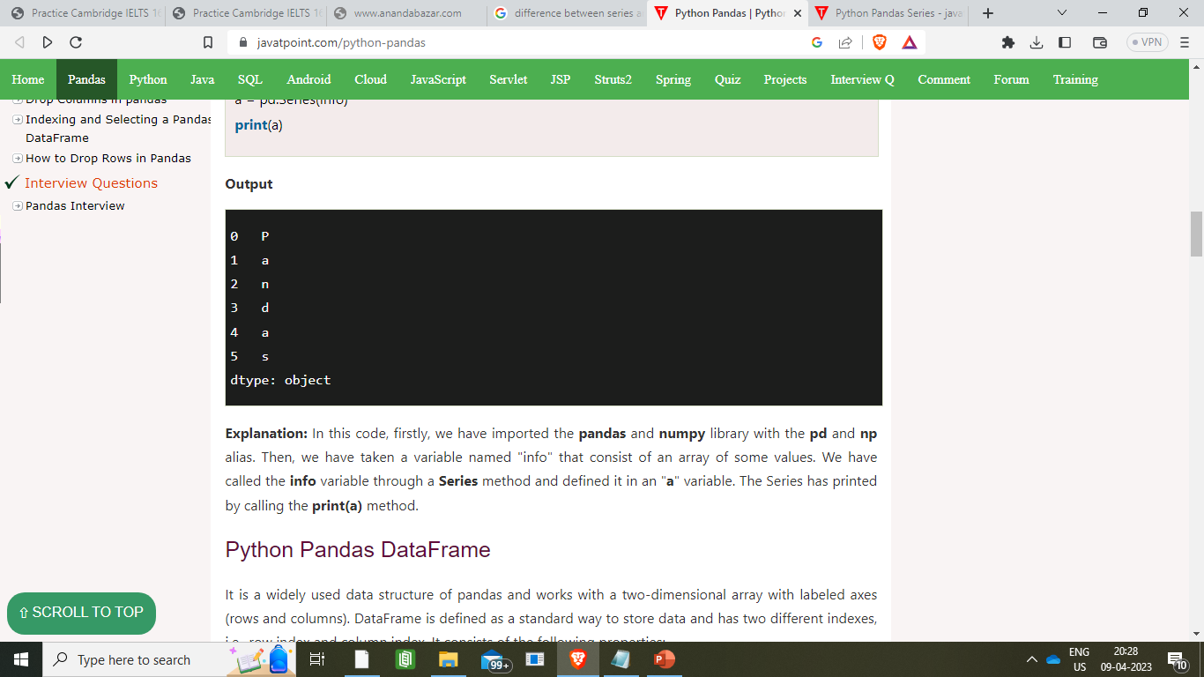
Creating Series from Array
import pandas as pd Output
import numpy as np
info = np.array(['P','a','n','d','a','s'])
a = pd.Series(info)
print(a)
Explanation:
In this code, firstly, we have imported the pandas and numpy library
Then, we have taken a variable "info" that consist of an array of some values.
We have called the info variable through a Series method and defined it in an "a" variable.
The Series has printed by calling the print(a) method.

Slide 8
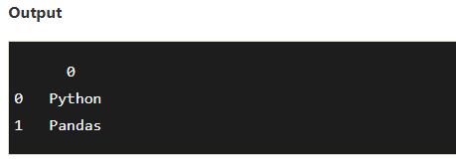
Python Pandas DataFrame
It is a widely used data structure of pandas and works with a two-dimensional array with labeled axes (rows and columns).
DataFrame is defined as a standard way to store data and has two different indexes, i.e., row index and column index.
Create a DataFrame using List:
import pandas as pd
# a list of strings
x = ['Python', 'Pandas']
Calling DataFrame constructor on list
df = pd.DataFrame(x)
print(df)

Slide 9
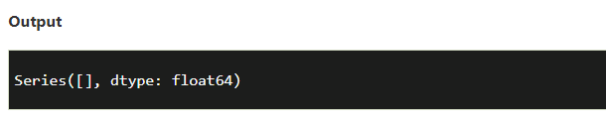
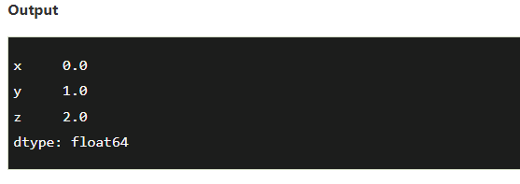
Creating a Series
Create an Empty Series
import pandas as pd
x = pd.Series()
print (x)
Create a Series from dict
import pandas as pd
import numpy as np
info = {'x' : 0., 'y' : 1., 'z' : 2.}
a = pd.Series(info)
print (a)

Slide 10
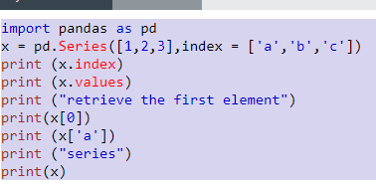
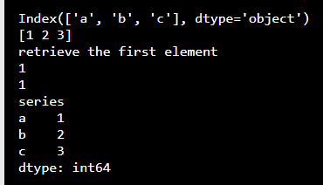
Accessing data from series with Position

Slide 11
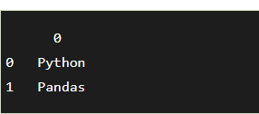
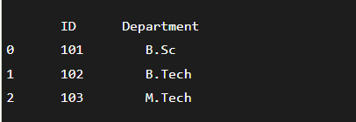
Create a DataFrame
Create an empty DataFrame
import pandas as pd
df = pd.DataFrame()
print (df)
Create a DataFrame from Dict of ndarrays/ Lists
import pandas as pd
info = {'ID' :[101, 102, 103],'Department' :['B.Sc','B.Tech','M.Tech',]}
df = pd.DataFrame(info)
print (df)

Slide 12
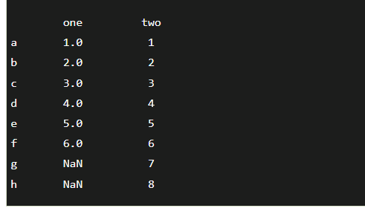
Create a DataFrame from Dict of Series
import pandas as pd
info = {'one' : pd.Series([1, 2, 3, 4, 5, 6], index=['a', 'b', 'c', 'd', 'e', 'f']),
'two' : pd.Series([1, 2, 3, 4, 5, 6, 7, 8], index=['a', 'b', 'c', 'd', 'e', 'f', 'g', 'h'])}
d1 = pd.DataFrame(info)
print (d1)
Here, a dictionary named "info" consists of two Series with its respective index.
For printing the values,
we have to call the info dictionary through a variable called d1 and pass it as an argument in print().

Slide 13
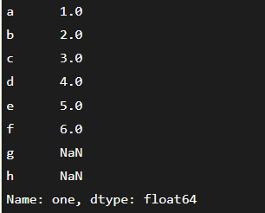
Column Selection
import pandas as pd
info = {'one' : pd.Series([1, 2, 3, 4, 5, 6], index=['a', 'b', 'c', 'd', 'e', 'f']),
'two' : pd.Series([1, 2, 3, 4, 5, 6, 7, 8], index=['a', 'b', 'c', 'd', 'e', 'f', 'g', 'h'])}
d1 = pd.DataFrame(info)
print (d1 ['one’])
Explanation:
a dictionary named "info" consists of two Series with its respective index.
Later, we have called the info dictionary through a variable d1 and selected the "one" Series from the DataFrame by passing it into the print().

Slide 14
Column Addition
# importing the pandas library
import pandas as pd
info = {'one' : pd.Series([1, 2, 3, 4, 5], index=['a', 'b', 'c', 'd', 'e']),
'two' : pd.Series([1, 2, 3, 4, 5, 6], index=['a', 'b', 'c', 'd', 'e', 'f'])}
df = pd.DataFrame(info)

Slide 15
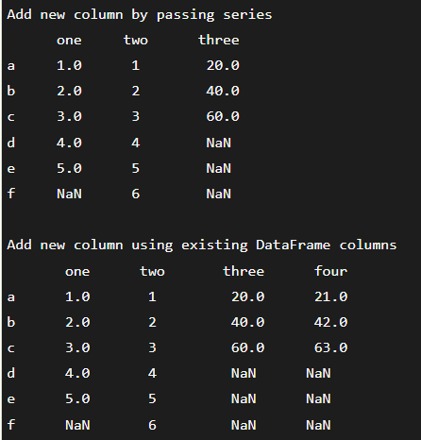
Column Addition
# Add a new column to an existing DataFrame object
print ("Add new column by passing series")
df['three']=pd.Series([20,40,60],index=['a','b','c'])
print (df)
print ("Add new column using existing DataFrame columns")
df['four']=df['one']+df['three']
print (df)

Slide 16
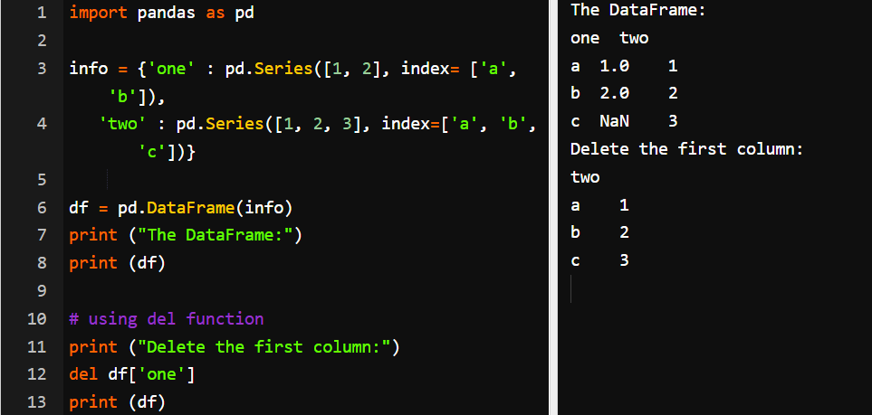
Column Deletion

Slide 17
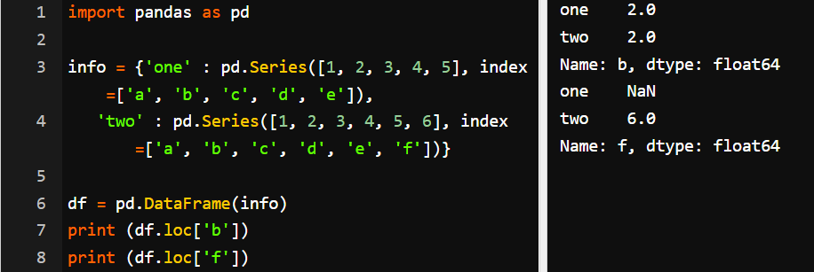
Row Selection

Slide 18
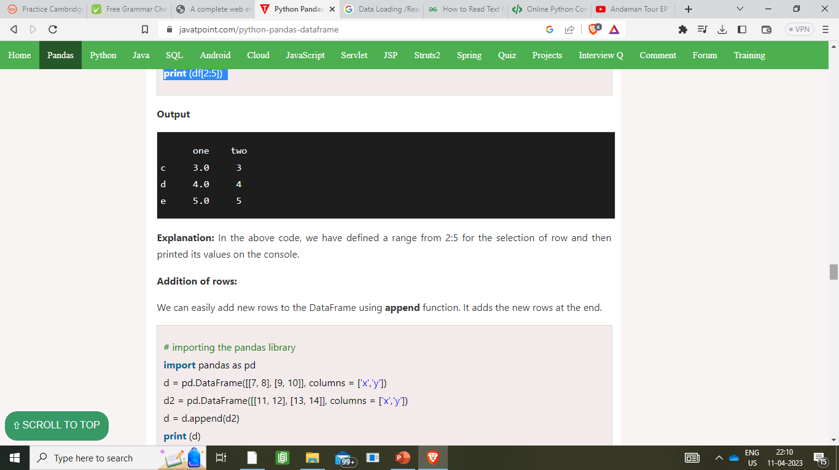
Slice Rows
# importing the pandas library
import pandas as pd
info = {'one' : pd.Series([1, 2, 3, 4, 5], index=['a', 'b', 'c', 'd', 'e']),
'two' : pd.Series([1, 2, 3, 4, 5, 6], index=['a', 'b', 'c', 'd', 'e', 'f'])}
df = pd.DataFrame(info)
print (df[2:5])

Slide 19
DataFrame Basic Functionality
T (Transpose)
Returns the transpose of the DataFrame. The rows and columns will interchange.
import pandas as pd
import numpy as np
# Create a Dictionary of series
d = {'Name':pd.Series(['Tom','James','Ricky','Vin','Steve','Smith','Jack']),
'Age':pd.Series([25,26,25,23,30,29,23]),
'Rating':pd.Series([4.23,3.24,3.98,2.56,3.20,4.6,3.8])}
# Create a DataFrame
df = pd.DataFrame(d)
print ("The transpose of the data series is:")
print (df.T)

Slide 20
Output
The transpose of the data series is:
0 1 2 3 4 5 6
Age 25 26 25 23 30 29 23
Name Tom James Ricky Vin Steve Smith Jack
Rating 4.23 3.24 3.98 2.56 3.2 4.6 3.8

Slide 21
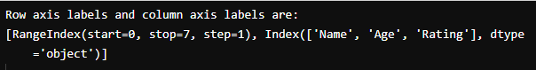
axes
import pandas as pd
import numpy as np
#Create a Dictionary of series
d = {'Name':pd.Series(['Tom','James','Ricky','Vin','Steve','Smith','Jack']),
'Age':pd.Series([25,26,25,23,30,29,23]),
'Rating':pd.Series([4.23,3.24,3.98,2.56,3.20,4.6,3.8])}
#Create a DataFrame
df = pd.DataFrame(d)
print ("Row axis labels and column axis labels are:")
print df.axes

Slide 22
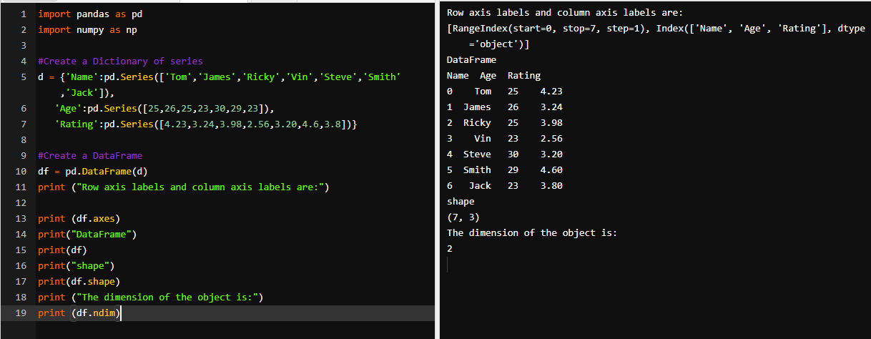
DataFrame Basic Functionality

Slide 23
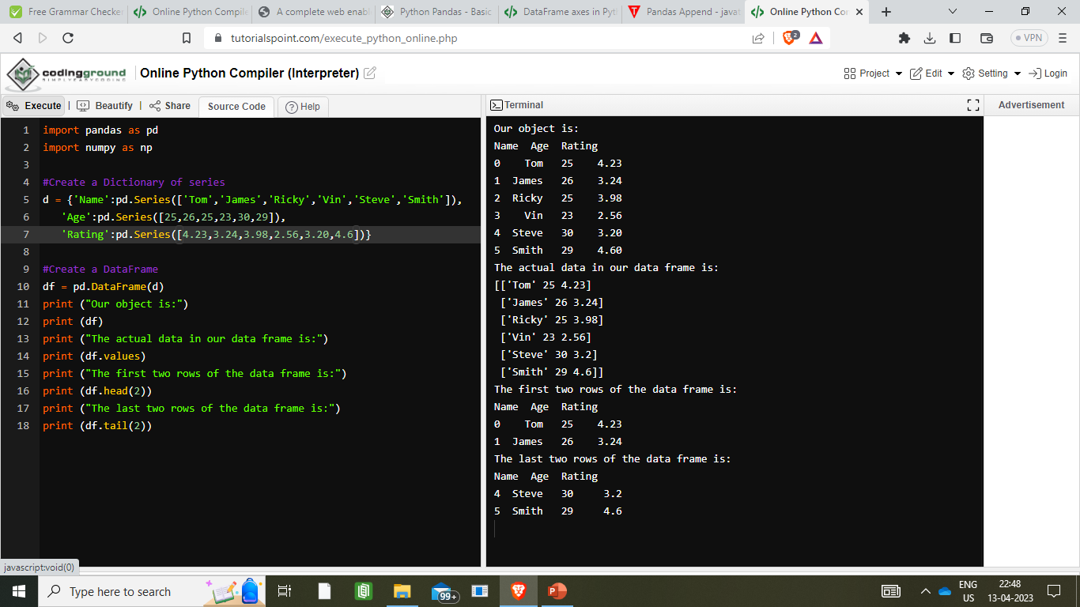
DataFrame Basic Functionality

Slide 24
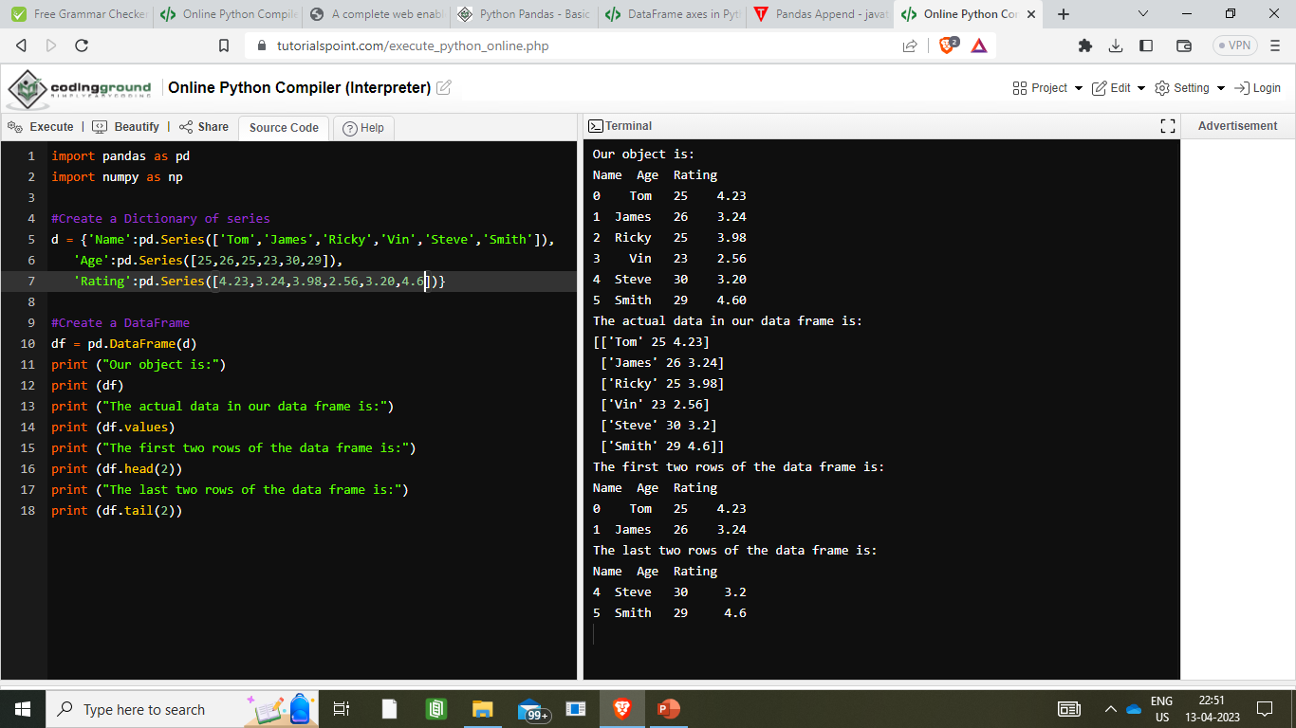
Output

Slide 25
Descriptive Statistics in Python Pandas
Sr.No. | Function | Description
1 | count() | Number of non-null observations
2 | sum() | Sum of values
3 | mean() | Mean of Values
4 | median() | Median of Values
5 | mode() | Mode of values
6 | std() | Standard Deviation of the Values
7 | min() | Minimum Value
8 | max() | Maximum Value
9 | abs() | Absolute Value

Slide 26
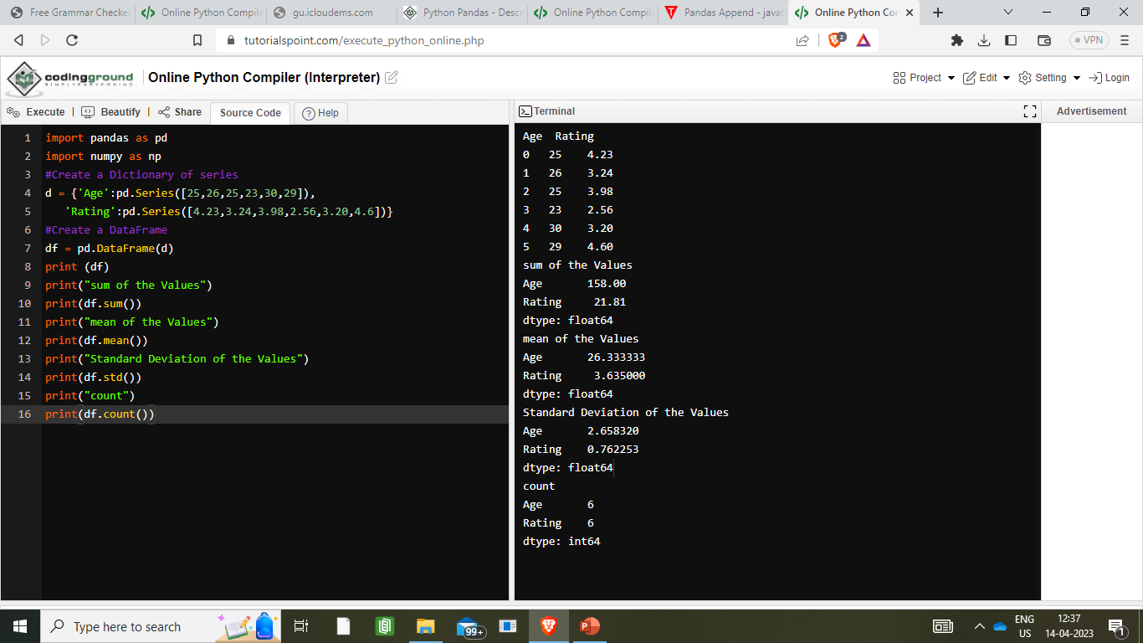
Example

Slide 27
Output

Slide 28
Summarizing Data
The describe() function computes a summary of statistics
import pandas as pd
import numpy as np
d = {'Name':pd.Series(['Tom','James','Ricky','Vin','Steve','Smith','Jack',
'Lee','David','Gasper','Betina','Andres']),
'Age':pd.Series([25,26,25,23,30,29,23,34,40,30,51,46]),
'Rating':pd.Series([4.23,3.24,3.98,2.56,3.20,4.6,3.8,3.78,2.98,4.80,4.10,3.65])}
#Create a DataFrame
df = pd.DataFrame(d)
print (df.describe())

Slide 29
Output
Age Rating
count 12.000000 12.000000
mean 31.833333 3.743333
std 9.232682 0.661628
min 23.000000 2.560000
25% 25.000000 3.230000
50% 29.500000 3.790000
75% 35.500000 4.132500
max 51.000000 4.800000

Slide 30
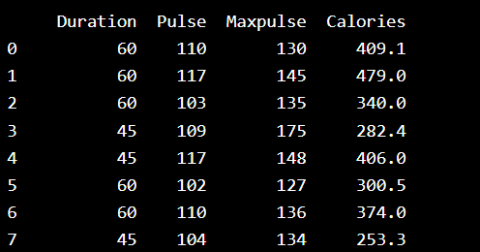
Read CSV Files
A simple way to store big data sets is to use CSV files (comma separated files).
Load the CSV into a DataFrame
import pandas as pd df = pd.read_csv('data.csv') print(df.to_string())

Slide 31
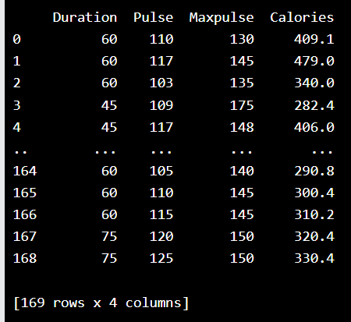
Read CSV Files
If you have a large DataFrame with many rows, Pandas will only return the first 5 rows, and the last 5 rows:
import pandas as pd
df = pd.read_csv('data.csv')
print(df)

Slide 32
Read JSON
import pandas as pd df = pd.read_json('data.json') print(df.to_string())

Slide 33
Read Excel
import pandas
excel_data_df = pandas.read_excel('records.xlsx', sheet_name='Employees')
# print whole sheet data
print(excel_data_df)

