Slide 1


INTERNSHIP FINAL PRESENTAION ON FRONT END DEVELOPMENT USING “REACT JS”
Tribhuvan University
Bachelor of Science in Computer Science and Information Technology (BSc.CSIT)
Swastik College
Chardobato, Bhaktapur
Prepared By : Dev Raj Basnet
Roll No : 24370/076

Slide 2
INTRODUCTION | 3
ORGANIZATION INTRODUCTION | 4
INTERN DEPARTMENT | 5
ORGANIZATION HIERARCHY | 6
INTERNSHIP DURATION | 7
ROLES AND RESPONSIBILITIES | 8
PROJECT INTRODUCTION | 9
OBJECTIVES | 10
SCOPES | 11
LIMITATION | 12
TASKS ACTIVITIES PERFORMED | 13
CONCLUSION | 14
LEARNING OUTCOMES | 15
REFERENCES | 16
Presentation
Outline
APPENDIX | 17-21

Slide 3
introduction
Organization Introduction
Intern Department
Project Introduction

Slide 4

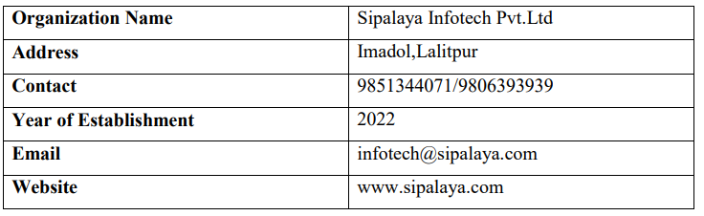
Organization introduction
Sipalaya Infotech Pvt. Ltd. is a professional software company in Kathmandu, Nepal.
They believe in providing cost effective and reliable services to their clients with their highly skilled team members.
Located at Imadol,Lalitpur.
Services are :
Web App Development
UI/UX and Graphic Design
SEO and Marketing
Mobile App Development

Slide 5
Intern department
Sipalaya Infotech provide 3 months long internship program according to domain they worked on.
I was hired as an intern in frontend learning and development department in React Js.
This internship is essential for Sipalaya Infotech as it prepares interns to become professional software developers and some may even receive job offers from the company upon completion.

Slide 6
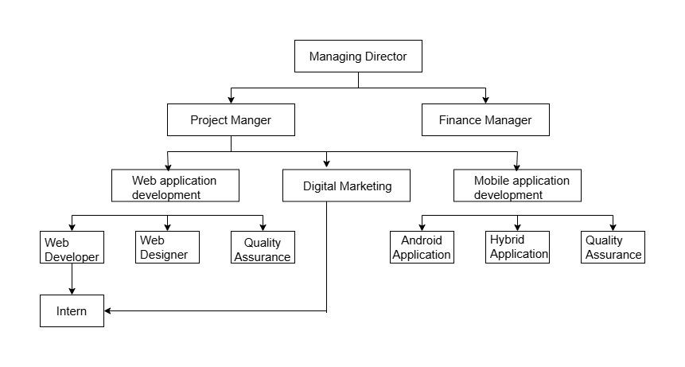
INTERN DEPARTMENT and organization hiearchy

Slide 7
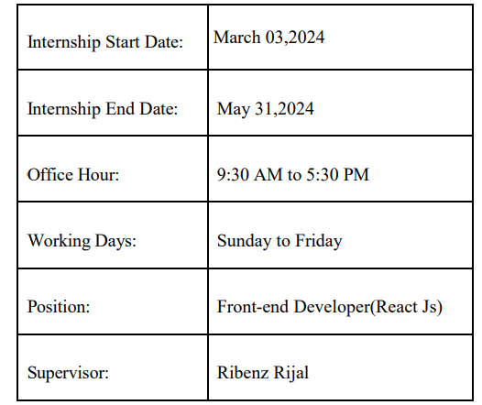
Internship duration

Slide 8
Roles and responsibilities
The roles and responsibilities that I have fulfill during my internships are listed below :
Attending daily stand-up meetings with colleagues
Performing the task assigned.
Documenting the task performed
Creating reusable components and layouts for the system
Fixing bugs and errors
Keeping the git repository updated
Developing a frontend of app from the provided requirements
Involvement and collaboration with another team

Slide 9
Project introduction
During my internship at Sipalaya Infotech, I undertook a significant project involving the development of website named “recipe finder”.
This platform was designed to create a robust and user-friendly application where users can search for recipes by keyword or name and found the ingredients, cuisine, preparation time, Instructions and Youtube videos for that recipe.
For the development, we utilize HTML, CSS, JavaScript and React Js was chosen for its component-based architecture which allows for the creation of reusable UI components enhancing development efficiency and maintainability.
In this project We use React Js basics like hooks components,state and props, routing ,JSX etc. for developing this project.

Slide 10
objectives
Create a visually appealing and easy-to-navigate interface using React JS.
Use external APIs like Forkify to access and display comprehensive recipe data, including ingredients, instructions, and related YouTube videos.
Ensure the application follows best practices in React for state management, component lifecycle, and hooks.

Slide 11
sCOPE
Comprehensive Recipe Search: Users can find recipes by entering a recipe name or keyword.
Detailed Information: Each recipe includes nutritional information, ingredients, and step-by-step instructions.
Enhanced User Experience: The interface is intuitive and easy to navigate, with related YouTube videos for visual guidance.

Slide 12
LIMITATION
Ingredient-Based Search and Personalization: The effectiveness of these features relies on the completeness and accuracy of the database and user data.
Dietary Restrictions: The website may not fully accommodate all dietary restrictions.
Nutritional Information Accuracy: Nutritional information might not be entirely accurate, particularly for user-submitted recipes.

Slide 13
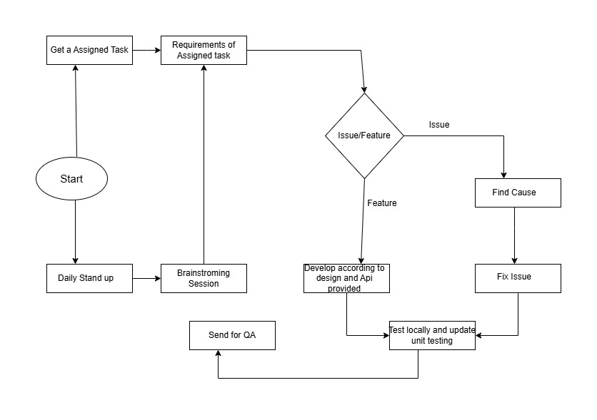
Tasks/Activities performed
During the Internship period, I have performed different tasks and which incudes understanding the work culture, the system requirements by having weekly meetings, designing the Recipe finder project as for the requirements and implementing the functionality according to it. Then, fixing bugs and errors is also one major task performed.

Slide 14
conclusion
Throughout my internship in Frontend development , I have gained invaluable experience and skills that have significantly enhanced my capabilities in networking. Working with React has not only deepened my understanding of Javascript frameworks but also provided practical insights into building efficient and scalable user interfaces.
During this internship, I had opportunity to:
Master React: I became proficient in components, state management,routing and JSX syntax, allowing me to build interactive and responsive UI components.
Collaborate in Agile Environment: Working within agile teams taught me how to communicate effectively, prioritize tasks and deliver results in iterative cycles.
Utilize Modern Development tools: I integrated tools like Git for version control, npm for package management and various testing frameworks to ensure code quality and performance.

Slide 15
Learning outcomes
I have learn from internship can be listed as follows :
Implementation of Higher Order Components (HOC) for reusing components logic.
Gain experience working in a professional environment.
Learn about the software development industry.
Git workflow.
Time Management.

Slide 16
REFERENCES
Cooper, A. (2019). Virtual DOM in React: A comparative analysis. *Journal of Software Development*, 12(2), 45-58.
Bach, C., et al. (2020). React and its potential for complex applications. *Journal of Web Engineering*, 19(3), 251-267.
Tuch, A. N., et al. (2018). User interface design principles for web applications. *International Journal of Human-Computer Interaction*, 34(5), 421-438.
Suman, P., et al. (2020). Performance optimization techniques in React applications. *Journal of Computer Science and Technology*, 25(3), 432-445.

Slide 17
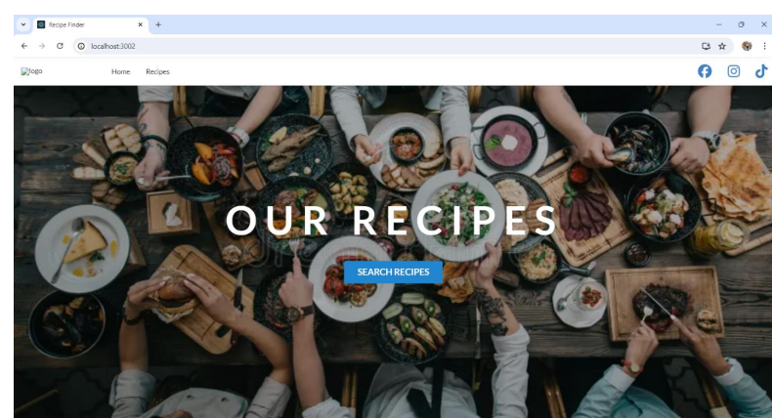
aPPENDIX

Slide 18
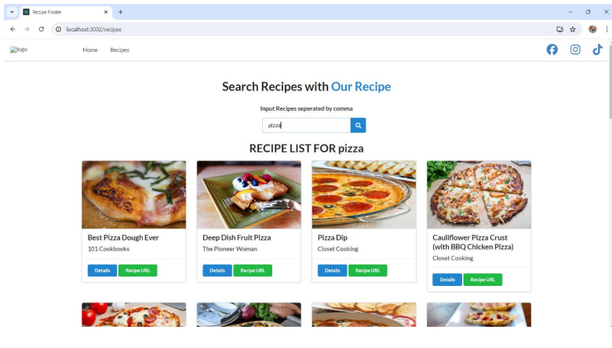
aPPENDIX

Slide 19
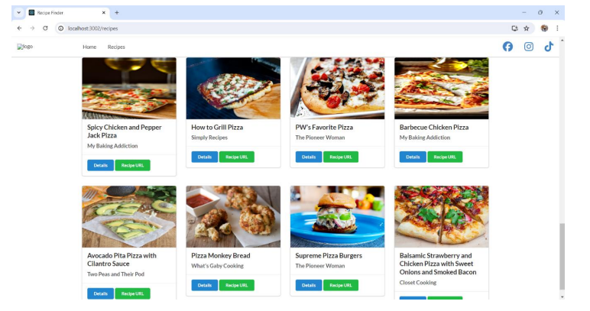
aPPENDIX

Slide 20
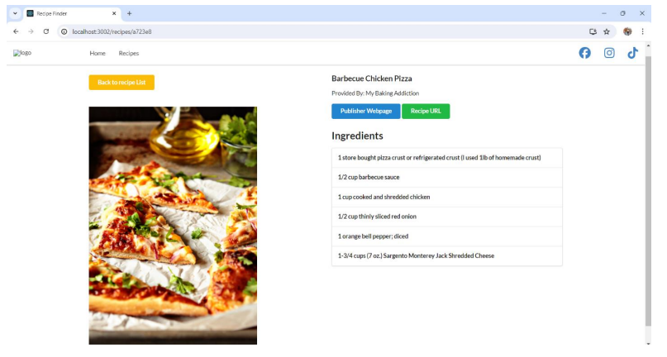
aPPENDIX

Slide 21
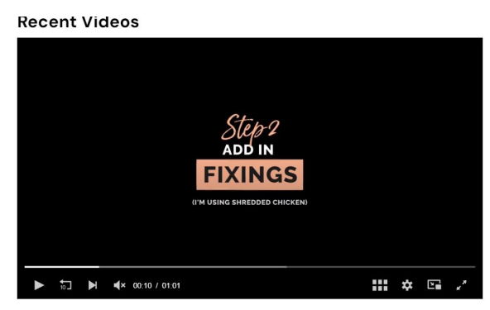
aPPENDIX

Slide 22
Thank you !!!!!!!

