Slide 1
businessplan
Coworkingspace – housing boat

Slide 2
Wouter Devriese
Working for IMEC as hardware prototyping engineer
De Krook, Ghent
Full-time
Educated as Engineer
Varia:
Chiro (scouting)
Musician
Creative, social and enterprising

Slide 3
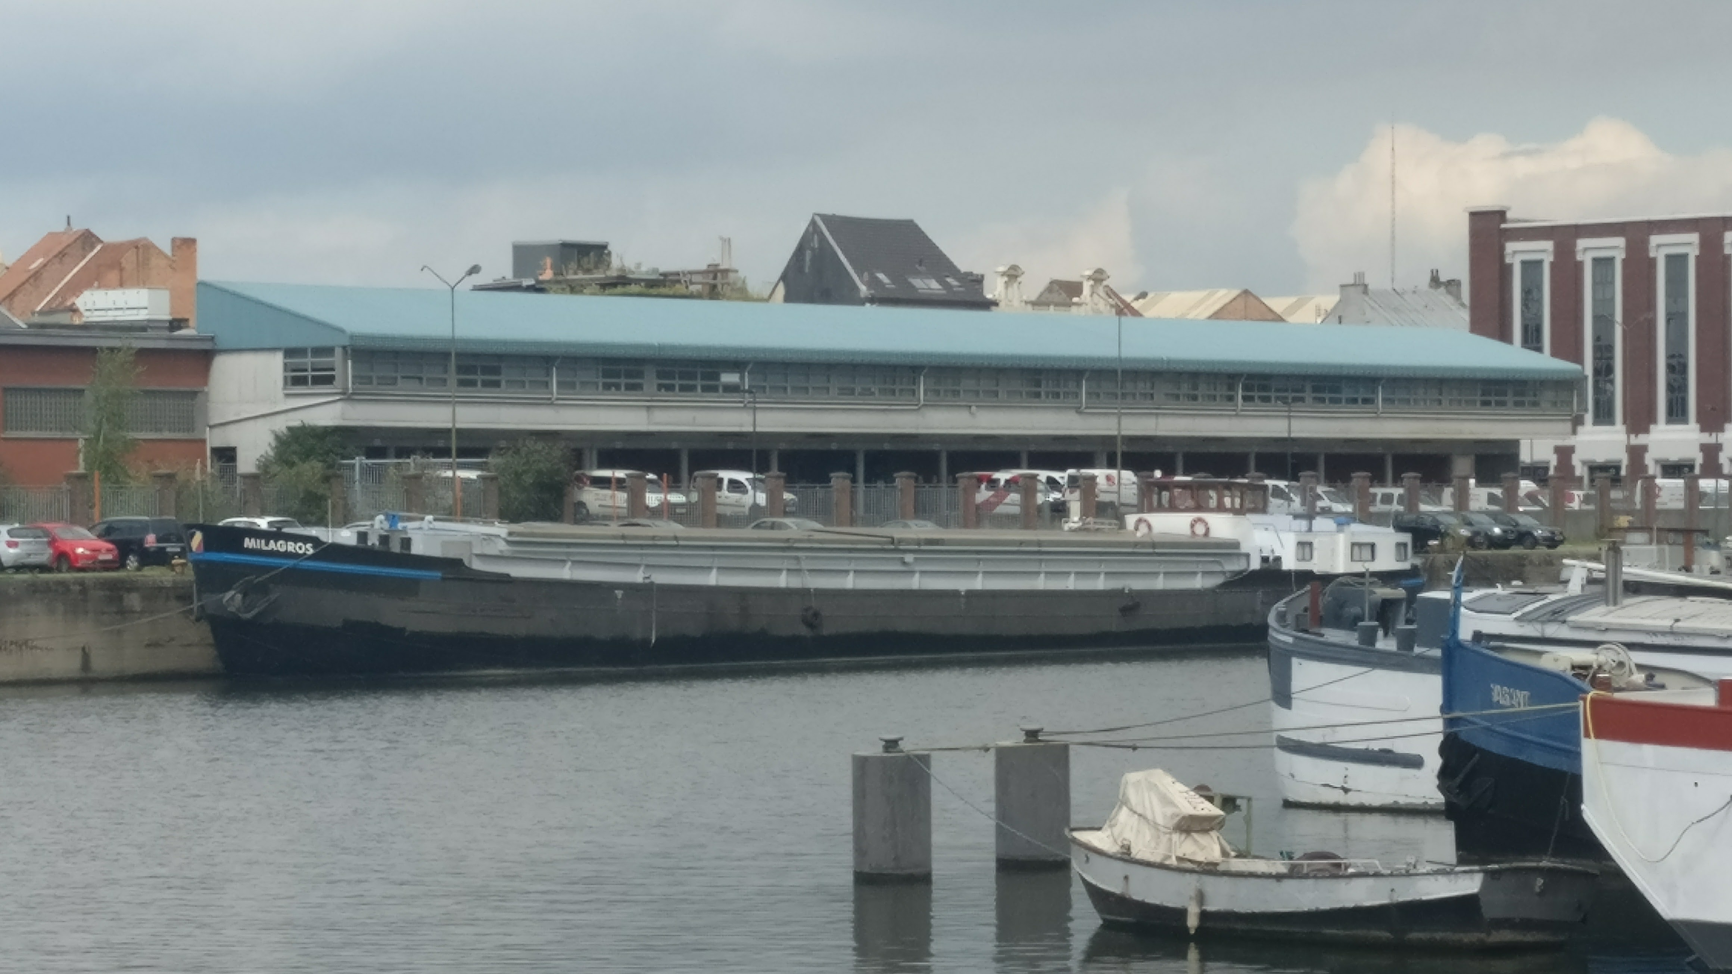
Plan: kempenaar Milagros Handelsdokkaai
House
Coworking-space

Slide 4
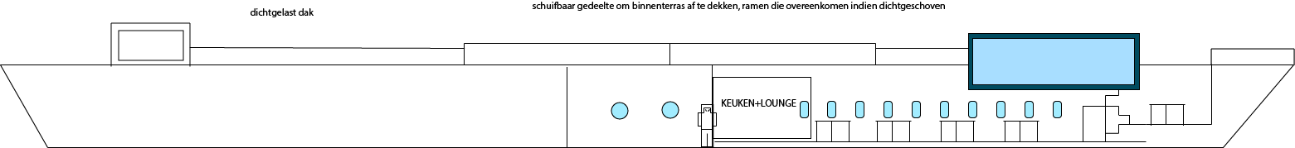
What?
Co-workingspace:
1 large space with 16 desks
Less desks than could be placed, to maintain spacious feeling
Lots of light, green and space
View on the canal
Basic work facilities:
Coffee, tea, refridgerator, microwave in small kitchen, toilet

Slide 5
What?
Co-workingspace:
Meeting room (1) in a second floor
Inner terrace that can be overrun in case of bad weather
Outer terrace
(3)
(2)
(1)

Slide 6
Co-workingspace
multiple co-workingspaces in Ghent
All kinds of
Lots of people searching for
Make sure I’m not addressing all people, but people with a unique location in mind
Reach out for clients:
Work (imec iStart & de Krook (small companies accompanying startups))
Social connections
Location of the boat (new ‘hip’ scene):
park, easy to reach with public transport, view on the water
Combined events with the commercial boats in the environment
Presence at startup events

Slide 7
House
Buy boat & start living in captain’s corridor
1
Good as a start
Wait on co-workingspace to be renovated + promotion campaign co-working space
2
Common work done for both house and co-workingspace
Finishing the house: non-crucial ➔ can be done on a slower pace and individual
3

Slide 8
Phases
Phase 1: buy boat
Phase 2: Renovations:
Common steel works
Done by professionals
Time is crucial
Assist when possible
Phase 3:
Renovate the house

Slide 9
Costs analytics: One-off costs
phase 1:
1
boat: 130.000 EUR (+5000 EUR commision)
Phase 2:
2
Renovation co-workingspace (part house): 120.000 EUR
(done in 6 months)
Phase 3:
3
Renovation house: 70.000 ^{EUR} (WCS)
Lower when done by myself

Slide 10
Costs analytics: yearly costs
Port charges: 7800 EUR
Costs drydock + reparations (1/7 jaar): 1400 EUR
cleaning: 3120 EUR
EGW: 2400 EUR
Internet: 500 EUR
Accountant: 500 EUR
Insurance: 1000 EUR
Costs of kitchen: 500 EUR
Publicity: 1000 EUR

Slide 11
Income
Each month: 1000 EUR own investment, 12k/year
Co-working:
1 desk rented @ 500 EUR/month
others @ 300EUR/month
 | 2018 | 2019 | 2020
BCS | 12000 (5cl*4m) | 34800 (clkl) | 42000 (10cl)
WCS | 9600 (3cl*4m) | 24000 (clkl) | 31200 (7cl)

Slide 12
Results
 | 2018 | 2018 | 2020
BCS
income | 12.000 | 34.800 | 42.000
Costs + depreciation | 23.243 | 25.314 | 26.485
revenue | -11.243 | 9.485 | 15.514
WCS
income | 9.600 | 24.000 | 31.200
Costs + depreciation | 23.243 | 25.314 | 26.485
revenue | -13.643 | -1.314 | 4.715

