Slide 1
COGAI4SCI LAB NUS INTERNSHIP ASSIGNMENT BY DEV RISHI VERMA
AD-AUTOGPT: AN AUTONOMOUS GPT FOR ALZHEIMER’S DISEASE INFODEMIOLOGY
22nd Oct, 2024

Slide 2

CONTENT
01
OVERVIEW
02
PROBLEM TO BE ADDRESSED
03
AD-AUTOGPT ARCHITECTURE
04
CASE STUDY AND EXPERIMENTAL RESULTS
05
POTENTIAL IMPROVEMENTS

Slide 3
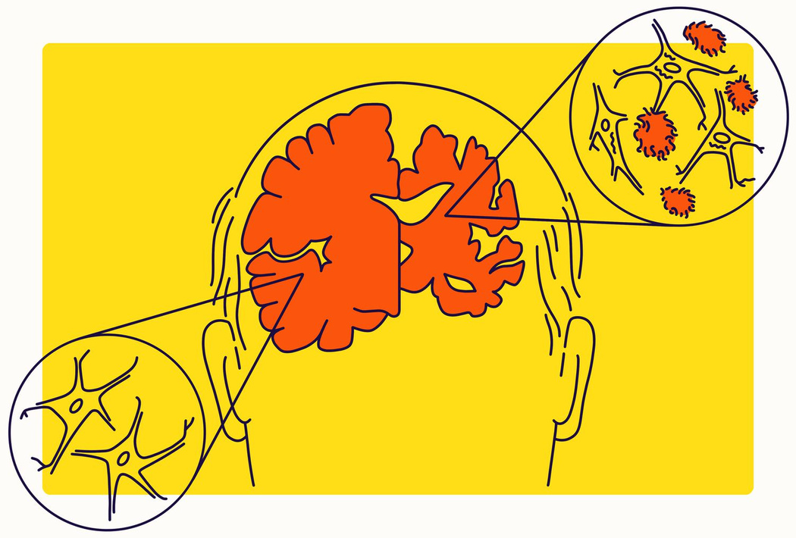
ALZHEIMER’S
Alzheimer's disease occurs due to abnormal changes in the brain, primarily involving two types of proteins: beta-amyloid and tau. Beta-amyloid proteins accumulate between nerve cells, forming plaques, while tau proteins inside the cells twist into tangles. These changes disrupt communication between brain cells and eventually lead to cell death, causing a decline in memory, thinking, and overall cognitive function. Over time, this damage spreads throughout the brain, leading to the progressive symptoms associated with Alzheimer's.

Slide 4

THE ISSUE
Despite the severity of Alzheimer's Disease (AD), a significant gap in data-driven public understanding persists, hindering the grasp of its complexities.
Public health professionals rely on labor-intensive methods like web scraping and API data collection to gather insights from various sources.
The vast scale of global data necessitates innovative approaches to efficiently extract actionable insights, while the required technical expertise limits access for many public health professionals.

Slide 5

WHY NOT AUTOGPT?
AutoGPT offers promise by automating data collection and analysis, but it faces challenges like inconsistent handling of unstructured data, limited understanding of nuanced topics, and a heavy reliance on computing power. These issues can hinder its broad application, underscoring the need for further improvements to better serve the public health community.

Slide 6

WHY AD-AUTOGPT?
Targeted Focus: AD-AutoGPT is specifically designed for Alzheimer's Disease, allowing for more relevant and precise insights in the public health domain.
Enhanced Data Processing: It improves efficiency and accuracy in data retrieval, summarization, and analysis, offering deeper insights into complex health narratives.
Dynamic Visualizations: AD-AutoGPT features robust visualization capabilities, enabling effective communication and interpretation of complex data.

Slide 7

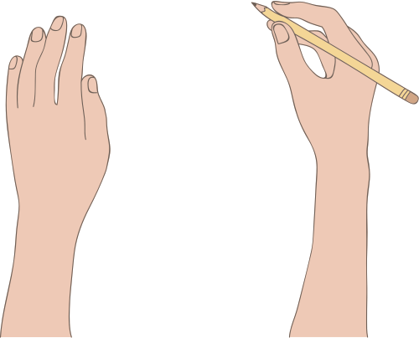
ARCHITECUTRE

Slide 8
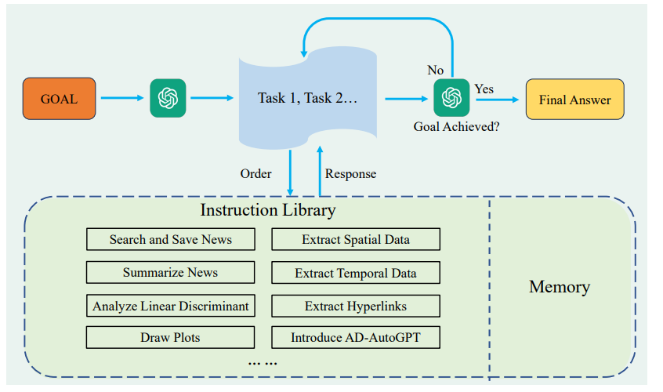
Input Prompt Components:
Question: Defines the problem the AI needs to solve.
Thought: Outlines the reasoning and thought process used to address the problem.
Action: Identifies the operation selected as the best solution.
Action Input: Provides the input needed for the function execution.
Output Prompt Components:
Observation: Presents the result of the function, guiding the AI’s next step.
Thought: Evaluates the observation and its influence on the next move.
Final Answer: Offers a conclusive judgment, with an iterative loop continuing until a satisfactory solution is reached.
AD-AutoGPT's framework features an instruction library of commands designed for public health infodemiology tasks, allowing for future expansion. It accesses GPT-4 to break down the main goal into smaller tasks, selecting and executing the most appropriate command for each sub-task. If the objective is not achieved, it continues to divide the task further until the final answer is returned.

Slide 9
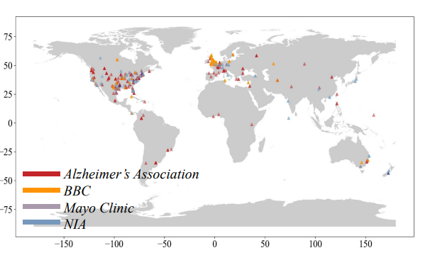
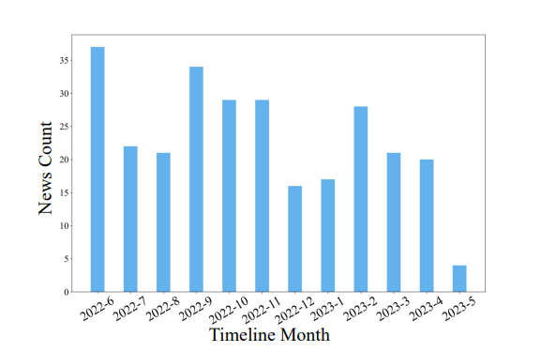
CASE STUDY AND EXPERIMENTAL RESULTS
Alzheimer's Disease News Information Retrieval
AD-AutoGPT autonomously gathered 277 news articles from reputable Alzheimer’s sources over a year, managing all aspects of the process—including text extraction, summarization, spatiotemporal analysis, topic modeling, and visualization—without human oversight.
Visualization of Spatiotemporal Data
The model visualized the geographical distribution of Alzheimer’s-related articles, revealing a significant concentration in the U.S. and Western Europe. A temporal analysis showed a notable surge in coverage during September 2022, demonstrating the model's ability to track trends over time.

Slide 10
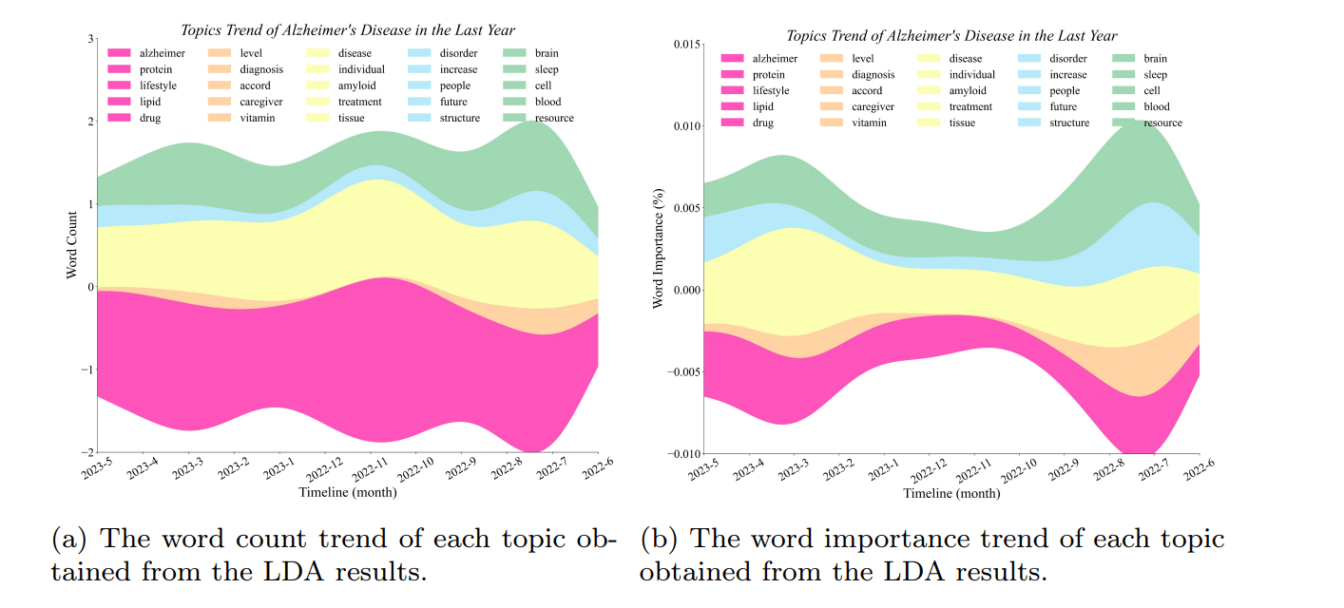
LDA Topic Modeling and Hot Topic Analysis
Using Latent Dirichlet Allocation (LDA), AD-AutoGPT identified key research topics and monitored keyword trends, enabling users to quickly grasp prevailing research without sifting through lengthy reports, thus streamlining the extraction of valuable insights from extensive information.

Slide 11

POSSIBLE IMPROVEMENTS

Slide 12
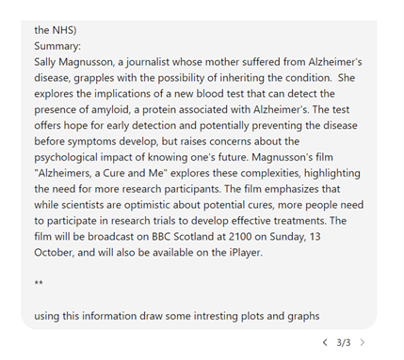
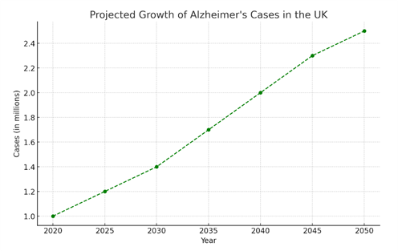
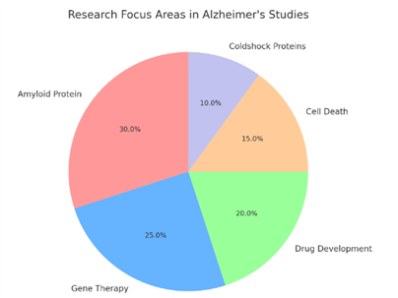
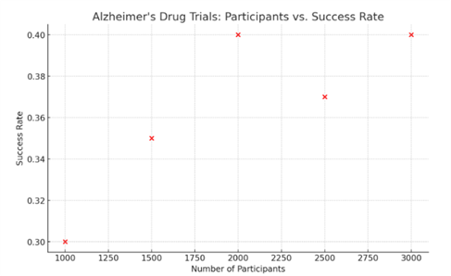
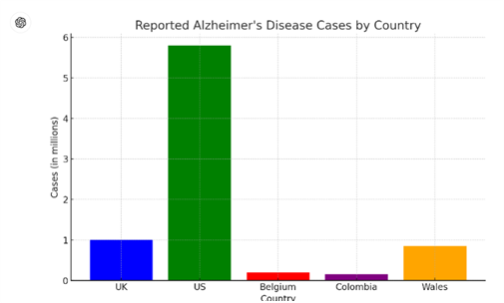
While the visualizations offer useful insights, they lack precision in addressing user queries, highlighting room for improvement. Instead of static plots generated from predefined commands, we could use GPT-4 for dynamic, query-driven visualizations, enhancing user experience with clearer, actionable insights.

Slide 13
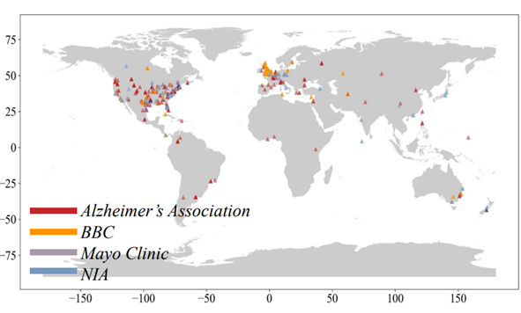

AD-AutoGPT currently relies on a limited set of news sources, such as BBC, Mayo Clinic, Alzheimer’s Association, and the National Institute on Aging (NIA), primarily from the US and UK. This narrow focus restricts the global scope of the data, as seen in the visualization map, which shows sparse representation from Asian countries and other regions, while the US and UK are densely populated with data points. Expanding the range of news sources and including research articles from various regions would provide a more comprehensive and accurate global perspective on Alzheimer’s disease trends and discussions.

Slide 14
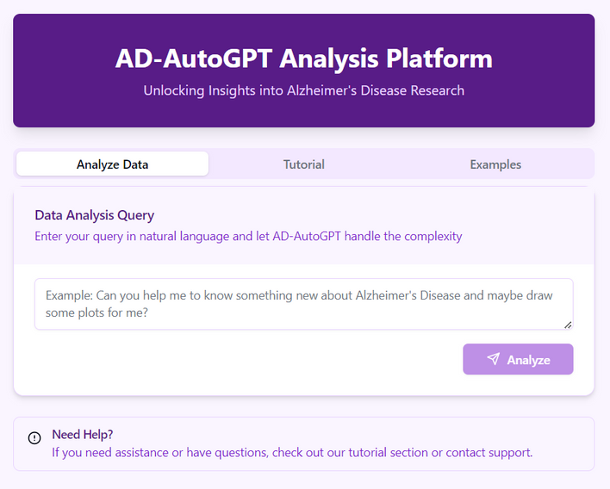
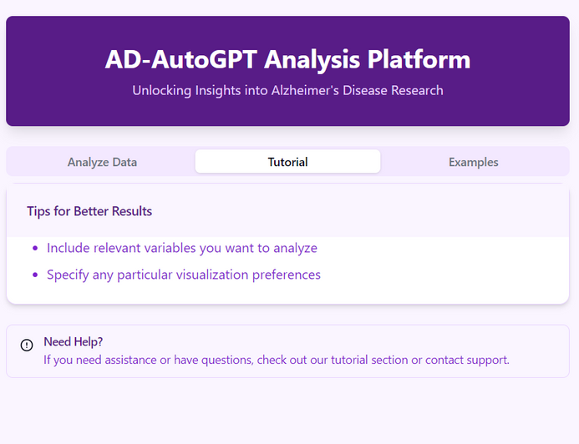
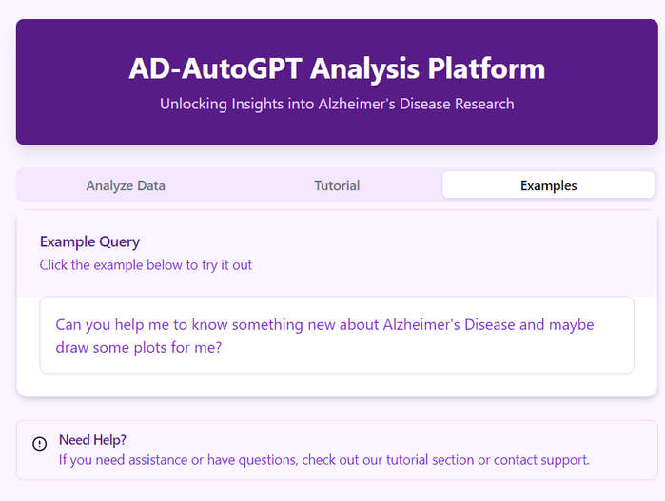
One key issue of using AD-AutoGPT is its complexity, which makes it difficult for the average user to navigate and apply properly. Given this, making it a user-friendly website could significantly improve accessibility. This platform would allow consumers to simply enter their queries and obtain responses, without having to comprehend the underlying technological details. A web interface might incorporate guided workflows, intuitive visualisations, and built-in tutorials, changing AD-AutoGPT from a technical tool to a useful resource for public health practitioners and researchers. This technique would allow a larger audience to profit from the benefits of advanced data analysis without having to deal with the complexities of the underlying model.

Slide 15
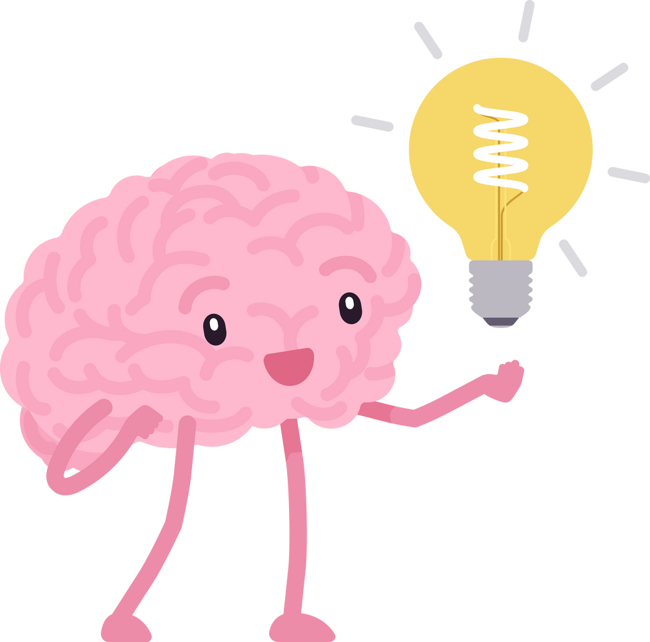
THANK YOU

