Slide 1
Big Mountain Resort
– Dev Joshi
Spring-Board Data Science Boot-camp
H
D
E
I
P
Notes:
<number>
Hypothesis: Create a Hypothesis with an emphasis on SMART principles. (S – Specific, M – Measurable, A – Achievable, R – Realistic, T – Timebound). If you cannot do this, you do not have a good grasp on the business problem.
Context: With context, we have clearly identified the problem at hand and have elucidated on how our initiative may solve this problem, alongside the commercial implications this will have on the business.
Criteria for Success: Clearly defining the criteria for success ensures that the scope of your work is clearly defined and understood. Otherwise, if this isn’t defined – your work will never end which will result in mismatched expectations.
Scope of Solution Space: Scoping out the solution space ensures that the business initiative is SPECIFIC for a certain segment or area. This prevents solutions that have been developed being scaled and applied for all other business units that the solution may not be responsible or scalable for.
Constraints within Solution Space: Looking forward, what are the foreseeable problems we are likely to encounter? Could this be stakeholder resistance? Could this be we don’t have access to the right data?
Stakeholders to provide key insight: Who are the people I need to speak to, to get the answers I need for my data analysis?
What key data sources are required?
Based off my discussions with the key stakeholders – can we clearly list out all the data sources we need so we can make a highly targeted request as opposed to a scatter-gun approach where we ask for a bit of everything?

Slide 2
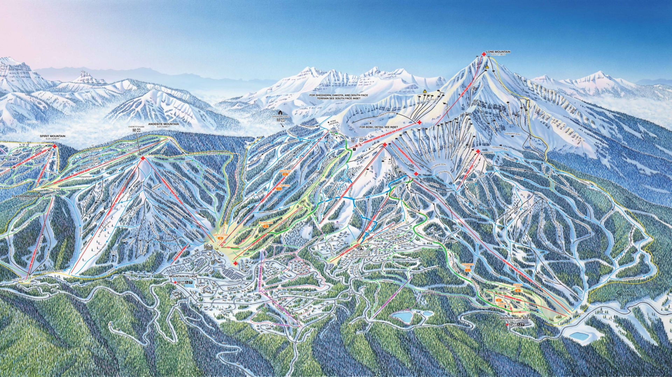
Big Mountain Resort
Problem Statement:
What opportunities exist for Big Moutain Resort to implement a more data-driven business strategy to increase the revenue for recouping the increased operational cost of $1.54MM for installing new chair list this season, while keeping the profit margins at 9.2% and give an insight on annual revenue for the season over the next year ?
H
D
E
I
P
Notes:
<number>
Hypothesis: Create a Hypothesis with an emphasis on SMART principles. (S – Specific, M – Measurable, A – Achievable, R – Realistic, T – Timebound). If you cannot do this, you do not have a good grasp on the business problem.
Context: With context, we have clearly identified the problem at hand and have elucidated on how our initiative may solve this problem, alongside the commercial implications this will have on the business.
Criteria for Success: Clearly defining the criteria for success ensures that the scope of your work is clearly defined and understood. Otherwise, if this isn’t defined – your work will never end which will result in mismatched expectations.
Scope of Solution Space: Scoping out the solution space ensures that the business initiative is SPECIFIC for a certain segment or area. This prevents solutions that have been developed being scaled and applied for all other business units that the solution may not be responsible or scalable for.
Constraints within Solution Space: Looking forward, what are the foreseeable problems we are likely to encounter? Could this be stakeholder resistance? Could this be we don’t have access to the right data?
Stakeholders to provide key insight: Who are the people I need to speak to, to get the answers I need for my data analysis?
What key data sources are required?
Based off my discussions with the key stakeholders – can we clearly list out all the data sources we need so we can make a highly targeted request as opposed to a scatter-gun approach where we ask for a bit of everything?

Slide 3

Big Mountain Resort : Context of the Problem
Big Mountain Resort, a ski resort located in Montana, offers spectacular views of Glacier National Park and Flathead National Forest, with access to 105 trails. Every year about 350000 people ski or snowboard at Big Mountain. Although Big Mountain offers a variety of facilities at the resort including recently added chair lift, the resort’s pricing strategy has been to charge a premium above the average price of resorts in its market segment. Big Mountain is seeking to implement a more data-driven business strategy to review the current approach. The Resort is seeking guidance from a new data-science team to select a better value for their ticket price so that a more judicious business strategy and investment strategy could be adopted in the future.
H
D
E
I
P
Notes:
<number>
Hypothesis: Create a Hypothesis with an emphasis on SMART principles. (S – Specific, M – Measurable, A – Achievable, R – Realistic, T – Timebound). If you cannot do this, you do not have a good grasp on the business problem.
Context: With context, we have clearly identified the problem at hand and have elucidated on how our initiative may solve this problem, alongside the commercial implications this will have on the business.
Criteria for Success: Clearly defining the criteria for success ensures that the scope of your work is clearly defined and understood. Otherwise, if this isn’t defined – your work will never end which will result in mismatched expectations.
Scope of Solution Space: Scoping out the solution space ensures that the business initiative is SPECIFIC for a certain segment or area. This prevents solutions that have been developed being scaled and applied for all other business units that the solution may not be responsible or scalable for.
Constraints within Solution Space: Looking forward, what are the foreseeable problems we are likely to encounter? Could this be stakeholder resistance? Could this be we don’t have access to the right data?
Stakeholders to provide key insight: Who are the people I need to speak to, to get the answers I need for my data analysis?
What key data sources are required?
Based off my discussions with the key stakeholders – can we clearly list out all the data sources we need so we can make a highly targeted request as opposed to a scatter-gun approach where we ask for a bit of everything?

Slide 4
Recommendations
Resort's Current Pricing Strategy:
For Big Mountain Resort to base their pricing mainly on just the market average won’t be enough to maximize their capitalization investment and can’t be sustainable to gain an edge over the competition.
Recommendations:
Our Model suggests that Mountain Resort’s ticket price is lower than the predicted model by 16.3 %, and the resort have many potential scenarios for either cutting costs by closing runs or increasing ticket price by increasing vertical drop, adding acres of snow making or increasing the longest run.
Increasing the vertical drop by 150 ft. and installing an addition chair lift would increase the ticket price by $1.99 resulting in revenue increase by $3474638. Repeating the previous one but adding 2 acres of snow making : Such a small increase in the snow making area made no difference.
Closing 2 and 3 number of runs successively reduces support for ticket price and so revenue. If Big Mountain closes down 3 runs, it seems they may as well close down 4 or 5 as there’s no further loss in ticket price. Increasing the closures down to 6 or more leads to a large drop.
H
D
E
I
P
Notes:
<number>
Hypothesis: Create a Hypothesis with an emphasis on SMART principles. (S – Specific, M – Measurable, A – Achievable, R – Realistic, T – Timebound). If you cannot do this, you do not have a good grasp on the business problem.
Context: With context, we have clearly identified the problem at hand and have elucidated on how our initiative may solve this problem, alongside the commercial implications this will have on the business.
Criteria for Success: Clearly defining the criteria for success ensures that the scope of your work is clearly defined and understood. Otherwise, if this isn’t defined – your work will never end which will result in mismatched expectations.
Scope of Solution Space: Scoping out the solution space ensures that the business initiative is SPECIFIC for a certain segment or area. This prevents solutions that have been developed being scaled and applied for all other business units that the solution may not be responsible or scalable for.
Constraints within Solution Space: Looking forward, what are the foreseeable problems we are likely to encounter? Could this be stakeholder resistance? Could this be we don’t have access to the right data?
Stakeholders to provide key insight: Who are the people I need to speak to, to get the answers I need for my data analysis?
What key data sources are required?
Based off my discussions with the key stakeholders – can we clearly list out all the data sources we need so we can make a highly targeted request as opposed to a scatter-gun approach where we ask for a bit of everything?

Slide 5
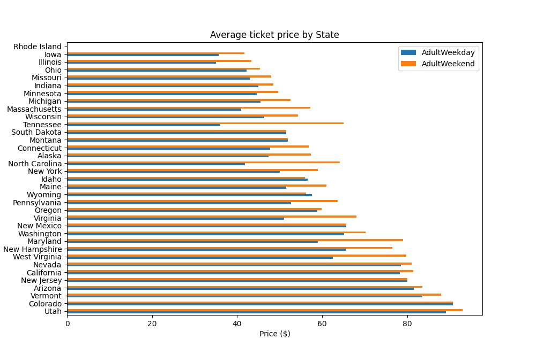
Adult Weekday and Weekend Prices
Average prices of Adult Weekday and Adult Weekend ticket. This showed how the average ticket price varied from state to state.
H
D
E
I
P
Notes:
<number>
Hypothesis: Create a Hypothesis with an emphasis on SMART principles. (S – Specific, M – Measurable, A – Achievable, R – Realistic, T – Timebound). If you cannot do this, you do not have a good grasp on the business problem.
Context: With context, we have clearly identified the problem at hand and have elucidated on how our initiative may solve this problem, alongside the commercial implications this will have on the business.
Criteria for Success: Clearly defining the criteria for success ensures that the scope of your work is clearly defined and understood. Otherwise, if this isn’t defined – your work will never end which will result in mismatched expectations.
Scope of Solution Space: Scoping out the solution space ensures that the business initiative is SPECIFIC for a certain segment or area. This prevents solutions that have been developed being scaled and applied for all other business units that the solution may not be responsible or scalable for.
Constraints within Solution Space: Looking forward, what are the foreseeable problems we are likely to encounter? Could this be stakeholder resistance? Could this be we don’t have access to the right data?
Stakeholders to provide key insight: Who are the people I need to speak to, to get the answers I need for my data analysis?
What key data sources are required?
Based off my discussions with the key stakeholders – can we clearly list out all the data sources we need so we can make a highly targeted request as opposed to a scatter-gun approach where we ask for a bit of everything?

Slide 6
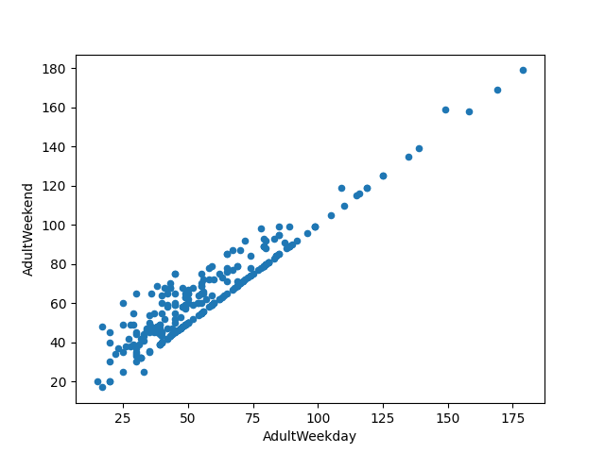
Model Ticket Price Target Plot
In the model ticket price target plot, there is a clear line where weekend and weekday prices are equal. Weekend prices being higher than weekday prices are restricted to sub $ 100 resorts.
H
D
E
I
P
Notes:
<number>
Hypothesis: Create a Hypothesis with an emphasis on SMART principles. (S – Specific, M – Measurable, A – Achievable, R – Realistic, T – Timebound). If you cannot do this, you do not have a good grasp on the business problem.
Context: With context, we have clearly identified the problem at hand and have elucidated on how our initiative may solve this problem, alongside the commercial implications this will have on the business.
Criteria for Success: Clearly defining the criteria for success ensures that the scope of your work is clearly defined and understood. Otherwise, if this isn’t defined – your work will never end which will result in mismatched expectations.
Scope of Solution Space: Scoping out the solution space ensures that the business initiative is SPECIFIC for a certain segment or area. This prevents solutions that have been developed being scaled and applied for all other business units that the solution may not be responsible or scalable for.
Constraints within Solution Space: Looking forward, what are the foreseeable problems we are likely to encounter? Could this be stakeholder resistance? Could this be we don’t have access to the right data?
Stakeholders to provide key insight: Who are the people I need to speak to, to get the answers I need for my data analysis?
What key data sources are required?
Based off my discussions with the key stakeholders – can we clearly list out all the data sources we need so we can make a highly targeted request as opposed to a scatter-gun approach where we ask for a bit of everything?

Slide 7
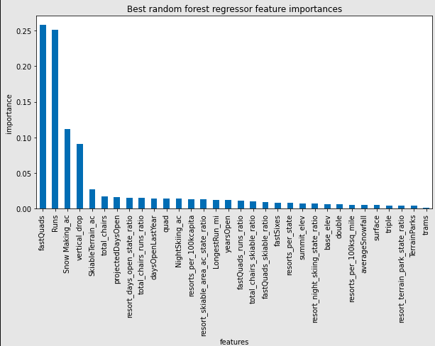
Dominant Features
Using random forest model, we found the dominant top four features in common with the linear model: fastQuads, Runs, Snow Making_ac, vertical_drop.
H
D
E
I
P
Notes:
<number>
Hypothesis: Create a Hypothesis with an emphasis on SMART principles. (S – Specific, M – Measurable, A – Achievable, R – Realistic, T – Timebound). If you cannot do this, you do not have a good grasp on the business problem.
Context: With context, we have clearly identified the problem at hand and have elucidated on how our initiative may solve this problem, alongside the commercial implications this will have on the business.
Criteria for Success: Clearly defining the criteria for success ensures that the scope of your work is clearly defined and understood. Otherwise, if this isn’t defined – your work will never end which will result in mismatched expectations.
Scope of Solution Space: Scoping out the solution space ensures that the business initiative is SPECIFIC for a certain segment or area. This prevents solutions that have been developed being scaled and applied for all other business units that the solution may not be responsible or scalable for.
Constraints within Solution Space: Looking forward, what are the foreseeable problems we are likely to encounter? Could this be stakeholder resistance? Could this be we don’t have access to the right data?
Stakeholders to provide key insight: Who are the people I need to speak to, to get the answers I need for my data analysis?
What key data sources are required?
Based off my discussions with the key stakeholders – can we clearly list out all the data sources we need so we can make a highly targeted request as opposed to a scatter-gun approach where we ask for a bit of everything?

Slide 8
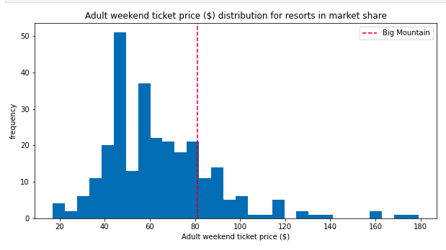
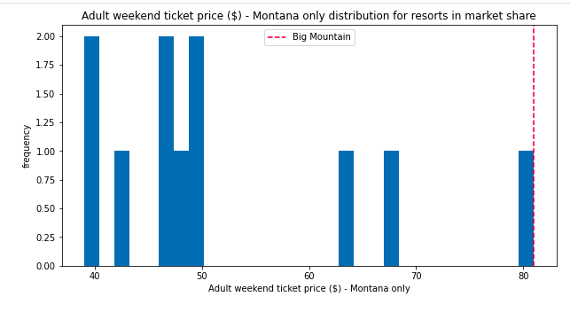
Adult Weekend Ticket Price
Big Mountain’s adult weekend ticket price is higher than many resorts nationally but there are still resorts with higher ticket prices (top figure).
Big Mountain is very high up in the adult weekend ticket price in the state of Montana (below figure).
H
D
E
I
P
Notes:
<number>
Hypothesis: Create a Hypothesis with an emphasis on SMART principles. (S – Specific, M – Measurable, A – Achievable, R – Realistic, T – Timebound). If you cannot do this, you do not have a good grasp on the business problem.
Context: With context, we have clearly identified the problem at hand and have elucidated on how our initiative may solve this problem, alongside the commercial implications this will have on the business.
Criteria for Success: Clearly defining the criteria for success ensures that the scope of your work is clearly defined and understood. Otherwise, if this isn’t defined – your work will never end which will result in mismatched expectations.
Scope of Solution Space: Scoping out the solution space ensures that the business initiative is SPECIFIC for a certain segment or area. This prevents solutions that have been developed being scaled and applied for all other business units that the solution may not be responsible or scalable for.
Constraints within Solution Space: Looking forward, what are the foreseeable problems we are likely to encounter? Could this be stakeholder resistance? Could this be we don’t have access to the right data?
Stakeholders to provide key insight: Who are the people I need to speak to, to get the answers I need for my data analysis?
What key data sources are required?
Based off my discussions with the key stakeholders – can we clearly list out all the data sources we need so we can make a highly targeted request as opposed to a scatter-gun approach where we ask for a bit of everything?

Slide 9
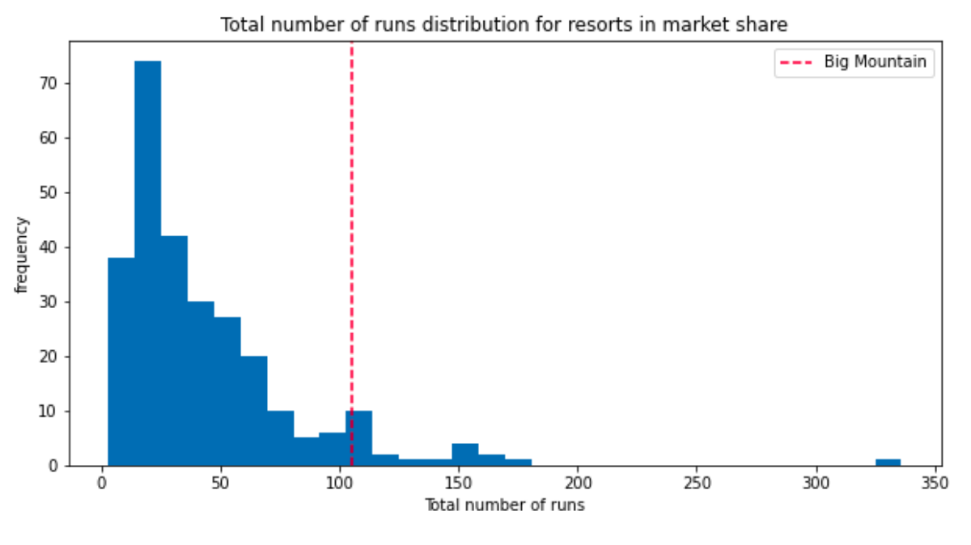
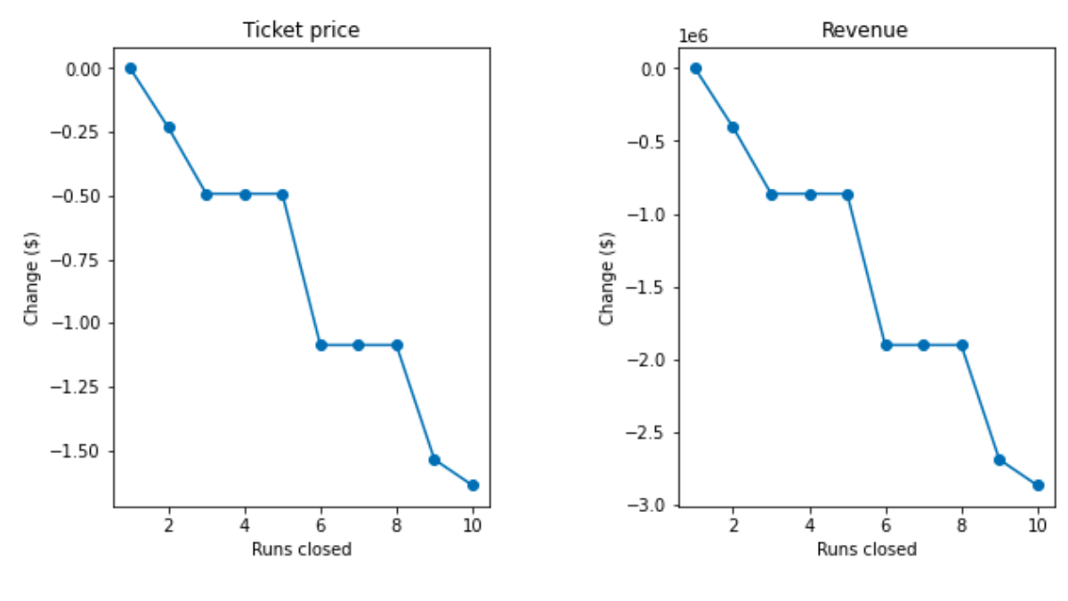
Closing up Runs
Big Mountain compares well for the number of runs. There are some resorts with more, but not many.
The model says closing one run makes no difference. Closing 2 and 3 successively reduces support for ticket price and so revenue.
If Big Mountain closes down 3 runs, it seems they may as well close down 4 or 5 as there's no further loss in ticket price.
Increasing the closures down to 6 or more leads to a large drop.
H
D
E
I
P
Notes:
<number>
Hypothesis: Create a Hypothesis with an emphasis on SMART principles. (S – Specific, M – Measurable, A – Achievable, R – Realistic, T – Timebound). If you cannot do this, you do not have a good grasp on the business problem.
Context: With context, we have clearly identified the problem at hand and have elucidated on how our initiative may solve this problem, alongside the commercial implications this will have on the business.
Criteria for Success: Clearly defining the criteria for success ensures that the scope of your work is clearly defined and understood. Otherwise, if this isn’t defined – your work will never end which will result in mismatched expectations.
Scope of Solution Space: Scoping out the solution space ensures that the business initiative is SPECIFIC for a certain segment or area. This prevents solutions that have been developed being scaled and applied for all other business units that the solution may not be responsible or scalable for.
Constraints within Solution Space: Looking forward, what are the foreseeable problems we are likely to encounter? Could this be stakeholder resistance? Could this be we don’t have access to the right data?
Stakeholders to provide key insight: Who are the people I need to speak to, to get the answers I need for my data analysis?
What key data sources are required?
Based off my discussions with the key stakeholders – can we clearly list out all the data sources we need so we can make a highly targeted request as opposed to a scatter-gun approach where we ask for a bit of everything?

Slide 10
Conclusions
After applying our Model for ski resort ticket price and leverage it to explore Big Mountain Resort’s potential scenarios for increasing revenue, we conclude that :
Increasing the vertical drop by 150 ft. and installing an addition chair lift would increase the ticket price by $1.99 resulting in revenue increase by $3474638. Repeating the previous one but adding 2 acres of snow making : Such a small increase in the snow making area made no difference.
Due to lack of data with respect to operating cost per used run and weekdays ticket price, the model cannot recommend closing down used runs or implementing a dynamic ticket pricing.
H
D
E
I
P
Notes:
<number>
Hypothesis: Create a Hypothesis with an emphasis on SMART principles. (S – Specific, M – Measurable, A – Achievable, R – Realistic, T – Timebound). If you cannot do this, you do not have a good grasp on the business problem.
Context: With context, we have clearly identified the problem at hand and have elucidated on how our initiative may solve this problem, alongside the commercial implications this will have on the business.
Criteria for Success: Clearly defining the criteria for success ensures that the scope of your work is clearly defined and understood. Otherwise, if this isn’t defined – your work will never end which will result in mismatched expectations.
Scope of Solution Space: Scoping out the solution space ensures that the business initiative is SPECIFIC for a certain segment or area. This prevents solutions that have been developed being scaled and applied for all other business units that the solution may not be responsible or scalable for.
Constraints within Solution Space: Looking forward, what are the foreseeable problems we are likely to encounter? Could this be stakeholder resistance? Could this be we don’t have access to the right data?
Stakeholders to provide key insight: Who are the people I need to speak to, to get the answers I need for my data analysis?
What key data sources are required?
Based off my discussions with the key stakeholders – can we clearly list out all the data sources we need so we can make a highly targeted request as opposed to a scatter-gun approach where we ask for a bit of everything?

