Slide 1
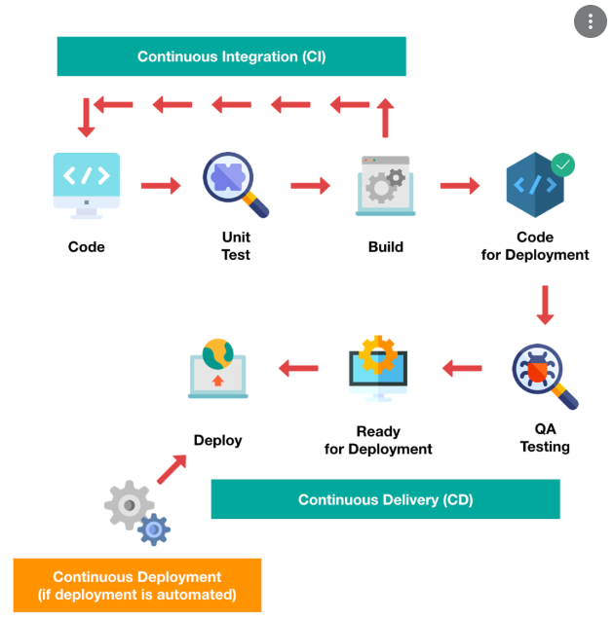
Business case for CICD

Slide 2
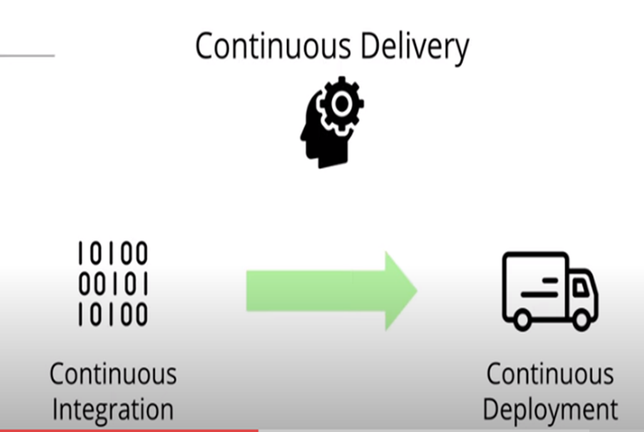
WHAT IS CICD?
Continuous integration - is the process by which every time a developer on the team checks in new code, automated builds and tests run. This is the first step in a series of quicker feedback loops that can help notify the developer of issues with their code, so they can make changes faster and continue focusing their time on what matters.
Continuous Delivery - is the process by which every time a developer on the team checks in new code, automated builds and tests run. This is the first step in a series of quicker feedback loops that can help notify the developer of issues with their code, so they can make changes faster and continue focusing their time on what matters.
Continuous Deployment -A software engineering approach in which the value is delivered frequently through automated deployments. Everything related to deploying the artifact fits here. It's the process of "Moving" the artifact from the shelf to the spotlight. Some common CD-related phases might include:

Slide 3
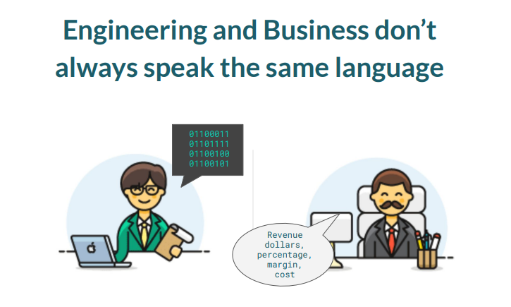
Benefits of cicd

Slide 4

Benefits of cicd
Technical Language | Value | Translation
Catch Compile Errors After Merge | Reduce Cost | Less developer time on issues from new developer code
Catch Unit Test Failures | Avoid Cost | Less bugs in production and less time in testing
Detect Security Vulnerabilities | Avoid Cost | Prevent embarrassing or costly security holes
Automate Infrastructure Creation | Avoid Cost | Less human error, Faster deployments
Automate Infrastructure Cleanup | Reduce Cost | Less infrastructure costs from unused resources
Faster and More Frequent Production Deployments | Increase Revenue | New value-generating features released more quickly
Deploy to Production Without Manual Checks | Increase Revenue | Less time to market
Automated Smoke Tests | Protect Revenue | Reduced downtime from a deploy-related crash or major bug
Automated Rollback Triggered by Job Failure | Protect Revenue | Quick undo to return production to working state

Slide 5

QUESTIONS ?

