Slide 1
Team 11
The Hungry Birds
CSC 375 - Intro to Systems Analysis
Chris Zhao
Devroop Banerjee
Nelson Dai
Tariq Chatur
Tom Qin
Wanjin Yoo

Slide 2
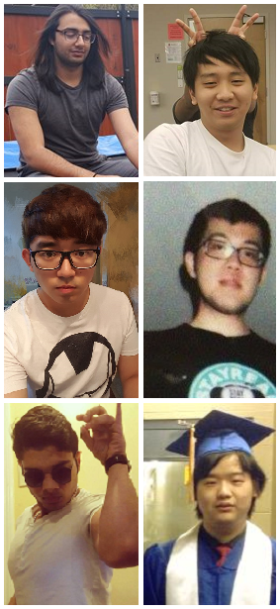
Introduction
Wanjin
Tariq
Nelson
Tom
Chris
Devroop
Normally this is where a tedious and lengthy introduction would be, that feels like it drags on forever, but this isn’t the time for that kind of play. We are working for the benefit of the people of Victoria. In 5 minutes you will be given everything you need to know about how we intend to improve your local food bank.

Slide 3

UVSS Food Bank
and Free Store
The Food Bank is located in the SUB (B007)
Hours: 9:30am - 5:00pm / Monday - Friday
Run by a team of dedicated staff and volunteers who offer all UVic students access to food essentials and household items
Currently uses a paper based system to keep track of the food/items taken by the students

Slide 4
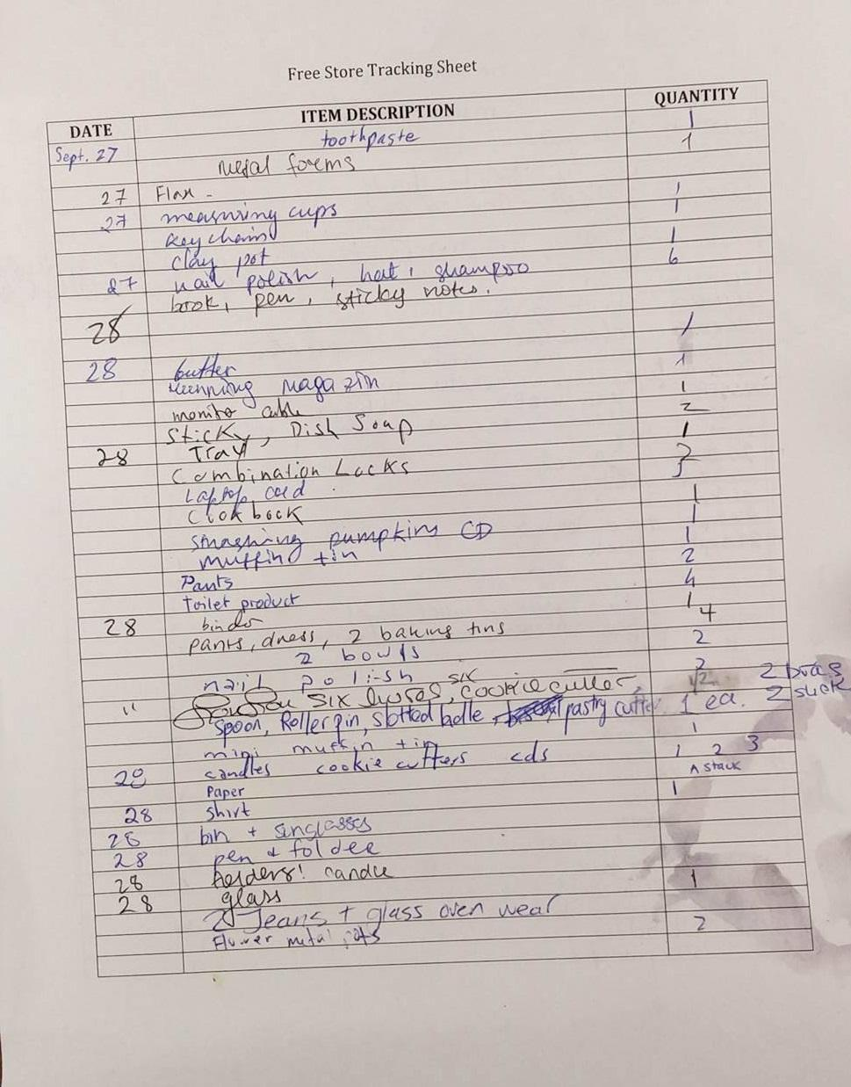
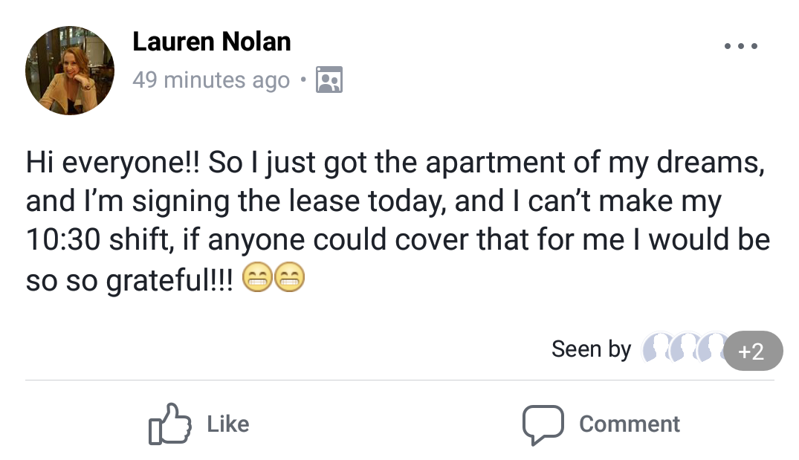
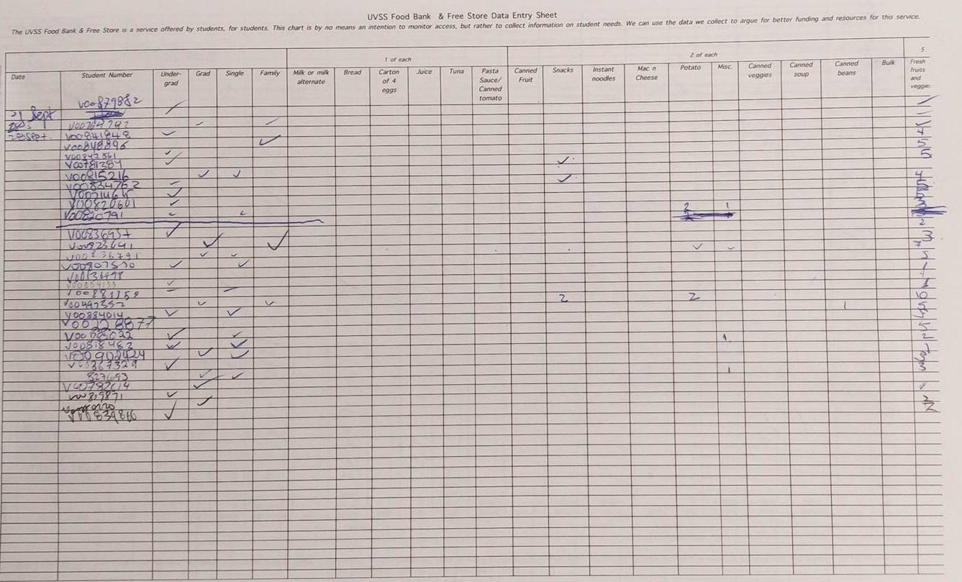
Background
The items taken are marked on the “Tracking Sheets”; confusing, messy, inaccurate
Volunteers post status updates
on the facebook page to change shifts
4 deliveries/week from numerous sources; tracking and managing inventory is difficult (inventory might be paid for or donated; can’t always categorize)

Slide 5

Problem
Paper based systems are the plague of modern organizations. They are cumbersome, inefficient, and rely on the death of our forest dwelling friends.

Slide 6

Objectives
To keep track of their inventory without the use of paper
A system that is easy to use for the volunteers who grant us their time
A way to easily store the inventory’s history

Slide 7
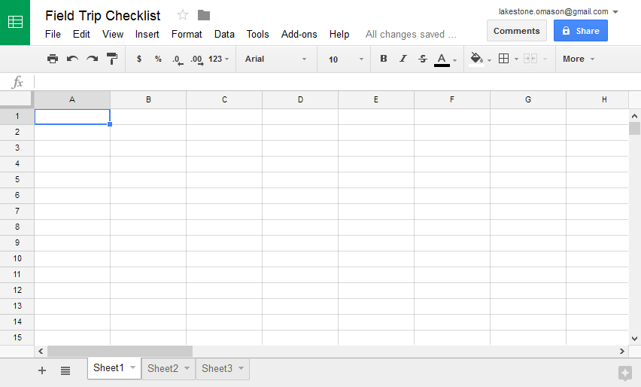
Approach
Google Sheets, may sound simple, because it is.
Cheap
Simple UI, easy to learn
Real time editing
Cloud storage
Useful functions such as Find and Sort

Slide 8

Any Questions?
No. They never have questions.

Slide 9
Thank You!
You’re welcome

