Slide 1
~ Alotta Cyclists ~
Prediction of Bike Sharing Demands

Slide 2
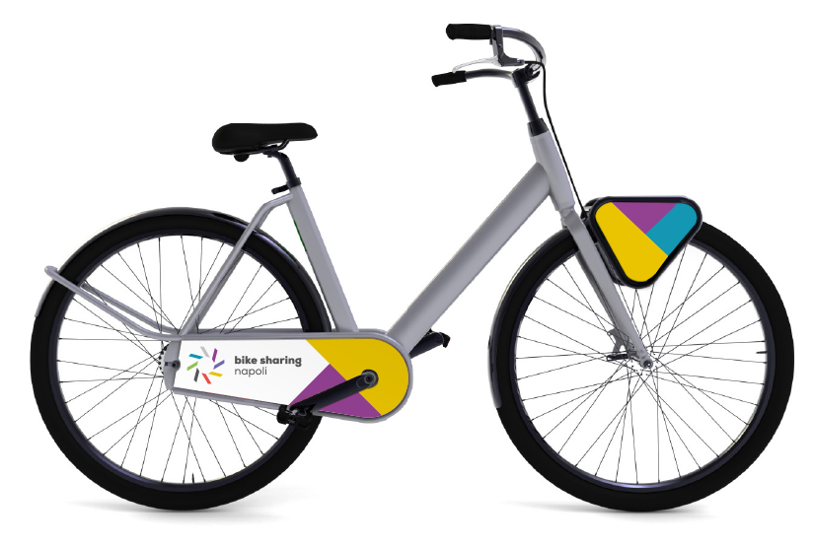
Bike sharing data

Slide 3

Project description
Predicting the number of bike rentals for a particular time and date

Slide 4

Data description
9 Attributes
4 discrete
5 continuous

Slide 5
Model evaluation
RMSE
R_squared value, or ccoefficient of determination, is a statistical measure of how well the regression line approximates the real data points.

Slide 6

Naïve attempt: linear regression
R squared value: 0.32
RMSE: 146.6
Serve as baseline model

Slide 7
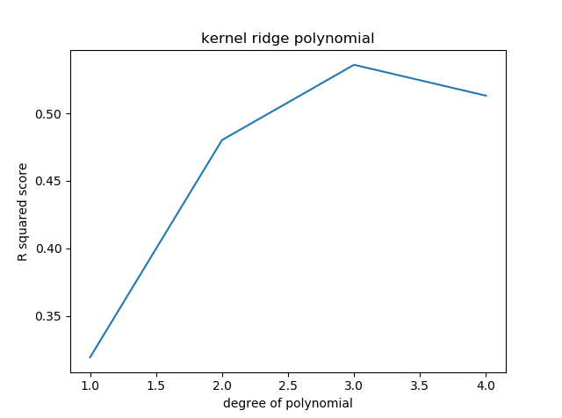
Kernel ridge:
Choose kernel
Tune –hyper parameters
Tuning failed
R^2 = 0.53

Slide 8
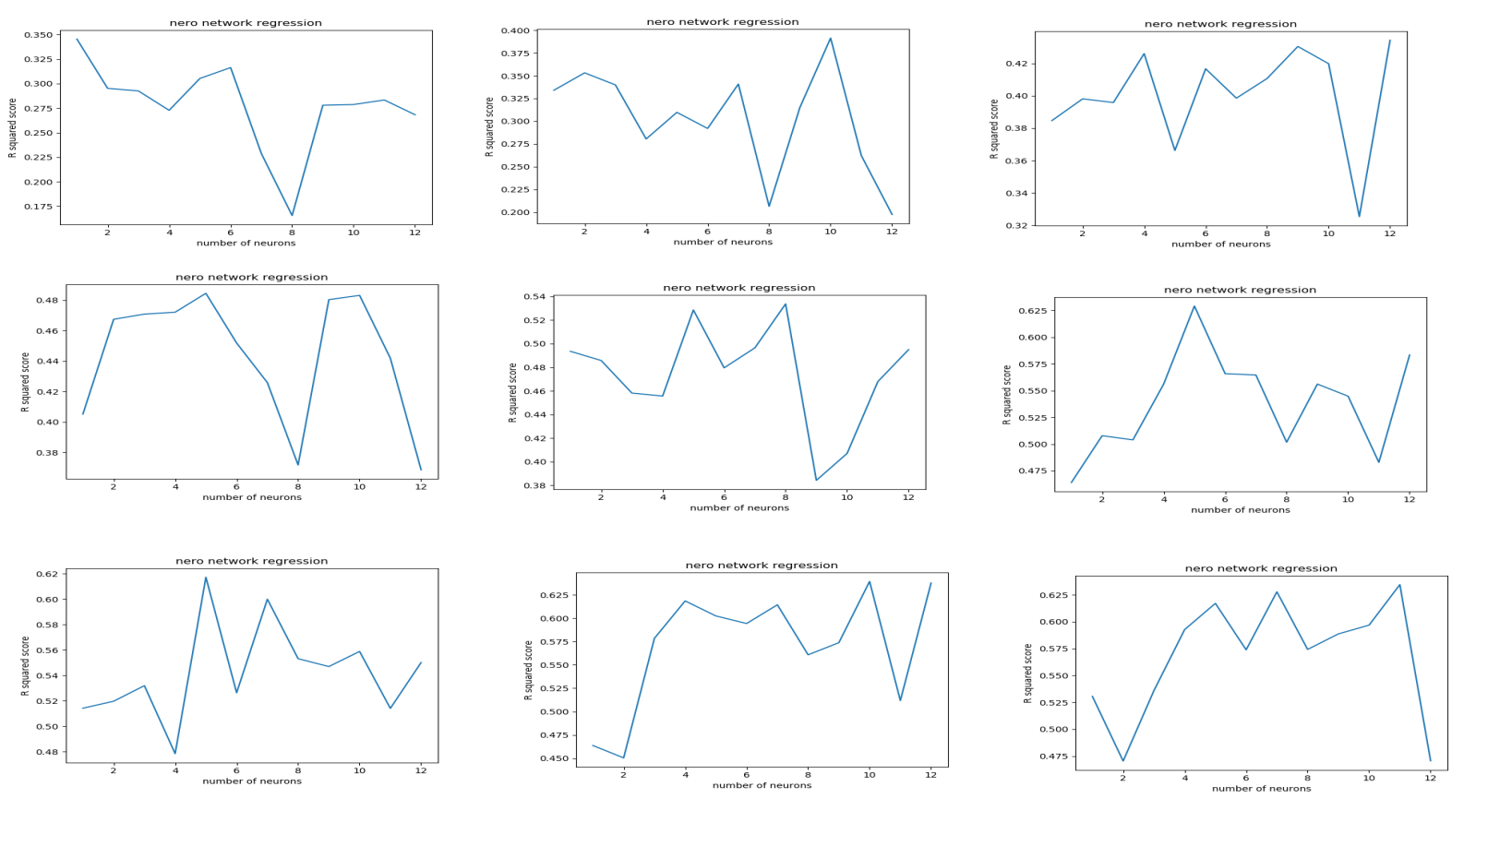
NN : MLP regression
Kernel selection
Parameter tuning
Unpredictable behavior
R^2 = 0.61
RMSE = 115.8

Slide 9
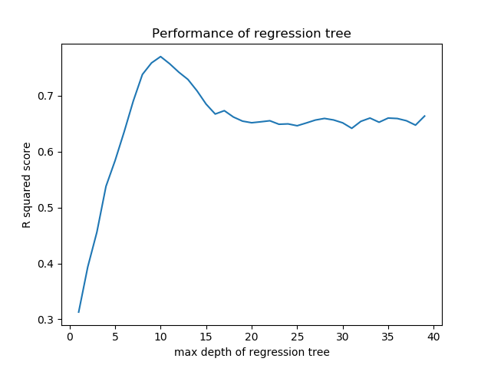
Regression Trees
R squared: 0.79
RMSE: 85.2
Note: model performance decreases when height of tree becomes too large. Sign of overfitting

Slide 10
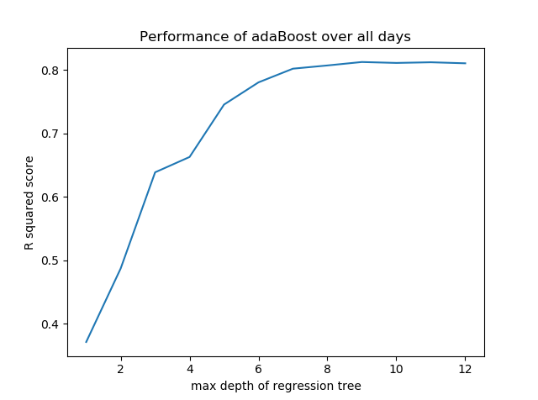
AdaBoost on regression Tree
Max Tree height: 8
R squared: 0.84
RMSE:

Slide 11
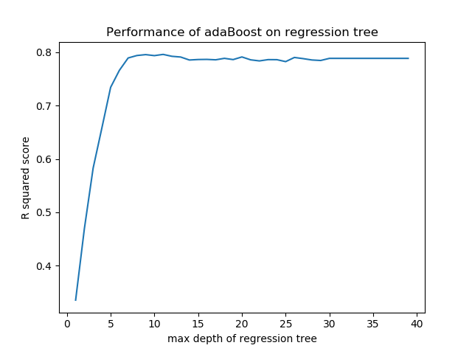
Comments on adaBoost

Slide 12
Future Work
Our models take a while to run because it is coded in python. We could code in other programs such as R to improve performance.
We could apply the same model to other modes of transportation

Slide 13
Summary
Models | R squared value | RMSE
Linear regression | 0.32 | 146.6
Kernel ridge(polynomial kernel) | 0.54 | 122.5
Neural net MLP regression | 0.61 | 115.8
Regression trees | 0.79 | 85.2
AdaBoost on Regression trees | 0.84 | 77.1

Slide 14
Questions

