Slide 1
Introduction to SQL

Slide 2
Objectives
Define terms
Interpret history and role of SQL
Define a database using SQL data definition language
Write single table queries using SQL
Establish referential integrity using SQL

Slide 3
SQL Overview
Structured Query Language
The standard for relational database management systems (RDBMS)
RDBMS: A database management system that manages data as a collection of tables in which all relationships are represented by common values in related tables

Slide 4
Purpose of SQL Standard
Specify syntax/semantics for data definition and manipulation
Define data structures and basic operations
Enable portability of database definition and application modules
Specify minimal (level 1) and complete (level 2) standards
Allow for later growth/enhancement to standard (referential integrity, transaction management, user-defined functions, extended join operations, national character sets)

Slide 5
Benefits of a Standardized Relational Language
Reduced training costs
Productivity
Application portability
Application longevity
Reduced dependence on a single vendor
Cross-system communication

Slide 6
SQL Environment
Catalog
A set of schemas that constitute the description of a database
Schema
The structure that contains descriptions of objects created by a user (base tables, views, constraints)
Data Definition Language (DDL)
Commands that define a database, including creating, altering, and dropping tables and establishing constraints
Data Manipulation Language (DML)
Commands that maintain and query a database
Data Control Language (DCL)
Commands that control a database, including administering privileges and committing data

Slide 7
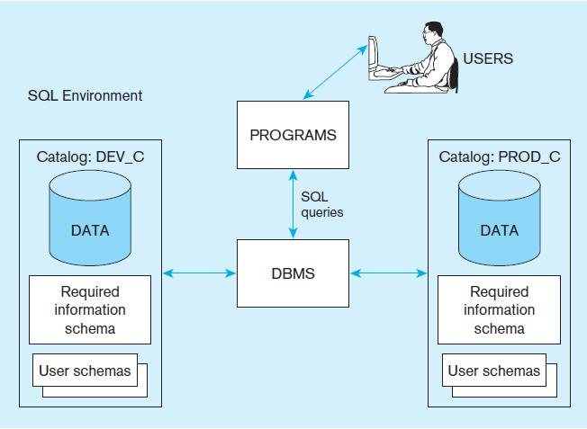
A simplified schematic of a typical SQL environment, as described by the SQL:

Slide 8
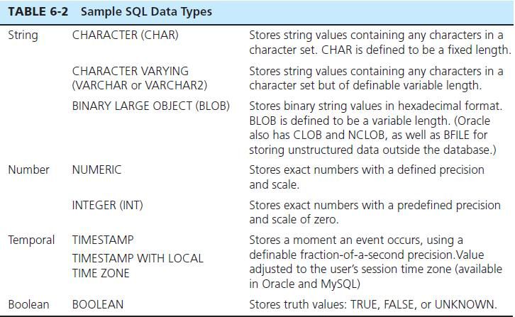
SQL Data Types

Slide 9
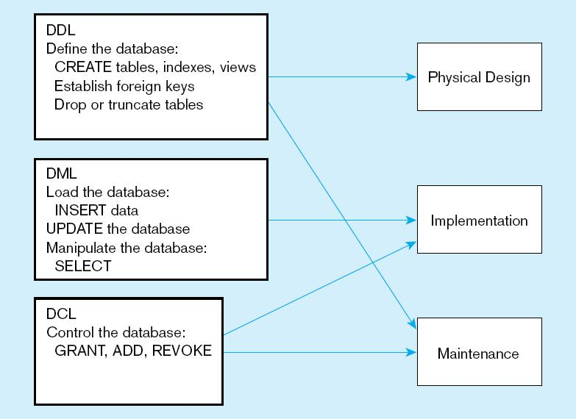
DDL, DML, DCL, and the database development process

Slide 10
SQL Database Definition
Data Definition Language (DDL)
Major CREATE statements:
CREATE SCHEMA–defines a portion of the database owned by a particular user
CREATE TABLE–defines a new table and its columns
CREATE VIEW–defines a logical table from one or more tables or views
Other CREATE statements: CHARACTER SET, COLLATION, TRANSLATION, ASSERTION, DOMAIN

Slide 11
Steps in Table Creation
Identify data types for attributes
Identify columns that can and cannot be null
Identify columns that must be unique (candidate keys)
Identify primary key–foreign key mates
Determine default values
Identify constraints on columns (domain specifications)
Create the table and associated indexes

Slide 12
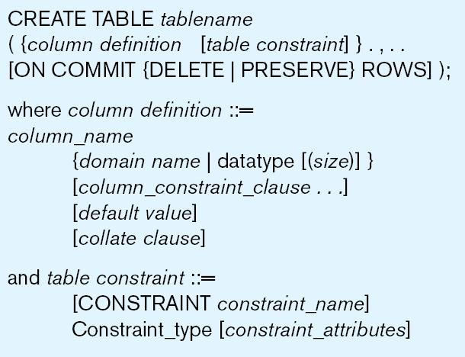
General syntax for CREATE TABLE statement used in data definition language

Slide 13
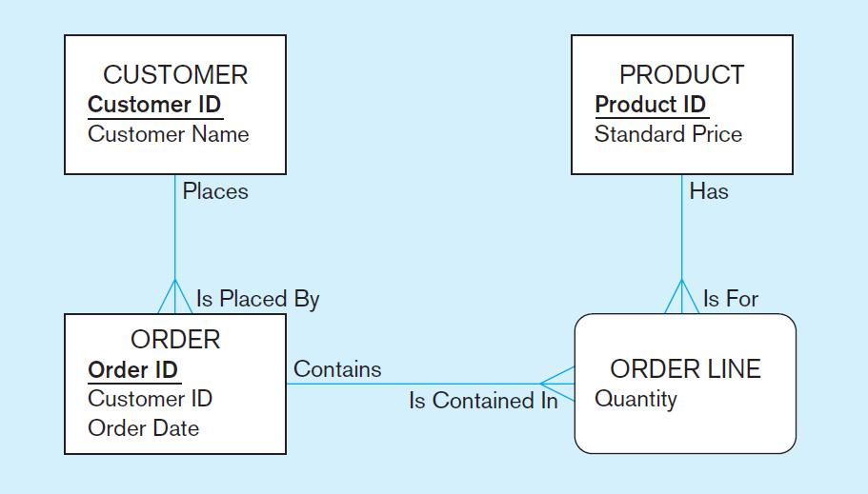
The following slides create tables for this enterprise data model

Slide 14
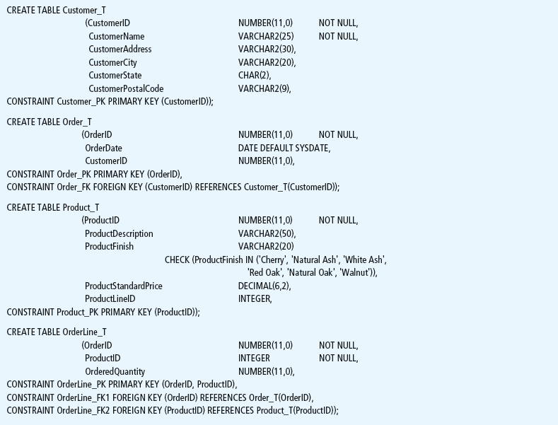
SQL database definition commands for Pine Valley Furniture Company (Oracle 11g)

Slide 15
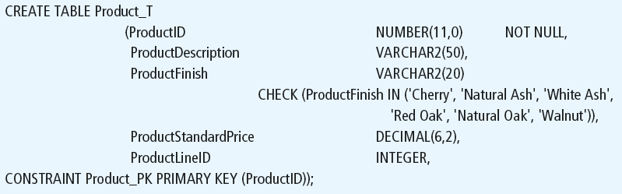
Defining attributes and their data types

Slide 16
Non-nullable specification
Identifying primary key

Slide 17
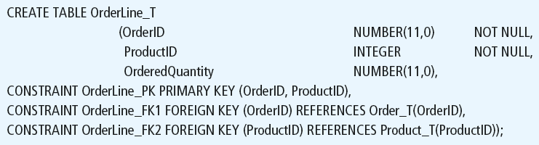
Non-nullable specifications
Some primary keys are composite– composed of multiple attributes

Slide 18
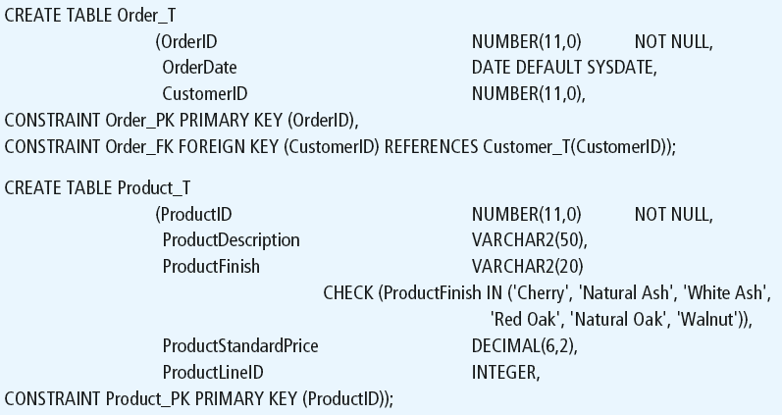
Controlling the values in attributes

Slide 19
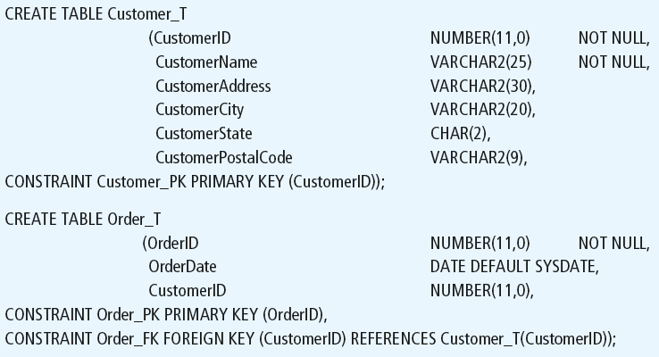
Identifying foreign keys and establishing relationships
Foreign key of dependent table

Slide 20
Data Integrity Controls
Referential integrity–constraint that ensures that foreign key values of a table must match primary key values of a related table in 1:M relationships
Restricting:
Deletes of primary records
Updates of primary records
Inserts of dependent records

Slide 21

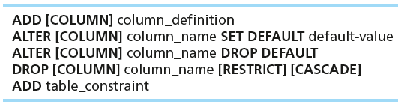

Changing Tables

Slide 22
Removing Tables
DROP TABLE statement allows you to remove tables from your schema:
DROP TABLE CUSTOMER_T

Slide 23



Insert Statement
Adds one or more rows to a table
Inserting into a table
Inserting from another table
Inserting a record that has some null attributes requires identifying the fields that actually get data

Slide 24
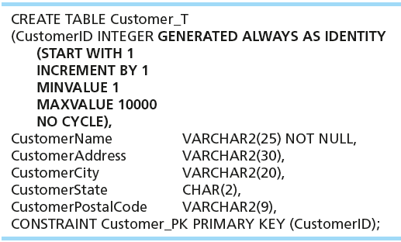
Creating Tables with Identity Columns
Inserting into a table does not require explicit customer ID entry or field list
INSERT INTO CUSTOMER_T VALUES ( ‘Contemporary Casuals’, ‘1355 S. Himes Blvd.’, ‘Gainesville’, ‘FL’, 32601);

Slide 25
Delete Statement
Removes rows from a table
Delete certain rows
DELETE FROM CUSTOMER_T WHERE CUSTOMERSTATE = ‘HI’;
Delete all rows
DELETE FROM CUSTOMER_T;

Slide 26

Update Statement
Modifies data in existing rows

Slide 27
Schema Definition
Control processing/storage efficiency:
Choice of indexes
File organizations for base tables
File organizations for indexes
Data clustering
Statistics maintenance
Creating indexes
Speed up random/sequential access to base table data
Example
CREATE INDEX NAME_IDX ON CUSTOMER_T(CUSTOMERNAME)
This makes an index for the CUSTOMERNAME field of the CUSTOMER_T table

Slide 28
SELECT Statement
Used for queries on single or multiple tables
Clauses of the SELECT statement:
SELECT
List the columns (and expressions) to be returned from the query
FROM
Indicate the table(s) or view(s) from which data will be obtained
WHERE
Indicate the conditions under which a row will be included in the result
GROUP BY
Indicate categorization of results
HAVING
Indicate the conditions under which a category (group) will be included
ORDER BY
Sorts the result according to specified criteria

Slide 29
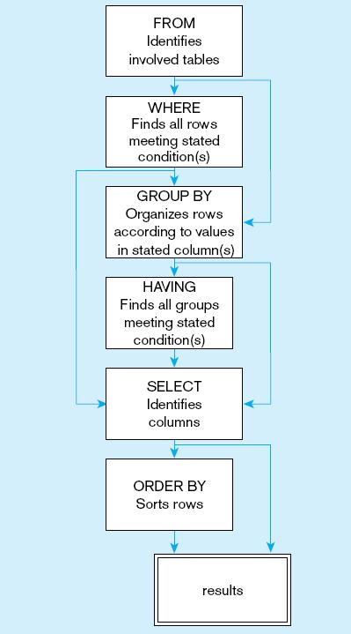
SQL statement processing order (based on van der Lans, 2006 p.100)

Slide 30
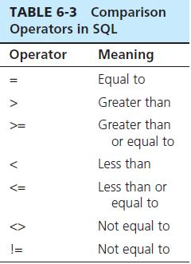

SELECT Example
Find products with standard price less than $275
Table 6-3: Comparison Operators in SQL

Slide 31
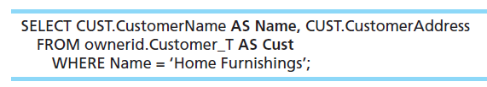
SELECT Example Using Alias
Alias is an alternative column or table name
Here, CUST is a table alias and Name is a column alias

Slide 32
SELECT Example Using a Function
Using the COUNT aggregate function to find totals
SELECT COUNT(*) FROM ORDERLINE_T
WHERE ORDERID = 1004;
Note: with aggregate functions you can’t have single-valued columns included in the SELECT clause, unless they are included in the GROUP BY clause.

Slide 33
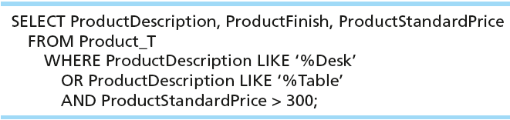
SELECT Example–Boolean Operators
AND, OR, and NOT Operators for customizing conditions in WHERE clause
Note: the LIKE operator allows you to compare strings using wildcards. For example, the % wildcard in ‘%Desk’ indicates that all strings that have any number of characters preceding the word “Desk” will be allowed.

Slide 34
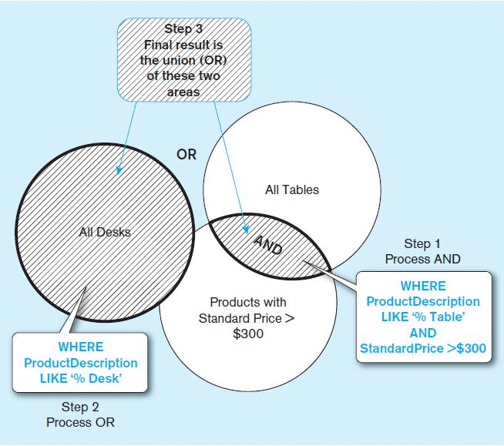
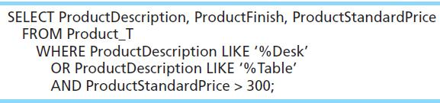
Figure 6-7 Boolean query A without use of parentheses
By default, processing order of Boolean operators is NOT, then AND, then OR

Slide 35
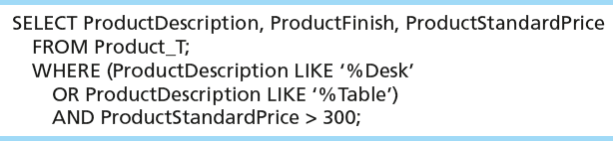
SELECT Example–Boolean Operators
With parentheses…these override the normal precedence of Boolean operators
With parentheses, you can override normal precedence rules. In this case parentheses make the OR take place before the AND.

Slide 36
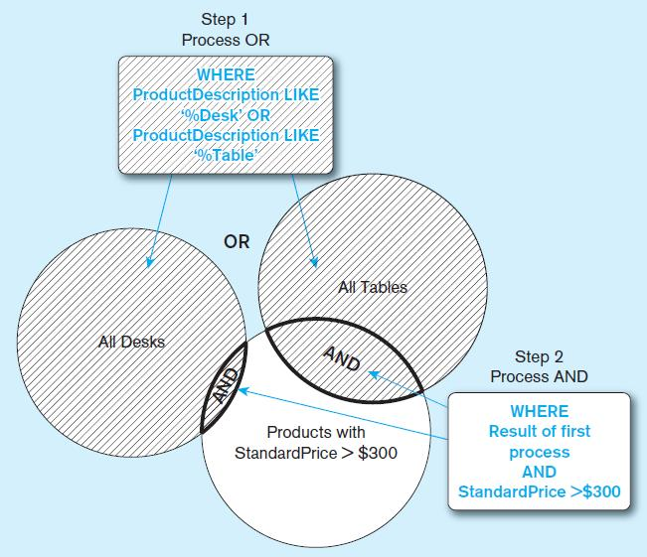
Figure 6-8 Boolean query B with use of parentheses

Slide 37
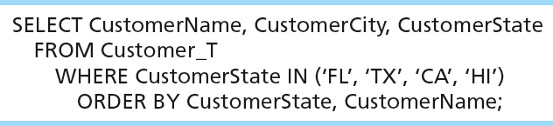
Sorting Results with ORDER BY Clause
Sort the results first by STATE, and within a state by the CUSTOMER NAME
Note: the IN operator in this example allows you to include rows whose CustomerState value is either FL, TX, CA, or HI. It is more efficient than separate OR conditions.

Slide 38

Categorizing Results Using GROUP BY Clause
For use with aggregate functions
Scalar aggregate: single value returned from SQL query with aggregate function
Vector aggregate: multiple values returned from SQL query with aggregate function (via GROUP BY)
We can use single-value fields with aggregate functions if they are included in the GROUP BY clause

Slide 39
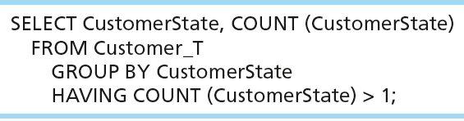
Qualifying Results by Categories Using the HAVING Clause
For use with GROUP BY
Like a WHERE clause, but it operates on groups (categories), not on individual rows. Here, only those groups with total numbers greater than 1 will be included in final result.

Slide 40
Using and Defining Views
Views provide users controlled access to tables
Base Table–table containing the raw data
Virtual Table–constructed automatically as needed; not maintained as real data
Dynamic View
A “virtual table” created dynamically upon request by a user
No data actually stored; instead data from base table made available to user
Based on SQL SELECT statement on base tables or other views
Contents materialized as a result of a query

Slide 41
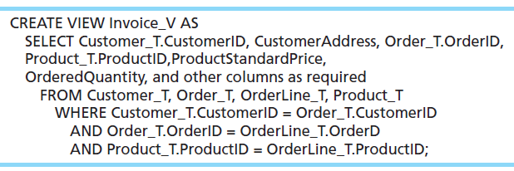
Sample CREATE VIEW
Query: What are the data elements necessary to create an invoice for a customer?
Save this query as a view named Invoice_V.

Slide 42
Advantages of Views
Simplify query commands
Assist with data security (but don't rely on views for security, there are more important security measures)
Enhance programming productivity
Contain most current base table data
Use little storage space
Provide customized view for user
Establish physical data independence

Slide 43
Disadvantages of Views
Use processing time each time view is referenced
May or may not be directly updateable

Slide 44
Thank You

