Slide 1


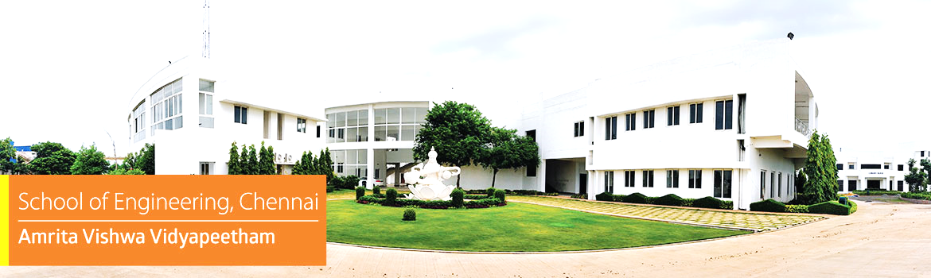

Embedded Systems Project
Ghost Vehicle in Fog Detector Using Pressure Wave Sensing Before Headlights Appear
Mentor :
Presented by :
Dr. C. Ganesh Kumar
Chairperson, Department of Electronics and Communication Engineering, School of Computing, Chennai
Akshaya M V - CH.EN.U4CCE24003
Devadharshini P - CH.EN.U4CCE24004
M Mukesh - CH.EN.U4CCE24015
1

Slide 2
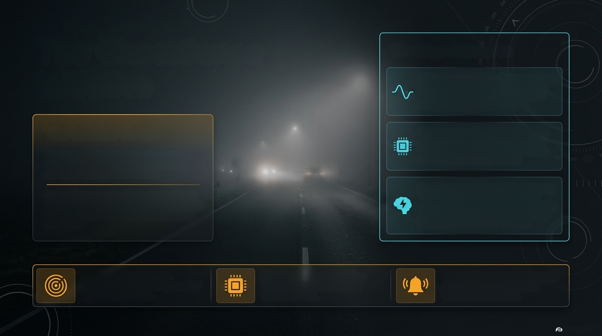
INTRODUCTION
Seeing the unseen: Predicting oncoming traffic before the headlights cut the fog
The Edge-Al Solution
A New Paradigm: Detecting approaching
vehicles before they become visible by
capturing the low-frequency pressure
waves they push ahead of them.
The Invisible Threat
The Technology Stack: Utilising highly
sensitive MEMS acoustic sensors, the
system processes physical data locally
on a Cortex-M microcontroller.
Dense fog critically reduces visual range
on highways and rural roads, rendering
standard headlights ineffective.
Zero-Latency Intelligence: By deploying
TinyML and Edge-Al methodologies
directly on the chip, we trigger life-saving
early warnings without relying on cloud
processing or visual line-of-sight.
Drivers face severely delayed detection of
approaching vehicles, drastically increasing
the likelihood of high-speed, catastrophic
collisions.
SENSE: Capture invisible
PROCESS: Execute real-time
signal analysis natively on a
Cortex-M core.
WARN: Trigger immediate visual
(LEDS/Display) and audible
(Buzzer) driver alerts.
pressure disturbances generated
by moving vehicles.

Slide 3





















LITERATURE SURVEY
Study of the research work
Hardware
/Software
S.NO
Title of the Paper
Year
Objective
Outcome
Inference
JUNE
2026
Improve obstacle detection in dense fog using adaptive multi-modal sensor fusion.
Hardware: Gated Camera, 3D LiDAR. Software: AFW-Net, Attention-based Adaptive Fusion, Uncertainty Estimation, Cross-modal Feature Extraction.
Achieved 82% AP at 50 m visibility, improving detection by 23.7% over conventional RGB-LiDAR fusion.
Adaptive sensor weighting, Reliable sensor fusion, Robust fog perception
Adaptive Sensor Fusion for Robust Perception in Dense Fog: A Gated Vision and LiDAR Integration Framework
hhttps://www.mdpi.com/1424-8220/26/12/3728
1.
Ensemble Artificial Intelligence Framework for Real-Time Automatic Vehicle Detection and Classifications
https://ieeexplore.ieee.org/abstract/document/11363414
May
2026
Develop an ensemble AI framework for accurate vehicle detection and classification under adverse weather.
Hardware: RGB Camera.
Software: YOLOv5, YOLOv7, YOLOv8, YOLOv10, DETR-ResNet50, Faster R-CNN, Dynamic Weighting, NMS, Ensemble Learning.
Achieved 96.6% mAP, 94.2% Precision, and 94.1% F1-score for multi-class vehicle detection.
Ensemble learning, High detection accuracy, Vision-dependent
2.
FogGate-YOLO: Traffic Object Detection in Foggy Environments Using Channel Selection Mechanisms
https://www.mdpi.com/1424-8220/26/6/1811
MAR
2026
Design a lightweight object detector specifically optimized for foggy environments.
Hardware: RGB Camera.
Software: YOLOv12, A2C2f-FSA Module, Bidirectional Feature Fusion Module (BFFM), GSConv, F-WIoU v3 Loss.
Improved mAP@0.5 by 5.2% (RTTS) and 7.3% (VOC-FOG) while maintaining real-time inference.
Fog-aware feature enhancement, Real-time detection, Camera limitations
3.
FogFusion: Robust 3D object detection based on camera-LiDAR fusion for autonomous driving in foggy weather conditions
https://journals.sagepub.com/doi/abs/10.1177/09544070251327229
MAR
2026
Improve 3D object detection in fog using enhanced camera-LiDAR fusion.
Hardware: RGB Camera, LiDAR. Software: Depth Completion Network with Fog Convolution (DCFC), Flexible Cylindrical Voxel (FCV), Cylindrical Fusion Module (CFM).
mproved detection performance by ≥3.32% over baseline methods on KITTI-C.
Enhanced 3D perception, Virtual point clouds, Costly sensor fusion
4.
Dynamic Visibility Recognition and Driving Risk Assessment Under Rain–Fog Conditions Using Monocular Surveillance Imagery
hhttps://www.mdpi.com/2071-1050/18/2/625
JAN
2026
Estimate road visibility and driving risk under rain-fog conditions using roadside surveillance images.
Hardware: Monocular CCTV Camera. Software: Koschmieder Scattering Model, Dark Channel Prior, Monte Carlo Simulation, Low Visibility Risk Field Force (LVRFF).
Achieved >86% visibility estimation accuracy and effectively identified high-risk driving zones.
Visibility estimation, Risk assessment, Infrastructure-based monitoring
5.

Slide 4
LITERATURE SURVEY
Study of the research work
Hardware
/Software
S.NO
Title of the Paper
Year
Objective
Outcome
Inference
Enhance performance in foggy-weather using a cost-effective vehicle detection system for distance, speed, and TTC-based collision warnings.
Software: SimYOLO-V5s_WIOU detector, Deep-SORT-based tracking
Hardware: RGB cameras with edge-capable platforms for real-time inference
SimYOLO-V5s_WIOU improved fog detection accuracy (up to +17.45% mAP50) on foggy driving, enhanced tracking reliability, and enabled TTC-based graded collision warnings.
SimSPPF and Wise-IoU improve fog detection reliability, while robust tracking and TTC-based warnings support safer collision avoidance.
ECE-VDTDA: A Robust and Computationally Efficient Collision Avoidance System for Driver Assistance in Foggy Weather
FEB
2026
6.
JAN
2026
Improve foggy roadside LiDAR tracking by reducing point-cloud noise and enabling collaborative multi-RSU perception.
Hardware: Roadside LiDAR-equipped RSUs for fog-affected traffic data collection.
Software: Fog-noise removal using adaptive filtering and multi-RSU cooperative tracking with PHD filtering
Improved detection accuracy by +8% (thin fog) and +29% (thick fog), with enhanced multi-class tracking performance.
Noise-aware denoising and multi-RSU PHD fusion improve foggy LiDAR detection, range, and tracking stability.
Multi-Target Tracking with Collaborative Roadside Units Under Foggy Conditions
7.
Fog-YOLO: A Real-Time Object Detector for Foggy Autonomous Driving Scenarios
FEB
2026
Develop a low-latency, fog-robust detector for autonomous driving with improved accuracy.
Hardware: RGB cameras with GPU-enabled platforms for real-time inference.
Software: Fog-YOLO with fog-aware modules and improved detection head
Improved mAP over YOLO baseline with better small/occluded object detection in varying fog while maintaining real-time performance.
Fog-aware features and improved detection heads enhance bounding boxes and reliability for foggy perception.
8.
3D Vision Object Detection for Autonomous Driving in Fog Using LiDAR
Improve foggy 3D object detection using LiDAR-based perception and fog-aware processing.
Hardware: Automotive LiDAR sensors evaluated under foggy conditions.
Software: LiDAR-based 3D detection with fog-mitigation techniques
Improved 3D detection accuracy and recall under fog compared to uncompensated LiDAR baselines.
Fog-aware processing preserves point-cloud features, enabling reliable 3D detection in poor visibility.
APR
2025
9.
Simulation of LiDAR Under Fog with Generative Adversarial Networks for Robust 3D Object Detection
OCT
2025
Generate realistic foggy LiDAR data using WGAN–LSTM to improve 3D detector robustness without real fog data collection.
Hardware: Velodyne VLP-32C LiDAR with fog-chamber and onboard ROS
Software: ROS-based LiDAR processing with WGAN-GP + LSTM fog simulation
Generated 80,000 foggy LiDAR frames using WGAN–LSTM, improving 3D detector robustness and reducing the need for real fog data collection.
GAN-based fog simulation reduces real-world data dependence and improves autonomous vehicle perception robustness.
10.

Slide 5
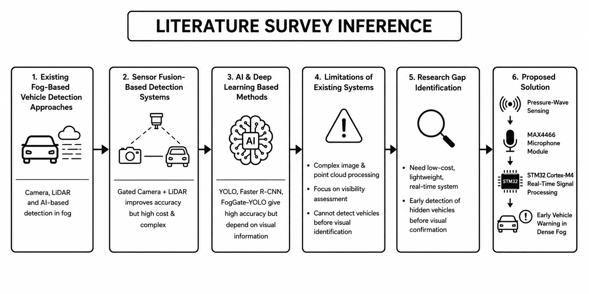
INFERENCE FROM LITERATURE SURVEY

Slide 6

12-Week Development Sprint
A structured roadmap from literature survey to functional Edge-Al prototype.
Phase & Focus
Week
Core Activity
Key Milestone
Phase 1: Foundation
Week 1-2
Literature Survey, Problem Analysis & Component
Procurement.
STM32/Cortex-M setup and architecture learning.
Hardware Procured &
Environment Setup
(Research & Hardware)
Week 3
Phase 2: Integration
Week 4
Sensor Interfacing & ADC Testing.
Data Collection from live moving vehicles.
Initial Signal Processing Implementation.
Week 5
Successful Sensor Data
Acquisition
(Interfacing & Data)
Week 6
Phase 3: Edge-Al
Week 7
Vehicle Detection Algorithm (TinyML) Development.
LED, Buzzer, and Display Integration.
System Testing, Calibration, and Optimisation.
Week 8
Functional Detection
Algorithm
(Algorithm & Alert)
Week 9
Phase 4: Finalisation
Week 10
Complete Prototype Assembly.
Result Analysis and Performance Evaluation.
Report Writing and PPT Preparation.
Week 11
Final Demonstration (Oct 6)
(Prototype & Delivery)
Week 12

Slide 7
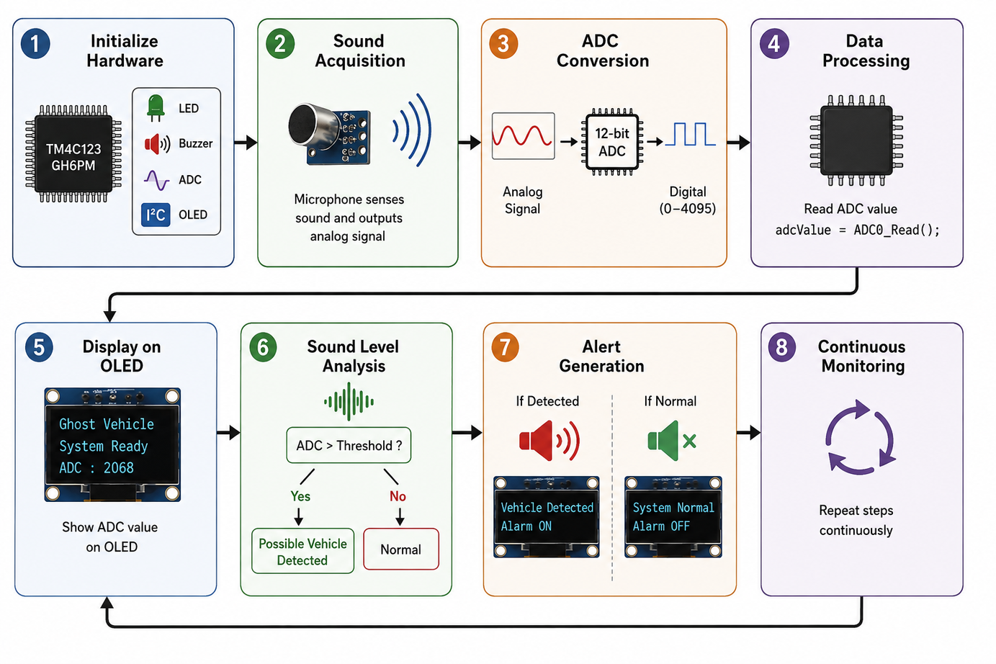
methodology

Slide 8
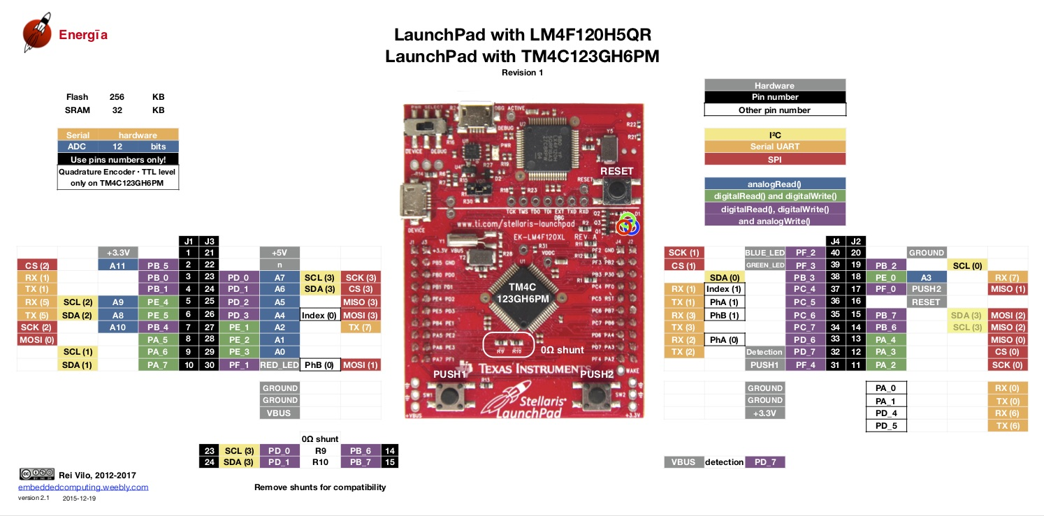
HARDWARE COMPONENTS
The TM4C123GH6PM is the central microcontroller of our project that acquires microphone signals, processes vehicle detection logic, and controls the OLED display, buzzer, and LEDs to provide real-time collision warnings in foggy conditions.
TM4C123GH6PM

Slide 9
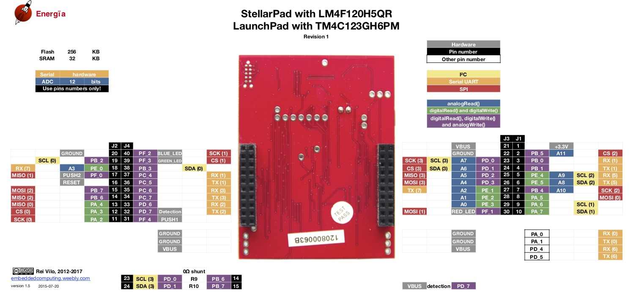
HARDWARE COMPONENTS
TM4C123GH6PM

Slide 10
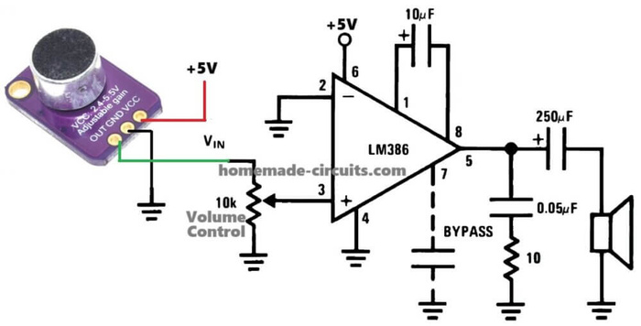
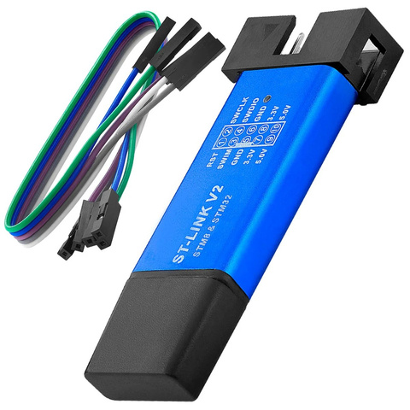
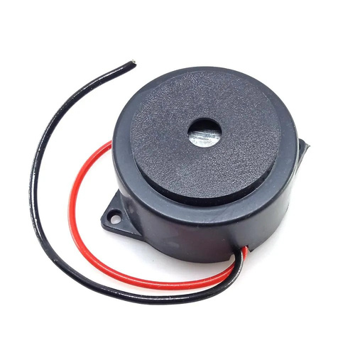
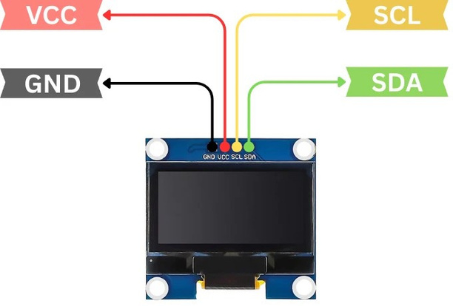
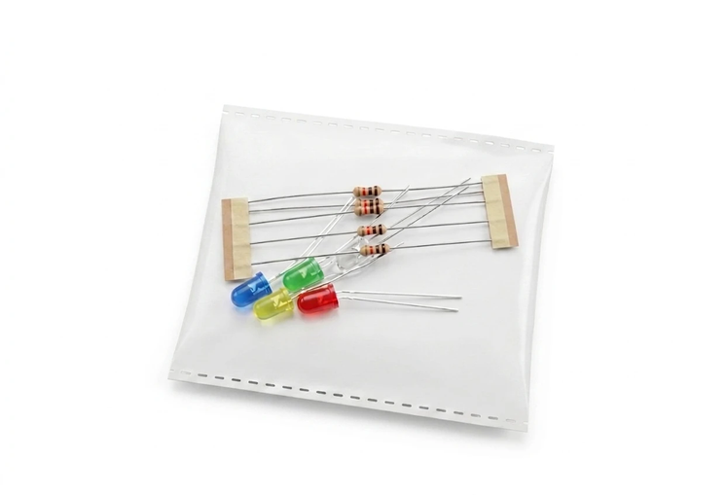
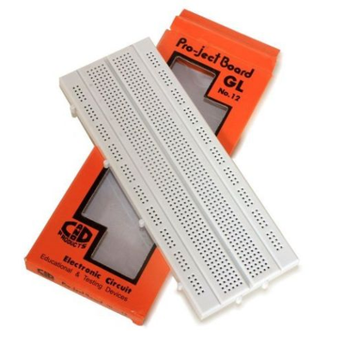
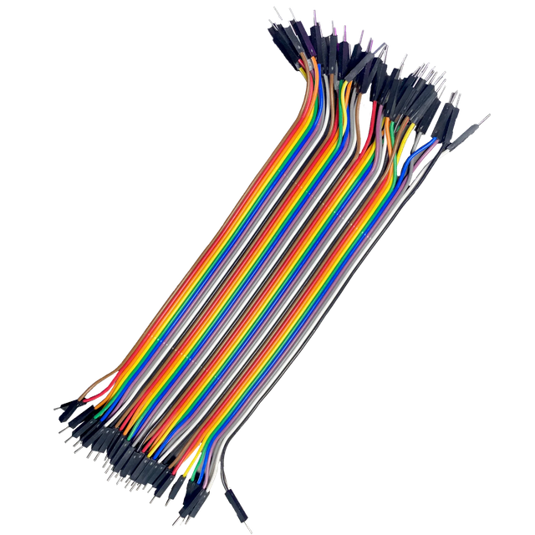
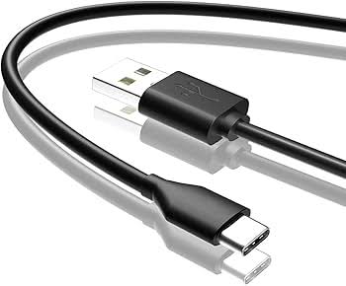
HARDWARE COMPONENTS
MAX4466 Analog Microphone Module
ST Link V2 Programmer
BUZZER
SSD1306 OLED Display
LEDS AND RESISTORS
BREADBOARD
JUMPER WIRES
USB CABLE

Slide 11
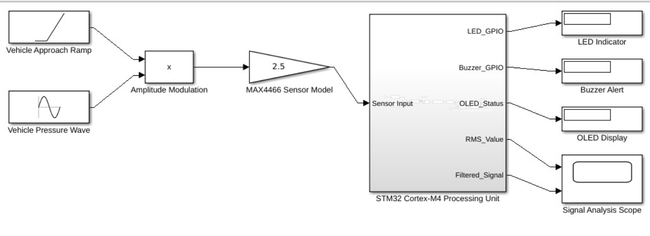
DEVELOP SIMULATION MODEL
The Simulink model represents the proposed ghost vehicle detection system, where vehicle-generated pressure waves are simulated and processed through the MAX4466 sensor model. The STM32 Cortex-M4 processing unit performs signal analysis and generates real-time alerts through LED, buzzer, and OLED display when a vehicle is detected

Slide 12
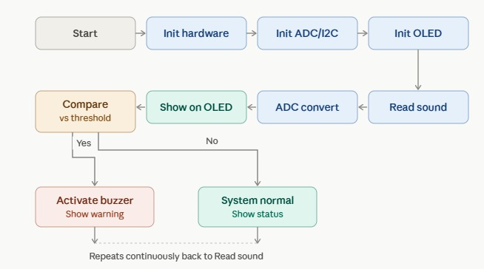
BLOCK DIAGRAM

Slide 13
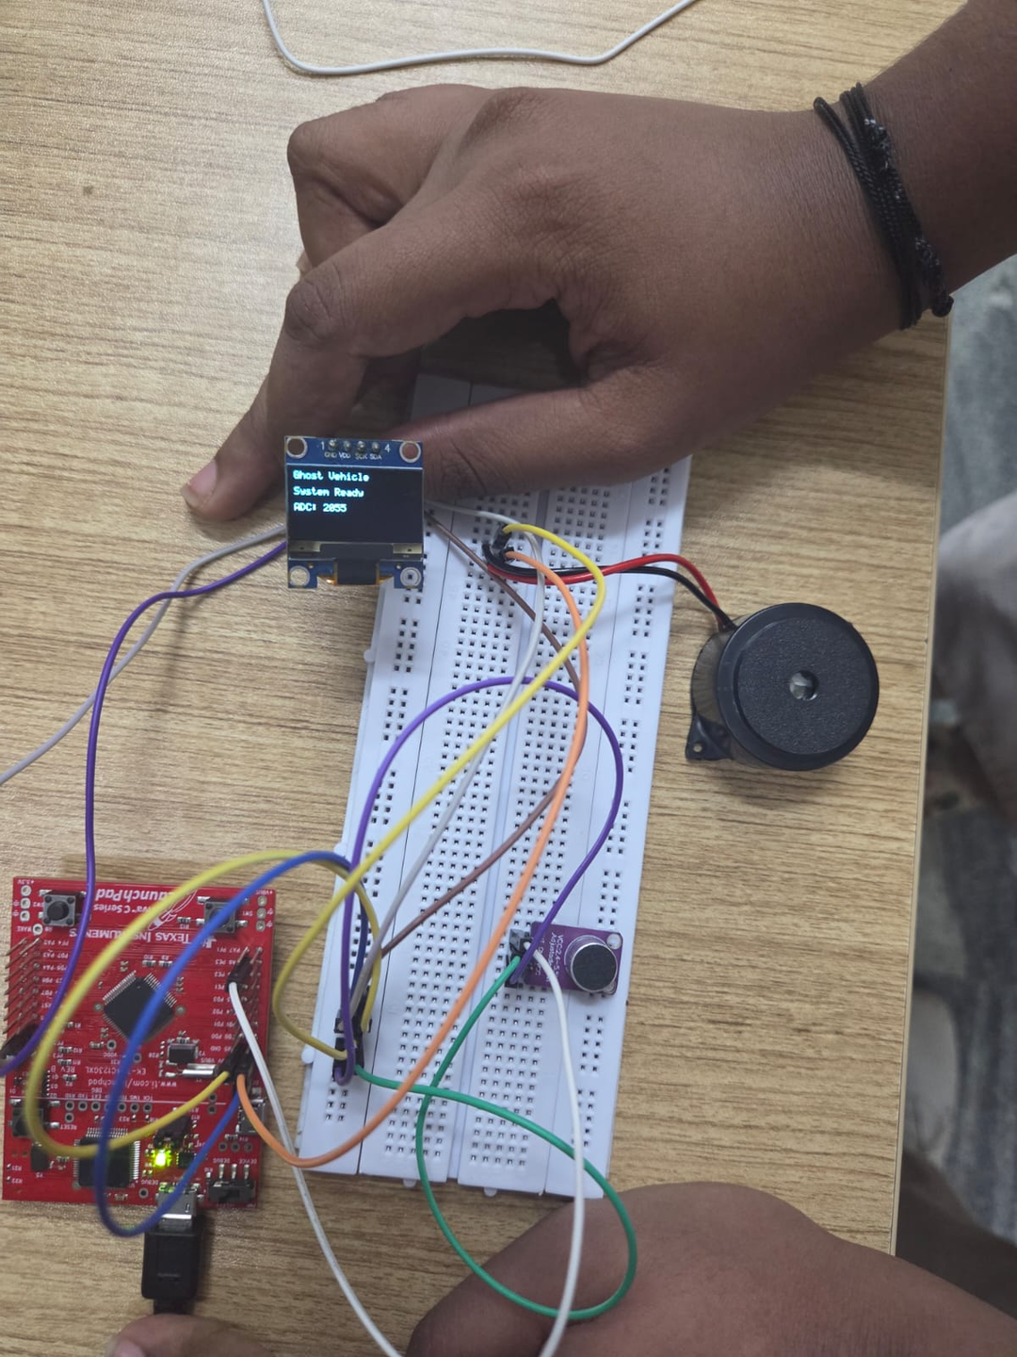
HARDWARE
MODEL

Slide 14
RESULTS
  Successfully interfaced the MAX4466 microphone sensor with the TM4C123GH6PM microcontroller.
  Real-time ADC values were successfully acquired from the pressure-wave sensor.
  The ADC reading was displayed correctly on the OLED display via I²C communication.
  The display confirmed that the Ghost Vehicle Detection System was initialized and functioning properly.
  The prototype successfully demonstrated real-time acoustic pressure-wave monitoring.
  The obtained results validate the feasibility of the proposed sensing approach for future ghost vehicle detection.

Slide 15
REFERENCES
[1]. Zhang, Fengyuan, et al. "Adaptive sensor fusion for robust perception in dense fog: A gated vision and LiDAR integration framework." Sensors 26.12 (2026): 3728.
[2]. Q. Yuan et al., "Ensemble Artificial Intelligence Framework for Real-Time Automatic Vehicle Detection and Classifications," in IEEE Access, vol. 14, pp. 16034-16050, 2026, doi: 10.1109/ACCESS.2026.3657829.
keywords: {Vehicle detection;Artificial intelligence;Accuracy;Real-time systems;Detectors;YOLO;Autonomous vehicles;Automobiles;Robustness;Feature extraction;Deep learning;dynamic weighting;ensemble learning;real-time vehicle detection},
[3].Wang, Quanxiang, Zhaofa Zhou, and Zhili Zhang. "Fog-YOLO: A Real-Time Object Detector for Foggy Autonomous Driving Scenarios." Symmetry 18.2 (2026): 322.
[4]. Zhang, Bingli, et al. "FogFusion: Robust 3D object detection based on camera-LiDAR fusion for autonomous driving in foggy weather conditions." Proceedings of the Institution of Mechanical Engineers, Part D: Journal of Automobile Engineering 240.4 (2026): 2312-2322.
[5].Xie, Zilong, et al. "Dynamic Visibility Recognition and Driving Risk Assessment Under Rain–Fog Conditions Using Monocular Surveillance Imagery." Sustainability 18.2 (2026): 625.

Slide 16


Thank You !

