Slide 1


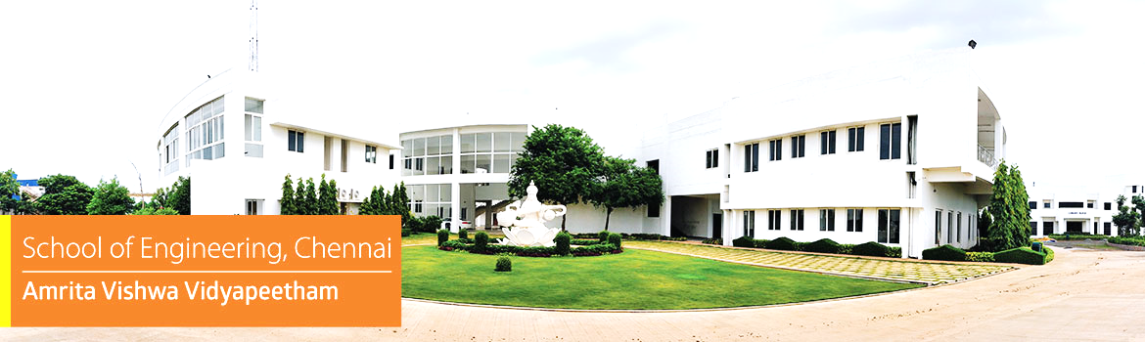

Embedded Systems Project
Ghost Vehicle Detection in Fog Using Pressure-Wave Sensing Before Visual Detection
Mentor :
Presented by :
Dr. C. Ganesh Kumar
Chairperson, Department of Electronics and Communication Engineering, School of Computing, Chennai
Akshaya M V - CH.EN.U4CCE24003
Devadharshini P - CH.EN.U4CCE24004
M Mukesh - CH.EN.U4CCE24015
1

Slide 2
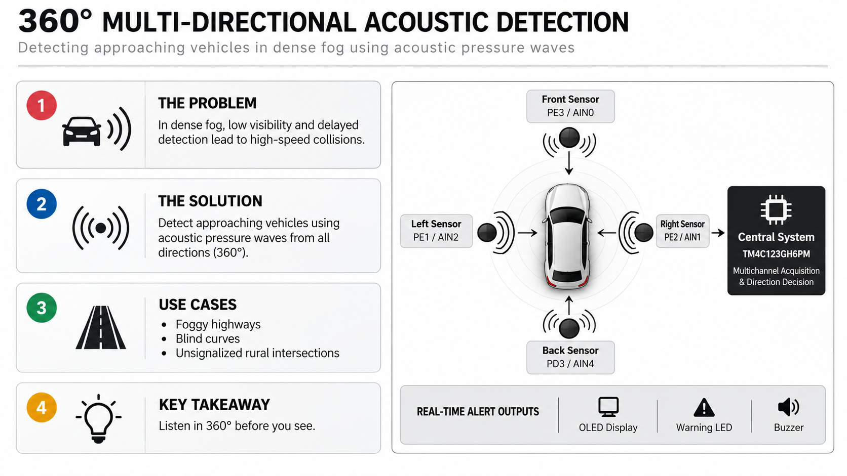
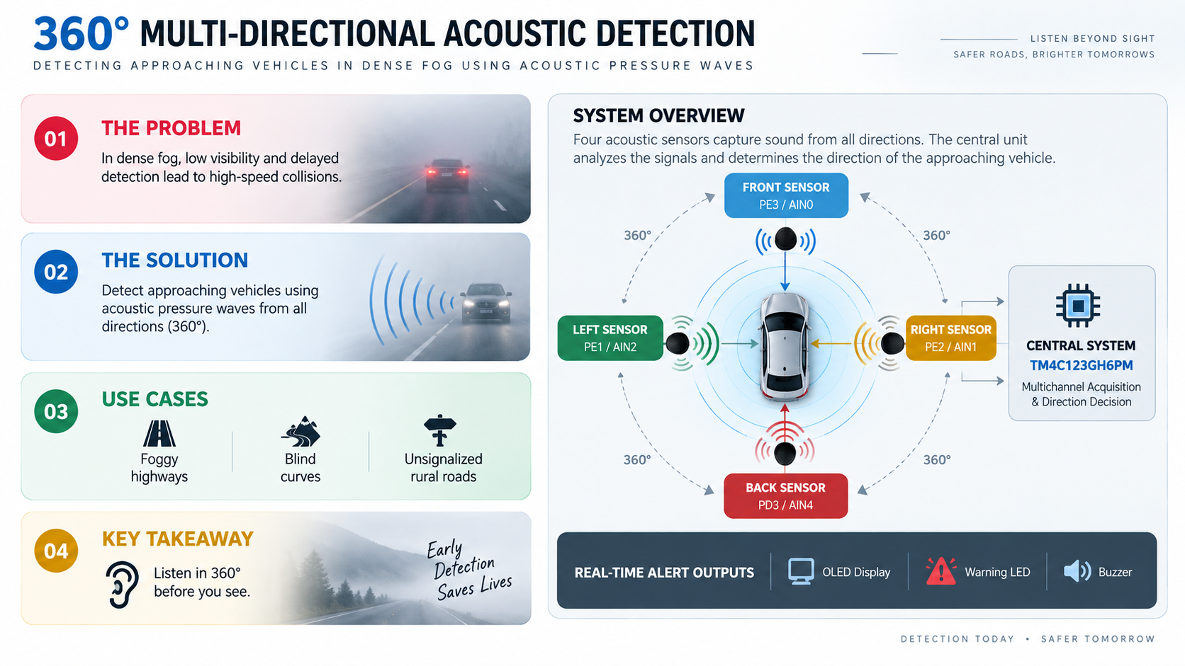
INTRODUCTION
[ REVIEW RUBRIC: PROJECT CONCEPT ]

Slide 3





















LITERATURE SURVEY
Study of the research work
Hardware
/Software
S.NO
Title of the Paper
Year
Objective
Outcome
Inference
Adaptive Sensor Fusion for Robust Perception in Dense Fog: A Gated Vision and LiDAR Integration Framework
JUNE
2026
Improve obstacle detection in dense fog using adaptive multi-modal sensor fusion.
Hardware: Gated Camera, 3D LiDAR.
Software: AFW-Net, Attention-based Adaptive Fusion, Uncertainty Estimation, Cross-modal Feature Extraction.
Achieved 82% AP at 50 m visibility, improving detection by 23.7% over conventional RGB-LiDAR fusion.
Adaptive sensor weighting, Reliable sensor fusion, Robust fog perception
1.
Ensemble Artificial Intelligence Framework for Real-Time Automatic Vehicle Detection and Classifications
Develop an ensemble AI framework for accurate vehicle detection and classification under adverse weather.
Hardware: RGB Camera.
Software: YOLOv5, YOLOv7, YOLOv8, YOLOv10, DETR-ResNet50, Faster R-CNN, Dynamic Weighting, NMS, Ensemble Learning.
Achieved 96.6% mAP, 94.2% Precision, and 94.1% F1-score for multi-class vehicle detection.
Ensemble learning, High detection accuracy, Vision-dependent
May
2026
2.
FogGate-YOLO: Traffic Object Detection in Foggy Environments Using Channel Selection Mechanisms
MAR
2026
Design a lightweight object detector specifically optimized for foggy environments.
Hardware: RGB Camera.
Software: YOLOv12, A2C2f-FSA Module, Bidirectional Feature Fusion Module (BFFM), GSConv, F-WIoU v3 Loss.
Improved mAP@0.5 by 5.2% (RTTS) and 7.3% (VOC-FOG) while maintaining real-time inference.
Fog-aware feature enhancement, Real-time detection, Camera limitations
3.
FogFusion: Robust 3D object detection based on camera-LiDAR fusion for autonomous driving in foggy weather conditions
MAR
2026
Improve 3D object detection in fog using enhanced camera-LiDAR fusion.
Hardware: RGB Camera, LiDAR. Software: Depth Completion Network with Fog Convolution (DCFC), Flexible Cylindrical Voxel (FCV), Cylindrical Fusion Module (CFM).
Improved detection performance by ≥3.32% over baseline methods on KITTI-C.
Enhanced 3D perception, Virtual point clouds, Costly sensor fusion
4.
Dynamic Visibility Recognition and Driving Risk Assessment Under Rain–Fog Conditions Using Monocular Surveillance Imagery
JAN
2026
Estimate road visibility and driving risk under rain-fog conditions using roadside surveillance images.
Hardware: Monocular CCTV Camera. Software: Koschmieder Scattering Model, Dark Channel Prior, Monte Carlo Simulation, Low Visibility Risk Field Force (LVRFF).
Achieved >86% visibility estimation accuracy and effectively identified high-risk driving zones.
Visibility estimation, Risk assessment, Infrastructure-based monitoring
5.

Slide 4
LITERATURE SURVEY
Study of the research work
Hardware
/Software
S.NO
Title of the Paper
Year
Objective
Outcome
Inference
Enhance performance in foggy-weather using a cost-effective vehicle detection system for distance, speed, and TTC-based collision warnings.
Software: SimYOLO-V5s_WIOU detector, Deep-SORT-based tracking
Hardware: RGB cameras with edge-capable platforms for real-time inference
SimYOLO-V5s_WIOU improved fog detection accuracy (up to +17.45% mAP50) on foggy driving, enhanced tracking reliability, and enabled TTC-based graded collision warnings.
SimSPPF and Wise-IoU improve fog detection reliability, while robust tracking and TTC-based warnings support safer collision avoidance.
ECE-VDTDA: A Robust and Computationally Efficient Collision Avoidance System for Driver Assistance in Foggy Weather
FEB
2026
6.
Multi-Target Tracking with Collaborative Roadside Units Under Foggy Conditions
JAN
2026
Improve foggy roadside LiDAR tracking by reducing point-cloud noise and enabling collaborative multi-RSU perception.
Hardware: Roadside LiDAR-equipped RSUs for fog-affected traffic data collection. Software: Fog-noise removal using adaptive filtering and multi-RSU cooperative tracking with PHD filtering
Noise-aware denoising and multi-RSU PHD fusion improve foggy LiDAR detection, range, and tracking stability.
7.
Improved detection accuracy by +8% (thin fog) and +29% (thick fog), with enhanced multi-class tracking performance.
Fog-YOLO: A Real-Time Object Detector for Foggy Autonomous Driving Scenarios
FEB
2026
Develop a low-latency, fog-robust detector for autonomous driving with improved accuracy.
Hardware: RGB cameras with GPU-enabled platforms for real-time inference.
Software: Fog-YOLO with fog-aware modules and improved detection head
Improved mAP over YOLO baseline with better small/occluded object detection in varying fog while maintaining real-time performance.
Fog-aware features and improved detection heads enhance bounding boxes and reliability for foggy perception.
8.
3D Vision Object Detection for Autonomous Driving in Fog Using LiDAR
APR
2025
Improve foggy 3D object detection using LiDAR-based perception and fog-aware processing.
Hardware: Automotive LiDAR sensors evaluated under foggy conditions.
Software: LiDAR-based 3D detection with fog-mitigation techniques
Improved 3D detection accuracy and recall under fog compared to uncompensated LiDAR baselines.
Fog-aware processing preserves point-cloud features, enabling reliable 3D detection in poor visibility.
9.
Simulation of LiDAR Under Fog with Generative Adversarial Networks for Robust 3D Object Detection
OCT
2025
Generate realistic foggy LiDAR data using WGAN–LSTM to improve 3D detector robustness without real fog data collection.
Hardware: Velodyne VLP-32C LiDAR with fog-chamber and onboard ROS
Software: ROS-based LiDAR processing with WGAN-GP + LSTM fog simulation
Generated 80,000 foggy LiDAR frames using WGAN–LSTM, improving 3D detector robustness and reducing the need for real fog data collection.
GAN-based fog simulation reduces real-world data dependence and improves autonomous vehicle perception robustness.
10.

Slide 5
LITERATURE SURVEY
Study of the research work
Hardware
/Software
Outcome
S.NO
Title of the Paper
Year
Objective
Inference
JUNE
2026
The paper aims to develop a passive acoustic system for long-range vehicle detection and tracking, even in poor visibility and harsh outdoor conditions.
Software: Beamforming, Accoustic source detection, , Tracking Algorithm, PCA, Sensor Fusion. Hardware: accoustic sensor array, optional acoustic baffle, data acquisition/recording
Field tests demonstrated reliable tracking up to 1 km, with the acoustic baffle reducing interference and improving signal quality.
Passive acoustic arrays offer stealthy long-range tracking, with baffles improving outdoor performance. They can complement radar and optical sensors.
Long range vehicle detection and tracking using acoustic arrays
11.
Distributed acoustic sensing enables real-time traffic monitoring and vehicle motion-state prediction
MAR
2026
To develop a DAS-based traffic monitoring system using RNNs with spatio-temporal attention, evaluating accuracy, efficiency, interpretability, and spatial transferability.
Hardware: DAS Interrogator, Fiber infrastructure
Software: Signal Processing, Feature extraction, ML/DL
The study used DAS data to classify noise, cars, and buses, achieving ~89% accuracy. Attention improved efficiency and interpretability, with good cross-location transferability.
DAS + RNNs enable continuous traffic monitoring, with attention improving accuracy and efficiency. Spatial transferability supports scalable city-wide monitoring.
12.
APR
2026
To track multiple vehicles in 2D using passive stereo microphones despite weak, noisy, or overlapping sounds, by jointly estimating their presence and trajectories.
Hardware: Multiple Microphones, Microphone Arrays
Software: Track Before Detect, Measurement Whitening, Multi-bin angular sound-intensity processing, Labeled Multi-Bernoulli filter
The preprint presents a TBD-LMB filter with measurement whitening for multi-target acoustic tracking. Earlier work showed accurate, low-variance 2D tracking, but the abstract provides no numerical performance results.
Passive acoustic sensing can track multiple vehicles by accumulating weak signals over time. The LMB filter estimates vehicle count and tracks, useful in low-visibility conditions.
Track-Before-Detect Based Multiple Vehicle Tracking with Stereo Microphone Arrays
13.
To develop an adaptive real-time vehicle detector that maintains accuracy in different fog conditions, especially for small or partially occluded vehicles.
Hardware: Vehicle mounted cameras, LiDAR, Radar
Software: GANs, YOLO, Image Processing Methods
The system achieves 97.7% mAP and 33.52 FPS, outperforming YOLOv5 by 4.2%. It handles light/medium fog directly, while dense fog uses GCA-Net defogging.
Adaptive switching improves accuracy and efficiency by using direct detection in light/moderate fog and defogging in dense fog. The 33.52 FPS suggests potential for real-time use.
Adaptive vehicle detection in foggy conditions based on improved YOLOv5.
JUL
2026
14.
To examine how night, fog, and rain affect vehicle detection, review existing solutions and datasets, and identify challenges and future directions for robust autonomous-driving perception.
Hardware: Velodyne VLP-32C LiDAR with fog-chamber and onboard ROS
Software: ROS-based LiDAR processing with WGAN-GP + LSTM fog simulation
The paper provides a structured review of vehicle-detection methods, datasets, challenges, and future directions, with no new model, dataset, or quantitative results.
Reliable perception requires condition-aware processing for night, fog, and rain. GAN enhancement and YOLO detectors are useful, but robustness remains challenging.
Autonomus driving vehicle detection methods under different low light scnes
APR
2026
15.

Slide 6
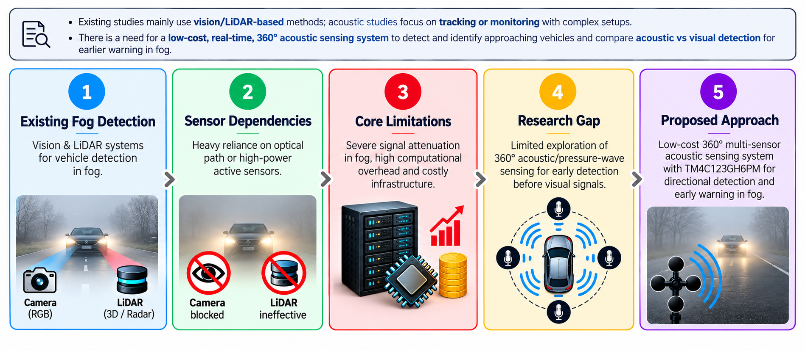
RESEARCH GAP & PROBLEM FORMULATION

Slide 7
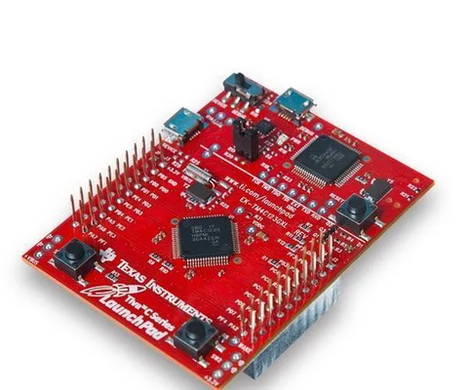
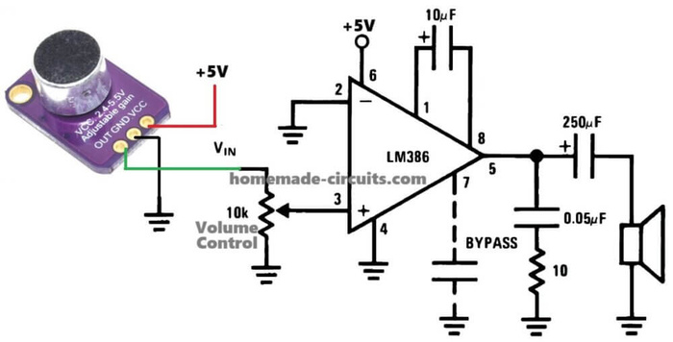
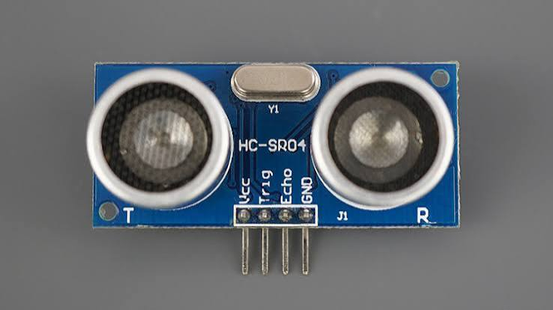
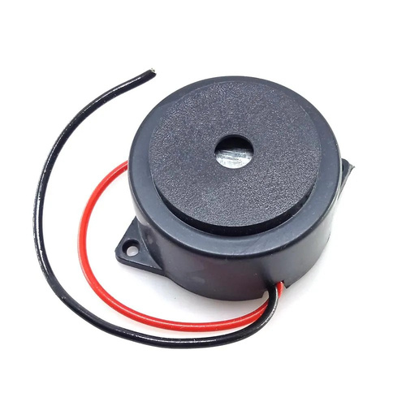
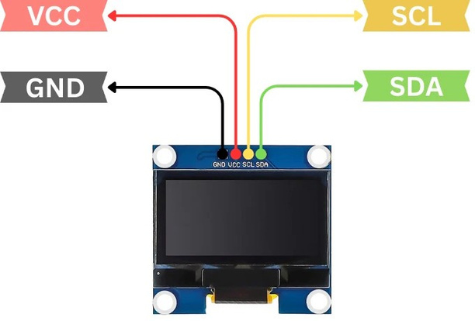
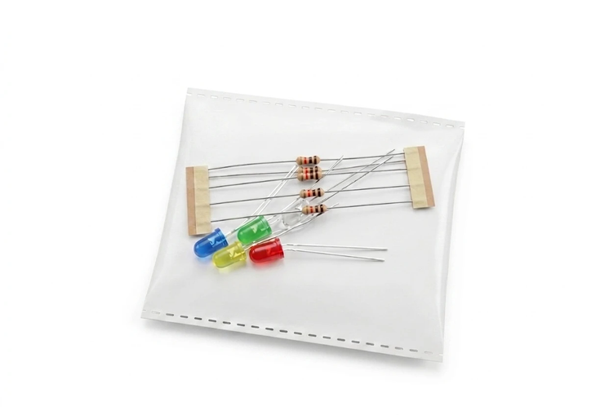
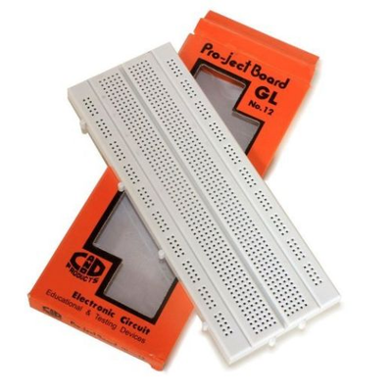
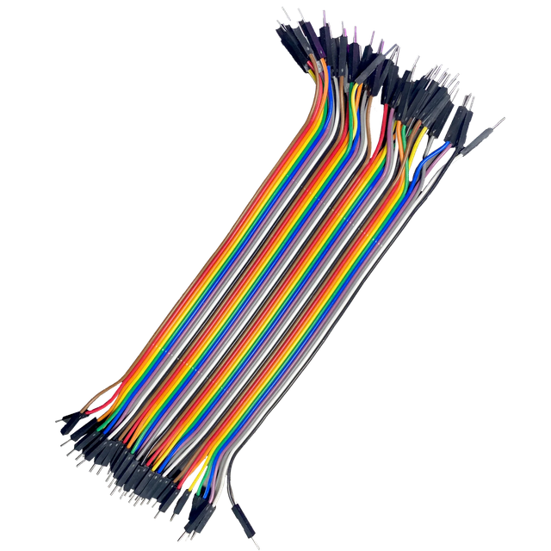
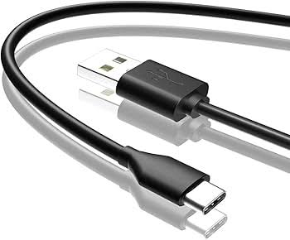
HARDWARE COMPONENTS
MAX4466 Analog Microphone Module
TM4C123GH6PM
ULTRASONIC SENSOR
BUZZER
SSD1306 OLED Display
LEDS AND RESISTORS
BREADBOARD
JUMPER WIRES
USB CABLE

Slide 8
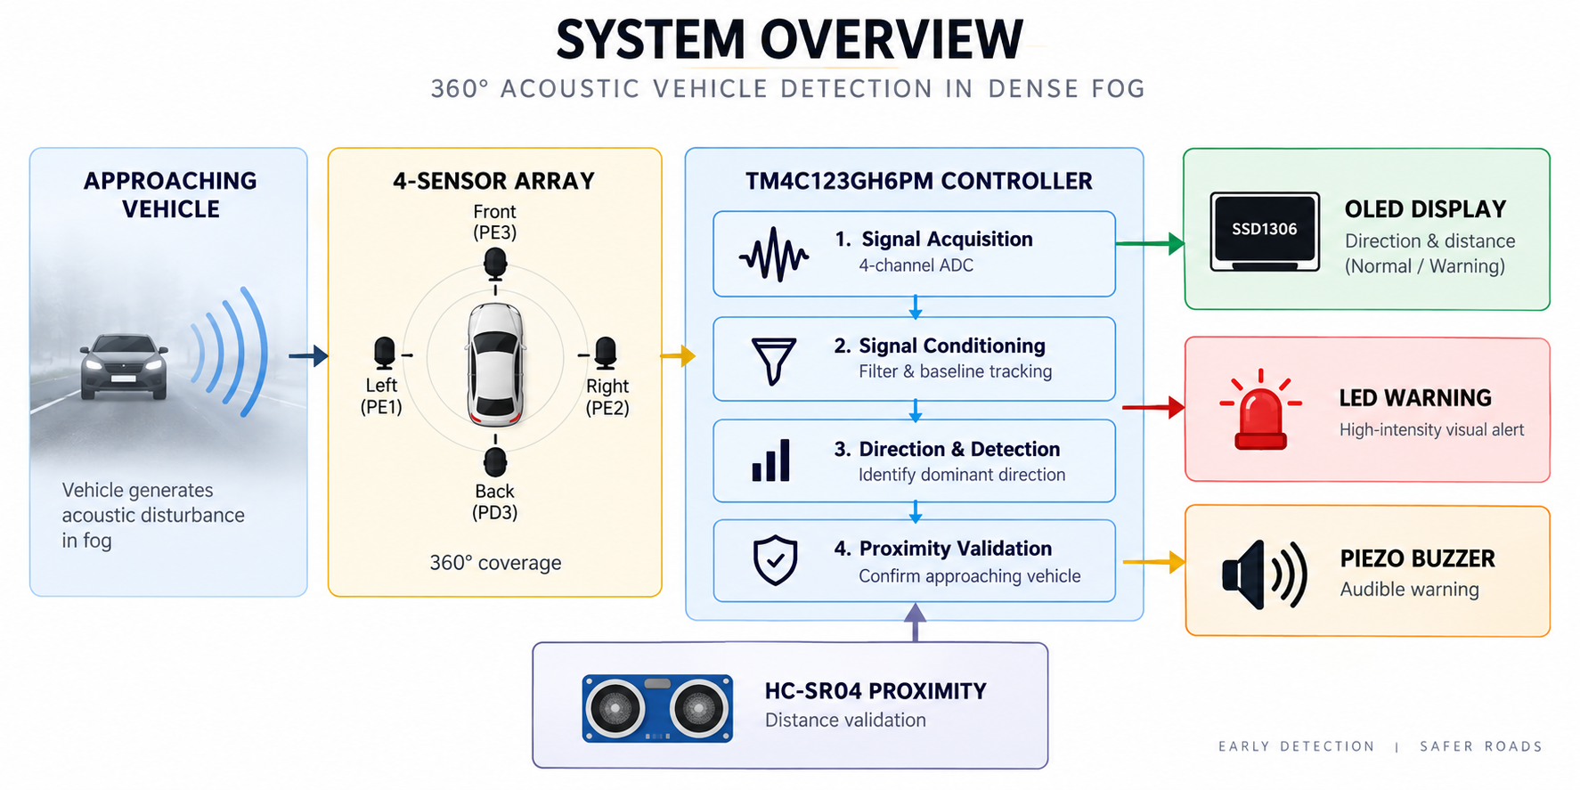
PROPOSED SYSTEM ARCHITECTURE

Slide 9
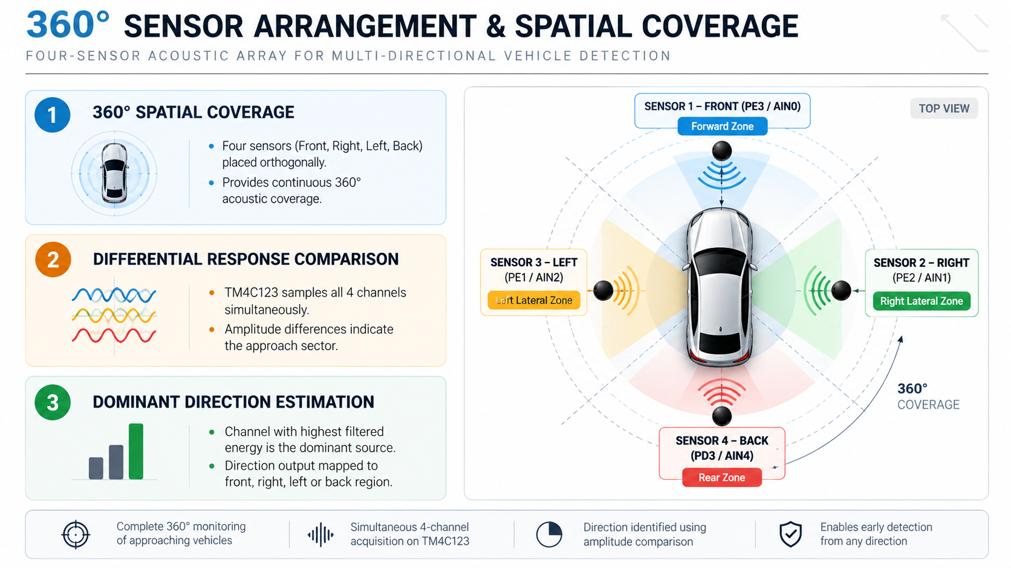
360-DEGREE SENSOR ARRANGEMENT & SPATIAL COVERAGE

Slide 10
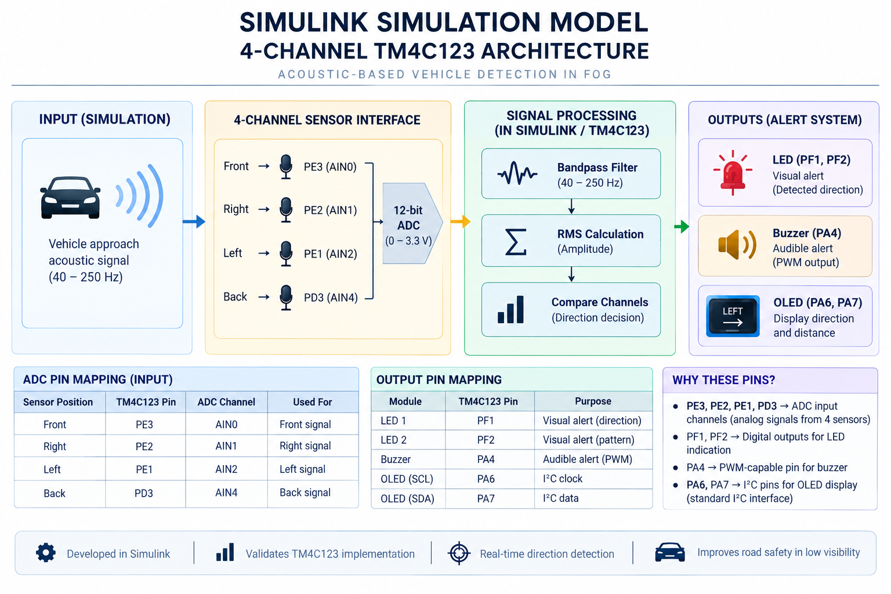
SIMULATION MODEL: 4-CHANNEL TM4C123 ARCHITECTURE

Slide 11
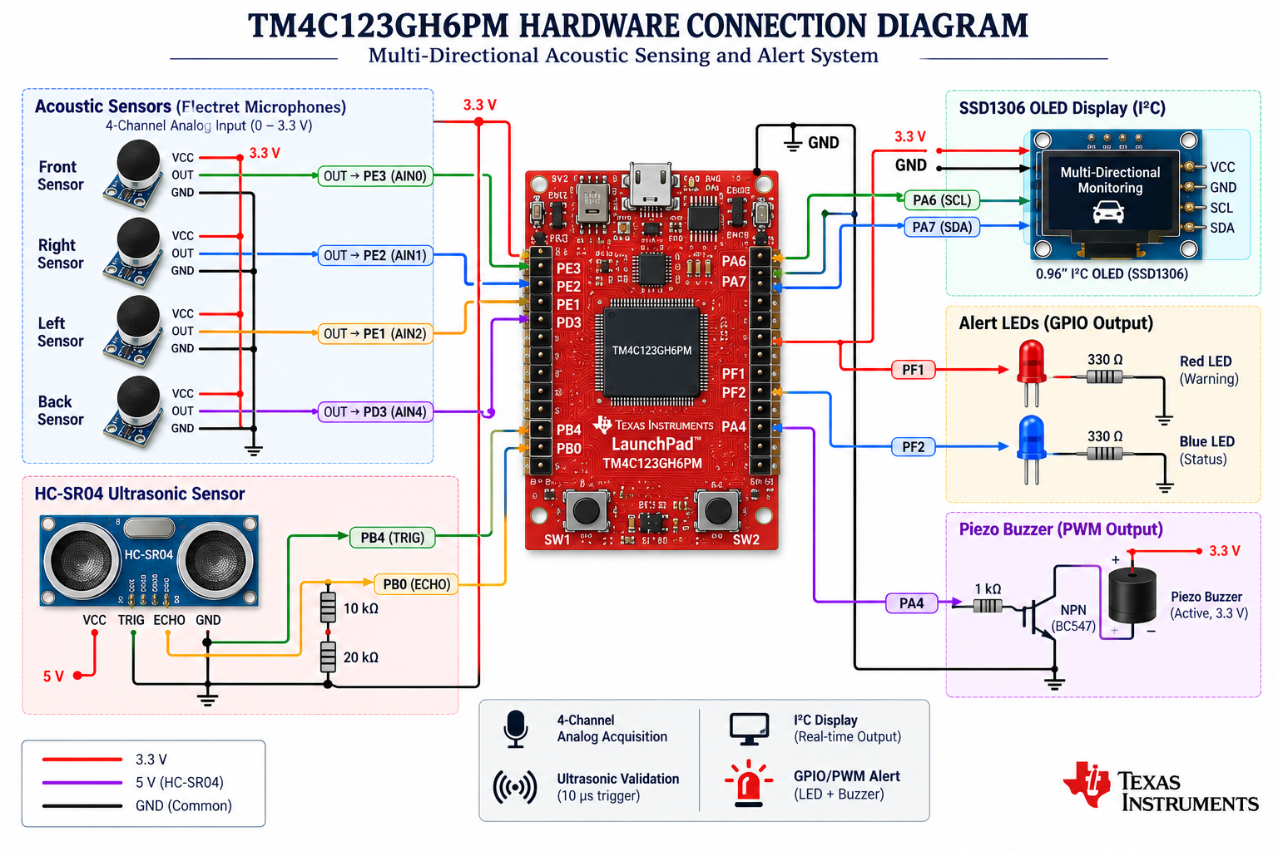
HARDWARE ARCHITECTURE & SUBSYSTEM INTERCONNECTS

Slide 12
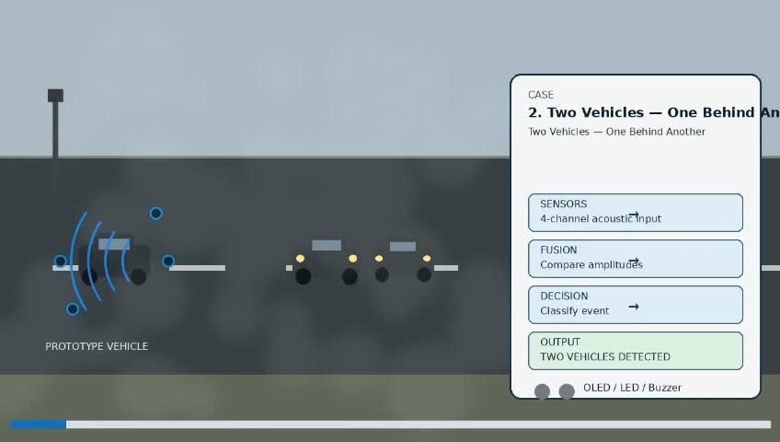
VEHICLE DETECTION & ALERT TO EACH CASE DEMO

Slide 13
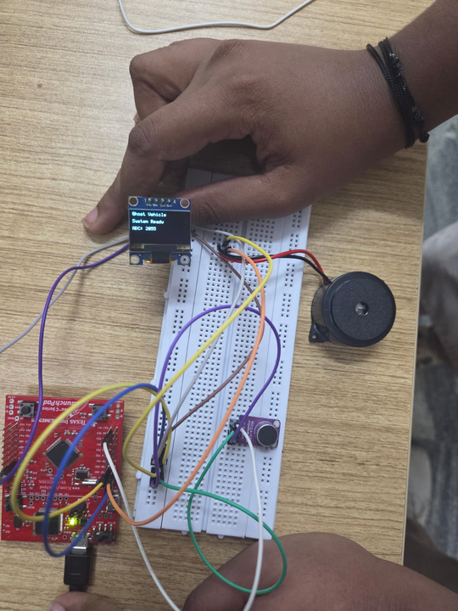
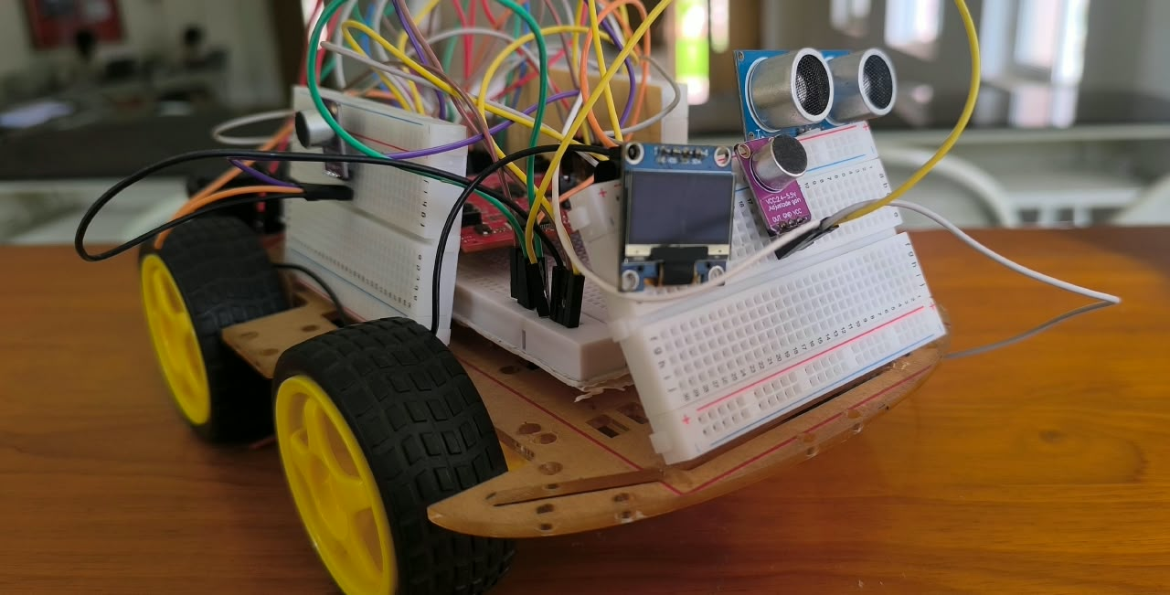
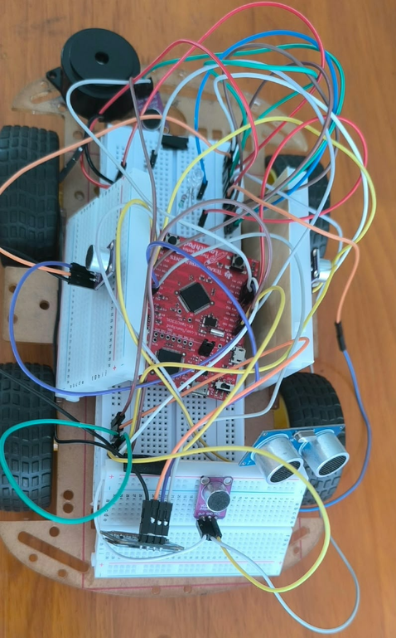
HARDWARE DEMONSTRATION & PROTOTYPE SETUP

Slide 14
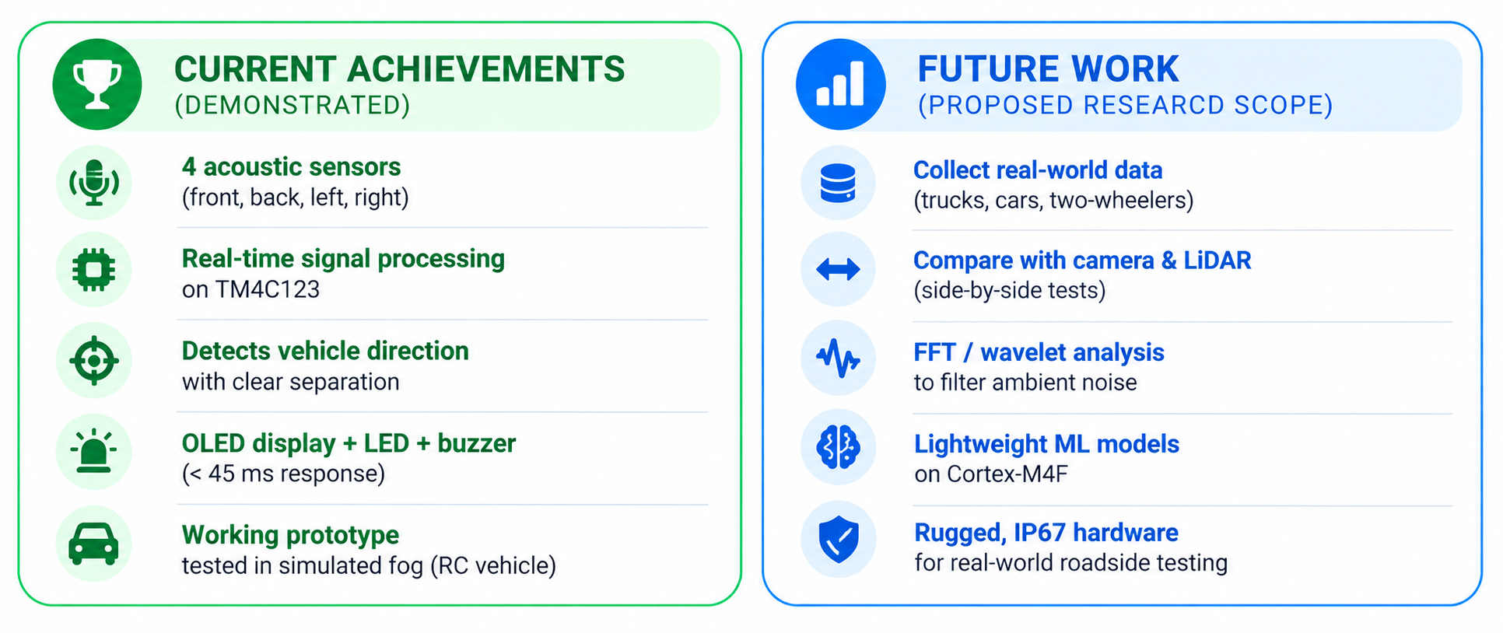
CONCLUSION & FUTURE WORK

Slide 15


Thank You !

