Slide 1

BABA BANDA SINGH BAHADUR ENGINEERING COLLEGE, FATEHGARH SAHIB
PRESENTATION ON CAR PRICE PREDICTION DURING EIGHT WEEKS SUMMER TRAINING
SUBMITTED BY
NAME: SACHIN KUMAR
ROLL NO.: 170280288

Slide 2
CONTENTS
What is Python?
Why Python?
Applications of Python
Introduction
Module Requirements
Algorithm Used
Methodology
Flow Chart
Scope
Objectives
Facility Required For Proposed Work
References
Screenshots

Slide 3

What is Python?
Python is an interpreted, object oriented & high level programming language with dynamic semantics. The programming language python was introduced in the late 1980’s by Guido Van Rossum at CWI in the Netherlands.

Slide 4
Why Python?
Readable and Maintainable Code
Compatible with Major Platforms and Systems
Robust Standard Library
Python Has a Healthy, Active and Supportive Community
Many Open Source Frameworks and Tools
Simplify Complex Software Development

Slide 5
Applications of Python
Software Development (Tkinter, PyQT, KIVY)
Back-End Web Development (Django, Flask)
Machine Learning, Artificial Intelligence and Deep Learning.
Data Science, Data Analytics and Data Visualization

Slide 6
Introduction
Car Price Prediction is a really an interesting machine learning problem as there are many factors that influence the price of a car in the second-hand market. In this competition, we will be looking at a dataset based on sale/purchase of cars where our end goal will be to predict the price of the car given its features to maximize the profit.

Slide 7
In this work, we have considered only a small subset of the factors mentioned above. The following are the variables used:
Price: The calculated retail price of GM cars.
Mileage: The total number of miles the car has been driven.
Make: The manufacturer of the car.
Model: The specific models for each car.
Trim: The type of car model.
Type: The car’s body type.
Cylinder: The number of cylinders present in engine.
Liter: The fuel capacity of the engine.
Doors: The number of doors in the car.
Sound: A categorical variable (binary), that represents whether upgraded speakers are present in the car (coded 1 if present).
Leather: A categorical variable (binary), that represents whether the car has leather interiors (coded 1 if present).
Using these attributes, we will try to predict the price by using the Statistical Analysis System (SAS) for exploratory data analysis.

Slide 8
Module Requirements
Flask: It is used to deploy the front-end web page.
Jsonify: It is a function in flask, which serializes data into JSON(JavaScript Object Notation) format.
Requests: Requests will allow you to send HTTP/1.1 requests using Python. With it, you can add content like headers, form data, multipart files, and parameters via simple Python libraries.
Pickle: It converts any kind of python objects into byte streams (0’s & 1’s).
NumPy: NumPy is a python library used for working with arrays.
Sklearn: Scikit-Learn is a free machine learning library for python, which supports various machine learning algorithm like random forests, k-neighbours etc.

Slide 9
Algorithm Used
Linear Regression: Model Training.
Random Forest Regression: Decision Parameter.
Gradient Boost: Decision Parameter with High Accuracy.
XGBoost: Enhance Performance and Speed of Model.
LightGBM: Create Categories in Model.
Deep Neural Network: Optimizes the Model by setting the Learning Rate.

Slide 10
Methodology
Business Understanding: The Business Understanding stage is crucial because it helps to clarify the goal of the customer.
Data Collection: The data used in this project will be taken from Kaggle.com. Austin Reese scraped the data from craigslist with non-profit purpose. It contains most all relevant information that Craigslist Provides on car sales including like price, condition, manufacturer etc.
Data Preparation: Data preparation is the process of cleaning and transforming raw data prior to processing and analysis. Data Preparation Steps are: Gather data, Discover and assess data, Cleanse and validate data, Transform and enrich data, Store data .
Exploratory Data Analysis: exploratory data analysis is an approach to analyse data sets to summarize their main characteristics, often with visual methods. A statistical model can be used or not, but primarily EDA is for seeing what the data can tell us beyond the formal modelling or hypothesis testing task.

Slide 11
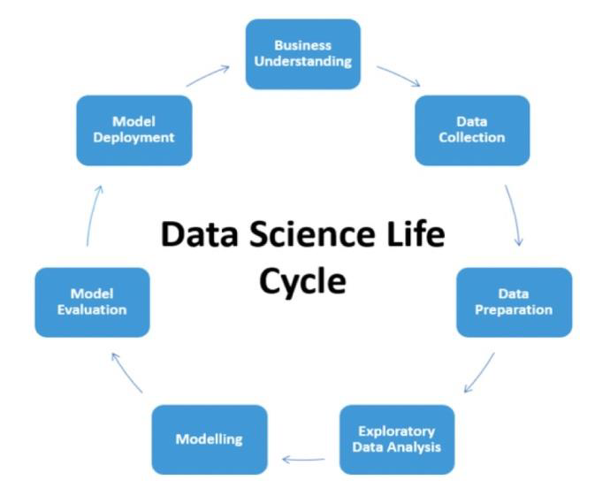
Modelling: Machine learning will be proposed for car price prediction system so will need to provide training data algorithm to learn from.
Model Evaluation: Proposed model will be evaluated and checks for its accuracy using several metrics for evaluation.
Model Deployment: Deployment of an ML-model simply means the integration of the model into an existing production environment which can take in an input and return an output that can be used in making practical business.

Slide 12
Flow Chart
Classification of Support Vector & Artificial Neural Networks
Data Collection
Data Preprocessing
Categorization with Random Forest
Cheap
Moderate
Expensive

Slide 13
Scope
Car price prediction can be a challenging task due to the high number of attributes that should be considered for the accurate prediction.
The price of cars with the available independent variables. It will be used by the management to understand how exactly the prices vary with the independent variables. They can accordingly manipulate the design of the cars, the business strategy etc. to meet certain price levels. Further, the model will be a good way for management to understand the pricing dynamics of a new market.

Slide 14
Objectives
To implement the MI algorithms or familiarize the data science.
To Collect and pre-process the data for predicting the car value market.
The major steps in the prediction process are collection and pre-processing the data.
To learning the MI for car value or price prediction and to proposed the car price prediction model.
Applying single machine algorithm on the data set accuracy was less than 50%.
Reduce risks.

Slide 15
Facility Required For Proposed Work
Software Requirements:
Front end Technologies: HTML5, CSS3
Programming Language: Python
Model Development: EDA, Supervised Machine Learning, Regression Algorithms
Model Development Libraries: Pandas, Numpy, Seaborn, Metaplotlib, Sklearn
Tools OR Software Used: MS-Excel, Jupyter Notebook, Spyder, Anaconda
Operating System: Windows 7/8/8.1/10
Browser: IE/Mozilla/Google Chrome
Hardware Requirements (minimum):
Processor: Intel Pentium 4 processor or higher or AMD Dual Core
Memory: at least 2 GB RAM
Display: 14’’ LCD
Hard-Disk Drive: 80 GB

Slide 16
References
https://github.com/krishnaik06/Car-Price-Prediction
https://www.kaggle.com/jpayne/852k-used-car-listings
https://youtu.be/ZhGDcTOzAFM
Listiani M. 2009. Support Vector Regression Analysis for Price Prediction in a Car Leasing Application. Master Thesis. Hamburg University of Technology.

Slide 17
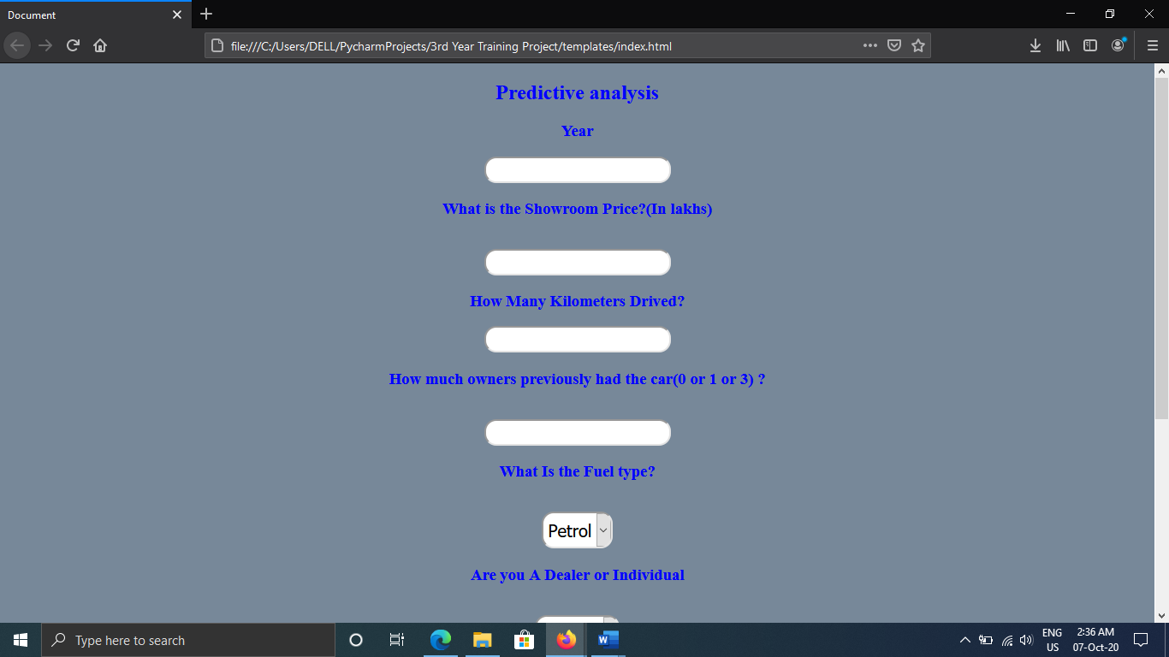
Screenshots

Slide 18
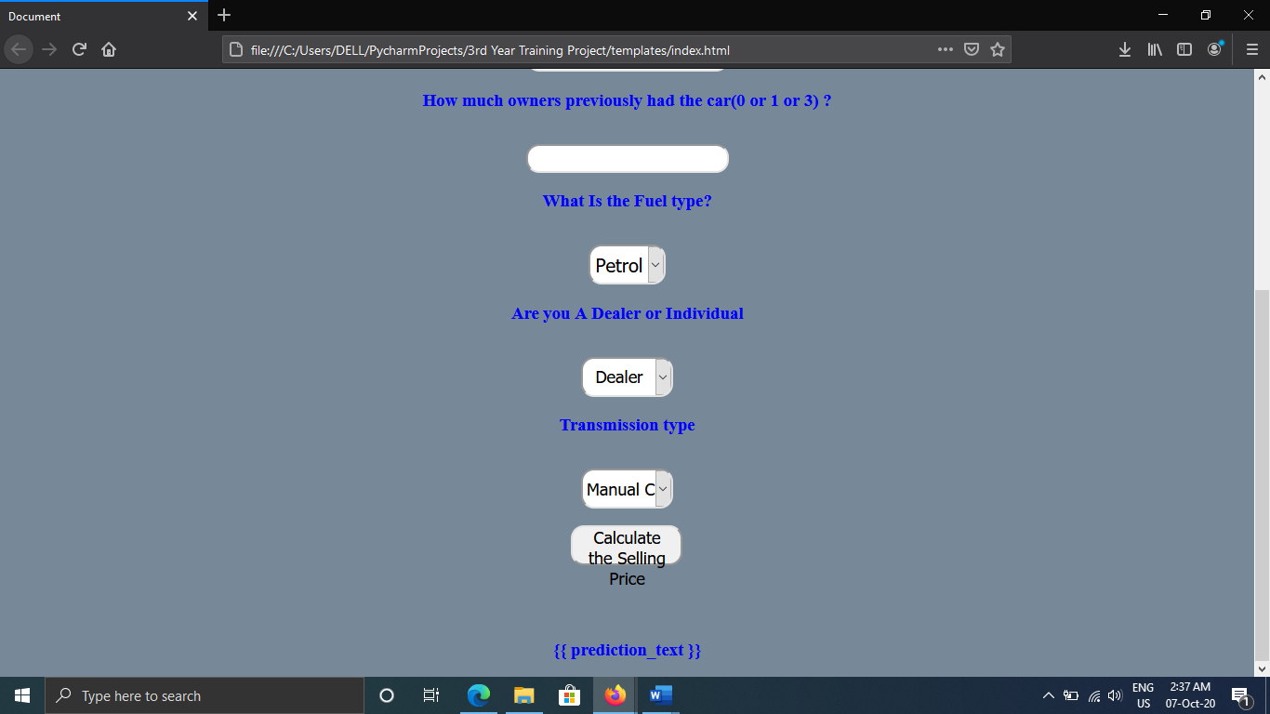

Slide 19
Thank
You

