Slide 1
Animating PowerPoint with data
👍👎
PyCon India 2020 Workshop
github.com/sanand0/pyconindia2020
twitter.com/sanand0

Slide 2
Agenda
3:00 - 15 min Introduction. Why bother with PowerPoint? What's SlideSense?
3:15 - 5 min Survey. Let's learn about you
3:20 - 10 min Demo. Automate certificates in PowerPoint with slidesense
3:30 - 10 min Hands-on: Set up your system (pip install slidesense on Google Colab)
3:40 - 20 min Hands-on: You automate certificates in PowerPoint with slidesense
Bonus exercise: Change the "Year" shape to reflect the year using the date
4:00 - 10 min Demo. Create certificates using the Python API
4:10 - 10 min Demo. Shifting causes of death
4:20 - 10 min Break
4:30 - 30 min Hands-on: You re-create shifting causes of death
5:00 - 15 min Learning more: Contest & workshop
5:15 - 15 min Q&A

Slide 3
Introduction
3:00 - 15 min Introduction. Why bother with PowerPoint? What's SlideSense?
3:15 - 5 min Survey. Let's learn about you
3:20 - 10 min Demo. Automate certificates in PowerPoint with slidesense
3:30 - 10 min Hands-on: Set up your system (pip install slidesense on Google Colab)
3:40 - 20 min Hands-on: You automate certificates in PowerPoint with slidesense
Bonus exercise: Change the "Year" shape to reflect the year using the date
4:00 - 10 min Demo. Create certificates using the Python API
4:10 - 10 min Demo. Shifting causes of death
4:20 - 10 min Break
4:30 - 30 min Hands-on: You re-create shifting causes of death
5:00 - 15 min Learning more: Contest & workshop
5:15 - 15 min Q&A

Slide 4
While I talk, you can set up your machine
Option 1: Install locally
Install Python
Option 2: Run on Google
Sign into colab.research.google.com
Run pip install gramex
You can do this while I talk ☺

Slide 5
With almost 1 billion users, PowerPoint is the largest medium to communicate data
Almost everyone has PowerPoint. No extra cost.
Almost everyone can use PowerPoint. No extra training.
Source: https://www.zdnet.com/article/about-that-1-billion-microsoft-office-figure/

Slide 6
PowerPoint uses an open format: Office XML
You don’t need PowerPoint to create/read PPTX file.
You can use Python for this.

Slide 7
Here’s a simple example of how to edit text in PowerPoint
pip install python-pptx
edit-pptx.py
from pptx import Presentation
prs = Presentation('input.pptx')
prs.slides[0].shapes[0].text = 'Hello world'
prs.save('output.pptx')

Slide 8
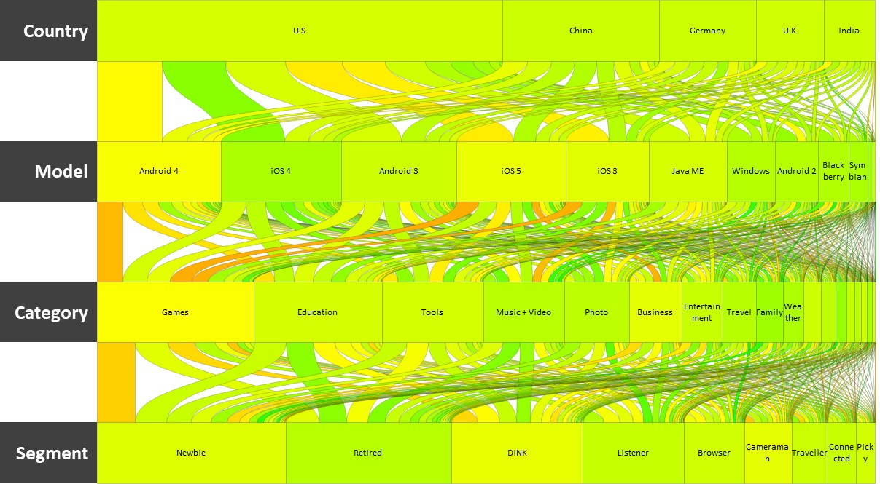
Here’s a sophisticated example of creating animations in PowerPoint

Slide 9
We created a platform called SlideSense to make this easy
Gramener.com/slidesense/

Slide 10
The core of this is open-source
pip install gramex

Slide 11
A quick survey: bit.ly/pyconppt
3:00 - 15 min Introduction. Why bother with PowerPoint? What's SlideSense?
3:15 - 5 min Survey. Let's learn about you
3:20 - 10 min Demo. Automate certificates in PowerPoint with slidesense
3:30 - 10 min Hands-on: Set up your system (pip install slidesense on Google Colab)
3:40 - 20 min Hands-on: You automate certificates in PowerPoint with slidesense
Bonus exercise: Change the "Year" shape to reflect the year using the date
4:00 - 10 min Demo. Create certificates using the Python API
4:10 - 10 min Demo. Shifting causes of death
4:20 - 10 min Break
4:30 - 30 min Hands-on: You re-create shifting causes of death
5:00 - 15 min Learning more: Contest & workshop
5:15 - 15 min Q&A

Slide 12
Let’s take a look at a simple example: bit.ly/pyconpptlab
3:00 - 15 min Introduction. Why bother with PowerPoint? What's SlideSense?
3:15 - 5 min Survey. Let's learn about you
3:20 - 10 min Demo. Automate certificates in PowerPoint with slidesense
3:30 - 10 min Hands-on: Set up your system (pip install slidesense on Google Colab)
3:40 - 20 min Hands-on: You automate certificates in PowerPoint with slidesense
Bonus exercise: Change the "Year" shape to reflect the year using the date
4:00 - 10 min Demo. Create certificates using the Python API
4:10 - 10 min Demo. Shifting causes of death
4:20 - 10 min Break
4:30 - 30 min Hands-on: You re-create shifting causes of death
5:00 - 15 min Learning more: Contest & workshop
5:15 - 15 min Q&A

Slide 13
Now, you do it
3:00 - 15 min Introduction. Why bother with PowerPoint? What's SlideSense?
3:15 - 5 min Survey. Let's learn about you
3:20 - 10 min Demo. Automate certificates in PowerPoint with slidesense
3:30 - 10 min Hands-on: Set up your system (pip install slidesense on Google Colab)
3:40 - 20 min Hands-on: You automate certificates in PowerPoint with slidesense
Bonus exercise: Change the "Year" shape to reflect the year using the date
4:00 - 10 min Demo. Create certificates using the Python API
4:10 - 10 min Demo. Shifting causes of death
4:20 - 10 min Break
4:30 - 30 min Hands-on: You re-create shifting causes of death
5:00 - 15 min Learning more: Contest & workshop
5:15 - 15 min Q&A

Slide 14
You can run SlideSense from within Python
3:00 - 15 min Introduction. Why bother with PowerPoint? What's SlideSense?
3:15 - 5 min Survey. Let's learn about you
3:20 - 10 min Demo. Automate certificates in PowerPoint with slidesense
3:30 - 10 min Hands-on: Set up your system (pip install slidesense on Google Colab)
3:40 - 20 min Hands-on: You automate certificates in PowerPoint with slidesense
Bonus exercise: Change the "Year" shape to reflect the year using the date
4:00 - 10 min Demo. Create certificates using the Python API
4:10 - 10 min Demo. Shifting causes of death
4:20 - 10 min Break
4:30 - 30 min Hands-on: You re-create shifting causes of death
5:00 - 15 min Learning more: Contest & workshop
5:15 - 15 min Q&A

Slide 15
Here’s the same Certificates example, using the Python API
pip install gramex
edit-pptx.py
import pandas as pd
from gramex.pptgen2 import pptgen
for index, row in pd.read_csv('people.csv').iterrows():
target = pptgen(
source='template.pptx',
rules=[
{'Name': {'text': row.Name}},
{'Course': {'text': row.Course}},
{'Date': {'text': row.Date}},
]
)
target.save(f'Certificate - {row.Name}.pptx')

Slide 16
Now, you do it
3:00 - 15 min Introduction. Why bother with PowerPoint? What's SlideSense?
3:15 - 5 min Survey. Let's learn about you
3:20 - 10 min Demo. Automate certificates in PowerPoint with slidesense
3:30 - 10 min Hands-on: Set up your system (pip install slidesense on Google Colab)
3:40 - 20 min Hands-on: You automate certificates in PowerPoint with slidesense
Bonus exercise: Change the "Year" shape to reflect the year using the date
4:00 - 10 min Demo. Create certificates using the Python API
4:10 - 10 min Demo. Shifting causes of death
4:20 - 10 min Break
4:30 - 30 min Hands-on: You re-create shifting causes of death
5:00 - 15 min Learning more: Contest & workshop
5:15 - 15 min Q&A

Slide 17
10 leading causes of death by age
Other forms of heart disease changed -3 ranks for age 1-4
2016
Age 1-4
5-9
10-14
15-19
20-24
25-34
35-44
45-54
55-64
65-74
75-84
85+
#1
Accidental injury
Malignant neoplasms
Transport accidents
Transport accidents
Accidental injury
Accidental injury
Accidental injury
Malignant neoplasms
Malignant neoplasms
Malignant neoplasms
Malignant neoplasms
Ischaemic heart diseases
2
Transport accidents
Transport accidents
Intentional self-harm
Intentional self-harm
Transport accidents
Transport accidents
Malignant neoplasms
Ischaemic heart diseases
Ischaemic heart diseases
Ischaemic heart diseases
Ischaemic heart diseases
Malignant neoplasms
3
Malignant neoplasms
Accidental injury
Malignant neoplasms
Assault
Intentional self-harm
Intentional self-harm
Intentional self-harm
Accidental injury
Other forms of heart disease
Chronic lower respiratory diseases
Chronic lower respiratory diseases
Other forms of heart disease
4
Assault
Assault
Accidental injury
Accidental injury
Assault
Assault
Transport accidents
Diseases of liver
Chronic lower respiratory diseases
Other forms of heart disease
Other forms of heart disease
Other degen. diseases of nerv. sys.
5
Ill-defined and unknown causes
Chronic lower respiratory diseases
Assault
Malignant neoplasms
Malignant neoplasms
Malignant neoplasms
Ischaemic heart diseases
Intentional self-harm
Diseases of liver
Cerebrovascular diseases
Cerebrovascular diseases
Symptomatic mental disorders
6
Congenital malform. of circ. sys.
Metabolic disorders
Cerebral palsy
Other forms of heart disease
Other forms of heart disease
Other forms of heart disease
Diseases of liver
Other forms of heart disease
Accidental injury
Diabetes mellitus
Other degen. diseases of nerv. sys.
Cerebrovascular diseases
7
Metabolic disorders
Congenital malform. of nervous sys.
Other forms of heart disease
Cerebral palsy
Event of undetermined intent
Diseases of liver
Other forms of heart disease
Hypertensive diseases
Diabetes mellitus
Hypertensive diseases
Symptomatic mental disorders
Chronic lower respiratory diseases
8
Congenital malform. of nervous sys.
Other forms of heart disease
Chronic lower respiratory diseases
Ill-defined and unknown causes
Ill-defined and unknown causes
Event of undetermined intent
Assault
Diabetes mellitus
Cerebrovascular diseases
Diseases of liver
Diabetes mellitus
Hypertensive diseases
9
Influenza and pneumonia
Cerebral palsy
Metabolic disorders
Event of undetermined intent
Cerebral palsy
Ischaemic heart diseases
Hypertensive diseases
Cerebrovascular diseases
Hypertensive diseases
Renal failure
Hypertensive diseases
Influenza and pneumonia
10
Other forms of heart disease
Congenital malform. of circ. sys.
Cerebrovascular diseases
Congenital malform. of circ. sys.
Mental disorders due to substance use
Ill-defined and unknown causes
Diabetes mellitus
Transport accidents
Intentional self-harm
Accidental injury
Extrapyramidal and movement disorders
Accidental injury
Per 100,000 people in age group
10
50
100
500
1000

Slide 18
Now you do it
3:00 - 15 min Introduction. Why bother with PowerPoint? What's SlideSense?
3:15 - 5 min Survey. Let's learn about you
3:20 - 10 min Demo. Automate certificates in PowerPoint with slidesense
3:30 - 10 min Hands-on: Set up your system (pip install slidesense on Google Colab)
3:40 - 20 min Hands-on: You automate certificates in PowerPoint with slidesense
Bonus exercise: Change the "Year" shape to reflect the year using the date
4:00 - 10 min Demo. Create certificates using the Python API
4:10 - 10 min Demo. Shifting causes of death
4:20 - 10 min Break
4:30 - 30 min Hands-on: You re-create shifting causes of death
5:00 - 15 min Learning more: Contest & workshop
5:15 - 15 min Q&A

Slide 19
Are you interested in learning more?
3:00 - 15 min Introduction. Why bother with PowerPoint? What's SlideSense?
3:15 - 5 min Survey. Let's learn about you
3:20 - 10 min Demo. Automate certificates in PowerPoint with slidesense
3:30 - 10 min Hands-on: Set up your system (pip install slidesense on Google Colab)
3:40 - 20 min Hands-on: You automate certificates in PowerPoint with slidesense
Bonus exercise: Change the "Year" shape to reflect the year using the date
4:00 - 10 min Demo. Create certificates using the Python API
4:10 - 10 min Demo. Shifting causes of death
4:20 - 10 min Break
4:30 - 30 min Hands-on: You re-create shifting causes of death
5:00 - 15 min Learning more: Contest & workshop
5:15 - 15 min Q&A

Slide 20
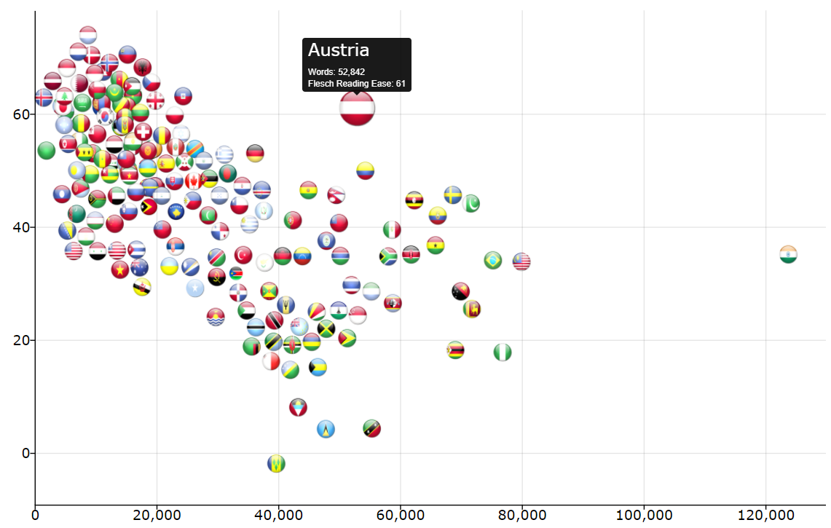
Show off your skills. Win a small prize.
See the visualization Readability of Constitutions
Download the dataset
Use the country flags from https://gramener.com/readability/png/Country.png, e.g. Afghanistan, Bolivia, Chat, etc.
Create 4 slides, each showing the scatterplot of words (X-axis) vs ease (Y-axis). The slides show:
Libya with the shortest constitution
India with the longest constitution
Luxembourg with the most readable constitution
St Vincent and the Grenadines with the least readable constitution

Slide 21
Show off your skills. Win a small prize.
Submit your results at bit.ly/pyconsubmission. This should include the:
Input PPTX
Output PPTX
Data (data.csv)
YAML configuration or Python code
Submission closes on 5 Oct 2020 midnight anywhere.
Everyone who submits can join a free workshop on automating presentations with Python.
The 3 best submissions get an Amazon.in gift voucher for Rs 3,000, Rs 2,000, and Rs 1,000, and an interview with Gramener to work on SlideSense, if you wish.

Slide 22
Q&A
3:00 - 15 min Introduction. Why bother with PowerPoint? What's SlideSense?
3:15 - 5 min Survey. Let's learn about you
3:20 - 10 min Demo. Automate certificates in PowerPoint with slidesense
3:30 - 10 min Hands-on: Set up your system (pip install slidesense on Google Colab)
3:40 - 20 min Hands-on: You automate certificates in PowerPoint with slidesense
Bonus exercise: Change the "Year" shape to reflect the year using the date
4:00 - 10 min Demo. Create certificates using the Python API
4:10 - 10 min Demo. Shifting causes of death
4:20 - 10 min Break
4:30 - 30 min Hands-on: You re-create shifting causes of death
5:00 - 15 min Learning more: Contest & workshop
5:15 - 15 min Q&A

